Slide 1
DMART ANALYSIS DASHBOARD
Name : Tejas Suresh Argade

Slide 2
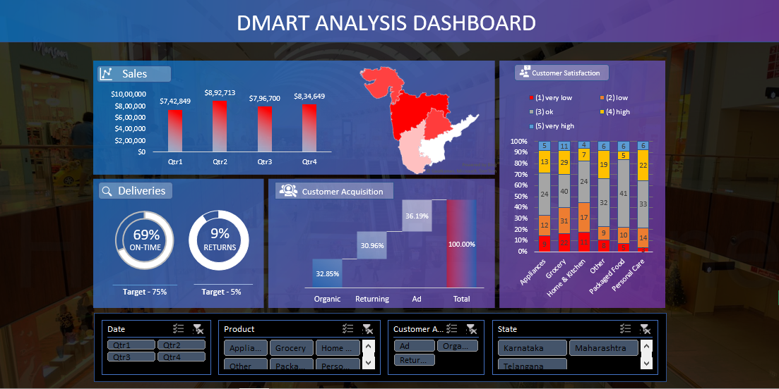
Dashboard

Slide 3
PROBLEM STATEMENTS
Which quarter faced the lowest number of sales?
What is the return percent in Andhra Pradesh?
What percent people are really less satisfied for which product?
Which state is a way back to achieve target in on-time deliveries?
Which quarter has been affected most for return orders?
Which of the customer acquisition has supported a lot and what was the percent ?
Which product lies most in "good" category?
Which customer acquisition is best in Andhra Pradesh?
Which quarter shows good on time delivery rate?
Which quarter faced the lowest number of sales in Maharashtra?
Hovering through the map which location shows lowest sales?
Which state can recover the target of return percent early?
Customer is satisfied mostly in which product?
In which state does acquisition for Ad has the lowest percent?

Slide 4
OUTCOME OF ANALYSIS
Increase in food demand in the Covid19 lockdown gave Quarter 2 a great sale which helped the company to understand a great resource management in crucial crises according to business perspective.
Seeing the rise in demand the on-time deliveries were crashing seeing a huge amount of orders to be made in time, were customer were not happy enough.
The Return rate showed a increase due to many factors which might include quality of the product, which should be considered to get them solved asap.
The Customer Acquisition here got a major part as seeing the upward in technology gave the customer a lot of opportunities to view the product or company via Ad and Organic ways, mainly the Returning criteria was increased due to good product.
The Dashboard here separately gives you a clear view on each and every products individual feedback of customer as how they are happy or not good with that product.

Slide 5
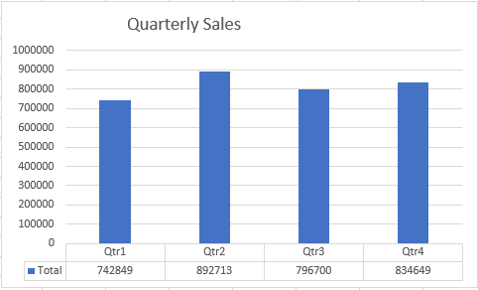
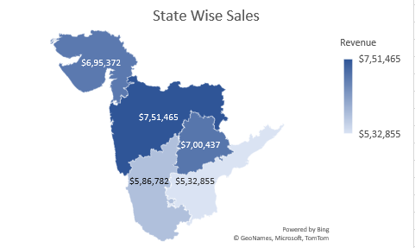
SALES

Slide 6
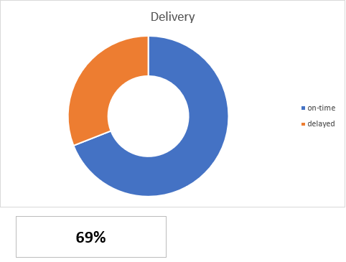
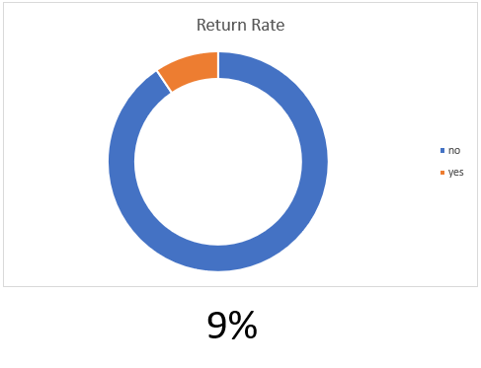
DELIVERIES

Slide 7
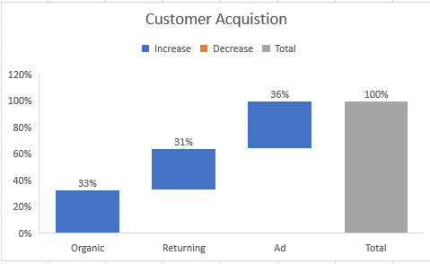
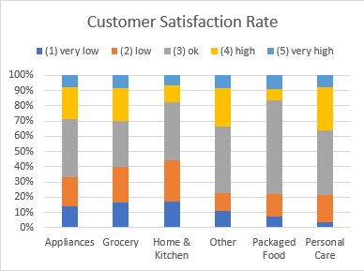
CUSTOMER ACQUISITION AND SATISFACTION

Slide 8
PERSONAL ANALYSIS
After analyzing the dashboard and looking throughout all the charts, we can see that the sales are hitting a good margin but still Quarter 3 had more returns which lead the barrier more to the product management to ensure quality of product.
Increase in staff for hubs might solve the on-time deliveries issue which might keep the bond safe with customers in this growing market.
Ads which are playing a great role should be kept consistent by maintaining a good marketing team and ensuring that there are also good deals and offers for the people giving a revisit.
Customer is not happy with the Grocery section so try to keep an inspection on product or see if the vendor should be changed if the product has any defects.

