Slide 1


Classroom Timetable Generator
Rungta International Skills University
Submitted By
Submitted To
Tejas Satishrao Bhaskarwar
Mr. Priyanshu
[Roll No. / Ru-00263.]
IBM SME
B.Tech 1st Sem IBM

Slide 2
Introduction
Preparing a class timetable by hand is slow and error-prone: subjects clash, some get too many periods in one day, and the weekly totals rarely add up.
The Classroom Timetable Generator is a Python 3 console application that automates this. You enter the number of days, the periods per day and each subject's weekly periods; the program validates the data and prints a ready-to-use, day-by-day timetable.
It is built using Lists, Dictionaries, Constraints and Scheduling logic.
Input-driven
Days, periods per day and subject-wise weekly periods
1
Rule-based
A subject gets at most 2 periods in a single day
2
Reliable
Input is validated and clear error messages are shown
3

Slide 3
Project Description & Problem Statement
PROBLEM STATEMENT · PS No. 93
Classroom Timetable Generator
Generate a weekly class timetable. Total periods must equal days × periods per day, and a subject can have at most 2 periods a day. Slots are filled by choosing the subject with the most periods left (ties: the one entered first).
Input: days, periods per day, subject-wise weekly periods
Output: day-by-day timetable, or a clear error message
RULES & CONSTRAINTS
1
Total periods = days × periods per day
2
Max 2 periods of one subject per day
3
Pick the subject with most periods left
4
Days named Mon, Tue, Wed, Thu, Fri, Sat
Language: Python 3 | Concepts: Lists · Dictionaries · Constraints · Scheduling

Slide 4
Technology & Tools Used
1
Python 3
Core language. The whole solution is one .py file, run from the console.
2
Lists & Dictionaries
A list holds the timetable day by day; a dictionary tracks the periods left for each subject.
3
Constraints & Scheduling
Greedy slot filling with a 2-periods-per-day limit and a total-slots check.
4
Console I/O & GitHub
input() and print() for the interface; code and report are uploaded to GitHub.
Tools: Python IDE / editor (e.g. VS Code) · Terminal · Git & GitHub

Slide 5
Working of the Project
1
Read & validate input
Days, periods per day and every subject's periods must be positive whole numbers.
WORKED EXAMPLE · TEST CASE 1
3 days × 3 periods · Maths 3, Physics 2, Programming 3, English 1
2
Check the totals
Total weekly periods must equal days × periods per day, and no subject may need more than 2 per day.
Day | Period 1 | Period 2 | Period 3
Mon | Maths | Programming | Maths
Tue | Physics | Programming | Maths
Wed | Physics | Programming | English
3
Track periods in a dictionary
Each subject maps to the number of periods still left to place.
4
Fill each slot
Pick the subject with the most periods left (tie: entered first), never more than 2 per day.
Mon Period 1: Maths and Programming both have 3 left, so Maths (entered first) wins.
5
Print the timetable
Show the result day by day: Mon, Tue, Wed …

Slide 6
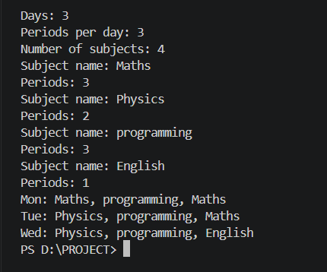
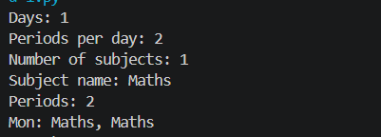
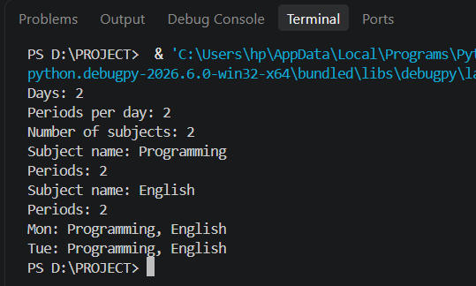
Project Screenshots
Paste your screenshot here
Paste your screenshot here
Paste your screenshot here
Test Case 1: Normal input
Test Case 2: Boundary input
Test Case 4: Different valid scenario

Slide 7
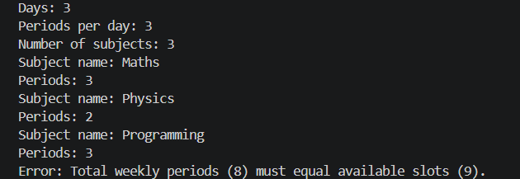
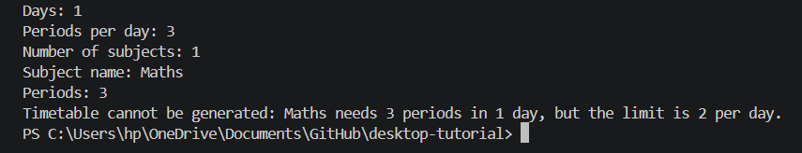
Screenshots: Invalid Input Handling
Paste your screenshot here
Paste your screenshot here
Test Case 3(a): Total periods do not match available slots
Test Case 3(b): Subject exceeds 2 periods per day
Invalid input is caught before scheduling, and the program prints a clear reason instead of a wrong timetable.

Slide 8
Thank You

