Slide 1

DR. D. Y. PATIL SCHOOL OF SCIENCE AND TECHNOLOGY TATHAWADE, PUNE
TITLE :- IMAGE CLASSIFICATION OF CIFAR-10 DATASET USING CNN.
PRESENTED BY :-
1.TEJAS BHAVSAR.
2.ROHAN MASHERE.
3.PRATHAMESH NANGARE.
GUIDED BY :- MRS AKANKSHA GOEL.

Slide 2
ABSTRACT.
Image classification is a very important issue in digital image analysis(Computer vision is concerned with the automatic extraction, analysis, and understanding of useful information from a single image or a sequence of images.) CNN is type of deep neural networks (DNN) that contains multiple layers such as convolutional layers, Integrated layer and fully integrated layer. Convolutional neural networks (CNNs) are widely used in pattern- and picture- recognition problems as they have a number of advantages compared to others strategies. CIFAR-10 is a very popular computer vision database. This database is well read in it many types of in-depth study of object recognition. This database contains 60,000 images separated by 10 target classes, each a section containing 6000 images of 32 * 32 shapes. This database contains images of low-resolution (32 * 32), which allows researchers to experiment with new algorithms.
The CIFAR-10 (Canadian Institute For Advanced Research) dataset is a well-known benchmark in the field of machine learning, specifically for image classification tasks. The CIFAR-10 dataset has 10 different categories of images in it. There is a total of 60000 images of 10 different classes naming “Airplane, Automobile, Bird, Cat, Deer, Dog, Frog, Horse, Ship, Truck”.
All the images are of size 32×32. There are in total 50000 train images and 10000 test images.
And from each class total train images is 5000 and test images is 1000.
Keywords : Deep Learning, Computer Vision, CNN, CIFAR-10, TensorFlow, keras.

Slide 3
Problem statement.
Develop a Convolutional Neural Network (CNN) model that can accurately classify images from the CIFAR-10 dataset into one of ten distinct categories. The model should be trained, validated, and tested on a dataset containing labeled images, where each image is assigned to one specific category. The goal is to create a model that can accurately predict the class of each image from the test set, achieving a high classification accuracy.

Slide 4
Introduction.
The image classification is the ability to capture a picture and categorize it successfully in one of the other classes. The goal of our work will be to build a model will be able to identify and classify images accurately. This project uses Convolutional Neural Networks(CNN) to train effectively model. The database used is the CIFAR-10 dataset. The CIFAR-10 database imported from cameras has 10 classes and we have built a model so much so that our model predicts a given image with excellent external accuracy any problems with excessive dressing or inadequacy.
CNNs are Deep Neural Networks (DNNs) that include several layers, such as convolutional layers, pooling layers, and fully connected layers. Convolutional neural networks (CNNs) are frequently employed in pattern and image recognition challenges because they provide several benefits over other approaches. CNNs are important in the field of computer vision and have a wide range of applications. The CIFAR-10 dataset, which we imported from Keras, comprises ten classes, and we built a model that accurately predicts the supplied image. Image classification is one of the most important applications of computer vision, and it has aided in the understanding of the convolution process and the many layers of Convolutional neural networks. Because the future will be more automated and digitalized, these technologies will definitely help us understand.
Scope and Proposed Model : This provides a straightforward way to identify different images from the database. The proposed system has been improved by the accuracy of the training and checking accuracy without overfilling. The proposed program is well done with ADAM(Adaptive Moment Estimation) optimizer for better results and good Performance of model. Images can be predicted in a database using the CNN algorithm in a great relief. Improves image quality separation. The proposed system can be easily changed to different fields, science and technology.
Key components of CNN models:
Convolutional Layers, Pooling Layers, Activation functions, Fully Connected Layers.

Slide 5
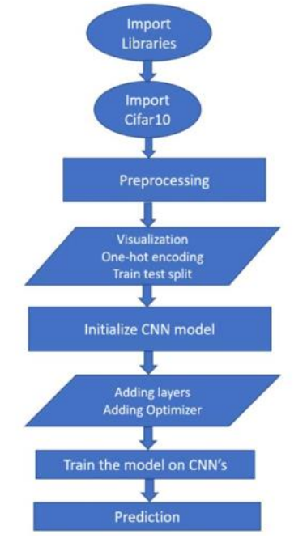
System Architecture.

Slide 6
Thank you!....

