Slide 1
Assertions
Mechanism: CREAT ASSERTION
Components include:
a constraint name,
followed by CHECK,
followed by a condition
Both CHECK and ASSERTION are database constraints defined by the SQL standards.
An important distinction is that a CHECK is applied to a specific base table, whereas an ASSERTION is applied to the whole database.
An assertion is a piece of SQL which makes sure a condition is satisfied.
It could mean locking out the whole table or even the whole database.

Slide 2
An expression that should be always true
When created, the expression must be true
DBMS checks the assertion after any change that may violate the expression
Must return True or False

Slide 3
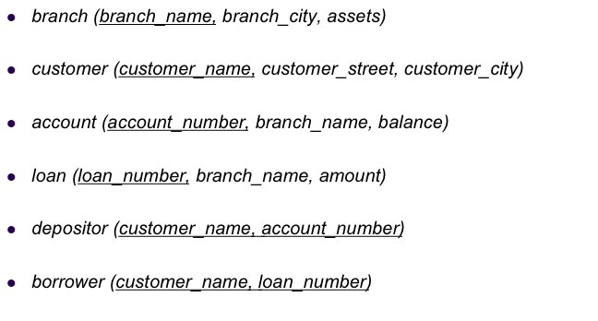
Example 1
Sum of loans taken by a customer does not exceed 100,000
Must return True or False (not a relation)
Create Assertion SumLoans Check
( 100,000 >= ALL
Select Sum(amount)
From borrower B , loan L
Where B.loan_number = L.loan_number
Group By customer_name );

Slide 4
Example 2
Number of accounts for each customer in a given branch is at most two
Create Assertion NumAccounts Check
( 2 >= ALL
Select count(*)
From account A , depositor D
Where A.account_number = D.account_number
Group By customer_name, branch_name );

Slide 5
Example 3
Customer city is always not null
Create Assertion CityCheck Check
( NOT EXISTS (
Select *
From customer
Where customer_city is null));

Slide 6
Assertions: An Example
“The salary of an employee must not be greater than the salary of the manager of the department that the employee works for’’
CREAT ASSERTION SALARY_CONSTRAINT
CHECK (NOT EXISTS (SELECT *
FROM EMPLOYEE E, EMPLOYEE M, DEPARTMENT D
WHERE E.SALARY > M.SALARY AND
E.DNO=D.NUMBER AND D.MGRSSN=M.SSN))
constraint name,
CHECK,
condition

Slide 7
Assertions vs. Triggers
Assertions do not modify the data, they only check certain conditions
Triggers are more powerful because they can check conditions and also modify the data
Assertions are not linked to specific tables in the database and not linked to specific events
Triggers are linked to specific tables and specific events.
All assertions can be implemented as triggers (one or more)
Not all triggers can be implemented as assertions
Oracle does not have assertions .

Slide 8
Example: Trigger vs. Assertion
All new customers opening an account must have opening balance >= $100. However, once the account is opened their balance can fall below that amount.
Trigger Event: Before Insert
We need triggers, assertions cannot be used
Create Trigger OpeningBal
Before Insert On Customer
For Each Row
Begin
IF (:new.balance is null or :new.balance < 100) Then
RAISE_APPLICATION_ERROR(-20004, 'Balance should be >= $100');
End IF;
End;

Slide 9
Embedded SQL

Slide 10
Embedded SQL is a method of combining the computing power of a programming language and the database manipulation capabilities of SQL.
Embedded SQL statements are SQL statements written inline with the program source code of the host language.
The first technique for sending SQL statements to the DBMS is embedded SQL. Because SQL does not use variables and control-of-flow statements, it is often used as a database sublanguage that can be added to a program written in a conventional programming language, such as C, C++ or Fortran.
This is a central idea of embedded SQL: placing SQL statements in a program written in a host programming language.
Approach: Embed SQL in the host language.
A preprocessor converts the SQL statements into special API calls.
Then a regular compiler is used to compile the code.

Slide 11
SQL provides a powerful declarative query language. There are queries that cannot be expressed in SQL, but can be programmed in C, Fortran, Pascal, Cobol, etc.
Nondeclarative actions -- such as printing a report, interacting with a user, or sending the result to a GUI -- cannot be done from within SQL.
The SQL standard defines embedding of SQL as embedded SQL and the language in which SQL queries are embedded is referred as host language. The result of the query is made available to the program one tuple (record) at a time. To identify embedded SQL requests to the preprocessor, we use EXEC SQL statement:
EXEC SQL embedded SQL statement END-EXEC
A semi-colon is used instead of END-EXEC when SQL is embedded in C or Pascal.

Slide 12
Before executing any SQL statements, the program must first connect to the database. This is done using:
EXEC-SQL connect to server user user-name using password;
Here, server identifies the server to which a connection is to be established.
Variables of the host language can be used within embedded SQL statements. They are preceded by a colon (:) to distinguish from SQL variables (e.g., :credit_amount )
Variables used as above must be declared within DECLARE section.
Syntax for declaring the variables, however, follows the usual host language syntax.
EXEC-SQL BEGIN DECLARE SECTION
int credit-amount ;
EXEC-SQL END DECLARE SECTION;

Slide 13
To write an embedded SQL query, we use the
declare c cursor for <SQL query>
statement. The variable c is used to identify the query
Example:
From within a host language, find the ID and name of students who have completed more than the number of credits stored in variable credit_amount in the host language
Specify the query in SQL as follows:
EXEC SQL
declare c cursor for select ID, name from student where tot_cred > :credit_amount
END_EXEC
The variable c (used in the cursor declaration) is used to identify the query

Slide 14
The open statement for our example is as follows:
EXEC SQL open c ;
This statement causes the database system to execute the query and to save the results within a temporary relation.

Slide 15
Embedded SQL statements: declare cursor, open, and fetch statements.
EXEC SQL
declare c cursor for
select cname, ccity
from deposit, customer
where deposit.cname = customer.cname and deposit.balance > :amount
END-EXEC
where amount is a host-language variable.
EXEC SQL open c END-EXEC;
This statement causes the DB system to execute the query and to save the results within a temporary relation.

Slide 16
A series of fetch statement are executed to make tuples of the results available to the program.
EXEC SQL fetch c into :cn, :cc END-EXEC
The program can then manipulate the variable cn and cc using the features of the host programming language.
A single fetch request returns only one tuple. We need to use a while loop (or equivalent) to process each tuple of the result until no further tuples.
We need to use close statement to tell the DB system to delete the temporary relation that held the result of the query.
EXEC SQL close c END-EXEC
Embedded SQL can execute any valid update, insert, or delete statements.

Slide 17
Updates Through Embedded SQL
Embedded SQL expressions for database modification (update, insert, and delete)
Can update tuples fetched by cursor by declaring that the cursor is for update
EXEC SQL
declare c cursor for select * from instructor where dept_name = ‘Music’ for update
We then iterate through the tuples by performing fetch operations on the cursor and after fetching each tuple we execute the following code:
update instructor set salary = salary + 1000 where current of c

Slide 18
Dynamic SQL

Slide 19
Dynamic SQL
Dynamic SQL is a programming methodology for generating and running statements at run-time.
It is mainly used to write the general-purpose and flexible programs where the SQL statements will be created and executed at run-time based on the requirement.
Ways to write dynamic SQL
PL/SQL provides two ways to write dynamic SQL
NDS – Native Dynamic SQL
DBMS_SQL

Slide 20

NDS
Native Dynamic SQL is the easier way to write dynamic SQL. It uses the 'EXECUTE IMMEDIATE' command to create and execute the SQL at run-time. But to use this way, the datatype and number of variable that to be used at run time needs to be known before. It also gives better performance and less complexity when compares to DBMS_SQL.

Slide 21
Syntax Explanation:
The above syntax shows EXECUTE IMMEDIATE command.
Clause INTO is optional and used only if the dynamic SQL contains a select statement that fetches values.
The variable type should match with the variable type of the select statement.
Clause USING is optional and used only if the dynamic SQL contains any bind variable.
Example1: In this example, we are going to fetch the data from emp table for emp_no '1001' using NDS statement.

Slide 22
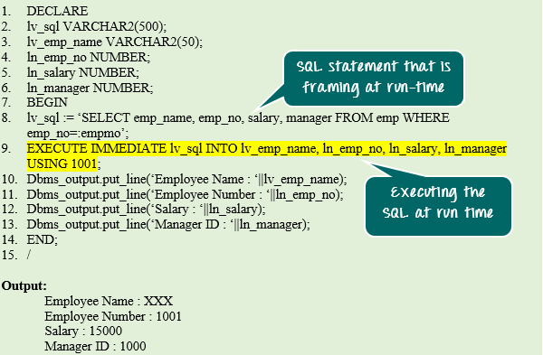

Slide 23
Code Explanation:
Code line 2-6: Declaring variables.
Code line 8: Framing the SQL at run-time. SQL contains the bind variable in where condition ':empno'.
Code line 9: Executing the framed SQL text (which is done in code line 8) using the NDS command 'EXECUTE IMMEDIATE'
The variables in 'INTO' clause (lv_emp_name, ln_emp_no, ln_salary, ln_manager) is used to hold the fetched values from the SQL query (emp_name, emp_no, salary, manager)
'USING' clause gives the values to the bind variable in the SQL query (:emp_no).
Code line 10-13: Displaying the fetched values.

Slide 24
DBMS_SQL for Dynamic SQL
PL/SQL provide the DBMS_SQL package that allows you to work with dynamic SQL. The process of creating and executing the dynamic SQL contains the following process
OPEN CURSOR: The dynamic SQL will execute in the same way as a cursor. So in order to execute the SQL statement, we must open the cursor.
PARSE SQL: The next step is to parse the dynamic SQL. This process will just check the syntax and keep the query ready to execute.
BIND VARIABLE Values: The next step is to assign the values for bind variables if any.
DEFINE COLUMN: The next step is to define the column using their relative positions in the select statement.
EXECUTE: The next step is to execute the parsed query.
FETCH VALUES: The next step is to fetch the executed values.
CLOSE CURSOR: Once the results are fetched, the cursor should be closed.

Slide 25
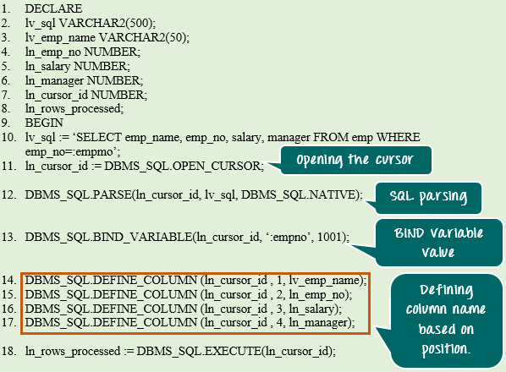

Slide 26
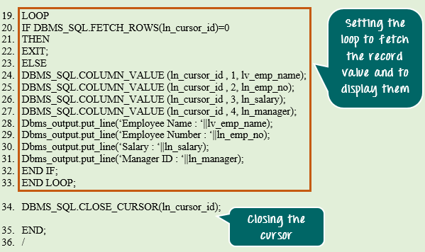

Slide 27
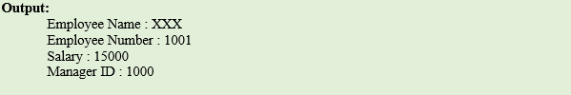

Slide 28
Code Explanation:
Code line 1-9: Variable declaration.
Code line 10: Framing the SQL statement.
Code line 11: Opening the cursor using DBMS_SQL.OPEN_CURSOR. It will return the cursor id which is opened.
Code line 12: After the cursor is opened, the SQL is parsed.
Code line 13: Bind variable '1001' is assigning to the cursor id instead ':empno'.
Code line 14-17: Defining the column name based on their relative position in the SQL statement. In our case, the relative position is (1) emp_name, (2) emp_no (3) salary (4) manager. So based on this position we are defining the target variable.
Code line 18: Executing the query using DBMS_SQL.EXECUTE. It returns the number of records processed.
Code line 19-33: Fetching the records using a loop and displaying the same.
Code line 20: DBMS_SQL.FETCH_ROWS will fetch one record from the rows processed. It can be called repeatedly to fetch all the rows. If it cannot fetch rows, it will return 0, thus exiting the loop.

Slide 29
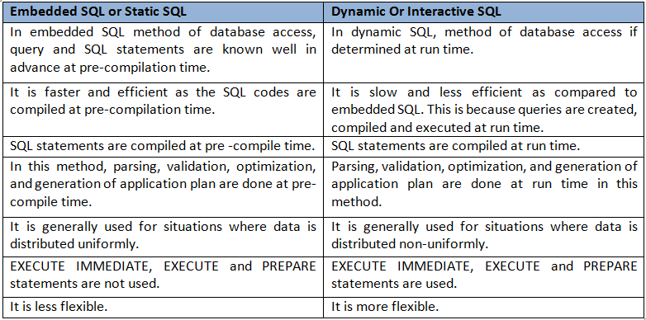

Slide 30
How to grant privlediges
previledges

Slide 31
END

