Slide 1
Overall DBMS-Architecture

Slide 2
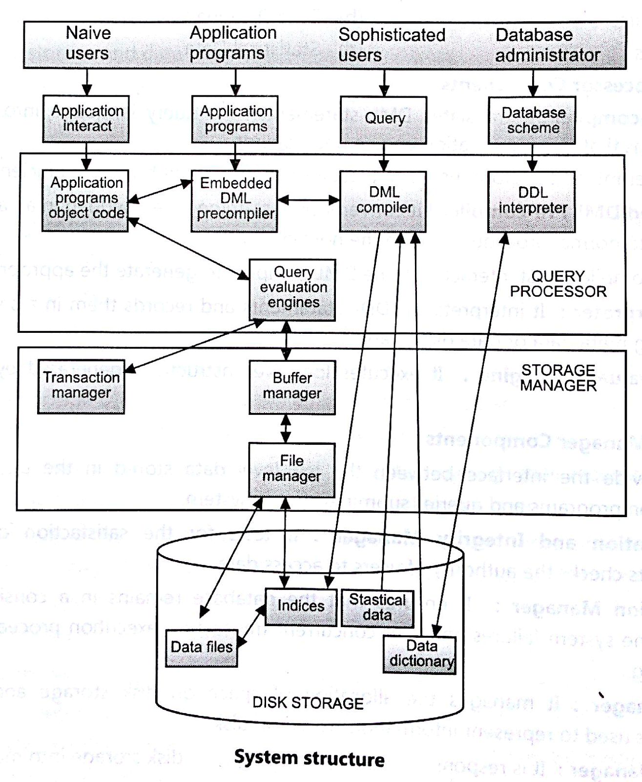

Slide 3
Database Users:
Users are differentiated by the way they expect to interact with the system:
Application programmers:
Application programmers are computer professionals who write application programs. Application programmers can choose from many tools to develop user interfaces.
Rapid application development (RAD) tools are tools that enable an application programmer to construct forms and reports without writing a program.
Sophisticated users:
Sophisticated users interact with the system without writing programs. Instead, they form their requests in a database query language.
They submit each such query to a query processor, whose function is to break down DML statements into instructions that the storage manager understands.

Slide 4
Specialized users :
Specialized users are sophisticated users who write specialized database applications that do not fit into the traditional data-processing framework.
Among these applications are computer-aided design systems, knowledge base and expert systems, systems that store data with complex data types (for example, graphics data and audio data)
Naïve users :
Naive users are unsophisticated users who interact with the system by invoking one of the application programs that have been written previously.
For example, a bank teller who needs to transfer $50 from account A to account B invokes a program called transfer. This program asks the teller for the amount of money to be transferred, the account from which the money is to be transferred, and the account to which the money is to be transferred.

Slide 5
Database Administrator:
Coordinates all the activities of the database system. The database administrator has a good understanding of the enterprise’s information resources and needs.
Database administrator's duties include:
Schema definition: The DBA creates the original database schema by executing a set of data definition statements in the DDL.
Storage structure and access method definition.
Schema and physical organization modification: The DBA carries out changes to the schema and physical organization to reflect the changing needs of the organization, or to alter the physical organization to improve performance.
Granting user authority to access the database: By granting different types of authorization, the database administrator can regulate which parts of the database various users can access.
Specifying integrity constraints.
Monitoring performance and responding to changes in requirements.

Slide 6
Query Processor:
The query processor will accept query from user and solves it by accessing the database.
Parts of Query processor:
DDL interpreter
This will interprets DDL statements and fetch the definitions in the data dictionary.
DML compiler
a. This will translates DML statements in a query language into low level instructions that the query evaluation engine understands.
b. A query can usually be translated into any of a number of alternative evaluation plans for same query result. DML compiler will select best plan for query optimization.
Query evaluation engine
This engine will execute low-level instructions generated by the DML compiler on DBMS.

Slide 7
Storage Manager/Storage Management:
A storage manager is a program module which acts like interface between the data stored in a database and the application programs and queries submitted to the system.
Thus, the storage manager is responsible for storing, retrieving and updating data in the database.
The storage manager components include:
Authorization and integrity manager: Checks for integrity constraints and authority of users to access data.
Transaction manager: Ensures that the database remains in a consistent state although there are system failures.
File manager: Manages the allocation of space on disk storage and the data structures used to represent information stored on disk.
Buffer manager: It is responsible for retrieving data from disk storage into main memory. It enables the database to handle data sizes that are much larger than the size of main memory.
Data structures implemented by storage manager.
Data files: Stored in the database itself.
Data dictionary: Stores metadata about the structure of the database.
Indices: Provide fast access to data items.

Slide 9
Prime and Non Prime Attributes in DBMS with Example
Prime Attributes –
Attribute set that belongs to any candidate key are called Prime Attributes. (union of all the candidate key attribute) {CK1 ∪ CK2 ∪ CK3 ∪ ……} If Prime attribute determined by other attribute set, then more than one candidate key is possible.
For example, If A is Candidate Key, and X→A, then, X is also Candidate Key
Non Prime Attribute – Attribute set does not belongs to any candidate key are called Non Prime Attributes.

Slide 10
Modelling Temporal Data
Temporal database stores data relating to time instances. It offers temporal data types and stores information relating to past, present and future time.
Temporal databases provide a uniform and systematic way of dealing with historical data.
More specifically the temporal aspects usually include valid time and transaction time. These attributes can be combined to form bitemporal data.
Valid time is the time period during which a fact is true in the real world.(Historical database)
Transaction time is the time period during which a fact stored in the database was known.(Rollback database)
Bitemporal data combines both Valid and Transaction Time.

Slide 11
Example:-Imagine that we come up with a temporal database storing data about the 18th century. The valid time of these facts is somewhere between 1700 and 1799, where as the transaction time starts when we insert the facts into the database, for example, January 21, 1998.
Consider data about employees with respect to the real world is stored in table.
Then, the following table could result:

Slide 12
EmpID | Name | Department | Salary | ValidTimeStart | ValidTimeEnd
10 | John | Research | 11000 | 1985 | 1990
10 | John | Sales | 11000 | 1990 | 1993
10 | John | Sales | 12000 | 1993 | INF
11 | Paul | Research | 10000 | 1988 | 1995
12 | George | Research | 10500 | 1991 | INF

Slide 13
The above valid-time table stores the history of the employees with respect to the real world. The attributes ValidTimeStart and ValidTimeEnd actually represent a time interval which is closed at its lower and open at its upper bound.
Thus, we see that during the time period [1985 - 1990), employee John was working in the research department, having a salary of 11000.
Then he changed to the sales department, still earning 11000. In 1993, he got a salary raise to 12000.
The upper bound INF denotes that the tuple is valid until further notice. It is now possible to store information about past states.
We see that Paul was employed from 1988 until 1995. In the corresponding non-temporal table, this information was (physically) deleted when Paul left the company.

Slide 14
Different Forms of Temporal Databases
The two different notions of time - valid time and transaction time - allow the distinction of different forms of temporal databases.
A historical database stores data with respect to valid time, a rollback database stores data with respect to transaction time.
A bitemporal database stores data with respect to both valid time and transaction time.
Commercial DBMS are said to store only a single state of the real world, usually the most recent state. Such databases usually are called snapshot databases.
A snapshot database in the context of valid time and transaction time is depicted in the following picture:

Slide 15
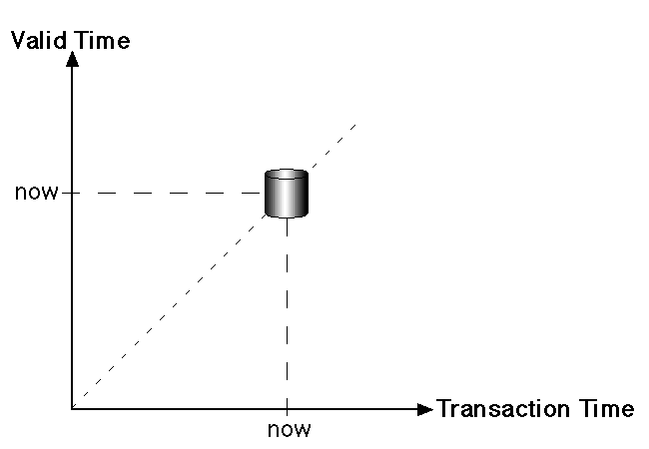

Slide 16
On the other hand, a bitemporal DBMS such as TimeDB stores the history of data with respect to both valid time and transaction time.
The history of when data was stored in the database (transaction time) is limited to past and present database states, since it is managed by the system directly which does not know anything about future states.
A table in the bitemporal relational DBMS TimeDB may either be a snapshot table (storing only current data), a valid-time table (storing when the data is valid wrt. the real world), a transaction-time table (storing when the data was recorded in the database) or a bitemporal table (storing both valid time and transaction time).

Slide 17
An extended version of SQL allows to specify which kind of table is needed when the table is created.
Existing tables may also be altered (schema versioning). Additionally, it supports temporal queries, temporal modification statements and temporal constraints.
The states stored in a bitemporal database are shown in fig.
Of course, a temporal DBMS such as TimeDB does not store each database state separately as depicted in the figure, it stores valid time and/or transaction time for each tuple.

Slide 18
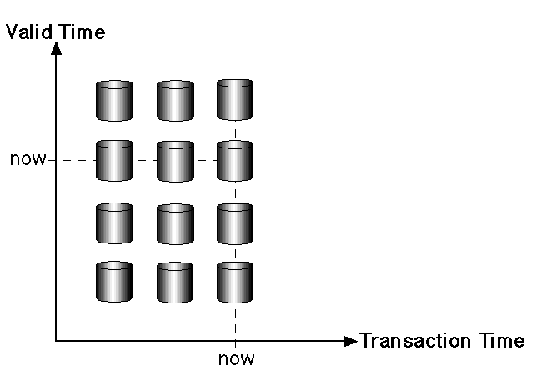

Slide 19
Canonical Cover

Slide 20
Canonical Cover - 1
Given a relation R with a set of FDs F
4 steps to find a canonical cover for F:
Step 1: Decompose all FDs in standard form
Replace each FD X → A1A2…Ak in F with X→A1, X→A2, …, X→Ak

Slide 21
Canonical Cover - 2
Step 2: Eliminate unnecessary attributes from LHS
For every FD X → A in F, check if the closure of a subset of X determines A. If so, remove redundant attribute(s) from X

Slide 22
Canonical Cover - 3
Step 3: Remove redundant FD(s)
For every FD X → A in G
Remove X → A from G, and call the result G’
Compute X+ under G’
If A ∈ X+, then X → A is redundant. Hence, we remove the FD X → A from G (That is, we rename G’ to G)

Slide 23
Canonical Cover - 4
Step 4: Make LHS of FDs unique
Replace X→A1, X→A2, …, X→Ak with X → A1A2…Ak

Slide 24
END

