Slide 1

Unit 3 Virtual Function
Memory Management: new and delete, pointers to objects, Accessing array using pointers, function pointers, Pointers to pointers, Friend function, Static function, this pointer, Virtual function, Dynamic binding
VIIT,Pune

Slide 2
Contents
Virtual Functions-
Pointers- indirection Operators
Memory Management: new and delete
Pointers to Objects
A Linked List Example
accessing Arrays using pointers
Function pointers
Pointers to Pointers
A Parsing Example
Debugging Pointers
Dynamic Pointers
Object Oriented Programming VIIT,Pune

Slide 3
Contents
smart pointers
shared pointers
Case Study : Design of Horse Race Simulation
Virtual Function- Friend Functions
Static Functions
Assignment and Copy Initialization
this Pointer
virtual function
dynamic binding
Virtual destructor
Object Oriented Programming VIIT,Pune

Slide 4
Pointers
Pointers are one of the strongest features in C/C++
Pointer is a variable that holds a memory address.
This address is the location of another object (typically another variable) in memory.
Uninitialized pointers (or pointers containing invalid values) can cause your system to crash.
Object Oriented Programming VIIT,Pune

Slide 5
Pointer Variables
A pointer declaration consists of a base type, an *, and the variable name. The general form for declaring a pointer variable is
type *var-name;
Type may be any valid type.
E.g. int *ip; // pointer to an integer
double *dp; // pointer to a double
float *fp; // pointer to a float
char *ch // pointer to character
The name of the pointer variable is specified by name
The base type of the pointer defines what type of variables the pointer can point to.
Technically, any type of pointer can point anywhere in memory
The actual data type of the value of all pointers, whether integer, float, character, or otherwise, is the same, a long hexadecimal number that represents a memory address

Slide 6
Pointer Operators
There are two special pointer operators: * and &.
The & is a unary operator that returns the memory address of its operand.
m = &count;
places into m the memory address of the variable count. This address is the computer's internal location of the variable.
It has nothing to do with the value of count.
You can think of & as returning "the address of." Therefore, the preceding assignment statement means "m receives the address of count."
Object Oriented Programming VIIT,Pune

Slide 7
Pointer Operators
The second pointer operator, *, is the complement of &. It is a unary operator that returns the value located at the address that follows.
For example, if m contains the memory address of the variable count,
q = *m; places the value of count into q.
Both & and * have a higher precedence than all other arithmetic operators except the unary minus, with which they are equal.
Object Oriented Programming VIIT,Pune

Slide 8
using namespace std;
int main () {
int var = 20; // actual variable declaration.
int *ip; // pointer variable
ip = &var; // store address of var in pointer variable
cout << "Value of var variable: ";
cout << var << endl; // print the address stored in ip pointer variable
cout << "Address stored in ip variable: ";
cout << ip << endl; // access the value at the address available in pointer
cout << "Value of *ip variable: ";
cout << *ip << endl;
return 0;
}
Value of var variable: 20
Address stored in ip variable: 0xbfc601ac Value of *ip variable: 20

Slide 9
Pointer Expressions
In general, expressions involving pointers conform to the same rules as other expressions
Pointer Assignments
As with any variable, you may use a pointer on the right-hand side of an assignment statement to assign its value to another pointer.
Object Oriented Programming VIIT,Pune

Slide 10
Pointer Assignments
#include <stdio.h>
int main(void)
{
int x;
int *p1, *p2;
p1 = &x;
p2 = p1;
printf(" %p", p2); /* print the address of x, not x's value! */
return 0;
}
Both p1 and p2 now point to x. The address of x is displayed by using the %p printf( ) format specifier, which causes printf( ) to display an address in the format used by the host computer.

Slide 11
Pointer Arithmetic
There are only two arithmetic operations that you may use on pointers: addition and subtraction.
let p1 be an integer pointer with a current value of 2000. Also, assume integers are 2 bytes long. After the expression
p1++;
p1 contains 2002, not 2001
Object Oriented Programming VIIT,Pune

Slide 12
Pointer Arithmetic
The same is true of decrements. For example, assuming that p1 has the value 2000, the expression
p1--; causes p1 to have the value 1998.
When applied to character pointers, this will appear as "normal" arithmetic because characters are always 1 byte long.
You are not limited to the increment and decrement operators. For example, you may add or subtract integers to or from pointers.
p1 = p1 + 12;
Object Oriented Programming VIIT,Pune

Slide 13
Pointer Arithmetic
Object Oriented Programming VIIT,Pune

Slide 14
Pointer Comparisons
You can compare two pointers in a relational expression. For instance, given two pointers p and q,
if(p<q) printf("p points to lower memory than q\n");
pointer comparisons are used when two or more pointers point to a common object, such as an array
Object Oriented Programming VIIT,Pune

Slide 15
Example
#include <stdio.h>
#include <stdlib.h>
#define SIZE 50
void push(int i);
int pop(void);
int *tos, *p1, stack[SIZE];
int main(void)
{
int value;
tos = stack; /* tos points to the top of stack */
p1 = stack; /* initialize p1 */
do {
printf("Enter value: ");
scanf("%d", &value);
if(value!=0) push(value);
else
printf("value on top is %d\n", pop());
} while(value! = -1);
return 0;
}
void push(int i)
{
p1++;
if(p1 == (tos+SIZE))
{
printf("Stack Overflow.\n");
exit(1);
}
*p1 = i;
}
Object Oriented Programming VIIT,Pune

Slide 16
Example(Continue..)
int pop(void)
{
if(p1==tos)
{
printf("Stack Underflow.\n");
exit(1);
}
p1--;
return *(p1+1);
}
In pop( ), the parentheses are necessary in the return statement. Without them, the statement would look like this:
return *p1 +1;
which would return the value at location p1 plus one, not the value of the location p1+1.
Object Oriented Programming VIIT,Pune

Slide 17
Array elements can be accessed using pointer notation as well as array notation.
// ptrnote.cpp
// array accessed with pointer notation
#include <iostream>
using namespace std;
int main()
{ //array
int intarray[5] = { 31, 54, 77, 52, 93 };
for(int j=0; j<5; j++) //for each element,
cout << *(intarray+j) << endl; //print value
return 0;
}
The C++ compiler is smart enough to take the size of the data into account when it performs arithmetic on data addresses.
It knows that intarray is an array of type int because it was declared that way.
So when it sees the expression intarray+3, it interprets it as the address of the fourth integer in intarray, not the fourth byte.

Slide 18
EXAMPLE 2
#include <iostream>
using namespace std;
int main ()
{
// an array with 5 elements.
double balance[5] = {1000.0, 2.0, 3.4, 17.0, 50.0};
double *p;
p = balance;
// output each array element's value
cout << "Array values using pointer " << endl;
for ( int i = 0; i < 5; i++ )
{
cout << "*(p + " << i << ") : ";
cout << *(p + i) << endl;
}
cout << "Array values using balance as address " << endl;
for ( int i = 0; i < 5; i++ )
{ cout << "*(balance + " << i << ") : "; cout << *(balance + i) << endl; }
return 0; }

Slide 19
Array values using pointer
*(p + 0) : 1000
*(p + 1) : 2
*(p + 2) : 3.4
*(p + 3) : 17
*(p + 4) : 50
Array values using balance as address
*(balance + 0) : 1000
*(balance + 1) : 2
*(balance + 2) : 3.4
*(balance + 3) : 17
*(balance + 4) : 50

Slide 20
Pointers and Functions
Three ways to pass arguments to a function: by value, by reference, and by pointer.
If the function is intended to modify variables in the calling program, these variables cannot be passed by value, since the function obtains only a copy of the variable.
However, either a reference argument or a pointer can be used in this situation.

Slide 21
// arguments passed by reference
#include <iostream>
using namespace std;
int main()
{
void centimize(double&); //prototype
double var = 10.0; //var has value of 10 inches
cout << “var = “ << var << “ inches” << endl;
centimize(var); //change var to centimeters
cout << “var = “ << var << “ centimeters” << endl;
return 0;
}
//--------------------------------------------------------------
void centimize(double& v) //It simply uses the argument name v; v and var are different names for the same thing.
{
v *= 2.54; //v is the same as var
}

Slide 22
// passptr.cpp
// arguments passed by pointer
#include <iostream>
using namespace std;
int main()
{
void centimize(double*); // argument is pointer to double
double var = 10.0; //var has value of 10 inches
cout << “var = “ << var << “ inches” << endl;
centimize(&var); //it supplies the address of the variable as the argument, this is not the variable itself, as it is in passing by reference, but the variable’s address.
cout << “var = “ << var << “ centimeters” << endl;
return 0;
}
//--------------------------------------------------------------
void centimize(double* ptrd) //it must use the dereference operator,
*ptrd, to access the value stored at this address
{
*ptrd *= 2.54; //*ptrd is the same as var
}

Slide 23
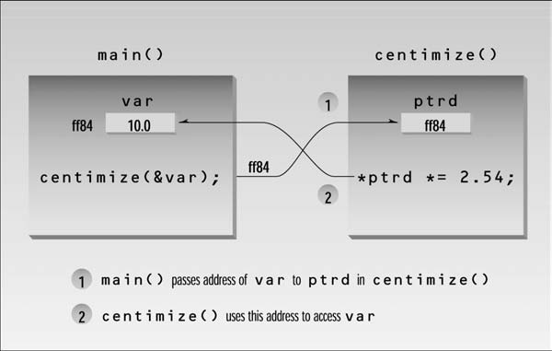
Passing a pointer as an argument to a function is in some ways similar to passing a reference.
They both permit the variable in the calling program to be modified by the function. However, the mechanism is different.
A reference is an alias for the original variable, while a pointer is the address of the variable.

Slide 24
Passing Arrays
varray[0]=25.4 centimeters
varray[1]=109.474 centimeters
varray[2]=243.586 centimeters
varray[3]=151.638 centimeters
varray[4]=221.742 centimeters
// array passed by pointer
#include <iostream>
using namespace std;
const int MAX = 5; //number of array elements
int main()
{
void centimize(double*); //prototype
double varray[MAX] = { 10.0, 43.1, 95.9, 59.7, 87.3 };
centimize(varray); //pass array address
for(int j=0; j<MAX; j++) //display new array values
cout << “varray[“ << j << “]=”
<< varray[j] << “ centimeters” << endl;
return 0;
}
//--------------------------------------------------------------
void centimize(double *ptrd) //double * is equivalent here to double[],
{
for(int j=0; j<MAX; j++)
*ptrd++ *= 2.54; //ptrd points to elements of varray
}

Slide 25
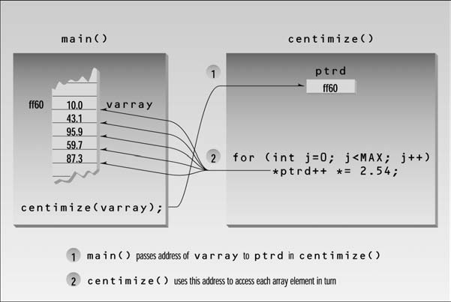

Slide 26
Pointers to String Constants
// strings defined using array and pointer notation
#include <iostream>
using namespace std;
int main()
{
char str1[] = “Defined as an array”;
char* str2 = “Defined as a pointer”;
cout << str1 << endl; // display both strings
cout << str2 << endl;
// str1++; // can’t do this; str1 is a constant
str2++; // this is OK, str2 is a pointer
cout << str2 << endl; // now str2 starts “efined...”
return 0;
}
But there is a subtle difference:
str1 is an address —that is, a pointer constant
while str2 is a pointer variable. So str2 can be changed, while str1 cannot,

Slide 27
Static vs. Dynamic Objects
Static object
(variables as declared in function calls)
Memory is acquired automatically
Memory is returned automatically when object goes out of scope
Dynamic object
Memory is acquired by program with an allocation request
new operation
Dynamic objects can exist beyond the function in which they were allocated
Object memory is returned by a deallocation request
delete operation
Object Oriented Programming VIIT,Pune

Slide 28
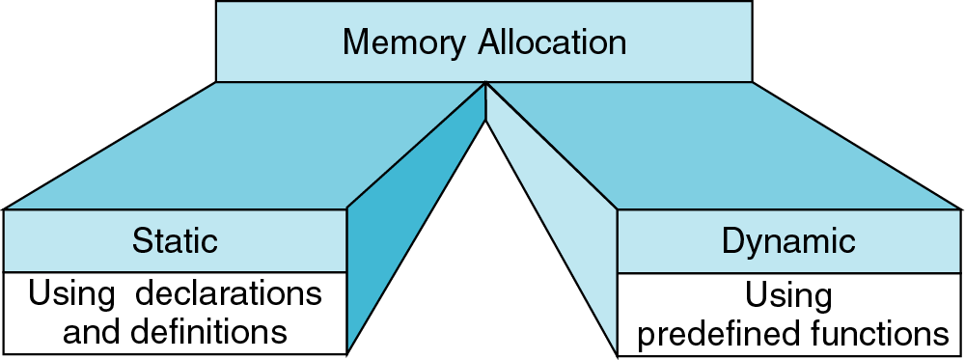
Memory Allocation
new
delete
Int *ptr;
ptr = new int[200];
…
delete [] ptr;
{
int a[200];
…
}
Object Oriented Programming VIIT,Pune

Slide 29
Memory Management Operator
new and delete operators are used to allocate and free the memory
This versatile operator obtains memory from the operating system and returns a pointer to its starting point.
Object can be created by using new and deleted by using delete operator
Syntax: Pointer variable = new data-type
// Pointer initialized with NULL
// Then request memory for the variable
int *p = NULL;
p = new int;
OR // Combine declaration of pointer // and their assignment
int *p = new int;

Slide 30
New operator Example
Int *p=new int;
Float *q=new float;
Example: int *p = new int(25);
float *q = new float(75.25);
Allocate block of memory:
new operator is also used to allocate a block(an array) of memory of type data- type.
Syntax:
pointer-variable = new data-type[size];
Example: int *p = new int[10]
Object Oriented Programming VIIT,Pune

Slide 31
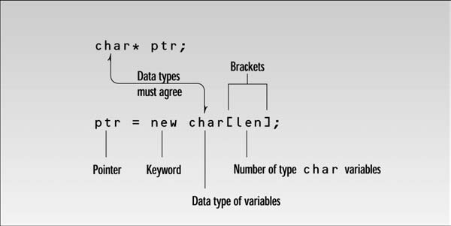

Slide 32
Normal Array Declaration vs Using new There is a difference between declaring a normal array and allocating a block of memory using new.
The most important difference is, normal arrays are deallocated by compiler (If array is local, then deallocated when function returns or completes).
However, dynamically allocated arrays always remain there until either they are deallocated by programmer or program terminates.

Slide 33
Delete operator Example
Data object no longer needed, it is destroyed to release memory space for reuse.
If your program reserves many chunks of memory using new, eventually all the available memory will be reserved and the system will crash.
To ensure safe and efficient use of memory, the new operator is matched by a corresponding delete operator that returns memory to the operating system.
Syntax
delete pointer variable
returns to the system whatever memory was pointed to by ptr.
Example :
delete q;
delete p;
Object Oriented Programming VIIT,Pune

Slide 34
// Release block of memory pointed by pointer-variable
Syntax : delete[] pointer-variable;
Example: // It will free the entire array pointed by p.
delete[] p;

Slide 35
int main ()
{
// Pointer initialization to null
int* p = NULL;
// Request memory for the variable using new operator
p = new int;
if (!p)
cout << "allocation of memory failed\n";
else
{
// Store value at allocated address
*p = 29;
cout << "Value of p: " << *p << endl;
}
float *r = new float(75.25);
cout << "Value of r: " << *r << endl;
// Request block of memory of size n
int n = 5;
int *q = new int[n];
if (!q)
cout << "allocation of memory failed\n";
else
{
for (int i = 0; i < n; i++)
q[i] = i+1;
cout << "Value store in block of memory: ";
for (int i = 0; i < n; i++)
cout << q[i] << “ "; //*(q+i)
}
// freed the allocated memory
delete p;
delete r;
// freed the block of allocated memory
delete[] q;
return 0;
}
Value of p: 29
Value of r: 75.25
Value store in block of memory: 1 2 3 4 5

Slide 36
//EXAMPLE : String with new and delete operator
#include <cstring> //for strlen
using namespace std;
int main()
{
char *str = “Idle hands are the devil’s workshop.”;
int len = strlen(str); //get length of str
char *ptr; //make a pointer to char
ptr = new char[len+1]; //set aside memory: string + ‘\0’
strcpy(ptr, str); //copy str to new memory area ptr
cout << “ptr=” << ptr << endl; //show that ptr is now in str
delete[ ] ptr; //release ptr’s memory
return 0;
}

Slide 37
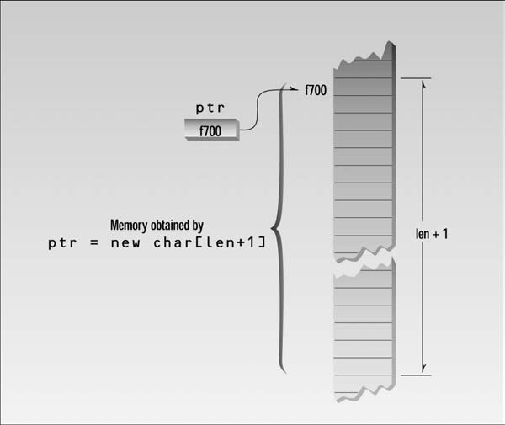

Slide 38
Pointers to Object(Continue..)
Object pointers are useful in creating objects at run time.
Used to access public members of an object.
When a pointer is incremented, it points to the next element of its type.
For example, an integer pointer will point to the next integer.
The same is true of pointers to objects.
Object Oriented Programming VIIT,Pune

Slide 39
Pointers to Object
When accessing members of a class given a pointer to an object, use the arrow (->) operator (membership-access operator) instead of the dot operator.
#include <iostream>
using namespace std;
class cl {
int i;
public:
cl(int j)
{
i=j;
}
int get_i()
{
return i;
}
};
int main()
{
cl ob(88), *p;
p = &ob; // get address of ob
cout << p->get_i(); // use -> to call get_i()
return 0;
}

Slide 40
Continue..
class cl {
int i;
public:
cl( )
{ i=0; }
cl(int j)
{ i=j; }
int get_i()
{ return i; }
};
int main()
{
cl ob[3] = {1, 2, 3};
cl *p;
int i;
p = ob; // get start of array
for(i=0; i<3; i++) {
cout << p->get_i() << "\n";
p++; // point to next object
}
return 0;
}
Object Oriented Programming VIIT,Pune

Slide 41
Continue..
You can assign the address of a public data member of an object to a pointer and then access that member by using the pointer
#include <iostream>
using namespace std;
class cl {
public:
int i;
cl(int j)
{ i=j; }
};
int main()
{
cl ob(1);
int *p;
p = &ob.i; // get address of ob.i
cout << *p; // access ob.i via p
return 0;
}
Object Oriented Programming VIIT,Pune

Slide 42
Example
class student
{
private:
int rollno;
string name;
public:
void get( )
{
cout<<"Enter the roll no.";
cin>>rollno;
cout<<"Enter name";
cin>>name;
}
void print( )
{
cout<<"Roll no, is\n"<<rollno;
cout<<"\nName is\n"<<name;
}
};
int main( )
{
student *ps=new student;
(*ps).get();
(*ps).print();
delete ps;
return 0;
}

Slide 43
int main()
{
Distance dist;
dist.getdist(); //access object members
dist.showdist(); // with dot operator
Distance* distptr; //pointer to Distance
distptr = new Distance; //points to new Distance object
distptr->getdist(); //access object members
distptr->showdist(); // with -> operator
cout << endl;
return 0;
}
class Distance //Distance class
{
private:
int feet;
float inches;
public:
void getdist() //get length from user
{
cout << “\nEnter feet: “; cin >> feet;
cout << “Enter inches: “; cin >> inches;
}
void showdist() //display distance
{
cout << feet << “\’-” << inches << ‘\”’; }
};

Slide 44
Pointers and Arrays
There is a close association between pointers and arrays
Example for how array elements are accessed.
#include <iostream>
using namespace std;
int main()
{ //array
int intarray[5] = { 31, 54, 77, 52, 93 };
for(int j=0; j<5; j++) //for each element,
cout << intarray[j] << endl; //print value
return 0;
}
Object Oriented Programming VIIT,Pune

Slide 45
Accessing Arrays using Pointers
array elements can be accessed using pointer notation as well as array notation.
#include <iostream>
using namespace std;
int main()
{ //array
int intarray[5] = { 31, 54, 77, 52, 93 };
for(int j=0; j<5; j++) //for each element,
cout << *(intarray+j) << endl; //print value
return 0;
}
Object Oriented Programming VIIT,Pune

Slide 46
Another example
#include<iostream>
using namespace std;
int main()
{
int a[5]={1,2,3,4,5};
int *p;
p=a;
cout<<"Printing the element inside the array using array:";
for(int i=0;i<5;i++)
{
cout<<"\n"<<*p;
p++;
}
return 0;
}
Object Oriented Programming VIIT,Pune

Slide 47
Pointer & function
there are three ways to pass arguments to a function: by value, by reference, and by pointer.
Passing Simple Variables
int main()
{
void centimize(double&); //prototype
double var = 10.0; //var has value of 10 inches
cout << “var = “ << var << “ inches” << endl;
centimize(var); //change var to centimeters
cout << “var = “ << var << “ centimeters” << endl;
return 0;
}
Object Oriented Programming VIIT,Pune

Slide 48
Passing Simple Variables
#include<iostream>
using namespace std;
int main()
{
void centimize(double&); //prototype
double var = 10.0; //var has value of 10 inches
cout << "var ="<< var << "inches" << endl;
centimize(var); //change var to centimeters
cout << "var = " << var << "centimeters" << endl;
return 0;
}
void centimize(double& v)
{
v *= 2.54; //v is the same as var
}
Object Oriented Programming VIIT,Pune

Slide 49
Argument passed pointer
int main()
{
void centimize(double*); //prototype
double var = 10.0; //var has value of 10 inches
cout << "val=" << var << "inches" << endl;
centimize(&var); //change var to centimeters
cout << "var=" << var << "centimeters" << endl;
return 0;
}
void centimize(double* ptrd)
{
*ptrd *= 2.54; //*ptrd is the same as var
}
Object Oriented Programming VIIT,Pune

Slide 50
An Array of Pointers to Objects
This arrangement allows easy access to a group of objects and is more flexible than placing the objects themselves in an array.
// ptrobjs.cpp
// array of pointers to objects
#include <iostream>
using namespace std;
class person //class of persons
{
protected:
char name[40]; //person’s name
public:
void setName() //set the name
{
cout << “Enter name: “;
cin >> name;
}
void printName() //get the name
{
cout << “\n Name is: “ << name;
}
};

Slide 51
int main()
{
person* persPtr[100]; //array of pointers to persons
int n = 0; //number of persons in array char choice;
do //put persons in array
{
persPtr[n] = new person; //make new object
persPtr[n]->setName(); //set person’s name
n++; //count new person
cout << “Enter another (y/n)? “; //enter another
cin >> choice; //person?
}
while( choice==’y’ ); //quit on ‘n’
for(int j=0; j<n; j++) //print names of
{ //all persons
cout << “\nPerson number “ << j+1;
persPtr[j]->printName(); //*(persPtr+j)
}
cout << endl;
return 0;}
Enter name: Stroustrup ←user enters names
Enter another (y/n)? y
Enter name: Ritchie
Enter another (y/n)? y
Enter name: Kernighan
Enter another (y/n)? n
Person number 1 ← program displays all names stored
Name is: Stroustrup
Person number 2
Name is: Ritchie
Person number 3
Name is: Kernighan

Slide 52

Pointer to pointer
A pointer to a pointer is a form of multiple indirection or a chain of pointers.
When we define a pointer to a pointer, the first pointer contains the address of the second pointer, which points to the location that contains the actual value.
Object Oriented Programming VIIT,Pune

Slide 53

Pointer to Pointer example
int main()
{
int a=5;
int b=10;
int *p;
int **pp;
int *p1;
int **pp1;
p=&a;
pp=&p;
p1=&b;
pp1=&p1;
cout<<"**pp="<<**pp<<"\n";
cout<<"**pp1"<<**pp1<<"\n";
cout<<"**pp+**pp1="<<**pp+**pp1;
return 0;
}
Output:
Object Oriented Programming VIIT,Pune

Slide 54
Linked List Example
The linked list provides a more flexible storage system in that it doesn’t use arrays at all.
Instead, space for each data item is obtained as needed with new and each item is connected or linked to the next data item using a pointer.
The individual items don’t need to be located contiguously in memory the way array elements are; they can be scattered anywhere.
Object Oriented Programming VIIT,Pune

Slide 55
Linked List Example(cont..)
Object Oriented Programming VIIT,Pune

Slide 56
Linked List Example(cont..)
struct link //one element of list
{
int data; //data item
link* next; //pointer to next link
};
class linklist //a list of links
{
private:
link* first; //pointer to first link
public:
linklist() //no-argument constructor
{ first = NULL; } //no first link
void additem(int d); //add data item (one link)
void display(); //display all links
};
Object Oriented Programming VIIT,Pune
Notes:
56

Slide 57
Linked List Example(cont..)
void linklist::additem(int d) //add data item
{
link* newlink = new link; //make a new link
newlink->data = d; //give it data
newlink->next = first; //it points to next link
first = newlink; //now first points to this
}
void linklist::display() //display all links
{
link* current = first; //set ptr to first link
while( current != NULL ) //quit on last link
{
cout << current->data << endl; //print data
current = current->next; //move to next link
}
}
Object Oriented Programming VIIT,Pune

Slide 58
Linked List Example(cont..)
int main()
{
linklist li; //make linked list
li.additem(25); //add four items to list
li.additem(36);
li.additem(49);
li.additem(64);
li.display(); //display entire list
return 0;
}
Object Oriented Programming VIIT,Pune

Slide 59
Continue..
Adding an Item to the List
A new link is inserted at the beginning of the list.
First, a new structure of type link is created by the line
link* newlink = new link;
This creates memory for the new link structure with new and saves the pointer to it in the newlink variable.
Object Oriented Programming VIIT,Pune

Slide 60
Continue
The following two lines set the data variable to the value passed as an argument to additem(), and the next pointer to point to whatever address was in first, which holds the pointer to the start of the list.
newlink->data = d;
newlink->next = first;
we want the first variable to point to the new link:
first = newlink;
Object Oriented Programming VIIT,Pune

Slide 61
Displaying the List Contents
we need to do is follow from one next pointer to another until we find a next that is NULL
cout << endl << current->data;
prints the value of the data, and
current = current->next;
moves us along from one link to another, until
current != NULL
Object Oriented Programming VIIT,Pune

Slide 62
Virtual base class
Grandparent
Parent 1
Parent 2
Child
In above case all the public as well as protected members of grandparent are inherited ‘twice’ , so child would have duplicate copies.
Can be avoided by making common base class(grandparent in this case) as virtual base class
Object Oriented Programming VIIT,Pune

Slide 63
Virtual function
When function is made virtual, C++ determines which function to use at run time based on type of object it is pointing and not type of the pointer
Pure virtual functions
Called do-nothing functions
virtual void display() =0;
Called pure virtual functions
Such functions are declared in base class and defined in derived classes.
Such classes are called as abstract base classes which constitute pure virtual functions
Object Oriented Programming VIIT,Pune

Slide 64
Normal Member Functions Accessed with Pointers
// notvirt.cpp
// normal functions accessed from pointer
#include <iostream>
using namespace std;
////////////////////////////////////////////////////////////////
class Base //base class
{
public:
void show() //normal function
{ cout << “Base\n”; }
};
////////////////////////////////////////////////////////////////
class Derv1 : public Base //derived class 1
{
public:
void show()
{ cout << “Derv1\n”; }
};
////////////////////////////////////////////////////////////////
class Derv2 : public Base //derived class 2
{
public:
void show()
{ cout << “Derv2\n”; }
};
////////////////////////////////////////////////////////////////
int main()
{
Derv1 dv1; //object of derived class 1
Derv2 dv2; //object of derived class 2
Base* ptr; //pointer to base class
ptr = &dv1; //put address of dv1 in pointer
ptr->show(); //execute show()
ptr = &dv2; //put address of dv2 in pointer
ptr->show(); //execute show()
return 0;
}

Slide 65
ptr = &dv1; // derived class address in base class pointer
the compiler is
perfectly happy, because type checking has been relaxed in this situation
rule is that pointers to objects of a derived class are typecompatible
with pointers to objects of the base class.
Now the question is, when you execute the line
ptr->show();
what function is called? Is it Base::show() or Derv1::show()?
The output from the program answers these
questions:
Base
Base

Slide 66
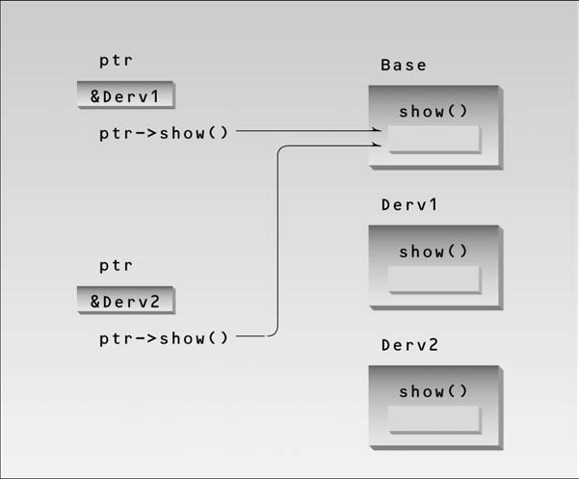

Slide 67
Virtual Member Functions Accessed with Pointers
// virt.cpp
// virtual functions accessed from pointer
#include <iostream>
using namespace std;
////////////////////////////////////////////////////////////////
class Base //base class
{
public:
virtual void show() //virtual function
{ cout << “Base\n”; }
};
////////////////////////////////////////////////////////////////
class Derv1 : public Base //derived class 1
{
public:
void show()
{ cout << “Derv1\n”; }
};
////////////////////////////////////////////////////////////////
class Derv2 : public Base //derived class 2
{
public:
void show()
{ cout << “Derv2\n”; }
};
////////////////////////////////////////////////////////////////
int main()
{
Derv1 dv1; //object of derived class 1
Derv2 dv2; //object of derived class 2
Base* ptr; //pointer to base class
ptr = &dv1; //put address of dv1 in pointer
ptr->show(); //execute show()
ptr = &dv2; //put address of dv2 in pointer
ptr->show(); //execute show()
return 0;
}

Slide 68
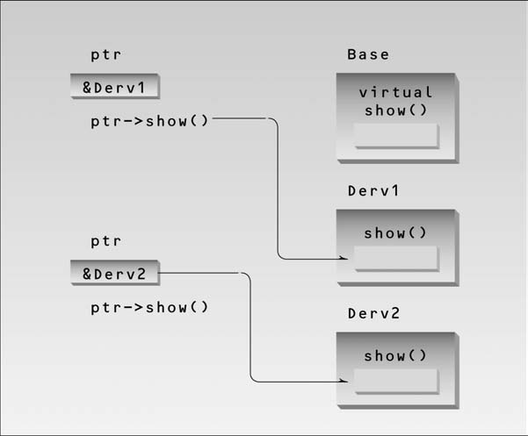
The output of this program is Derv1 Derv2

Slide 69
But in VIRT the compiler
doesn’t know what class the contents of ptr may contain. It could be the address of an object
of the Derv1 class or of the Derv2 class. Which version of draw() does the compiler call? In
fact the compiler doesn’t know what to do, so it arranges for the decision to be deferred until
the program is running.
At runtime, when it is known what class is pointed to by ptr, the
appropriate version of draw will be called. This is called late binding or dynamic binding.
(Choosing functions in the normal way, during compilation, is called early binding or
static binding.) Late binding requires some overhead but provides increased power and
flexibility.

Slide 70
Abstract Classes and Pure Virtual Functions

Slide 71
Example VBC
Class A { // grandparent
};
Class B1 : virtual public A // Parent 1
{
};
Class B2 : public virtual A // parent 2
{
}
Class C : public B1, public B2 // child
{ // only one copy of A will be inherited
}
Object Oriented Programming VIIT,Pune

Slide 72
Virtual base class example
Student
test
sports
result
Object Oriented Programming VIIT,Pune

Slide 73
Program
Class student – roll_no, get_no(), display_no()
Class test : virtual public student
-- sub1, sub2, get_marks(), display_marks()
Class sports : public virtual student
-- score, get_score(), display_score()
Class result : public test, public sports
-- total, display_total()
Object Oriented Programming VIIT,Pune

Slide 74
Pointer to derived classes
Void main(){
Base *bptr; // base pointer
Base b;
bptr = &b; // base addr
bptr→show();
derived d;
bptr =&d;
bptr→show();
Class Base
{
void show(){}
}
Class derived : public base
{
void show(){}
}
Object Oriented Programming VIIT,Pune

Slide 75
Virtual functions
To use pointer to base class to refer to all derived objects, achieved using virtual functions
Calss base
{
void display();
virtual void show();
};
Class derived : public base{
Void display();
Void show()
}
void main(){
base b;
derived d;
base *bptr;
bptr=&b;
bptr→display();
bptr→show();
bptr=&d;
bptr→display();
bptr→show();
}
Object Oriented Programming VIIT,Pune

Slide 76
Abstract Class
Contain at least one virtual function
Used to provide interface to subclasses
Class which is derived from abstract class should define the pure virtual function
We can not initialize the abstract class
We can not create object of abstract class. But we can create pointer to abstract class.
It can contain the normal function also.
Object Oriented Programming VIIT,Pune

Slide 77
Abstract Class
void display()
{
cout<<"\n First derived class";
}
};
class dev2:public parent
{
public:
void display()
{
cout<<"\n second derived class";
}
};
class parent
{
public:
virtual void display()=0;
void print()
{
cout<<"This is part of parent class";
}
};
class dev1: public parent
{
public:
Object Oriented Programming VIIT,Pune

Slide 78
Abstract Class
int main()
{
cout<<"Demostartion of Abstract class";
parent *ob;
dev1 d1;
dev2 d2;
ob->print();
ob=&d1;
ob->display();
ob=&d2;
ob->display();
return 0;
}
Object Oriented Programming VIIT,Pune

Slide 79
Object Oriented Programming VIIT,Pune

Slide 80
C
Object Oriented Programming VIIT,Pune

Slide 81
C
Object Oriented Programming VIIT,Pune

Slide 82
C
Object Oriented Programming VIIT,Pune

Slide 83
C
Object Oriented Programming VIIT,Pune

Slide 84
C
Object Oriented Programming VIIT,Pune

Slide 85
C
Object Oriented Programming VIIT,Pune

