Slide 1
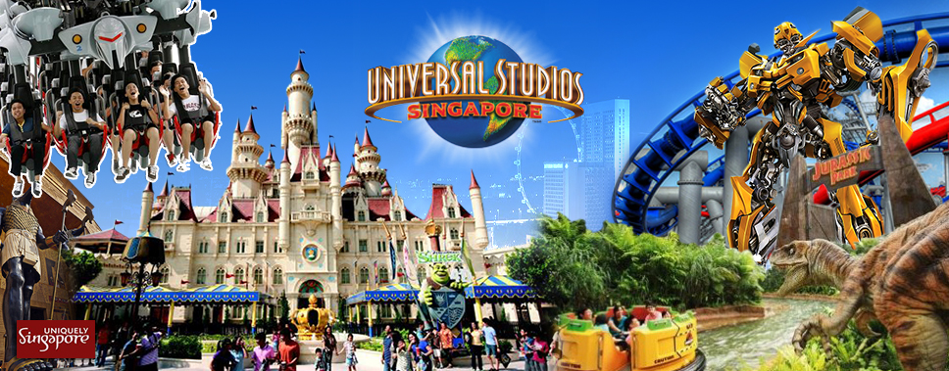

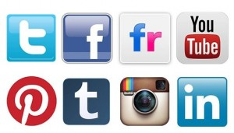
Impact of Web & Social Media on Tourism
- Tejas Phadnis

Slide 2
Background
The tourism industry thrives on information.
Data-driven evidence based decisions possible due to the enormous new big data repositories.
Travellers leave different digital traces behind on the Web when using mobile technologies.

Slide 3
Problem Statement
Design a digital support system to
Analyze selected web & social media data about two most popular tourist attractions of Singapore namely, Universal Studios, Singapore and Gardens by the Bay.
Use these finding to predict number of tourists visiting these attractions in next three months.

Slide 4
Business Benefits
Travellers:
Get consolidated information to make informed decision.
Compare tourist attractions to plan travel.
Administrators:
Review negative feedback & take corrective steps
Use prediction of number of tourist to implement flexible ticket pricing, promotions, adequate security arrangements and other logistic operations.

Slide 5




Data Sources
Pre-Trip/On-Route | On Destination | Selected Data Source
Web Searches |  | Google Trends
Customer Reviews |  | TripAdvisor
Social Media | Social Media | Twitter
Other Data | Data Source
Monthly Tourist Data Hotel Booking Data | http://www.singstat.gov.sg/statistics/browse-by-theme/tourism-tables

Slide 6

Data Volume
 | Universal Studios, Singapore | Gardens by the Bay
Avg. Yearly Reviews | 1944 | 6984
Avg. Yearly Web Searches | 3768 | 1464
Avg. Yearly Tweets | 27408 | 26592

Slide 7
Data Collection - TripAdvisor
Feature | Description
Attraction | Name of the attraction
Attraction Type | Attraction type e.g. Theme Park, Gardens, Nature & Park
Review Month | YearMonth (YYYYMM) when review is recorded
Visit Month | YearMonth (YYYYMM) of actual visit
Reviewer Rating | On the scale of 1 to 5 where 1 = Terrible and 5 = Excellent
Reviewer Level | On the scale of 1 to 10
Reason for Poor Rating | Extract reason from Text &/or Long Text. Broadly divided into five categories; expensive, long queue, ongoing maintenance, staff and others.
Reviewer Type | Five categories of Reviewers; family, couples, solo, business and friends.
Text | High level review description.
Long Text | Detailed review text.

Slide 8
Data Collection – Google Trends
Feature | Description
Attraction | Name of the attraction
Attraction Type | Attraction type e.g. Theme Park, Gardens, Nature & Park
Month | YearMonth (YYYYMM)
No. Of Web Searches | Google Trend data (topic search) for month YYYYMM
Region 1 | Location where search term was most popular
Region 2 | Location where search term was 2nd most popular
Region 3 | Location where search term was 3rd most popular

Slide 9
Data Collection – Twitter
Feature | Description
Attraction | Name of the attraction
Attraction Type | Attraction type e.g. Theme Park, Gardens, Nature & Park
Month | YearMonth (YYYYMM)
No. Of Tweets | Total number of tweets
Positive Tweets | Positive Tweets
Negative Tweets | Negative Tweets
Neutral Tweets | Neutral Tweets
Location | Location of geotagged to tweet

Slide 10
Data Collection – Other Data
Monthly Tourist Data
Feature | Description
Month | YearMonth (YYYYMM)
Number of Tourists | Total number of tourist
Hotel Booking Data
Feature | Description
Month | YearMonth (YYYYMM)
Available Rooms | Available Room-Nights (Number)
Occupied Rooms | Gross Lettings (Room-Nights) (Number)
Occupancy Rate | Standard Average Hotel Occupancy Rate (Per Cent)

Slide 11
Data Collection – Key Aspects
Collect data for certain period (6 months / 1 year)
We will use API / WebScraping to extract data from social media
Text Analytics (Sentiment Analytics)
TripAdvisor poor rating - Extract reason from Text &/or Long Text.
Classify tweets into positive, negative and neutral.
Geotagging – The geo tagged tweets will be used to identify number of tourist visited the attraction.
Timeseries dataset as the observations are consecutive monthly measurements. The number of tourists can be predicted based on previous month web / social media activity

Slide 12

Data Analysis - Questions
As a business traveller, I have only limited time to explore Singapore, which attraction I should not miss?
Which is the most family friendly attraction in Singapore?
What is the most talked-about attraction in Singapore?
What is the expected number of tourists visiting Universal Studios, Singapore, next month?
What are the main concerns bothering families visiting Universal Studios, Singapore?
What is the overall tourist experience over the period of time?

Slide 13
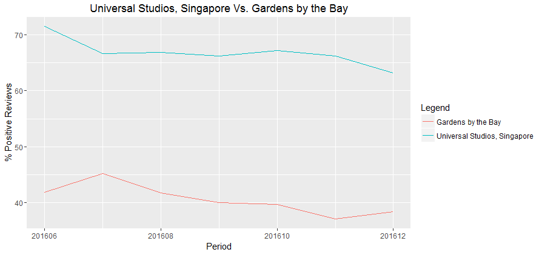
Data Analysis - TripAdvisor Reviews

Slide 14
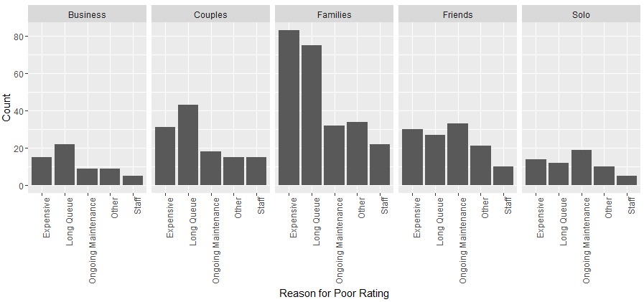
Data Analysis - TripAdvisor Reviews

Slide 15
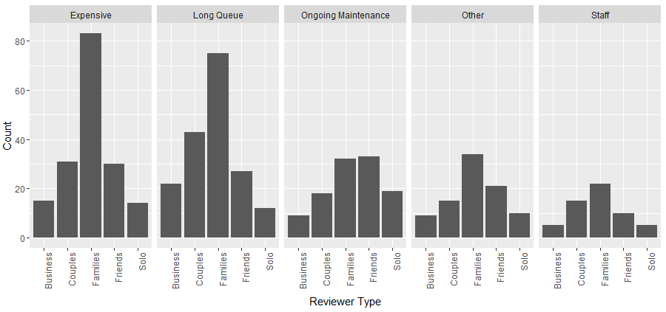
Data Analysis - TripAdvisor Reviews

Slide 16
Sub-sequent phases
Attractions | - Singapore Zoo - Night Safari Jurong Bird Park
Web Searches | Google popular times info about eateries (like McDonalds) in the vicinity of attraction might indicate number of travellers visiting attraction.
Social Media data | Facebook , Flickr / Instagram.
Blogging Sites
Transaction Data | - Airline Booking Tour Online Booking

