Slide 1
Study Guide - Format
Final exam format – a combination of multiple choice questions and written questions
Cover from Patterns in Software Architecture to Architecture in the Cloud
A total of 150 points max:
Multiple Choice Questions (75 points)
20 to 25 questions
Written Questions (75 points)
8 to 10 questions
Extra Credit questions ( up to 10 points)

Slide 2
Study Guide
“Multiple Choice” Questions
Same question format as in the quizzes/review sections
Choose all that apply
Fill in the blank
Find missing items
True/False
No partial credits

Slide 3
Study Guide – Sample Questions
What is unit testing? And how architecture plays a role in unit testing?
What is the difference between Black-Box and White-Box testing?
List at least four activities associated with testing and description for each listed activity
Should the architecture and project manager be the same person? Provide your rationale
What is integration testing? And how architecture plays a role in integration testing?
What is a cloud architecture?
Describe briefly the Cloud Service Models

Slide 4
Sample Questions (cont.)
What is the difference between design patterns and architectural patterns?
Describe Client-Server architectural pattern
How does Event Bus (Publish-Subscribe) pattern work?
What are the benefits and issues of Layered Architecture?
What is the Enterprise Service Bus role in the Service-Oriented Architecture?
What impact does the introduction of SOA have on an organization’s capabilities? How would you convince a non-technical manager of its benefits?

Slide 5
Sample Questions (cont.)
What does it mean if you describe a software architecture as being “agile”? How do you design for “agility”?
What are the techniques to keep code and architecture consistent? Provide a brief description for each technique
Why should the architect not avoid technical details?
What are the challenges of a complex system?
What are the best practices for a situation where there are many people involved in development?
Describe Model-View-Controller pattern
What are the benefits and issues in Pipe and Filter Pattern?

Slide 6
Patterns in SW Architecture
CSPC 464-01 Fall 2017
Prof. Son Nguyen

Slide 7
Review
An architecture must be documented:
To ensure that a single version of truth exists
To be communicated in a way to let its stakeholder use it properly
To provide technical baseline for the next product
For historical basis for test planning.
Architecture documentation serves as:
a means of education
a primary vehicle for communication among stakeholders
a basis for system analysis and construction
a vehicle for contract negotiation.
Notes:
A, B, and C
A, B, and C

Slide 8
Review
Formal notations for architecture document:
Views are described in a notation that has a precise semantics
Architecture description languages (ADLs) is used for formal notations
ADLs is useful in supporting automation to provide analysis of the architecture
Views are described using general-purpose editing tools.
Documenting architecture in an agile development project:
Produce just enough architectural design information
Don’t feel obliged to fill up all sections of the template
Must produce 4+1 view.
if information is not needed, don’t document it
<End of Review>
Notes:
A, B, and C
A, B, and D

Slide 9
Reusable Architecture Assets
CSPC 464-01 Fall 2017
Prof. Son Nguyen
Oct 10, 2017

Slide 10
Trivia
What does the acronym CD-ROM stand for?
What does RGB stand for?
In what year was the first Apple computer released?
The companies HP, Apple, and Microsoft were all started in a what?
CERN launched the very first website in what year?
What was the highest selling single model of PC ever (with over 17 million units produced)?
Hints: Compact-disk read-only memory, red green blue, 1976, garage, 1990, the Commodore 64
Notes:
Compact-disk read-only memory
Red, Green, Blue
1976
Garage
1990
The Commodore 64

Slide 11
Review
Client-Server architectural pattern
A server provides services to only one client.
A client component requests services from the server component
Server is not listening for client(s).
Clients and Servers may reside on different machine
Master-Slave pattern
supports fault tolerance
The master component distributes the work among identical slave components
The Master-slave pattern is applied for instance in service-oriented system.
Is used in parallel computation
Notes:
B and D
A, B, and D

Slide 12
Review
Pipe and Filter pattern
provides a structure for systems that produce a stream of data
Pipes may be used for buffering or for synchronization
Data is not passed through pipes.
Filters do not need to store intermediate results in files
Having large numbers of independent filters can add computational overhead
P2P pattern
Seen as symmetric client-server pattern
Peers can be added and removed from the P2P network with no significant impact
There is guarantee about quality of service in P2P
HTTPS is an example of P2P pattern.
Multiple peers have overlapping capabilities
Notes:
A, B, D, and E
A, B, and E

Slide 13
Review
Event-bus pattern
A pattern that deals with events
Event sources publish messages to particular channels on an event bus
Listeners are not notified of messages that are published
Generation and notification of messages is synchronous.
Event bus may become the bottleneck
MVC pattern
Model, View, and Command are parts of the MVC pattern.
View displays the information to the user
User input can invoke a change in the model via the controller
Web presentation is an example of MVC pattern
MVC pattern is not suitable for multiple GUIs.
<end>
Notes:
A, B, and E
B, C, and D

Slide 14
Layered Architecture and Patterns
CSPC 464 Fall 2017
Prof. Son Nguyen

Slide 15
Sumary/Review
Is the Client-Server pattern a form of
layered pattern? (Yes/No)
What level do the Clients form?
ISO/OSI Network model is an example of layer pattern? (True/False)
Layers are also divided in s____
Hints: Yes, higher, True, Segments
Notes:
Yes
Higher
True
Segments
segments

Slide 16
Summary/Review
Layered architecture benefits:
A lower layer can be reused without changes by different h__ layers
Layers make st______ easier
Changes can be made within the layer without affecting other ___
A developer can develop/test particular layers in___ of other layers
Examples of layer pattern:
JVM
Web application systems
Standard C Library
Client and server
Parallel computation.
Hints: higher, standardization, layers, independently
Notes:
Higher
Standardization
Layers
Independently
Parallel computation is the only one that is incorrect
easier

Slide 17
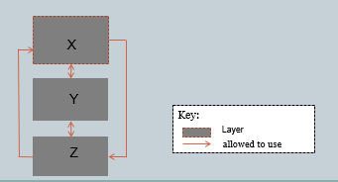
Summary/Review
Issues of Layered architecture
The addition of layers adds up-front c__ and complexity to the system
The lower layers may perform u____ work, not required by the higher layer
Performance overhead due to repeated transformations of data and context s_____
Hints: Cost, unnecessary, switching
Is it a layer pattern?
Notes:
Cost
Unnecessary
Switching
Is that a layer diagram – NO.
Cost, unnecessary, switching

Slide 18
Service Oriented Architecture (SOA)
CSPC 464 Fall 2017
Prof. Son Nguyen

Slide 19
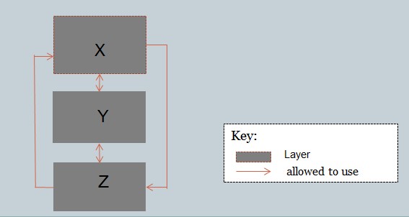
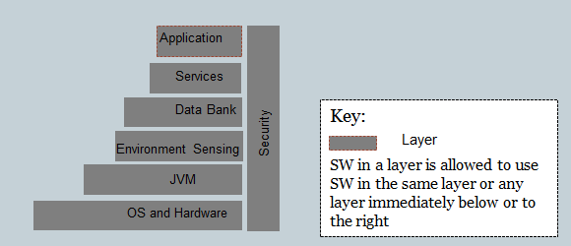
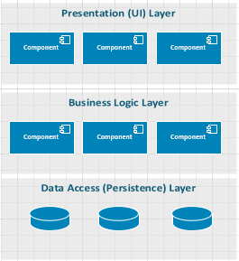
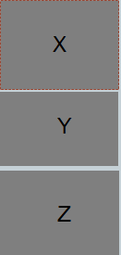
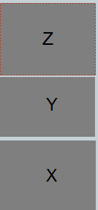

Review – Layered ARCHITECTURE
Which of the following is/are layered architecture(s)?
a b C
Are these the same design?
Notes:
A and C
No

Slide 20
Review
Is the Client-Server pattern a form of
layered pattern? (Yes/No)
What level do the Clients form?
ISO/OSI Network model is an example of layer pattern? (True/False)
Layers are also divided in s ____
Notes:
Yes
Higher
True
Segments

Slide 21
Review
Layered architecture benefits:
A lower layer can be reused without changes by different higher layers
Layers make customization easier.
Changes can be made within the layer without affecting other layers
A developer can develop/test particular layers independently of other layers
Examples of layer pattern:
JVM
Web application systems
Standard C Library
Client and server
Fault tolerance.
Notes:
A, C, and D
A, B, C, and D
easier

Slide 22
Review
Issues of Layered architecture
The addition of layers adds up-front cost and complexity to the system
The lower layers may perform unnecessary work, not required by the higher layer
Performance overhead due to repeated transformations of data and context switching
Layers contribute a significant security risk.
A layered architecture is one of the few places where “above” and “below” do not matter. (True/False)
Notes:
A, B, and C
False

Slide 23
Agile Software Architecture
CSPC 464 Fall 2017
Prof. Son Nguyen

Slide 24
Review
Service-Oriented Architecture
an architecture entirely composed of services
does not care about implementations
can be realized with any suitable technology platform
user services are used as a platform for the support of SOA.
Web services include technology standards:
SOAP
WSDL
XML,XML Schema
ADL.
Notes:
A, B, and C
A, B, and C

Slide 25
Review
SOA components
Service providers
Service consumers
USB.
Registry of Services
Orchestration server/engine:
Is a component of SOA
Orchestrates the interaction among various services
Executes scripts upon the occurrence of a specific event
Is a connector used in SOA.
Notes:
A, B , and D
A, B, and C
SOA components: USB is not but ESB is

Slide 26
Review
SOA Connectors:
Simple Object Access Protocol (SOAP)
Representational State Transfer (REST)
Synchronous messaging.
SMTP
SOA Tools:
IBM’s WebSphere MQ
Microsoft’s MSMQ
All features necessary for enterprise-level computing are fully available for SOA at this moment.
The next generation of development tools and application servers promises to support hosting a cloud platform as a service
Notes:
A, B, and D
A, B, and D

Slide 27
Review
Benefits of Service-Oriented Architecture
Portability.
SOA employs web services using open standards
Service providers and consumers can run on different platforms
SOA components such as the ESB or the registry allow dynamic reconfiguration
Issues of SOA:
Complex to design and implement
Performance overhead
Lack of message delivery guarantees
Difficult to manage user services.
<END
Notes:
B, C, and D
A, B, and C

Slide 28
Summary
Agile refers to an approach to SW architecture and development that
Emphasizes rapid and flexible development
De-emphasize project and process infrastructure
Build an architecture that enables agility
Agile approaches: moving f___, embracing c____, releasing o___, getting fe___.
Agile mindset: team dy____, customer co____
R___t and a____t to changes
Hints: fast, change, often, feedback, dynamic, collaboration, react and adapt
Agility requires good c_____
Notes:
Fast, changes
Often, feedback
Dynamic, collaboration
React, adapt
communication

Slide 29
Architecture, Implementation, and Testing
CSPC 464-01 Fall 2017
Prof. Son Nguyen
02 November 2017

Slide 30




Burger emoji
What was the proper order of a burger's toppings?
Apple
Google
Samsung
Microsoft
Hints: Lettuce, tomato, cheese, meat
Notes:
D

Slide 31
Review
Agile refers to an approach to SW architecture and development that
Emphasizes rapid and flexible development
De-emphasize project and process infrastructure
React to change within its environment
Stick to the existing plan.
Building an architecture that enables agility
Agile approaches: moving fast, embracing change, releasing often, getting feedback.
Agile mindset: team dynamics, customer collaboration
Reacts to changes
Does not require team interaction.
SOA provides agility (True/False)
Notes:
A, B, and C
A, B, and C
True

Slide 32
Review
Micro-services:
each service only does one thing but does that thing very well
A micro-service may typically be less than one hundred lines of code
If change is needed, services can be rewritten from scratch, potentially in a different programming language
Micro services have a common database.
Many teams building software systems that are much more monolithic in nature, where
everything is bundled together
deployed as a single unit
extremely complex to build.
usually takes more effort to adapt in the face of changing
requirements
Notes:
A, B, and C
A, B, and D

Slide 33
Review
Agility requires good communication. You need to be able to effectively communicate the vision of what it is you’re building. (True/False)
Documenting architecture in Agile project:
if information is not needed, don’t document it
Produce a view if and only if it addresses the concerns of an explicitly identified stakeholder
Produce the documentation in prioritized stages to satisfy the needs of the stakeholders who need it now
Need to complete all the documentation up front.
Notes:
True
A, B, and C

Slide 34
Review
How much agility to do you need? Guidance
Agile processes were used for small-to-medium-sized projects with short timeframes
If you are building a large and complex system with relatively stable and well understood requirements, it is probably optimal to do a large amount of architecture up front
Too much agility can result in chaos
All up-front architecture planning is wasteful.
<end of review>
Notes:
1) A, B, and C

Slide 35
Summary
Architecture plays a key role in both implementation and testing
In the implementation phase, using f......., code t…….., and keeping Code and Architecture ______
During testing the architecture determines what is being tested at which stage of development.
Types of testing:
U… Testing
I…….. Testing
A…….. Testing
B…. Box and W…. Box Testing
Testing activities:
Test P…….
Test D…….
Test E………
Test Reporting and D….. Analysis
Notes:
Framework, code template, consistent
Unit testing, integration testing, acceptance testing, black box and white box,
Test planning, test development, test execution, Defect Analysis
Framework, code template, consistent
Unit, integration, acceptance, Black & White box testing
Planning, development, execution, defect

Slide 36
Software Architecture - A case study
CSPC 464-01 Fall 2017
Prof. Son Nguyen
07 November 2016

Slide 37
Self-Driving cars could make jaywalking legal
A report released this week from the National Association of City Transportation Officials, a nonprofit representing cities on transportation issues, lays out a vision for the future of city streets as autonomous vehicles arrive
The blueprint suggests generally limiting self-driving vehicles to 20 mph and allowing pedestrians to cross streets anywhere, rather than only at intersection crosswalks
The technology in self-driving cars will be able to identify when a person is trying to cross a street, and slow down. This could impact the concept of jaywalking.
http://money.cnn.com/2017/11/03/technology/culture/autonomous-vehicles-jaywalking/index.html

Slide 38
Review
Two critical areas in system building are i_____ and t__________
Architecture is intended to serve as the blueprint for implementation (True/False)
Often architectures and implementations rely on the same set of vocabulary (True/False.)
Notes:
Implementation and Testing
True
False

Slide 39
Review
When the code and its intended architecture drift apart, it is called a_____ e_____
There are four techniques to help keep the code and the architecture consistent.
Embedding the Design in the Code
Frameworks
Design quality measures.
Need a strong management and process discipline to help prevent erosion
Notes:
Architecture Erosion
A, B, and D. C should have been Code templates
Code templates would have been the fourth technique.

Slide 40
Review
Frameworks
reusable sets of libraries or classes for a software system
are a place where architecture and implementation meet
can be small and straightforward
can increase cost in design task.
Ways to achieve code alignment with the architecture:
Sync at life-cycle milestone
sync at crisis
Sync at check-in
Sync at check-out.
Notes:
A, B, and C
A, B, and C

Slide 41
Review
Unit testing
Refers to tests run on specific pieces of software
tests the software in standalone fashion
provides confidence that each of the system’s building blocks is exhibiting as much as correctness as is possible on its own
Tests the interfaces between elements.
How architecture plays a role in unit testing?
A unit corresponds to an architecture element
A unit may correspond to a class in object-oriented software
Architecture defines connectors assigned to each unit.
A unit may correspond to a layer, or part of layer
Notes:
A, B, and C
A, B, and D

Slide 42
Integration Testing - review
Integration Testing
refers to tests running on units.
tests what happen when separate software units start to work together
Concentrates on finding problems related to the interfaces between elements in a design
is a test of all elements of the system, including software and hardware in their intended environment
How architecture plays a role in integration testing?
The integration testing plan is based on the architecture
The interfaces specified in the architecture determine the integration tests that are created and run
Integration testing is where runtime quality attribute requirements can be tested
Interfaces between elements are the only part of the architecture.
Notes:
B, C, and D
A, B, and C

Slide 43
Review
Acceptance testing is a kind of system testing that is performed by developers. (True/False.)
Black-box testing is also known as F_______
Unlike black box testing, white box testing uses specific knowledge of programming code to examine outputs (True/False)
Notes:
False
Functional testing
True

Slide 44
The Architect’s Role
Some of the things, an architect can do to facilitate quality testing:
a) The architect can design the system so that it is highly t______
b) The architect can work with the test team (and other stakeholders) to come up with a definition of testability requirements using sc_______
c) The architect insures that testers have access to the s____ code, design documents, and the change records
d) The architect gives testers the ability to install multiple versions of software product on a single machine. This helps testers compare versions, isolating when a bug was introduced.(True/False)
The architect cannot afford to ignore the testing process because if, after delivery, something goes seriously wrong, the architect will be one of the people brought in to diagnose the problem (True/False)
<End of Review>
Notes:
Testable, Scenarios, Source code, True
True
Highly testable, scenarios/usecases, source code

Slide 45

Software Architect and the Team
CSPC 464-01 Fall 2017
Prof. Son Nguyen
09 November 2016

Slide 46

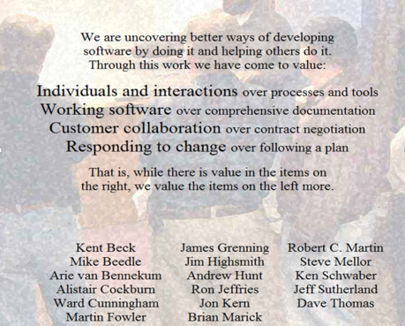
Question # 1
Today many software teams have aspirations of becoming agile, driven by this declaration.
What is ______________?
Notes:
Agile Manifesto or Manifesto for Agile SW Development
Individuals and Interactions over Processes and Tools
Working software over comprehensive documentation
Customer collaboration over contract negotiation
Responding to change over following a plan

Slide 47
Question # 2
Many teams building software systems using this model, where
everything is bundled together
deployed as a single unit
usually takes more effort to adapt in the face of changing requirements
What is ______________?
Notes:
Monolithic model

Slide 48
Question # 3
In order to achieve the code alignment with the architecture, this approach happens when a project has found itself in a technical quagmire and needs architectural guidance to get it going again.
What is ____________?
Notes:
Sync at crisis

Slide 49
Question # 4
This is also known as structural testing?
What is ____________?
Notes:
WB testing

Slide 50
Question # 5
This activity is done by the development team usually with the customer to adjudicate disposition of each discovered fault or problem. What is ____________?
<The End>
Notes:
Defect Analysis

Slide 51
Architecting Complex Systems
CSPC 464-01 Fall 2017
Prof. Son Nguyen
14 November 2017

Slide 52
The Architect and Development
What is the purpose of the SW development discipline?
To perform detailed design tasks
To perform the acceptance testing.
To unit-test the implementation
To integrate the work of individual developers
Ultimately to produce an executable system
Notes:
1) A, C, D, and E

Slide 53
The Architect and Development
The role of architect with respect to development:
Identify components of the system and their interfaces to be designed and implemented
To identify any development-related standards, guidelines, and reusable assets
Keep the code and the architecture consistent
To support performance testing.
Notes:
1) A, B, and C

Slide 54
The Architect and Test
What is the purpose of the test discipline?
To find and document defects in software quality
To validate that the system functions as designed and as required
To provide detailed design of a system.
To involve in several level of testing: unit testing, integration testing, acceptance testing, black box/ white-box testing, etc.
The role of the Architect with respect to Test:
To ensure that the architecture is t……
Good architectures, when required to, get involved in the details in terms of detailed design, coding, or testing (True/False)
Notes:
A, B, and D
Testable
True

Slide 55
The Architecture and Development Environment
The role of the Architect with respect to the development environment
Define architecture/technology standards (Java EE) and guidelines
Identify tools (Rhapsody, UML) to support any architecture standards
Establish the software inspection process.
Ensure that an appropriate infrastructure is available to implement and test the system
Notes:
A, B, and D
C should be:
Integration between codes (from model to code)

Slide 56
The Architecture and Project Management
The purpose of the project management is :
A) To provide a framework for managing the project
B) To provide practical guidelines for planning, staffing, executing, and monitoring the project,
C) To provide a framework for managing risk
D) To provide technical guidance to the development team.
Notes:
1) A, B, and C

Slide 57
The Architect and Configuration Management (CM)
The purpose of the CM discipline is to identify and manage elements that should be placed under CM control (True/False)
Many elements are versioned individually and also assigned to one or more configurations:
do…….ts,
mo….ls,
source …..,
Exe……,
project p….s,
test s…..
Hints: Documents, models, code, executables, plans, scripts
Notes:
True
Documents, Models Source Code, Executables, Project Plans, Test Scripts
Documents, models, code, executables, plans, scripts

Slide 58
The Architect and Change Management
The purpose of change management discipline is:
To restrict and audit changes to work products
Includes the organization (change control board) to assess the cost, schedule, and impact of a changes
Includes that ability to track changes in work products (history and rationale of changes made)
Concerned with measuring the current performance of the product.
Architect identifies the impact of making any changes in term of elements affected cost, and risk (True/False)
Notes:
A, B, and C
True

Slide 59
Summary
We have examined various aspects of a software development project and the involvement of the architect with respect to other disciplines and roles on the team
Business a……
Dev……..
T…..
Development env........
Project m……
Conf……….. manager
Ch…. Manager
<end of review>
Notes:
Business analysist, Developments, Testing, Development Environment, Project Management, Configuration manager, Change manager
Business analysis, development, testing, environment, management, configuration, change

Slide 60
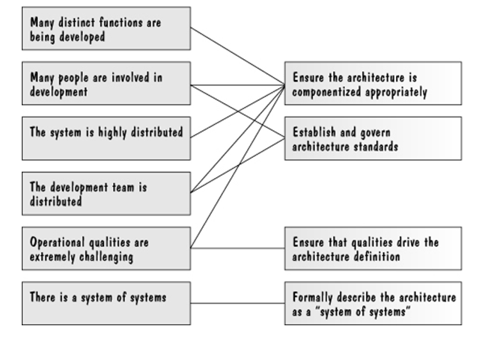
Challenges of Complex System and Associated Best Practices
Challenges
Best Practices

Slide 61
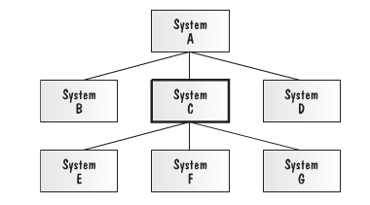
There Is a System of Systems
Another characteristic of complex systems is that they may be composed of subsystems that are significant enough to be considered systems in their own right.
Also, the system for which an architect is responsible may actually be a subsystem of something much larger.
In the figure below, System C is a subsystem of System A and has three subsystems of its own, E, F, and G

Slide 62
Architecture in the Cloud
CSPC 464 Fall 2017
Prof. Son Nguyen
28 November 2017

Slide 63
Challenges of Complex System and Associated Best Practices
Challenges of Complex System :
Many distinct functions are being developed
Many people are involved in development
The system is highly distributed
The development team is self-managed.
Best practices:
Ensure the architecture is componentized appropriately
Ensure that the architecture is well documented.
Establish and govern architecture standards
Ensure that qualities drive the architecture definition
Notes:
A, B, and C
A, C, and D
Documentation is not necessary for good practices

Slide 64
Best Practice
To ensure the integrity of the architecture across the team (which may be large and distributed), it is important to establish the relevant standards that all team members conform to when designing or developing the solution (True/False)
It is essential for the architect to ensure that the qualities (performance, availability, etc.) are captured, described, considered, and veriﬁed at the beginning of the project (True/False.)
Notes:
True
False
You do not verify at the beginning.

Slide 65
Review
The SOA can itself be considered to be the system (normally at an enterprise-wide or organization-wide level), with each service representing a subsystem within the SOA (True/False)
Architecting highly distributed system will not be benefit from an appropriate separation of concerns. (True/False.)
Notes:
True
False

Slide 66
Architecture for the Edge
An edge-dominant system is one that depends crucially on the inputs of users for its success
Users participate in information creation aka “cr………….”
and even its organization (“folksonomy”).
These systems, part of the “Web ---.0” movement, are having profound social, political, and economic consequences.
All successful edge-dominant systems, and the organizations that develop and use these systems, share a common ecosystem structure known as the “M…………” structure.
This structure shows how cust……., e…-users, d….., and “pro…..” are related.
Hints: Crowdsourcing, web 2.0, metropolis, customers, end users, developers, and “prosumers”
Notes:
Crowdsourcing, Web 2.0
Metropolis, Customer, End-users, Developers, Prosumers
Crowdsourcing, web 2.0, metropolis, customers, end users, developers, and “prosumers” are related

Slide 67
Architecture for the Edge
Edge systems bring a new life-cycle model to the fore, in which
requirements are not completely k….,
software developed in planned increments is replaced by software that is constantly c……..,
and projects are staffed by members ou….. the purview of the central developing organization.
The dominant pattern for edge systems is the C…/Per…….. pattern.
Hints: Known, changing, outside, core/periphery
Notes:
Known, Changing, Outside,
Core, Periphery
Known, changing, outside, core/periphery

Slide 68
Architecture for the Edge
To work, the core needs to be
highly mod……,
highly rel…..,
and highly ro….. with respect to external faults.
Cores are often designed as a set of services with well-documented A…, discovery and registration, and sophisticated error detection and reporting.
Hints: Modular, reliable, robust, APIs
<End of Review>
Notes:
1) Modular, Reliable, Robust, APIs
Known, changing, core/periphery. Modular, reliable, robust, APIs

Slide 69
Architecture in the Cloud II
CSPC 464 Fall 2017
Son Nguyen
30 November 2017

Slide 70
Review
Cloud computing is computing in which large groups of remote servers are networked to allow the centralized data s…… , and online access to computer s…… Clouds can be classified as pr _______, pu_________ or h_______
Any user of an application in the cloud does not need to know :
where that application and the data it uses are situated
that thousands of other users are sharing it
who provides the SLA.
how their data was backed up
http://en.wikipedia.org/wiki/Cloud_computing
Notes:
Data storage, computer services or resources
Private, public or hybrid

Slide 71
Review
Apple iCloud, Dropbox, Netflix, Amazon Cloud Drive, Flickr, Google Drive, Microsoft Office 365, Yahoo Mail -- those are all cloud s__________.
The essential characteristics of cloud computing (based, in part, on definitions provided by the U.S. National Institute of Standards and Technology, or NIST) are the following:
On-demand self-service. .
Ubiquitous (Broad) network access.
Resource pooling.
Rapid elasticity.
Measured service
Fast deployment.
Notes:
Cloud services

Slide 72
Review
Resource pooling.
The cloud provider’s computing resources are pooled.
Computing resources can efficiently serve multiple consumers.
The provider can dynamically assign physical and virtual resources to consumers, according to their instantaneous demands.
Resources usage cannot be monitored.
Software as a Service (SaaS)
The consumer in this case is an end-…..
The consumer uses a_______that happen to be running on a cloud.
The applications can be as varied as email, calendars, video streaming, and real-time collaboration.
The consumer does not m_______or c______the underlying cloud infrastructure.
Notes:
End user, application, manage, control

Slide 73
Review
Platform as a Service (PaaS)
The consumer in this case is a d_________ or a s___________
The platform provides a variety of services that
the consumer may choose to use.
The consumer deploys a_______ onto
the cloud infrastructure using programming
languages and tools supported by provider
The consumer does not m______ or c______ the
underlying cloud infrastructure, including network, servers, operating
systems, or storage, but has c_______over the deployed applications
and possibly application hosting environment configurations.
Some levels of quality attributes (e.g., uptime, response time,
security, fault correction time) may be specified by
s_________________
Notes:
Developer, system admin, application, manage/control, service-level agreement (SLA)

Slide 74
Review
Infrastructure as a Service (IaaS)
The consumer in this case is a d __________ or s___________.
The capability provided to the consumer is to provision processing, storage, networks, and other fundamental computing resources where the consumer is able to d_____and r____ arbitrary software, which can include operating systems and applications.
The consumer does not manage or control the underlying cloud infrastructure but has c __________ over operating systems, storage, deployed applications, and possibly limited control of select networking components (e.g., host firewalls).
Again, S_________are often used to specify key quality attributes.
Notes:
Developer/system admin, deploy/run, control, SLA

Slide 75
Review
It is possible that a cloud is owned by one party and operated by a different party (True/False)
Private cloud.
The cloud infrastructure is owned solely by a single organization
It Is operated solely for applications owned by that organization
The primary purpose of the organization is not the selling of cloud services
It is owned by an organization selling cloud services.

Slide 76
Review
Community cloud supports a specific community that has shared concerns (e.g., mission, security requirements, policy, and compliance considerations) (True/False)
Hybrid cloud is the cloud infrastructure that is a composition of two or more clouds (private, community, or public) that remain unique entities (True/False)
An organization that utilizes
a private cloud except for periods when spikes in load lead to servicing some requests from a public cloud. Such a technique is called “cloud b_________.”
Notes:
Cloud bursting

Slide 77
Review
Economic considerations have made almost all startups deploy into the cloud. (True/False)
Many large enterprises deploy a huge portion of their applications into the cloud (True/False.)
Almost every enterprise with substantial computation should at least consider the cloud as a deployment platform. (True/False)
<end of review>

