Slide 1
Crop Optimisation Using ML and Crowdsourcing Data
Presenter:Tejas Ghoti
Seminar Guide:Mr. Naman Buradkar Seminar Reviewer:Mrs. Amruta Patil
Date:14/10/25

Slide 2
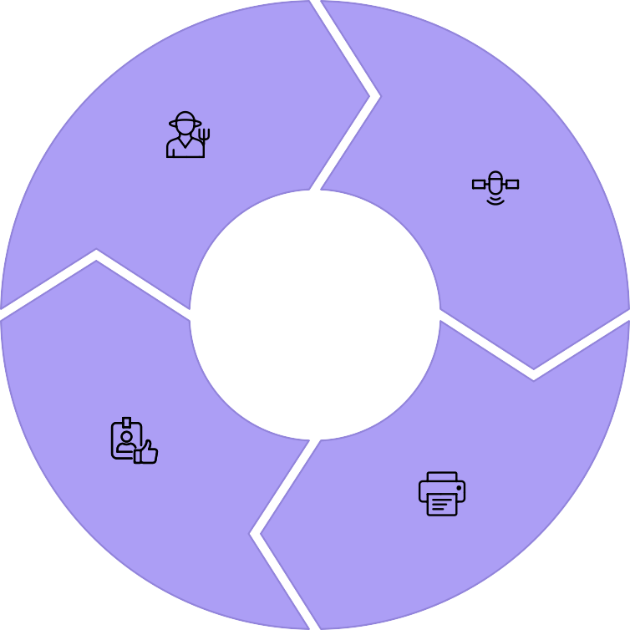

The Participatory Data Ecosystem
We are building a rich, ground-truth dataset from the bottom up, breaking the traditional top-down approach to agricultural advice.
Farmer Input
Operational data via mobile app.
Data Collection
Multi-layered data aggregation.
Actionable Advice
Hyper-localized recommendations.
ML Processing
Stacked ensemble model training.

Slide 3
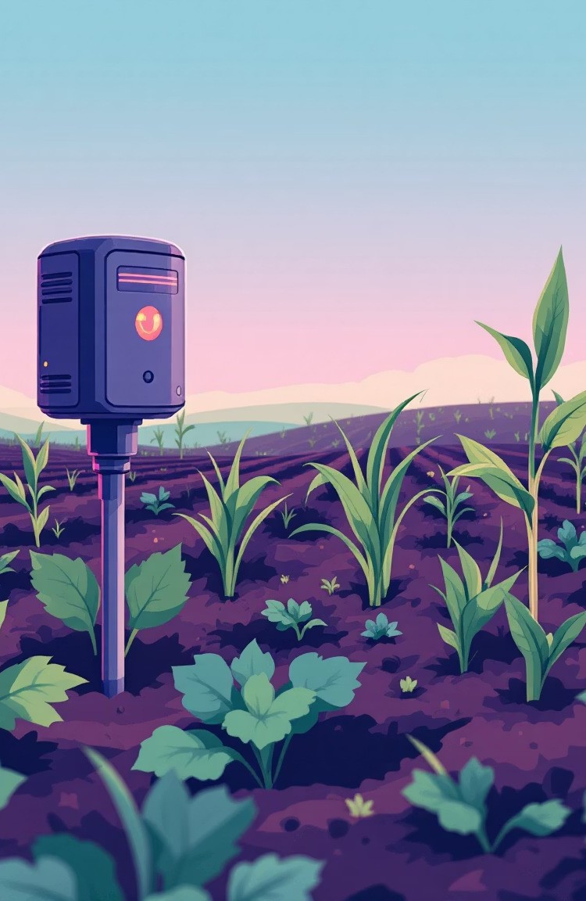
Multi-Layered Data Sources
Farmer- Reported
Data
Crop Details (type, variety, sowing dates).
Farm Practices (fertilizer, irrigation, tillage).
Phenological Observations (growth, pests, disease, images).
Sensor- Driven Data
Real-time, quantitative environmental measurements.
Soil moisture, nutrient (N-P-K), and pH levels.
Ambient temperature and humidity (DHT22).
External Data Integration
Regional weather forecasts for context.
Satellite imagery (e.g., NDVI for vegetation health).

Slide 4

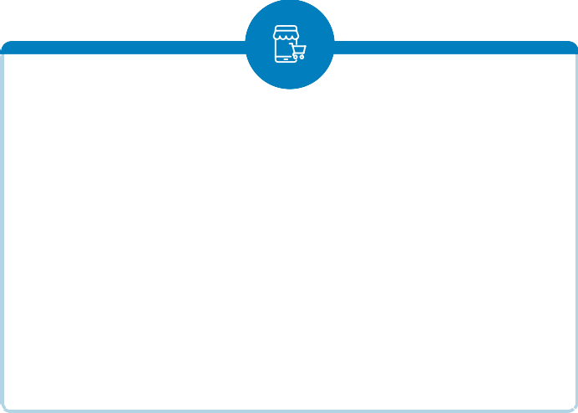

The Technology Stack: Accessible & Affordable
Low-Cost IoT Sensors
Distributed network using ESP32 microcontrollers for soil and ambient data.
LoRaWAN Connectivity
Long Range Wide Area Network for sending small data packets over several kilometers in areas with poor internet.
Offline-First Mobile App
Vernacular, icon-based Android application allowing data input without immediate internet access.

Slide 5

Ensuring Trust and Provenance with Blockchain
Blockchain for Trust
A permissioned blockchain (like Hyperledger Fabric) records every data submission as an immutable transaction.
This ensures data provenance and transparency for managing an incentive system through smart contracts (e.g., micropayments or premium access).

Slide 6
Phased Implementation Strategy
Model Bootstrapping
Use initial collected data to train a stacked ensemble machine learning model, combining algorithms like Random Forest and XGBoost for high accuracy.
Pilot Program with FPOs
Start with tech-savvy Farmer Producer Organizations. Deploy community-owned sensor kits and train core farmers to refine technology and build trust.
Regional Expansion
Scale up to more districts and states, continuously refining models with increasingly diverse and rich data.
Federated Learning
Transition to a privacy-preserving model where ML is trained locally. Only anonymized model updates are sent centrally, ensuring raw data never leaves the farmer's control.

Slide 7



The Power of Federated Learning
Local Training
The ML model is trained directly on the farmer's device or a local FPO server.
Privacy Preserved
Raw data remains on the device, addressing farmer concerns about data ownership and control.
Central Aggregation
Only anonymized model updates are sent to the central server for global model improvement.

Slide 8



Transformative Benefits for Indian Farmers
Hyper-Localized Advisories
Tailored advice for specific field conditions, including precise irrigation and optimized fertilizer plans.
Increased Profitability
Reduced costs by optimizing input use (water, fertilizer) and better yield predictions for optimal selling decisions.
Data Monetization & Ownership
Blockchain ensures farmers own their data, potentially creating a new revenue stream through anonymized data sales.
Democratization of Technology
Advanced precision agriculture tools become accessible and affordable for smallholder farmers.

Slide 9
Crog Daia ColBction
Sea use
Deem liee \Dt I
Forost (RFP
ANN
Train rq
LST€4
ML/DL Modules
Testng ard Evaluator
Decision
(Based On b8St
New Crop Data
Predation
Image -1

Slide 10
Addressing Key Challenges
Proactive strategies are in place to mitigate technical and social hurdles during implementation.
Intermittent Connectivity
Mitigation: Use of LoRaWAN for sensors and an
offline-first mobile application.
Digital Literacy
Mitigation: Simple, icon-based, vernacular app with voice assistance and on-ground FPO training.
Cost of Sensors
Mitigation: Community-owned sensor model managed by FPOs for economic viability.
Data Ǫuality
Mitigation: Cross-validation, outlier detection algorithms, and smart contracts rewarding high- quality data.

Slide 11
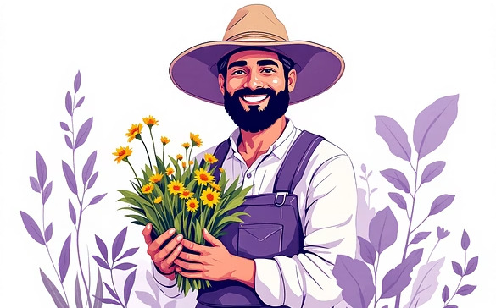

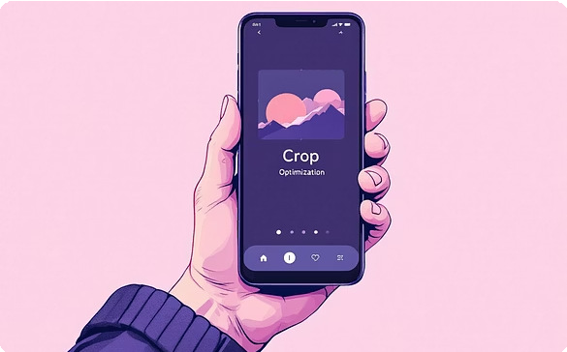
The Future of Precision Agriculture
Data-Driven Growth
By combining machine learning with crowdsourced, ground-truth data, we are empowering smallholder farmers to achieve unprecedented efficiency and profitability.

Slide 12
References Used:
Klompenburg, Thomas & Kassahun, Ayalew & Catal, Cagatay. (2020). Crop yield prediction using machine learning .Computers and Electronics in Agriculture. 177. 105709. 10.1016/
ShuaibuN., Obunadike G. N., and JamiluB. A., “CROP YIELD PREDICTION USING SELECTED MACHINE LEARNING ALGDRITHMS”, FJS, vol. 8, no. 1,
pp. 61 - 68, Mar. 2024.
iii. R. Gebbers and V. I. Adamchuk, “Precision agriculture and food security,”
"Data-Driven Decision Support System for Precision Agriculture., vol. 327, no. 5967,
pp. 828-831, Feb. 2010

