Slide 1
ISBMS · PGDM 2025–27 · SEMESTER III · SESSION 3 OF 10
TODAY
Module 3
Model Context Protocol & Agent Orchestration
3 hours
Hour 1 MCP · Hour 2 agent
teams · Hour 3 memo lab
No heavy code
Hours 1 and 2 are pictures
and plain English.
Tejas Jadhav, CFA, FRM
Faculty · Agentic AI & Advanced Analytics in Finance (PGDM-SEM3-SPEC-AIFINANCE)
tejasgjadhav.github.io/AIFINANCE
3
AGENTS WRITE ONE INVESTMENT
MEMO BEFORE YOU LEAVE
ISBMS · PGDM 2025–27 · AGENTIC AI & ADVANCED ANALYTICS IN FINANCE
MODULE 3 · 01

Slide 2
THE PLAN
What we do in these three hours
HOUR 1 · 60 MIN
The connector
HOUR 2 · 60 MIN
The team
HOUR 3 · 60 MIN
The lab
▪ What MCP is, in one picture
▪ Four roles: researcher, analyst, writer, reviewer
▪ Three agents, one investment memo
▪ Tools as a menu the model reads
▪ Three wirings: line, parallel, manager
▪ One real NSE-listed company
▪ Long documents and short memory
▪ CrewAI and LangGraph, in one line each
▪ Design task: a credit analyst agent
▪ Where agent crews fit on a finance desk
Our goal for today: three agents that turn one company's public numbers into a one-page investment memo, hand-off by hand-off.
ISBMS · PGDM 2025–27 · AGENTIC AI & ADVANCED ANALYTICS IN FINANCE
MODULE 3 · 02

Slide 3
HOUR 1 · MODEL CONTEXT PROTOCOL
What is MCP? One plug for every tool
THE PROBLEM
THE STANDARD
HOW A CALL WORKS
Every pair needs a wire.
One common plug.
Ask, fetch, answer.
Before MCP, each AI app needed custom code for each tool. Five apps and six tools means thirty separate connections.
MCP is an open standard that Anthropic released in 2024. You wrap a tool once as an MCP server. Any AI app that speaks MCP can then use it.
The app shows the model the tool menu. The model picks a tool and sends the inputs. The tool returns live data and the model answers from it.
EXAMPLE
Your screener, your spreadsheet, your mail and your data feed: each one wired to each assistant, again and again.
EXAMPLE
USB-C did the same job for chargers: one port, every device.
EXAMPLE
“Where is the NIFTY now?” The model calls the market-data tool and answers with the fetched number, not from its training memory.
Most AI pilots in banks stall on this wiring, not on the model.
Claude, ChatGPT and most agent tools now speak MCP.
The model never guesses what a tool holds. It asks.
Why it matters: you connect a tool once, and every MCP app on the desk can use it from that day on.
ISBMS · PGDM 2025–27 · AGENTIC AI & ADVANCED ANALYTICS IN FINANCE
MODULE 3 · 03

Slide 4
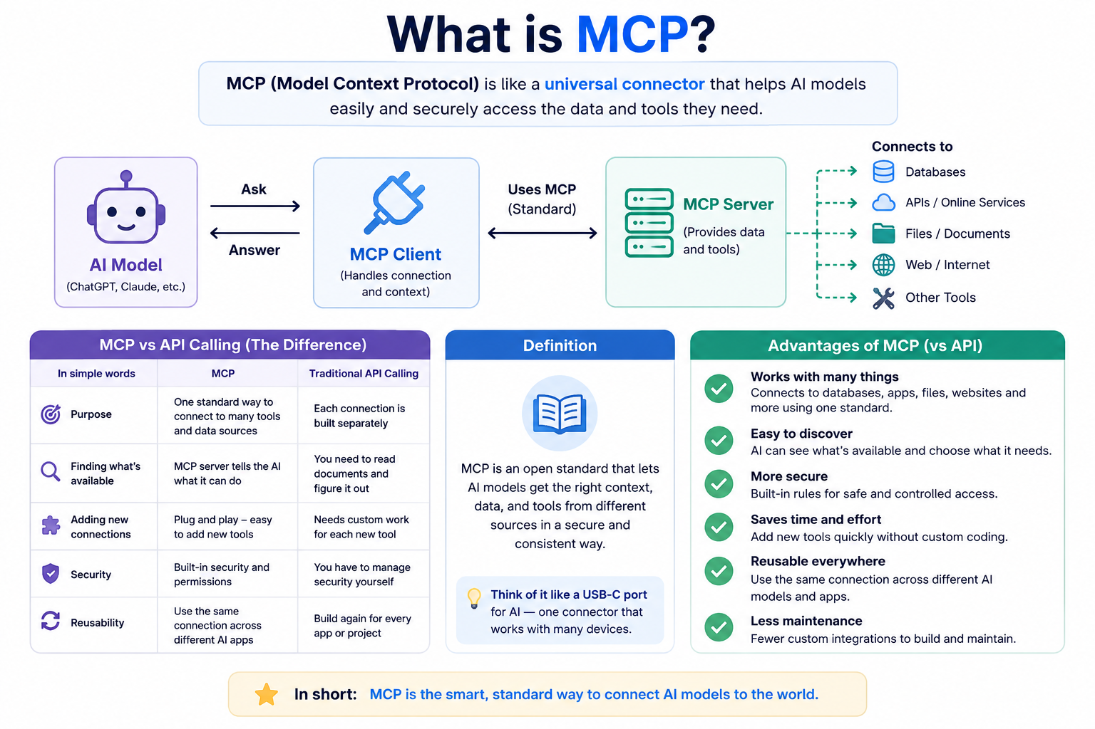

Slide 5
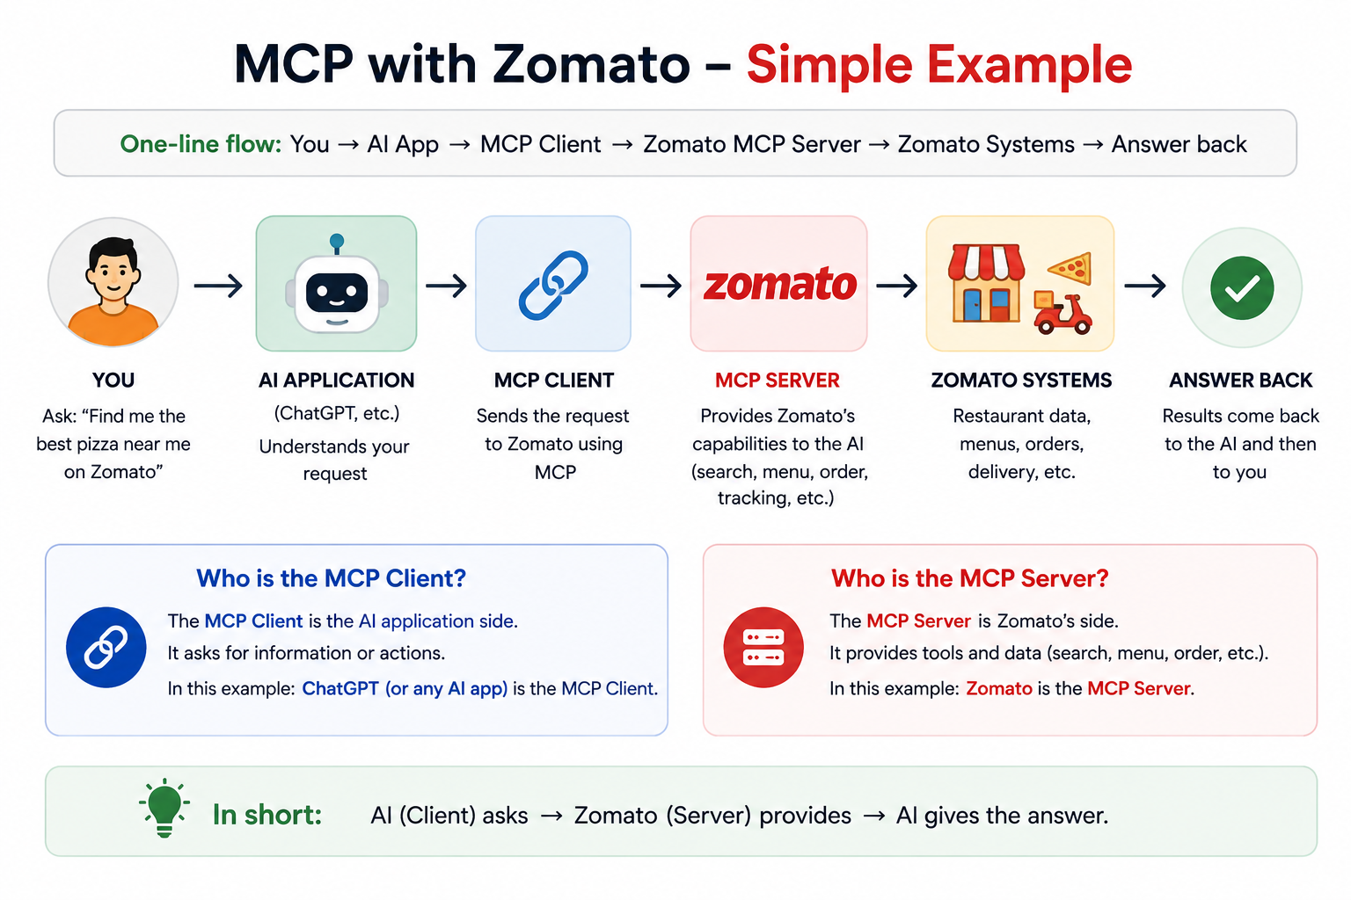

Slide 6
HOUR 1 · TOOLS AND MEMORY
A tool is a menu entry. Context is a small desk.
THE TOOL MENU
CONTEXT AND MEMORY
A tool definition tells the model three things.
A model holds a limited amount of text at once. That space is the context window, and one annual report with its call transcripts overflows it.
1
The name: get_share_price.
2
What it does: returns the last traded price for a ticker.
▪ Fetch only the pages the question needs
▪ Summarise old turns, carry the summary forward
3
What inputs it needs: the ticker symbol.
▪ Keep a running fact sheet, not the whole chat
The model reads the menu like a diner and orders what it needs.
This habit is called a rolling context.
IN CLASS
Design the tool menu for a credit analyst agent. Start with a statement reader, a ratio calculator and a bureau check.
EXAMPLE
A credit agent reading a 400-page annual report fetches the debt schedule, not the chairman's letter.
The design rule: an agent is a normal model given a menu of tools and a way to fetch just what it needs.
ISBMS · PGDM 2025–27 · AGENTIC AI & ADVANCED ANALYTICS IN FINANCE
MODULE 3 · 04

Slide 7
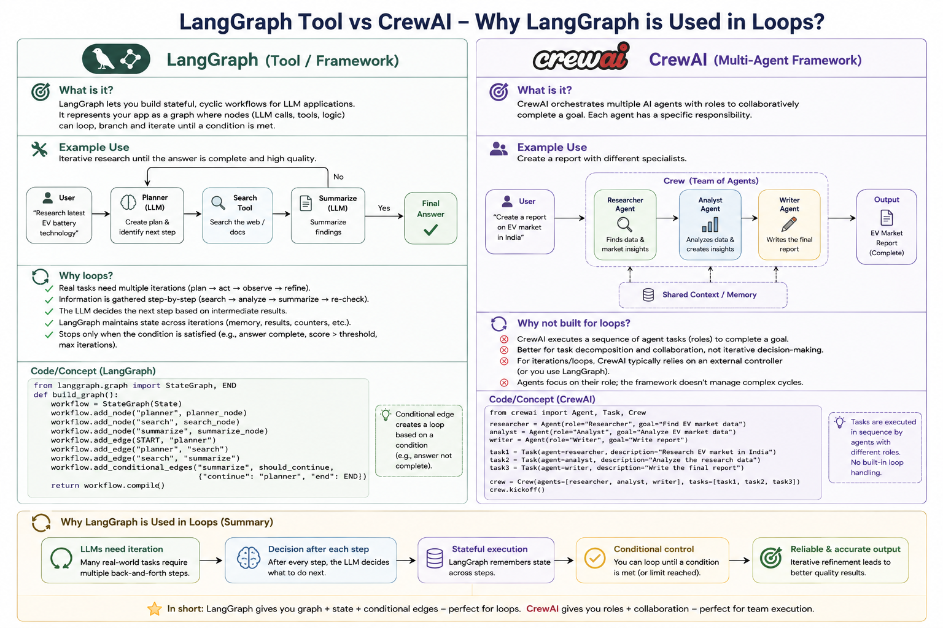
HOUR 2 · Some tools
CrewAI and LangGraph
CREWAI
LANGGRAPH
Describe the team in English.
Draw the workflow.
You write each agent's role and goal as plain text. The library runs the crew for you, in order. It is the easiest first tool for a student.
You define the boxes and arrows in code, and loops and branches are allowed. The reviewer-rejects-and-resends loop lives here.
EXAMPLE
role: equity research analyst · goal: compute the ratios and state a view in five plain lines.
EXAMPLE
If the reviewer scores the memo below 7, the graph loops back to the writer with the comments.
THE PART PEOPLE MISS
The model — Claude, GPT or Gemini — is the worker inside every box, and the framework is only the org chart. A weak prompt stays weak in any framework, so write each agent's brief as carefully as a junior's.
In our lab: we use the simplest wiring — three agents in a line, each with one job.
ISBMS · PGDM 2025–27 · AGENTIC AI & ADVANCED ANALYTICS IN FINANCE
MODULE 3 · 07

Slide 8
HOUR 2 · AGENT TEAMS
One agent is a worker. A crew is a team.
RESEARCHER
ANALYST
WRITER
REVIEWER
Gathers the facts.
Reads the numbers.
Drafts the memo.
Checks and rejects.
Pulls the prices, results and news for one company. Hands a clean fact sheet forward.
Computes growth, margins and leverage from the facts. Writes down what the numbers mean.
Turns the facts and the analysis into one page a manager can read in two minutes.
Compares every claim in the memo to the source facts. Sends weak work back.
The same shape exists on every research desk: a junior gathers, a senior reads, one person drafts, and the head signs. The crew copies the org chart, not the person.
One line to remember: give each agent one job and one hand-off, exactly as you would brief a junior on the desk.
ISBMS · PGDM 2025–27 · AGENTIC AI & ADVANCED ANALYTICS IN FINANCE
MODULE 3 · 05

Slide 9
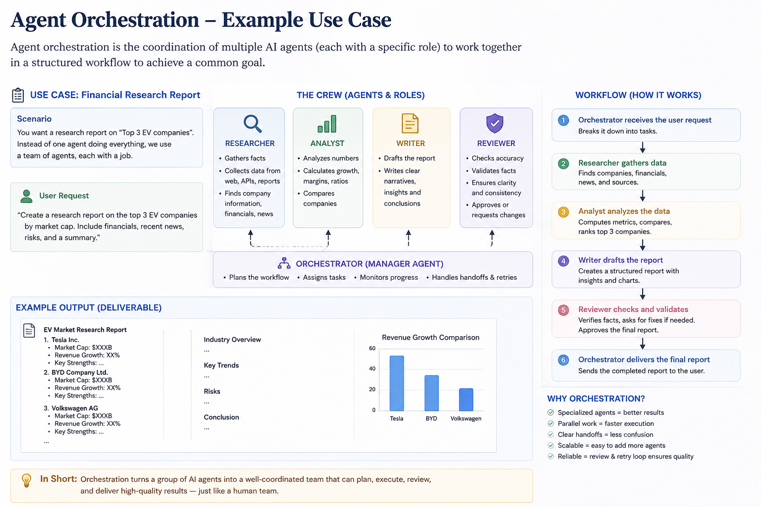

Slide 10
HOUR 2 · THREE WAYS TO WIRE A CREW
In a line, all at once, or under a manager
SEQUENTIAL
PARALLEL
HIERARCHICAL
One after another.
All at once.
A manager delegates.
CO A
CO B
CO C
→
MERGE
PLANNER
RESEARCH
→
ANALYSE
→
WRITE
↙
↘
Three screens run together, then merge.
AGENT 1
AGENT 2
CRITIC
Each agent starts when the one before it finishes. The output of one is the input of the next.
Independent agents run at the same time. A final step merges what they found.
A planner splits the job and hands out tasks. A critic checks the work and can send it back.
Use it when every step needs the last step's output. Today's lab runs this way.
Use it for independent tasks, like screening three companies at once.
Use it when the plan itself can change mid-job.
Worth remembering: planner, executor and critic is the pattern behind most agent products that work today.
ISBMS · PGDM 2025–27 · AGENTIC AI & ADVANCED ANALYTICS IN FINANCE
MODULE 3 · 06

Slide 11
HOUR 3 · IN-CLASS LAB
The lab: three agents write an investment memo
One real NSE-listed company goes in. A one-page memo comes out, written hand-off by hand-off.
THE BUILD
THE CLASS RUN
1
The Research Agent collects the company's public facts: price, revenue, profit, debt.
▪ Instructor demo: the three-agent crew runs in Claude Code
▪ The class picks the NSE company on the day
2
The Analysis Agent computes growth, margins and leverage, then writes its reading.
▪ We read each hand-off, not just the final memo
3
The Writing Agent turns both into a one-page memo with a clear view.
The hand-offs are the lesson. The memo is just the receipt.
TRY IT FREE AT HOME
No API key is needed. The course site carries the same pipeline as a small Python project, plus the three agent prompts to run in any free AI chat. tejasgjadhav.github.io/AIFINANCE
PEER REVIEW · THE SCORE
Swap memos with the next group and score three things: every number carries a source, the view follows from the numbers, and you would send it upstairs.
What you have at the end: a memo written by three agents, and your scorecard telling you whether to trust it.
ISBMS · PGDM 2025–27 · AGENTIC AI & ADVANCED ANALYTICS IN FINANCE
MODULE 3 · 08

Slide 12
PRACTICE QUESTIONS
Six questions before the exam
Q1
What is MCP? What problem does it solve? Give an example, the USB-C parallel, and say how it helps in finance.
TIP Every app-and-tool pair needed its own wiring. MCP is one standard plug: wrap a tool once and every MCP app can use it. In finance, one market-data or screener server then serves every assistant on the desk.
Q2
An agent must answer from a 400-page annual report that overflows the context window. What does it do?
TIP It fetches only the pages the question needs and carries a rolling summary of what came before.
Q3
Name the four crew IN Multi agent investment flow roles and what each hands to the next.
TIP The researcher hands facts, the analyst hands ratios and a view, the writer hands the memo, the reviewer hands weak work back.
Q4
When do you wire agents in parallel instead of in a line?
TIP When the tasks are independent — three companies screened at once, merged at the end.
Q5
A reviewer must be able to reject the memo and send it back. Which framework style fits, and why?
TIP The graph style, LangGraph. Loops and branches need a graph; a simple line has no way back.
Q6
Why does the memo pipeline end with a reviewer instead of going straight to the manager?
TIP The writing reads confident even when a number is wrong. Someone must check the memo against the source first.
The tip is the shape of the answer, not the whole answer. Two or three sentences each in the exam.
MODULE 3 · 09

Slide 13
PRACTICE QUESTIONS
Q7
We connected TradingView to Claude. Was that RAG or MCP? (Hint: think of the Zomato demo.)
TIP MCP. TradingView, like Zomato, was wrapped as an MCP server and Claude called its tools live. RAG retrieves passages from documents. MCP connects tools.
The tip is the shape of the answer, not the whole answer. Two or three sentences each in the exam.
MODULE 3 · 10

Slide 14
SESSION 3 OF 10 · THANK YOU
Questions?
Ask about anything from today: MCP, the crew roles, the three wirings, or the lab.
Tejas Jadhav, CFA, FRM
Faculty · Agentic AI & Advanced Analytics in Finance
tejasgjadhav.github.io/AIFINANCE · slides and the free lab are on the site
Before Session 4: write down one finance task you would split across three agents, and give each agent one job.
ISBMS · PGDM 2025–27 · AGENTIC AI & ADVANCED ANALYTICS IN FINANCE
MODULE 3 · 11

