Slide 1
ISBMS · PGDM 2025–27 · SEMESTER III · SESSION 4 OF 10
TODAY
Module 4
Algorithmic Trading & Execution Strategies
3 hours
Hour 1 signals · Hour 2
backtesting · Hour 3 bot lab
No heavy maths
Every idea is one rule you
can write in one sentence.
Tejas Jadhav, CFA, FRM
Faculty · Agentic AI & Advanced Analytics in Finance (PGDM-SEM3-SPEC-AIFINANCE)
tejasgjadhav.github.io/AIFINANCE
1
TRADING BOT, BACKTESTED,
BEFORE YOU LEAVE
ISBMS · PGDM 2025–27 · AGENTIC AI & ADVANCED ANALYTICS IN FINANCE
MODULE 4 · 01

Slide 2
THE PLAN
What we do in these three hours
HOUR 1 · 60 MIN
The market
HOUR 2 · 60 MIN
The test
HOUR 3 · 60 MIN
The lab
▪ The order book: bids, asks and the spread
▪ In-sample, out-of-sample, walk-forward
▪ One sentence into Codex: momentum on NIFTY 50
▪ Order types, SEBI's rules, the Medallion Fund
▪ Sharpe, Sortino, max drawdown, and costs
▪ Two years of test data, 12 months of signal
▪ Three signal families: momentum, mean reversion, pairs
▪ Costs, overfitting and data snooping
▪ Read the monthly table against the 5% target
▪ Simulation: match five orders on a virtual order book
▪ Case: Knight Capital lost $440M in 45 minutes
▪ Costs at 25, 50 and 100 bps, live in class
Our goal for today: one trading rule, tested honestly on two years of NSE data, with a report that says whether to trust it.
ISBMS · PGDM 2025–27 · AGENTIC AI & ADVANCED ANALYTICS IN FINANCE
MODULE 4 · 02

Slide 3
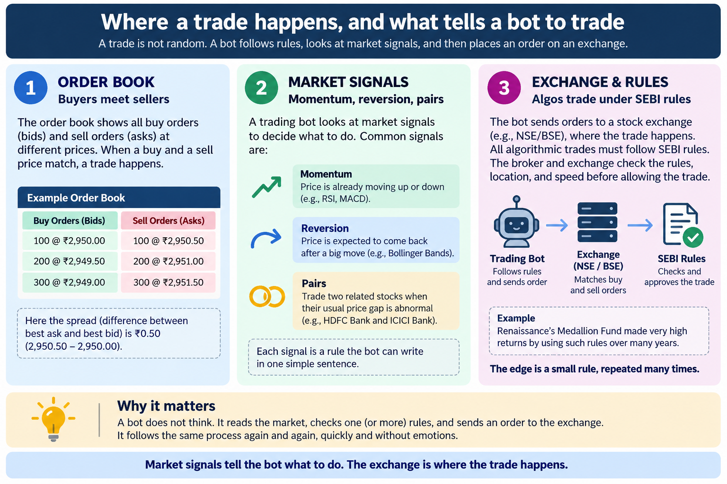

Slide 4
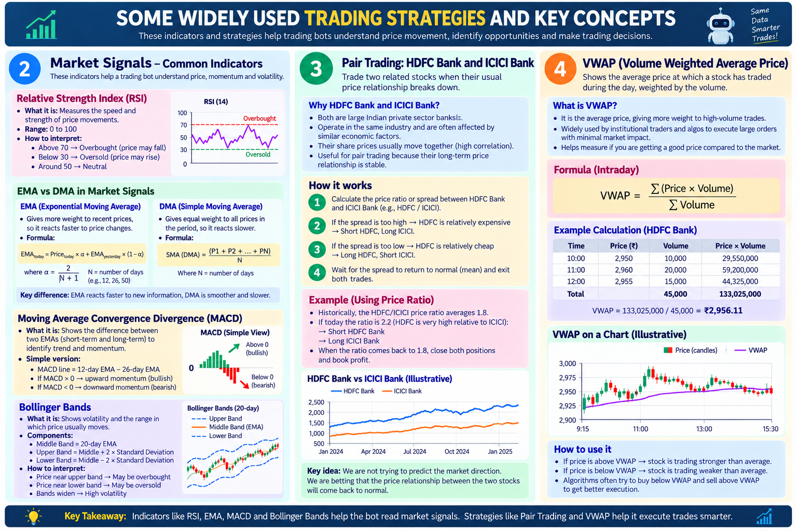

Slide 5
THE ONE IDEA BEHIND EVERY BOT
A trading bot is a goal plus a loop
GOAL
LOOP
GOAL + LOOP
What you want, as a rule.
Same steps, on a timer.
That is a trading agent.
A goal is one sentence a machine can check. It says what to buy, when to buy it, and when to get out. If you cannot write it in one sentence, the bot cannot run it.
A loop repeats a short list of steps on a timer. Fetch the price. Check the rule. Act. Write it down. Repeat. The loop never gets bored and never skips a step.
Put the goal inside the loop and you have a bot. Add a stop, a size limit and a log, and you have a bot you can trust. Every agent in this course is built the same way.
FETCH
→
CHECK
→
ACT
→
LOG
↺
EXAMPLE
Buy when the stock closes above its 20-day high. Sell at +2% or at −1%.
EXAMPLE
Every day at 15:36, the loop reads the closing prices of 200 stocks and checks each one against the rule.
EXAMPLE
Goal: sell an options credit spread after a breakout. Loop: scan at 15:36 daily, send the signal to Telegram, record the result at expiry.
The goal is the rule.
The loop is the clock.
Goal plus loop equals agent.
One line to remember: the goal is the rule, the loop is the clock, and a bot is nothing more than the two together.
ISBMS · PGDM 2025–27 · AGENTIC AI & ADVANCED ANALYTICS IN FINANCE
MODULE 4 · 05

Slide 6
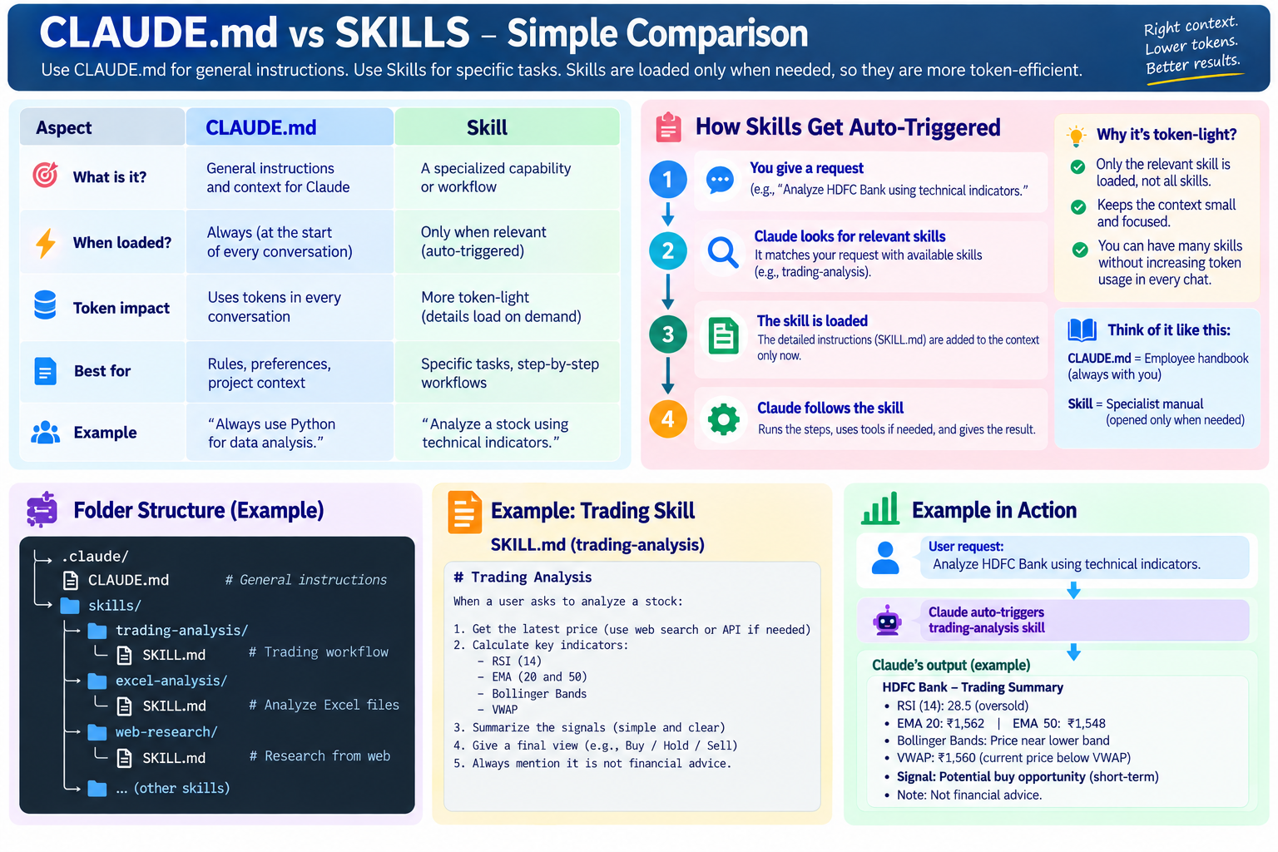

Slide 7
HOUR 2 · BACKTESTING METHODOLOGY AND CASE STUDY
Backtesting: how to test a rule without fooling yourself
TEST HONESTLY
THREE NUMBERS
CASE · KNIGHT CAPITAL
Split the data first.
Return, risk, worst fall.
$440 million in 45 minutes.
In-sample is the data you build the rule on. Out-of-sample is data the rule has never seen. Walk-forward repeats that split year by year. Overfitting is a rule that fits the past and fails the future. Data snooping is trying 100 rules and reporting the one that worked.
The Sharpe ratio is the average return divided by its ups and downs. Sortino counts only the downside moves. Max drawdown is the biggest fall from a peak to the next low. Subtract brokerage, STT and the spread before you compute any of them.
On 1 August 2012 Knight Capital pushed new software to eight servers. One server kept old test code. At the open it sent millions of unwanted orders. Knight lost $440 million before anyone stopped it, and the firm was sold within months.
EXAMPLE
Build on 2019 to 2024. Test on 2025 to 2026 once. A rule that wins 80% in-sample and 55% out-of-sample was fitted, not found.
EXAMPLE
A rule made 20% a year with a 30% max drawdown. Your investor lost a third of the money on the way.
EXAMPLE
The bug was not the strategy. It was a deploy with no kill switch and nobody watching the first minutes.
Out-of-sample is the only test that counts.
A Sharpe above 1 after costs is good. Above 3 is usually a bug.
Every bot needs an off switch a human can reach.
The exam line: a backtest is a ceiling on what a rule can earn, never a promise.
ISBMS · PGDM 2025–27 · AGENTIC AI & ADVANCED ANALYTICS IN FINANCE
MODULE 4 · 06

Slide 8
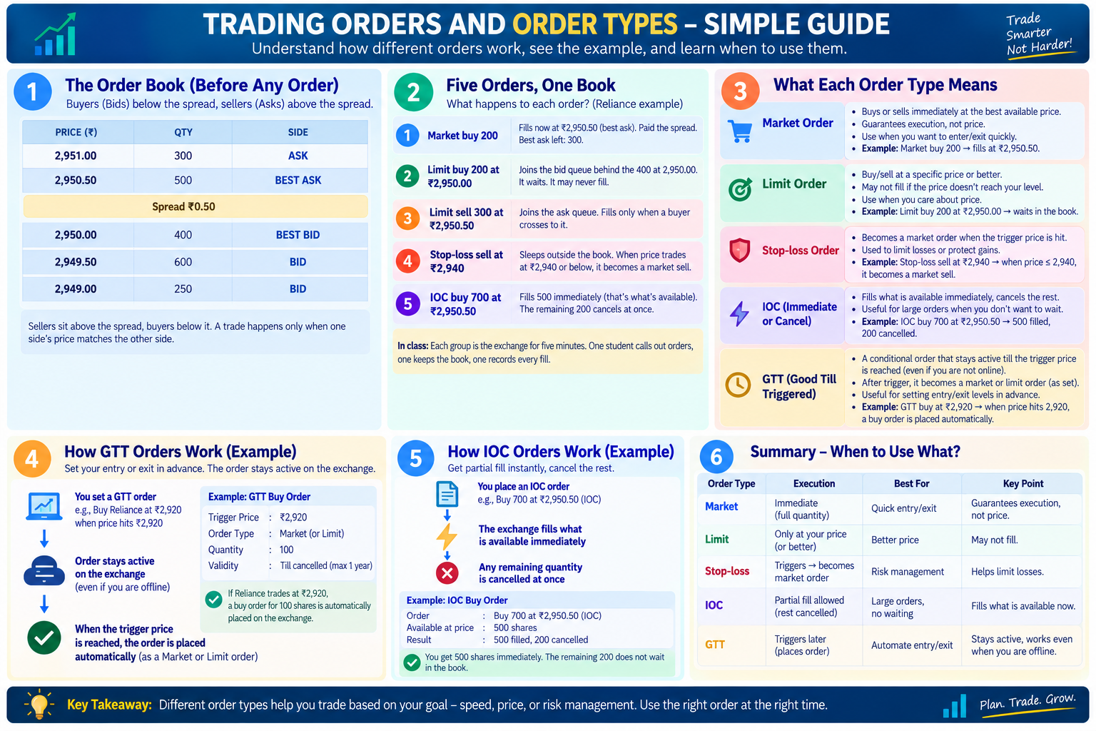

Slide 9
HOUR 3 · LIVE LAB IN CODEX
The lab: one sentence in, a momentum backtest out
We type one English sentence into Codex. Codex writes a plan, asks for approval, then builds and runs the backtest in front of the class.
THE BRIEF WE TYPED
THE PLAN CODEX WROTE
“We want to run a Momentum strategy on last two year NSE data with a goal that we get monthly returns above 5%.”
1
Download 36 months of NSE data: 12 to form the signal, 24 to test on.
2
At each month-end, rank the NIFTY 50 stocks by 12-1 momentum: the return from 12 months ago to one month ago.
WHAT CODEX DID BEFORE WRITING CODE
3
Hold the top five at 20% each, long only, and trade at the next session's open.
▪ Checked the workspace and found no data or code
4
Charge 25, 50 and 100 bps round trip, and compare each run to the NIFTY 50 total return.
▪ Asked us three questions, then searched for NSE data sources
▪ Wrote a plan and asked “Implement this plan?” before touching a file
5
Write out holdings, turnover, trades, NAV and monthly returns. Halt on missing history instead of filling it.
WHAT YOU DO IN CLASS
Approve the plan. Read the monthly return table and count the months above 5%. Then read the same table at 25, 50 and 100 bps and see what costs take away.
THE LESSON
Codex called 5% a month an aggressive target and treated it as a constraint to test, not a return to promise. That is the right habit. The goal was our sentence. Codex turned it into a loop of month-ends.
What you have at the end: a backtest you wrote as one sentence, and a monthly table that says whether 5% a month was ever real.
ISBMS · PGDM 2025–27 · AGENTIC AI & ADVANCED ANALYTICS IN FINANCE
MODULE 4 · 07

Slide 10
LIVE TRADE · WHERE THE DATA COMES FROM
Why a live bot needs a broker API, not Yahoo Finance
YAHOO FINANCE
BROKER API · UPSTOX OR ZERODHA
OPTION PREMIUMS
Good for yesterday.
Price and order on one wire.
Yahoo has none for NSE.
Yahoo's NSE quote runs about 15 minutes late, and the yfinance library scrapes a web page. There is no bid, no ask and no depth. Minute bars are patchy and unadjusted. It cannot place an order, and its terms allow personal viewing only.
Live ticks over a WebSocket, tens of milliseconds behind the exchange, with five levels of bid and ask. Official one-minute history, adjusted, back years. The bot places, modifies and cancels orders in the same session and logs the fill. The data is licensed.
No option chain, no premium, no futures and no open interest for any Indian contract. The broker API carries the live chain and one-minute premium history for expired contracts from October 2024. Before that, NSE's daily bhavcopy gives settlement premiums back years. Before 2019, nothing.
EXAMPLE
Our Module 4 lab, a daily momentum backtest on two years of closes, runs on Yahoo data. For that job it is fine.
EXAMPLE
An Upstox read-only token is free and needs no trading permission. Orders need a separate trading token, which we never switch on in class.
EXAMPLE
A credit-spread bot cannot even see its own instrument on Yahoo. Every intraday options backtest we ran has a two-year window for this reason.
Use it for end-of-day work and homework.
Use it for anything intraday or anything with a spread.
Any options bot starts at the broker API.
The split: daily cash equities on Yahoo is fine. Anything intraday, any bid and ask, and any option premium needs the broker API or the NSE bhavcopy.
ISBMS · PGDM 2025–27 · AGENTIC AI & ADVANCED ANALYTICS IN FINANCE
MODULE 4 · 08

Slide 11
PRACTICE QUESTIONS
Six questions before the exam
Q1
Reliance shows bid ₹2,950.00 and ask ₹2,950.50. What does a market buy pay, and what does a limit buy at ₹2,950.00 do?
TIP The market buy pays ₹2,950.50 now. The limit buy waits at ₹2,950.00 and may never fill.
Q2
Sort these into momentum, mean reversion or pairs: RSI, Bollinger Bands, cointegration.
TIP RSI is momentum, Bollinger Bands are mean reversion, cointegration is pairs trading.
Q3
Write a trading bot as a goal plus a loop for a 20-day breakout rule.
TIP Goal: buy above the 20-day high, sell at +2% or −1%. Loop: each day fetch the close, check the rule, act, log, repeat.
Q4
A rule wins 80% in-sample and 55% out-of-sample. What happened, and what do you report?
TIP It was overfitted. Report the out-of-sample number, the costs and the drawdown, and do not trade it yet.
Q5
Two rules both earn 18% a year. One had a 12% max drawdown, the other 40%. Which would you hold, and which number tells you?
TIP The 12% one. Max drawdown is the worst fall an investor has to sit through: same return, a third of the pain.
Q6
What did Knight Capital's failure teach about deploying a bot, and what one control would have saved it?
TIP The bug was a bad deploy on one server, not the strategy. A kill switch that a human can reach within minutes.
The tip is the shape of the answer, not the whole answer. Two or three sentences each in the exam.
MODULE 4 · 09

Slide 12
PRACTICE QUESTIONS
Q7
You want to buy Infosys only if it dips to ₹1,500, and you will not chase it. Which order type, and what is the risk?
TIP A limit buy at ₹1,500. It waits in the queue and may never fill if the price does not come down.
Q8
You hold a stock at ₹800 and want out automatically if it falls to ₹760. Which order type, and what happens if it opens at ₹740 after a gap?
TIP A stop-loss at ₹760. It becomes a market sell once ₹760 trades, so in a gap it fills near ₹740, not at ₹760.
Q9
When would a trading bot send an IOC order instead of a limit order?
TIP When it must not leave an order sitting in the book, such as near the close or in a fast move. IOC fills what it can now and cancels the rest.
Q10
Write the loop for a bot that trades a 20-day breakout on daily closes. List the steps in order and say what it logs.
TIP After each close: fetch the 20-day high and today's close, check the rule, size the trade, place the order with its stop, log the signal and the fill, wait for tomorrow.
Q11
Your bot's loop runs every minute. What must sit in the loop before the order step so that Knight Capital cannot repeat?
TIP A kill-switch check: a cap on orders per minute and a daily loss cap. If either trips, the loop stops sending and alerts a human.
Before Session 5: write one trading rule in one sentence, and list the three numbers you would need before you trust it.
The tip is the shape of the answer, not the whole answer. Two or three sentences each in the exam.
MODULE 4 · 10

