Slide 1
Why VS Code is on every developer's desk
Visual Studio Code, the free code editor from Microsoft
1
It is free and runs everywhere.
Does my language run in VS Code?
Mac, Windows and Linux. Open source. No licence to buy, so every office can standardise on it.
Python
Python extension by Microsoft. Run button, debugger, Jupyter notebooks.
Yes
2
One editor covers every language.
You install an extension for the language you need. The editor stays the same, so a team does not relearn a tool per project.
Java
Extension Pack for Java by Microsoft and Red Hat. Maven, Gradle, Spring Boot.
Yes
3
The terminal, the debugger and Git live inside it.
.NET / C#
C# Dev Kit by Microsoft. Many .NET teams still use the bigger Visual Studio, which is a different product.
You write, run, step through and commit code in one window. You do not switch apps.
Yes
4
AI assistants plug in as extensions.
Others
JavaScript, SQL, R, Go, C++ and most others, each through its own extension.
Claude Code and GitHub Copilot sit in a side panel and read the open project.
Yes
VS Code does not run the language itself. It calls the interpreter or compiler you installed, such as python, java or dotnet. Install those first, then point VS Code at them.
About three in four developers use it (Stack Overflow Developer Survey 2024, 73.6%).
AI IN FINANCE · THE COMPLETE CRASH COURSE
1

Slide 2
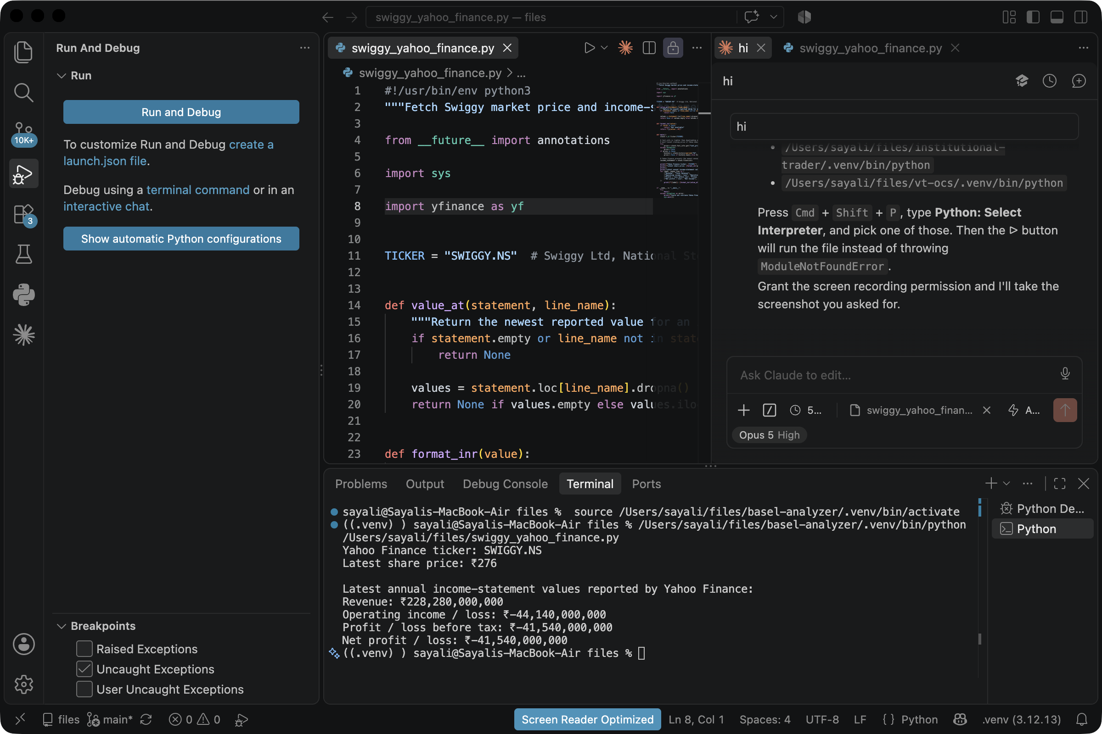
Demo: run a Python file in VS Code
swiggy_yahoo_finance.py pulls Swiggy's share price and income statement from Yahoo Finance
1
Open the folder.
File → Open Folder, then pick the project folder. The Explorer on the left lists its files.
2
Open the file.
Click swiggy_yahoo_finance.py in the Explorer. It opens in the editor in the middle.
3
Pick the Python interpreter.
Press Cmd+Shift+P, type Python: Select Interpreter, choose the venv. The choice shows at the bottom right.
4
Press the Run button.
The ▷ triangle at the top right of the editor runs the file.
5
Read the output.
It appears in the Terminal tab at the bottom. Here it printed the price and four income-statement lines.
6
Fix a missing package.
If the terminal says ModuleNotFoundError, type pip install yfinance in that same terminal and run again.
Editor in the middle, Terminal output at the bottom, Claude Code panel on the right.
Practice: change TICKER to "RELIANCE.NS", run the file again and write down the Revenue line.
AI IN FINANCE · THE COMPLETE CRASH COURSE
2

