Slide 1
ISBMS · PGDM 2025–27 · SEMESTER III · SESSION 5 OF 10
TODAY
Module 5
Risk Modelling — PD Models & Monte Carlo VaR
Two questions
Will this borrower pay?
How much can this book lose?
No heavy maths
Every number today comes
from one multiplication or
one sorted list.
Tejas Jadhav, CFA, FRM
Faculty · Agentic AI & Advanced Analytics in Finance (PGDM-SEM3-SPEC-AIFINANCE)
tejasgjadhav.github.io/AIFINANCE
1
VaR ENGINE, BUILT AND
READ, BEFORE YOU LEAVE
ISBMS · PGDM 2025–27 · AGENTIC AI & ADVANCED ANALYTICS IN FINANCE
MODULE 5 · 01

Slide 2
THE PLAN
What we do in these three hours
HOUR 1 · 60 MIN
HOUR 2 · 60 MIN
HOUR 3 · 60 MIN
Will they pay?
How much can we lose?
Build it
▪ PD, LGD and EAD, and the one line that joins them
▪ Three ways to compute VaR, and why they disagree
▪ A Monte Carlo VaR engine on five NSE stocks
▪ Basel II and where the bank is allowed to use its own model
▪ 10,000 simulated days on a multi-asset portfolio
▪ 10,000 paths, then 95% and 99% VaR and CVaR
▪ Building a PD model: logistic regression, trees, XGBoost
▪ CVaR: the question VaR refuses to answer
▪ An AI-written risk note, checked against the numbers
▪ Reading the score: Gini, KS, AUC-ROC, and SHAP
▪ Basel III thresholds at 95% and 99%
▪ One PDF report you can hand to somebody
THE GRADED ASSIGNMENT IS INTRODUCED TODAY. You will build a risk report on a portfolio of your own and defend the numbers in it.
The whole module in one line: two questions, two numbers, and the honesty to say how wrong each number could be.
ISBMS · PGDM 2025–27 · AGENTIC AI & ADVANCED ANALYTICS IN FINANCE
MODULE 5 · 02

Slide 3
BASEL II
Basel II (2004) — Three Pillars
Expanded to cover Credit, Market & Operational Risk using the famous '3 Pillar' structure.
🏛️ Pillar 1 — Minimum Capital
🔍 Pillar 2 — Supervisory Review
📢 Pillar 3 — Market Discipline
Still 8% CAR (same as Basel I)
CREDIT RISK: Standard, IRB (basic), Advanced IRB
MARKET RISK: Standardised or Internal Model (VaR)
OPS RISK: Basic Ind. (15%), Standardised (12–18%),
AMA (own model)
Regulators check if banks hold ENOUGH capital
Bank must have ICAAP (Internal Capital Adequacy
Assessment Process)
Regulator can demand MORE capital than minimum
Banks must DISCLOSE their risks publicly
Capital structure, risk exposures, & RWA
Aims to let markets penalise risky banks
Key Formulas at a Glance
Credit Risk (Standardised)
Market Risk (VaR)
Ops Risk (Basic Indicator)
RWA = Exposure × Risk Weight
CAR = Capital / RWA ≥ 8%
Capital = max(VaR, 3×avg VaR_60)
VaR: 99% confidence, 10-day
Capital = 15% × Avg Gross Income
(avg of last 3 positive years)

Slide 4
HOUR 1 · CREDIT RISK
Three numbers, one multiplication
PD
4%
LGD
45%
EAD
₹8,00,000
Probability of Default
Loss Given Default
Exposure at Default
How likely is it that this borrower stops paying in the next year?
If they do stop, how much of the money do we never get back?
How much will actually be outstanding on the day they stop?
EXPECTED LOSS = PD × LGD × EAD 4% × 45% × ₹8,00,000 = ₹14,400 per loan
Say it in words
Out of a hundred loans like this one, four go bad. When one goes bad we lose 45 paise in the rupee on the ₹8 lakh still outstanding. So we price ₹14,400 into every loan, whether it goes bad or not.
The part students miss
Expected loss is a cost, not a surprise. It is budgeted and priced in. Capital is held for the UNEXPECTED loss, which is the year four loans becomes eleven.
Basel II, in one sentence: a bank that can prove its own PD, LGD and EAD models work is allowed to use them to set its own capital.
ISBMS · PGDM 2025–27 · AGENTIC AI & ADVANCED ANALYTICS IN FINANCE
MODULE 5 · 04

Slide 5
PUTTING IT ALL TOGETHER — Complete Basel III Capital Calculation
Step-by-step: Calculate total capital needed for a bank under Basel III:
Risk Type | Method | RWA (₹ Crore) | Capital = RWA × 8%
💳 Credit Risk | Standardised: loans × risk weights | 9,00,000 | 72,000
📉 Market Risk | VaR × √10 × 3 → RWA = Capital × 12.5 | 1,25,000 | 10,000
⚙️ Operational Risk | Basic Indicator: 15% of avg gross income × 12.5 | 93,750 | 7,500
TOTAL RWA / CAPITAL |  | 11,18,750 | 89,500
Now break down that ₹89,500 Crore MINIMUM into Basel III tiers — the buffer sits on top of it:
CET1 (4.5%)
AT1 (1.5%)
Tier 2 (2%)
Buffer (2.5%)
50,344 Cr
16,781 Cr
22,375 Cr
27,969 Cr
Equity + Retained Earnings
Special bonds
Subordinated debt
Conservation buffer — extra, on top of the 8%
💧 LCR Check: HQLA ÷ 30-day outflows ≥ 100%
Example: 1,200 ÷ 950 = 126.3% ✅
⚖️ Leverage Check: Tier 1 ÷ Total Exposure ≥ 3%
Example: 67,125 ÷ 14,00,000 = 4.8% ✅

Slide 6
HOUR 1 · BASEL II
Who is allowed to use their own model?
Every bank must hold capital against its loans. Basel II gave banks two ways to work out how much.
THE STANDARDISED APPROACH
THE IRB APPROACH
The regulator gives you the numbers.
The bank estimates its own numbers.
▪ A loan gets a risk weight from a published table.
▪ Foundation IRB: the bank estimates PD. The regulator still sets LGD and EAD.
▪ The weight comes off the borrower's external rating.
▪ Advanced IRB: the bank estimates PD, LGD and EAD itself.
▪ The bank models nothing and estimates nothing.
▪ This is where every model in this module actually gets used.
▪ Simple to run, and it usually demands more capital.
▪ Permission is granted by the supervisor, and it can be taken away.
WHY A BANK WANTS ITS OWN MODEL, IN ONE SUM
Take a ₹100 crore corporate book. On the standardised weight of 100% the bank holds 8% of ₹100 crore, which is ₹8 crore. Suppose its own model justifies an effective weight of 60%. Now it holds 8% of ₹60 crore, which is ₹4.8 crore. The same book has freed ₹3.2 crore of capital to lend again.
Basel II is a bargain, not a gift: prove your model works and you may set your own capital. Fail to prove it and you go back to the regulator's table.
ISBMS · PGDM 2025–27 · AGENTIC AI & ADVANCED ANALYTICS IN FINANCE
MODULE 5 · 06

Slide 7
HOUR 1 · BUILDING THE Probality of Default
MODEL
From five ratios to one probability – Logistical Regression
Here is one borrower. These are numbers you already know how to compute from a balance sheet.
Current ratio
Debt to equity
Interest cover
Sales growth
Times paid late
1.4
2.1
2.3
−4%
3
SCORE = −3.2 + (0.8 × debt to equity) − (0.5 × interest cover) + (0.4 × times late) → PD = 4%
Say what just happened
Every ratio gets a weight. Multiply each ratio by its weight and add them up. That total is the score. A curve then squeezes the score into a number between 0 and 1, and that number is the probability of default. There is nothing else inside a logistic regression.
Why banks still start here
You can print this model on one line. You can point at the weight that hurt this borrower. A supervisor can recompute it by hand. For a regulated lending decision, that matters more than the last two points of accuracy.
Do it live: change interest cover from 2.3 to 1.1 in front of the class, recompute the score, and watch the PD move.
ISBMS · PGDM 2025–27 · AGENTIC AI & ADVANCED ANALYTICS IN FINANCE
MODULE 5 · 07

Slide 8
HOUR 1 · THE CHOICE EVERY TEAM ARGUES ABOUT
The older model, or the one that predicts better?
Check Live Demo- 3 ways in Live file
LOGISTIC REGRESSION
DECISION TREE
XGBOOST
One weight per ratio, added up.
A flowchart of yes and no questions.
Hundreds of small trees, voting.
+ You can print it, explain one decline, and defend it line by line.
+ Anyone can read it. Interest cover below 1.5? Then debt to equity above 3?
+ Each tree fixes the mistakes of the one before it. Usually the most accurate.
− It assumes each ratio pushes in a straight line, which is not always true.
− Change the data slightly and the tree redraws itself completely.
− There is no single weight to point at, so a decline is hard to explain.
WHAT YOU ACTUALLY GAIN AND LOSE
On the same data XGBoost usually buys you a few points of accuracy. That is real, and it is smaller than people expect. What it costs you is the sentence you give the customer who was declined. Most banks build both, use the sharper one to challenge the simpler one, and ship the one they can explain.
The rule of thumb: the newer the model, the better it predicts and the harder it is to defend to the person you just declined.
ISBMS · PGDM 2025–27 · AGENTIC AI & ADVANCED ANALYTICS IN FINANCE
MODULE 5 · 08

Slide 9
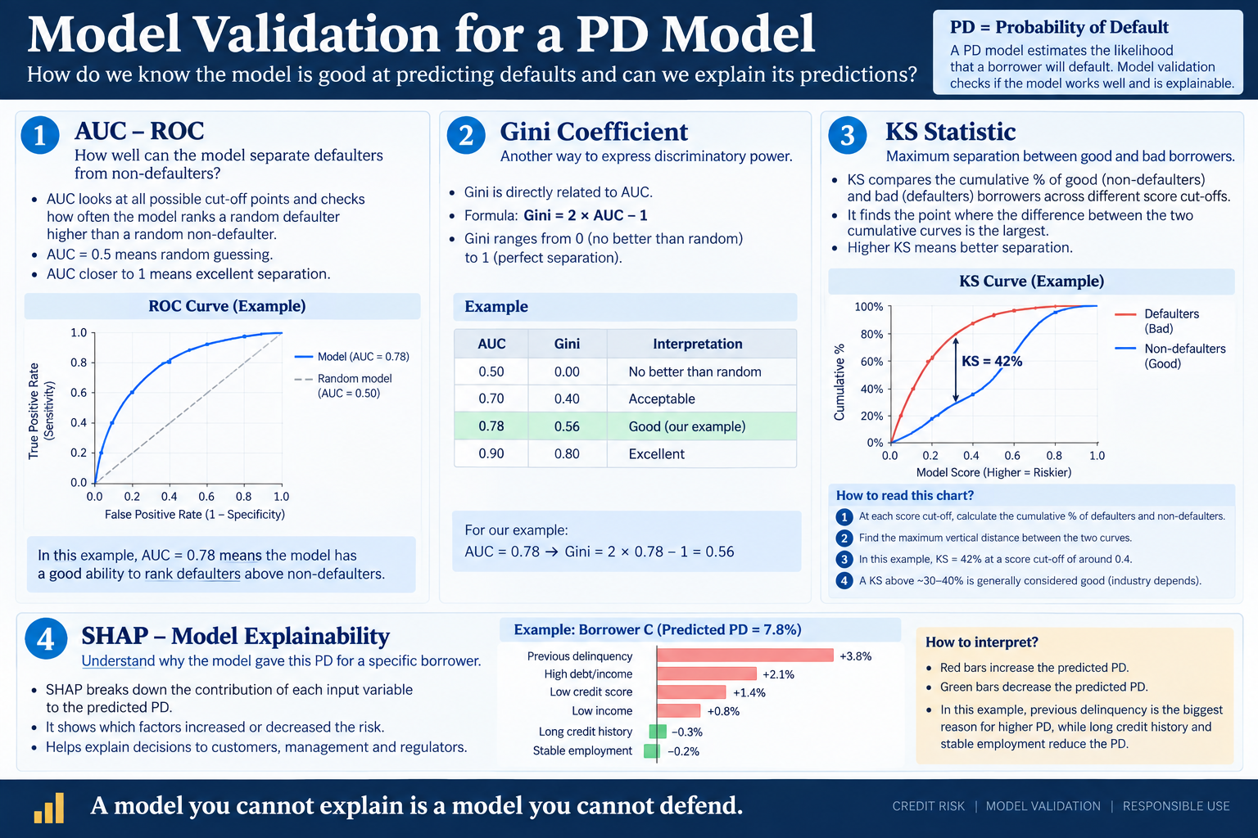

Slide 10
HOUR 2 · MARKET RISK
VaR is one sentence. The rest is how you compute it.
A 99% one-day VaR of ₹6,60,000 means this: on 99 days out of 100, we should lose less than ₹6,60,000. It says nothing about the hundredth day.
HISTORICAL SIMULATION
PARAMETRIC
MONTE CARLO
Replay the last 500 days that actually happened.
Assume a normal curve and use one volatility number.
Invent 10,000 tomorrows from volatility and correlation.
+ Assumes nothing about the shape of returns.
+ Fast, and you can do it in a spreadsheet.
+ Handles many assets and odd payoffs.
− You only ever see what already occurred.
− Real markets have fatter tails than normal.
− Only as good as the assumptions you fed it.
CVaR, the question VaR ducks
VaR tells you the edge of the bad 1%. CVaR tells you the average loss once you are inside it. VaR says ₹6.6 lakh; CVaR might say ₹9.4 lakh.
Basel III asks for both levels
95% and 99% are the thresholds you report. Run all three methods on the same portfolio and you get three different answers. That gap is the lesson.
ISBMS · PGDM 2025–27 · AGENTIC AI & ADVANCED ANALYTICS IN FINANCE
MODULE 5 · 10

Slide 11
HOUR 3 · THE LAB
Build it, compare it, then test it
THE SENTENCE WE TYPE
“Build a Monte Carlo VaR engine for five NSE stocks, run 10,000 paths, and give me 95% and 99% VaR and CVaR.”
PART A · 35 MIN
PART B · 10 MIN
PART C · 15 MIN
Build it
Compare it
Test it
▪ Five NSE stocks, two years of daily returns
▪ Run the same portfolio through historical and parametric
▪ Count the breaches over 250 real trading days
▪ Each stock's volatility, and how the five move together
▪ Three methods, three different answers
▪ At 99% you expect two or three, not nine
▪ Ten thousand simulated tomorrows
▪ Which one do you report, and why that one?
▪ Basel zones: 0-4 green, 5-9 yellow, 10 or more red
▪ Sort them: the 100th worst is your 99% VaR, and the tail past it is CVaR
▪ The gap between them is your uncertainty, made visible
▪ A red zone means rebuild it, not explain it away
Why Part C matters most: building a VaR takes 35 minutes. Finding out it breached nine times when it should have breached three takes 15.
ISBMS · PGDM 2025–27 · AGENTIC AI & ADVANCED ANALYTICS IN FINANCE
MODULE 5 · 11

Slide 12
PRACTICE QUESTIONS
Six questions before the exam
Q1
A loan has PD 3%, LGD 40% and EAD ₹5,00,000. What is the expected loss, and who pays it?
TIP ₹6,000. The borrower pays it, priced into the interest rate, whether or not this loan goes bad.
Q2
Explain the difference between expected loss and unexpected loss, and what each is funded by.
TIP Expected loss is budgeted and priced in. Unexpected loss is the bad year, and capital is held against it.
Q3
A PD model scores AUC 0.78. Say what that means without using the word AUC.
TIP Take a defaulter and a non-defaulter at random; 78 times in 100 the model scores the defaulter as riskier.
Q4
Whar are different methods of PD Modelling? Is it required for Standardized Approach? How you can use AI for Modelling Risk ?
Tip – This is the essence of this module. Please take notes of slides and u should have the answer ☺
Q5
Historical, parametric and Monte Carlo give three different VaRs on one portfolio. Why, and which do you report?
TIP Each assumes something different about returns. Report the method your policy names, and disclose the other two.
Q6
Your 99% one-day VaR is ₹6.6 lakh. In 250 trading days you breach it nine times. What does that tell you?
TIP You expected about 2 or 3. Nine says the model understates risk, and it must be rebuilt, not explained away.
Before Session 6: pick five listed stocks, and write down the one thing that would make all five fall together.
The tip is the shape of the answer, not the whole answer. Two or three sentences each in the exam.
MODULE 5 · 12

