Slide 1

Course on Python
Dr. Deepti Sharma
Professor (IT)
JIMS Sec-5, Rohini

Slide 2
Table of Contents
Introduction to Python
Numpy Library
Pandas Library
Data Visualization Using Matplot Library

Slide 3
What is Python?
Python is a free, community-developed programming language
Run from:
  command line
  Integrated Development Environment (IDE)
  Jupyter Notebook
Basic Python: minimal installed libraries, but extensible via modules from the community
Python is the "wild west" of programming – everyone does what they want!
Anaconda installs a bulked-up version of Python that includes many common data science libraries, Jupyter notebooks, and and IDE.
I recommend installing Anaconda if you are serious about data analysis.

Slide 4
Applications of Python
Embedded scripting language
3D Software
Web development
GUI-based desktop applications
Image processing and graphic design applications
Scientific and computational applications
Operating Systems
© Oxford University Press 2017. All rights reserved.

Slide 5
Areas to Explore
SCIENTIFIC TOOLS : for simulating and analyzing complex systems
SciPy library is mainly used for numerical integration and optimization.
NumPy provides N-dimensional array objects which can be used to perform linear algebra, Fourier transform and other mathematical operations.
SymPy library is used to generate symbolic mathematics.
Matplotlib is the oldest and most popular plotting library available for Python.
  Statistics
    Statsmodels is a Python library used for statistical analysis. It supports various models and features like linear aggression models, generalized linear models, discrete choice models and functions for time series analysis.

Slide 6
  Machine Learning : effective and adaptive tool to learn from experience and by a dataset.
Scikit library is mainly used for numerical integration and optimization.
NumPy provides N-dimensional array objects which can be used to perform linear algebra, Fourier transform and other mathematical operations.
SymPy library is used to generate symbolic mathematics.
Matplotlib is the oldest and most popular plotting library available for Python.
  Data Analysis
    Pandas library changed the landscape of data analysis in Python altogether and is available under BSD license. Pandas is built on top of NumPy and has two important data structures, namely Series and Data Frame.

Slide 7
  Hypertext Transfer Protocol Library
      Python has a standard HTTP library called urllib.request to carry out most of the HTTP operations
    Database Connectors
      MySQL and PostgreSQL are the popular open source databases.
    Webframeworks
      Django and Flask are the two most popular web frameworks
  Cloud Computing
      OpenStack is entirely written in Python and is used to create a scalable private and public cloud.

Slide 8
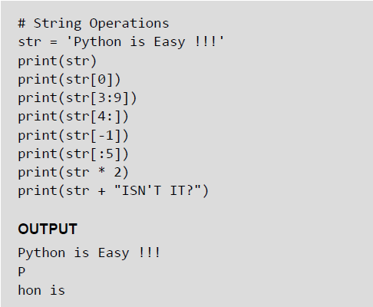
Slice Operations on Strings
You can extract subsets of strings by using the slice operator ([ ] and [:]). You need to specify index or the range of index of characters to be extracted. The index of the first character is 0 and the index of the last character is n-1, where n is the number of characters in the string.
If you want to extract characters starting from the end of the string, then you must specify the index as a negative number. For example, the index of the last character is -1.
Examples:
© Oxford University Press 2017. All rights reserved.

Slide 9
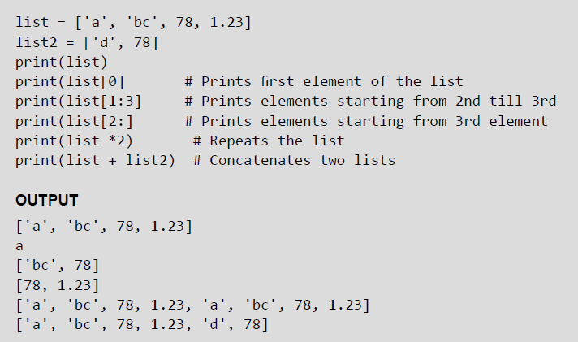
Lists
Lists are the most versatile data type of Python language. A list consist of items separated by commas and enclosed within square brackets The values stored in a list are accessed using indexes. The index of the first element being 0 and n-1 as that of the last element, where n is the total number of elements in the list. Like strings, you can also use the slice, concatenation and repetition operations on lists.
Examples:
© Oxford University Press 2017. All rights reserved.

Slide 10
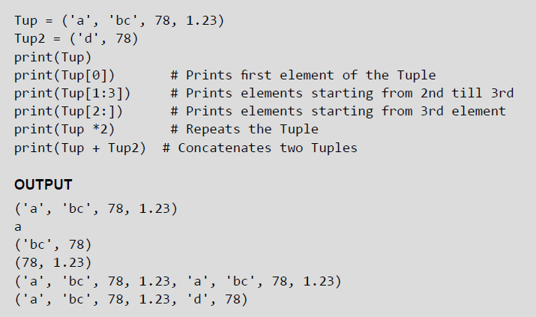
Tuples
A tuple is similar to the list as it also consists of a number of values separated by commas and enclosed within parentheses. The main difference between lists and tuples is that you can change the values in a list but not in a tuple. This means that while tuple is a read only data type, the list is not.
Examples:

Slide 11
Dictionary
Python’s dictionaries stores data in key-value pairs. The key values are usually strings and value can be of any data type. The key value pairs are enclosed with curly braces ({ }). Each key value pair separated from the other using a colon (:). To access any value in the dictionary, you just need to specify its key in square braces ([]).Basically dictionaries are used for fast retrieval of data
Example:
© Oxford University Press 2017. All rights reserved.

Slide 12
Range() Function
If range() function is given a single argument, it produces an object with values from 0 to argument-1. For example: range(10) is equal to writing range(0, 10).
• If range() is called with two arguments, it produces values from the first to the second. For example, range(0,10).
• If range() has three arguments then the third argument specifies the interval of the sequence produced. In this case, the third argument must be an integer. For example, range(1,20,3).
Examples:

