Slide 1

Project Title: Seasonal Agriculture Performance Analysis
Student Name: Teja Shanbhag
AICTE STU ID: STU6a5e75021491c1784575234

Slide 2

PROBLEM STATEMENT
(Agricultural activities are influenced by seasonal variations in environmental conditions, farming practices, resource availability and market conditions. As a result, agricultural performance may differ from one season to another. However, raw agricultural data does not clearly explain how agricultural performance changes across seasons or what patterns can be observed in different seasonal conditions. The problem is to analyze the given agricultural dataset and investigate seasonal differences in agricultural performance by identifying meaningful patterns, trends, relationships and variations within the available data.

Slide 3
Project Description
This project analyzes agricultural activities across Kharif, Rabi and Zaid seasons using the provided agricultural dataset. The analysis examines seasonal differences in crop yield, production, resource usage, environmental conditions and economic performance. The workflow includes data exploration, cleaning and preparation, statistical summaries, seasonal comparisons, relationship analysis and visualization. The findings are interpreted to identify meaningful seasonal patterns, variations and relationships that can support evidence-based agricultural planning.

Slide 4

WHO ARE THE END USERS?
Agricultural stakeholders involved in seasonal planning and decision-making.

Slide 5

Technology Used
• Python
• Pandas
• Matplotlib
• Google Colab
• Jupyter Notebook (.ipynb)

Slide 6
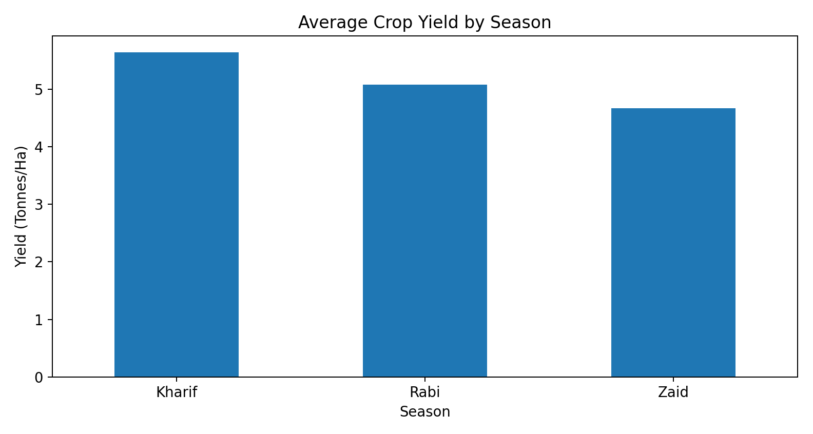
Result 1 — Seasonal Crop Yield
Kharif has the highest average crop yield at 5.64 tonnes/ha.

Slide 7
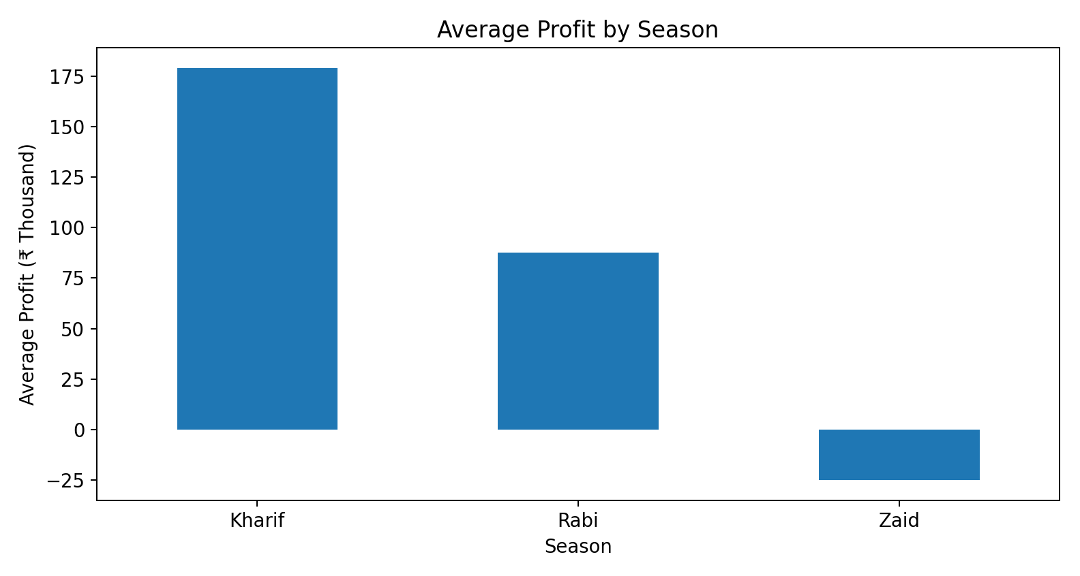
Result 2 — Seasonal Profit
[Add screen shots of your code ]
Kharif has the highest average profit at ₹178,915.

Slide 8
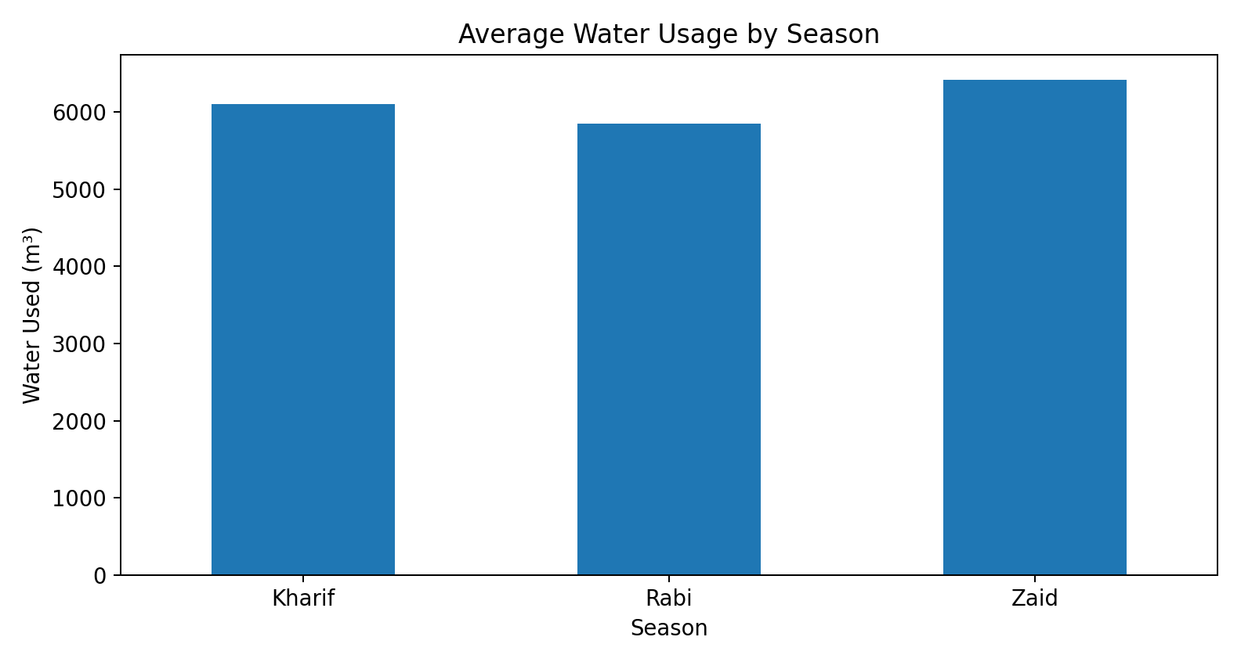
Result 3 — Seasonal Water Usage
[Add screen shots of your code ]
Zaid has the highest average water usage at 6,420 m³.

Slide 9
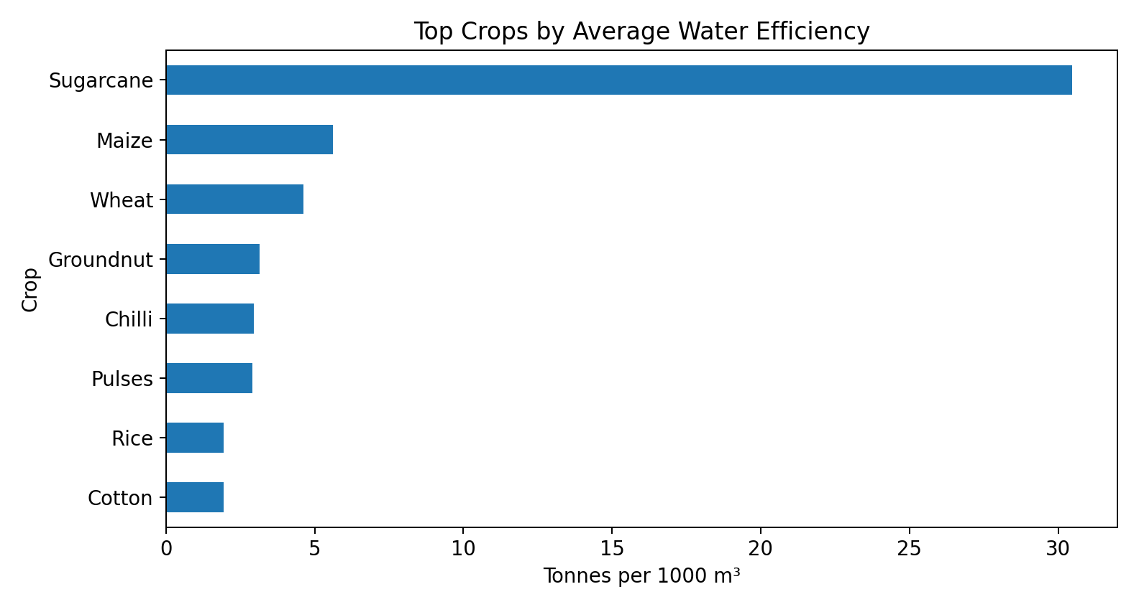
Result 4 — Water Efficiency by Crop
[Add screen shots of your code ]
Sugarcane has the highest average water efficiency among the crops shown, at 30.48 tonnes per 1000 m³.

Slide 10
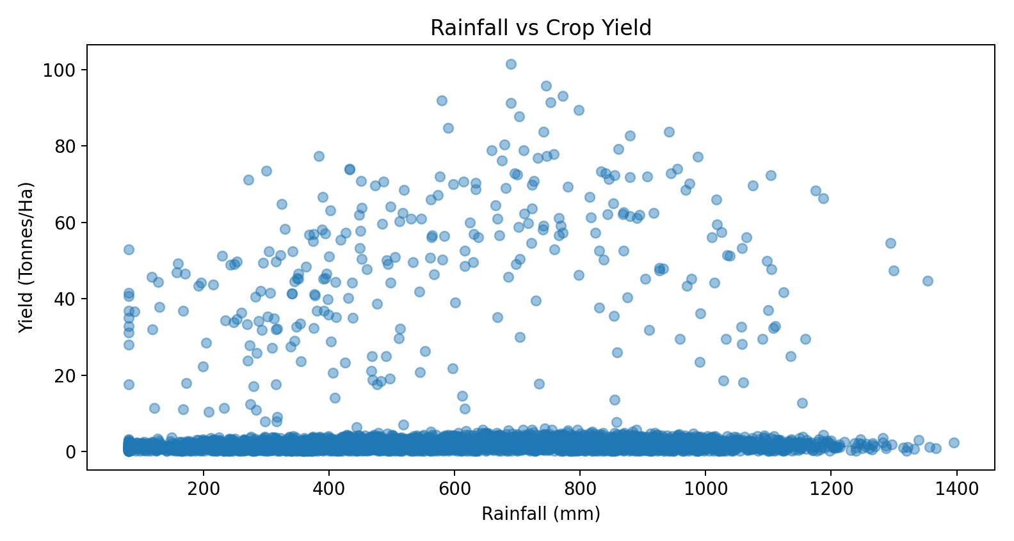
Result 5 — Rainfall and Crop Yield
[Add screen shots of your code ]
Rainfall and crop yield show a correlation of 0.03; the scatter plot is used to examine their relationship.

Slide 11
Future Scope
• Extend the analysis with more years and regions to study longer-term seasonal trends.
• Add market-price and weather forecasts for forward-looking planning.
• Build interactive dashboards for farmers and agricultural decision-makers.
• Develop predictive models for yield, profit, water demand and crop risk.
• Integrate real-time farm and environmental data for continuous monitoring.

Slide 12
GitHub Link
https://github.com/tejashanbhag5/Seasonal_Agriculture_Performance_Analysis
https://github.com/tejashanbhag5/Seasonal_Agriculture_Performance_Analysis

Slide 13
VOIS Course completion certificate
Course name – Data Visualization
[Insert your Data Visualization certificate image/PDF here]

Slide 14
Thank you
.
.

