Slide 1

Project Title - CarDekho Dataset Trend Analysis
Teja Shanbhag
STU6a5e75021491c1784575234

Slide 2

PROBLEM STATEMENT
To analyze used-car data from CarDekho and identify the major patterns affecting resale prices. The project examines manufacturing year, present price, kilometers driven, fuel type, seller type, transmission and ownership to generate useful insights for understanding the used-car market.

Slide 3
This project uses the CarDekho used-car dataset to perform data cleaning, exploratory data analysis and visualization. Duplicate records were identified and removed. The cleaned dataset contains 299 records and 9 columns. Python and Pandas were used for data handling, while Matplotlib was used to visualize pricing and market trends. The analysis compares selling prices across fuel type, seller type, transmission and ownership, and studies relationships between selling price, present price, vehicle age and kilometers driven.

Slide 4

WHO ARE THE END USERS?
• Used-car buyers – compare prices and understand market patterns • Car sellers and dealers – evaluate resale-price trends • Automotive analysts – study used-car market behavior • Automobile businesses – support pricing and inventory decisions

Slide 5

Technology Used
Python Pandas – data loading, cleaning and analysis Matplotlib – charts and visualizations Google Colab – project execution environment

Slide 6
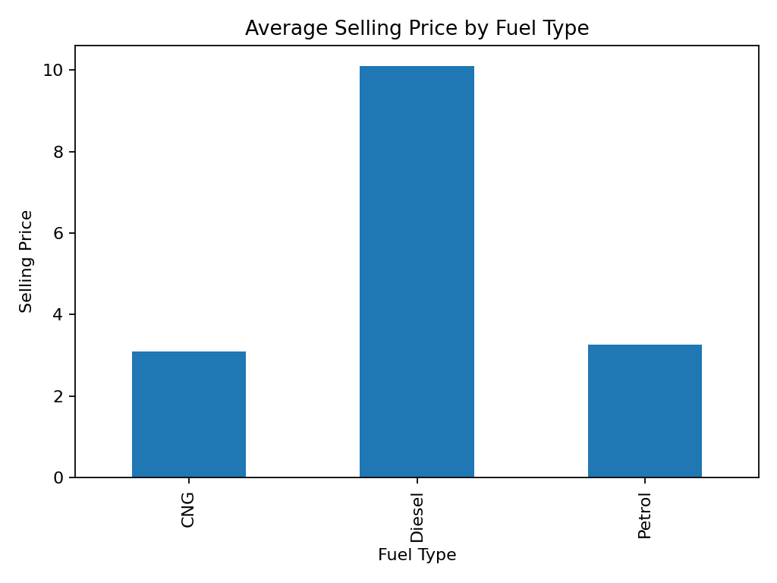
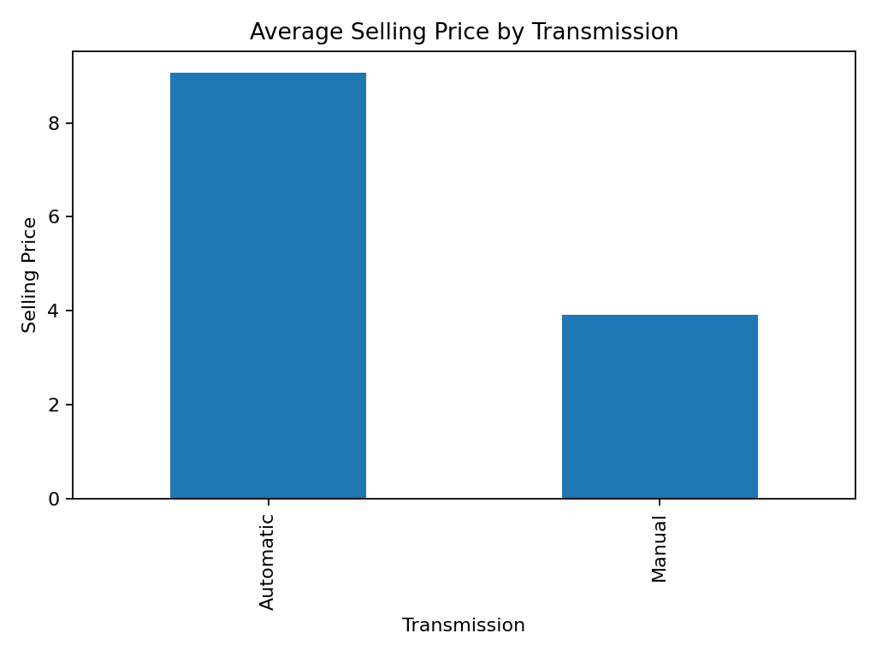
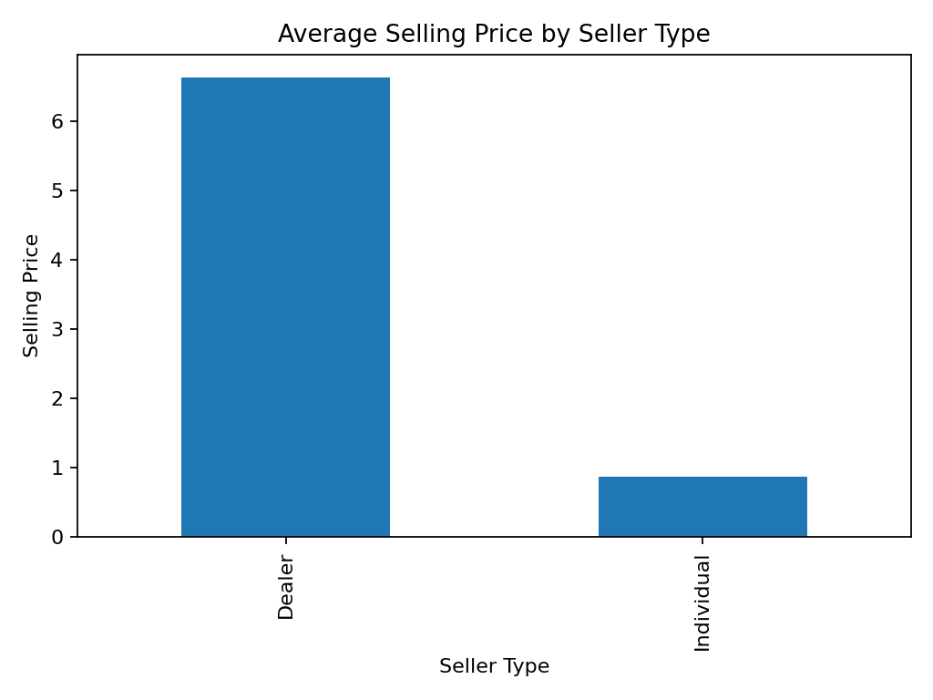
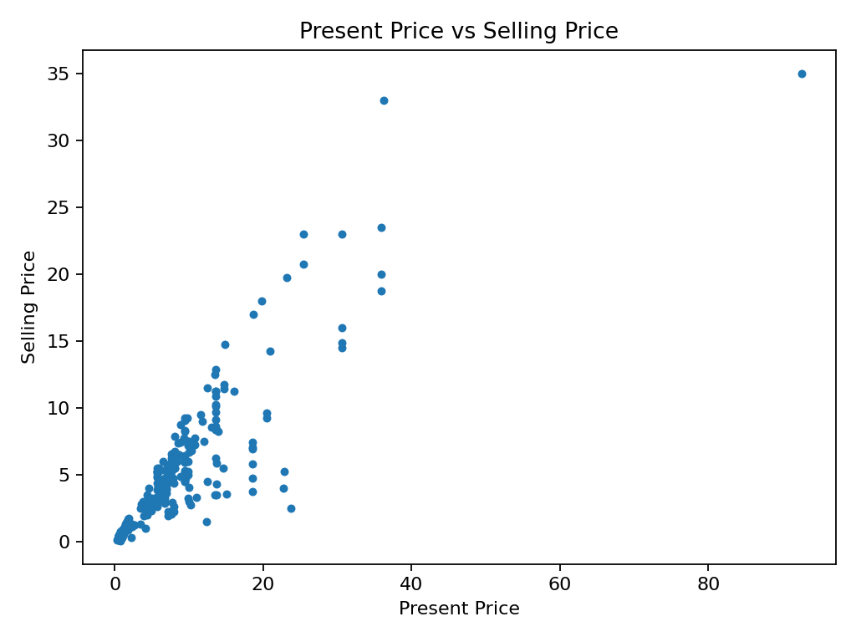
RESULTS
Demo Link
Key results: dataset = 299 unique records; years = 2003–2018. Average selling price is highest for Diesel (₹10.10 lakh), Automatic transmission (₹9.07 lakh), and Dealer sales (₹6.63 lakh). Selling price has a strong positive relationship with present price (r=0.88).
Demo / GitHub Link: Add your actual project link here

Slide 7
Thank you
.
.

