Slide 1


Slide 2

Atlas Quest: Country Info Showcase
By:
Tejas MH Rajeev Mangalapalli
Kushal Jantli

Slide 3
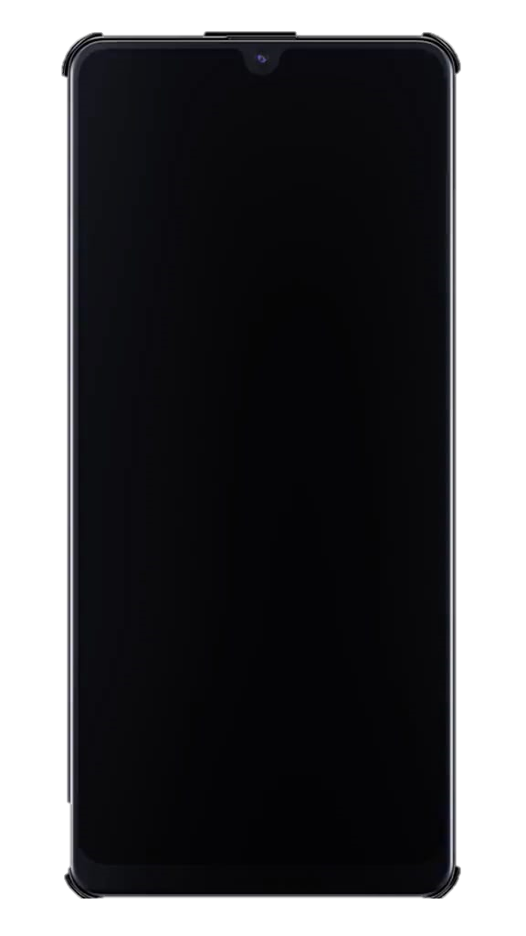

Slide 5
Summary
As we reach the end of our Flutter Primer course organized by PESU I/O, we have created a fullstack app for our final project.
The app was coded on Dart programming language, using Flutter Framework and REST Countries API.
The app accepts a country name as the input and displays information about the country such as it’s capital city, currency, languages spoken and much more.
It also provides an error message if a country that does not exist is entered.
The app can be used for a quick fact check and to improve your knowledge about the countries of the world.

Slide 6
