Slide 1


Slide 2

Atlas Quest: Country Info Showcase
By:
Tejas MH Rajeev Mangalapalli
Kushal Jantli

Slide 3
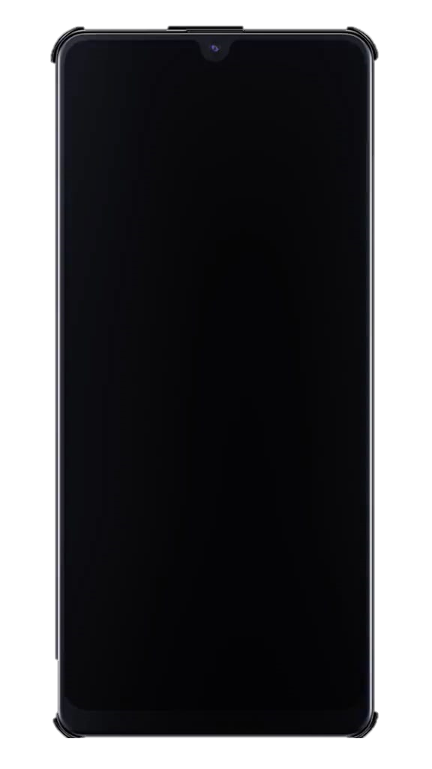

Slide 5
Summary
As we reach the end of our Flutter Primer course organized by PESU I/O, we have created a fullstack app for our final project.
The app was coded on Dart programming language, using Flutter Framework and REST Countries API.
The app accepts a country name as the input and displays information about the country such as it’s capital city, currency, languages spoken and much more.
It also provides an error message if a country that does not exist is entered.
The app can be used for a quick fact check and to improve your knowledge about the countries of the world.

Slide 6
About the API
A REST / RESTful API) is an application programming interface (API) that conforms to the constraints of REST architectural style and allows for interaction with RESTful web services.
REST stands for representational state transfer.
REST Countries API is a basic REST API that delivers information about the countries in JSON format. Each country’s data offers essential information, such as the capital city, population, languages, currencies, regions, and country code.

Slide 7
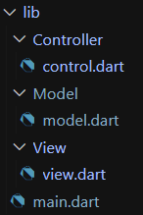
Model-View-Controller (MVC) Architecture
Model component corresponds to all the data-related logic that the user works with.
View component is used for all the UI logic of the application.
Controllers act as an interface between Model and View components to process all the business logic and incoming requests, manipulate data using the Model component and interact with the Views to render the final output.
Now, let us look at the code.

Slide 8
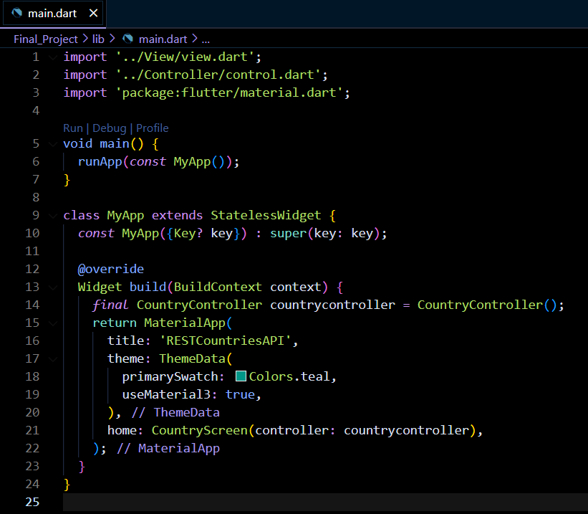

Slide 9
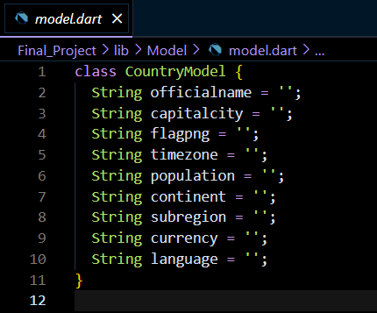

Slide 10
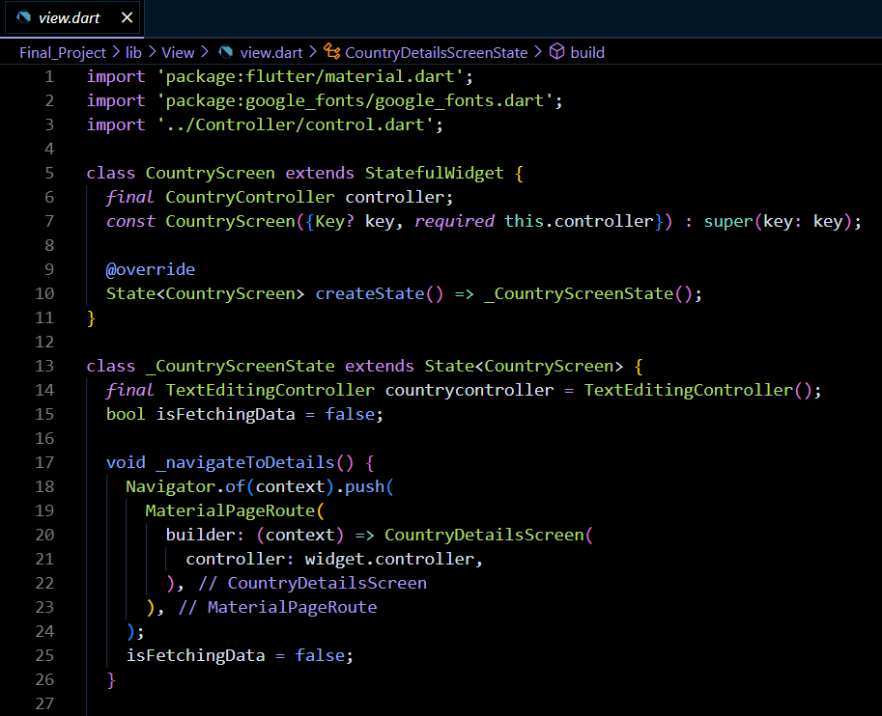

Slide 11
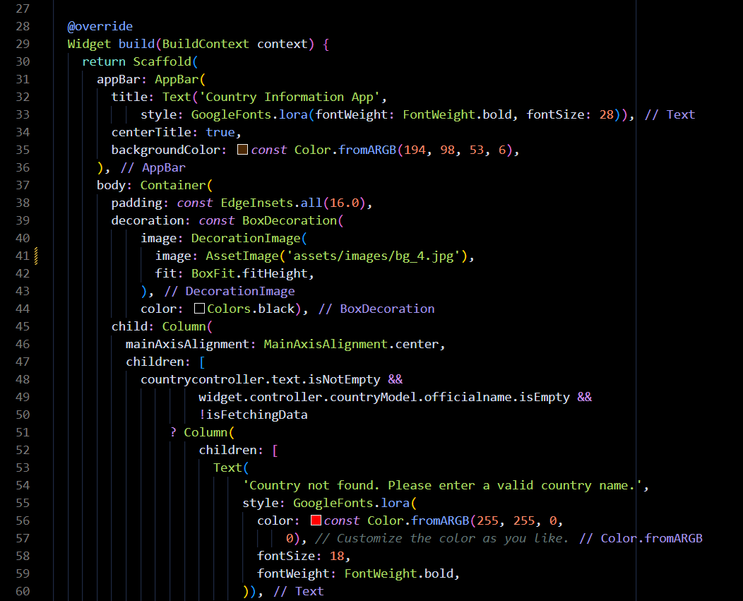

Slide 13
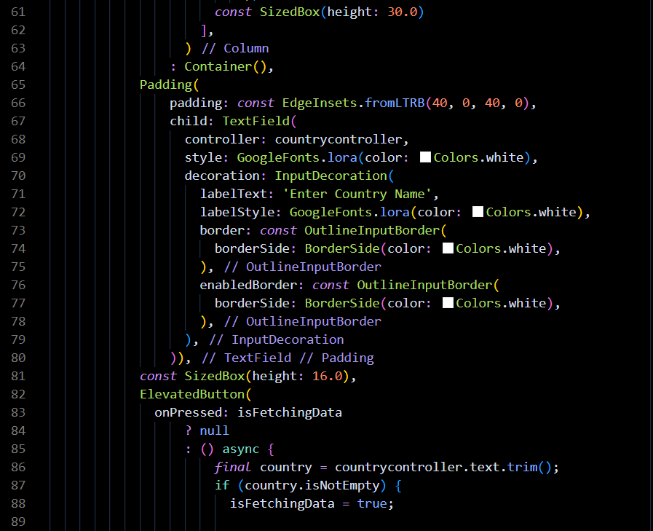

Slide 14
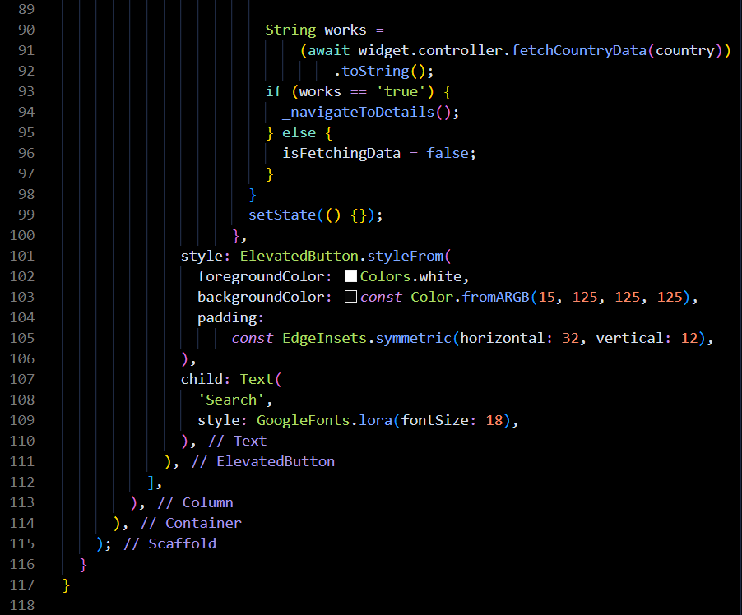

Slide 15
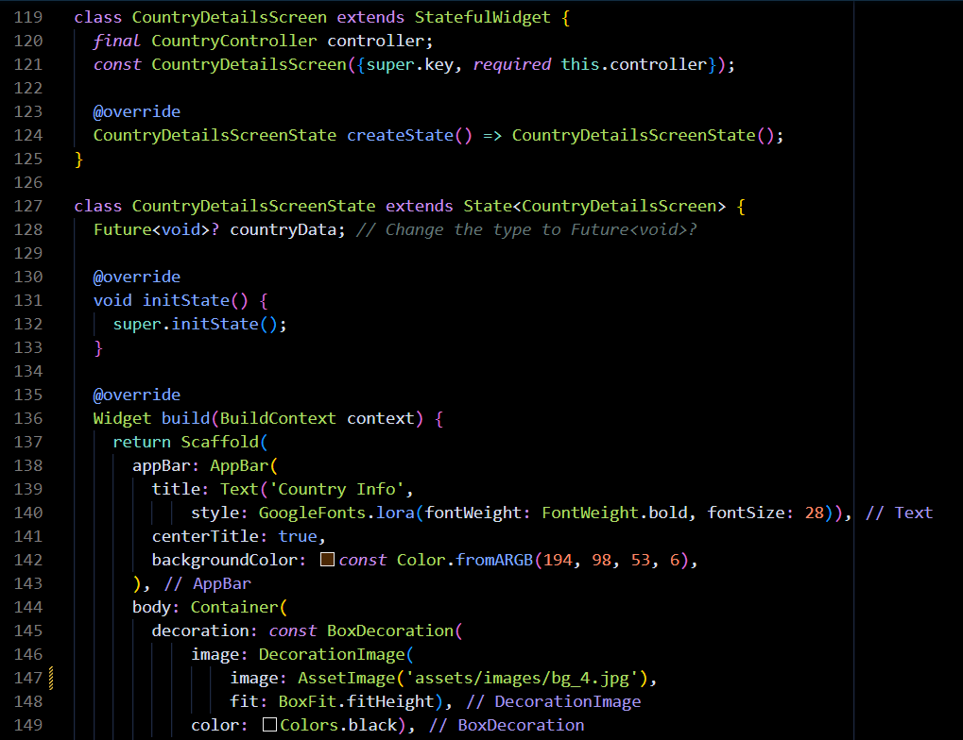

Slide 16
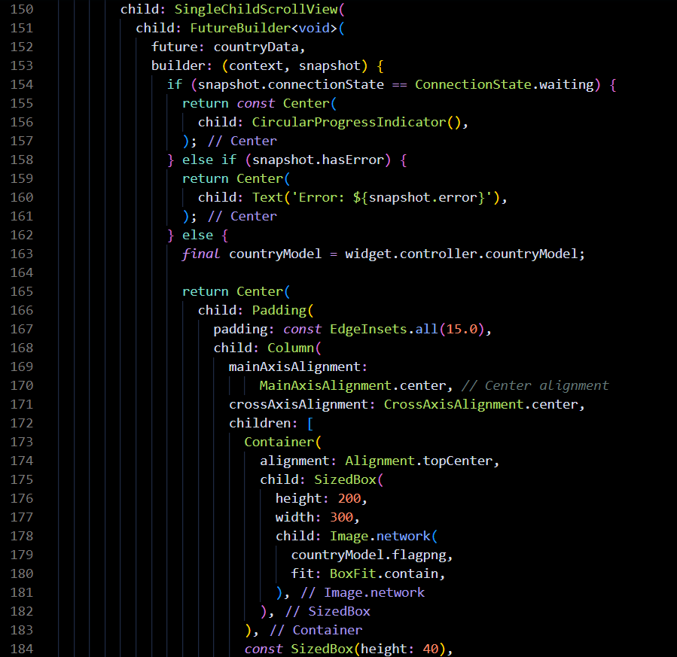

Slide 17
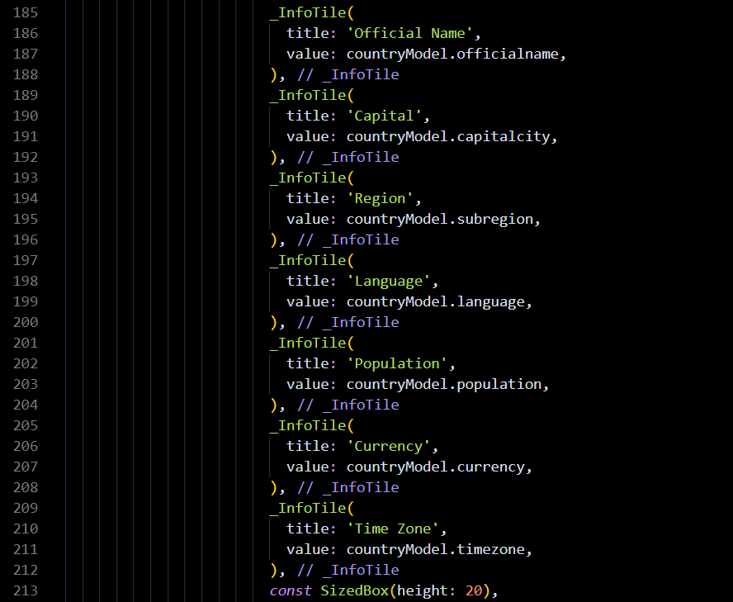

Slide 18
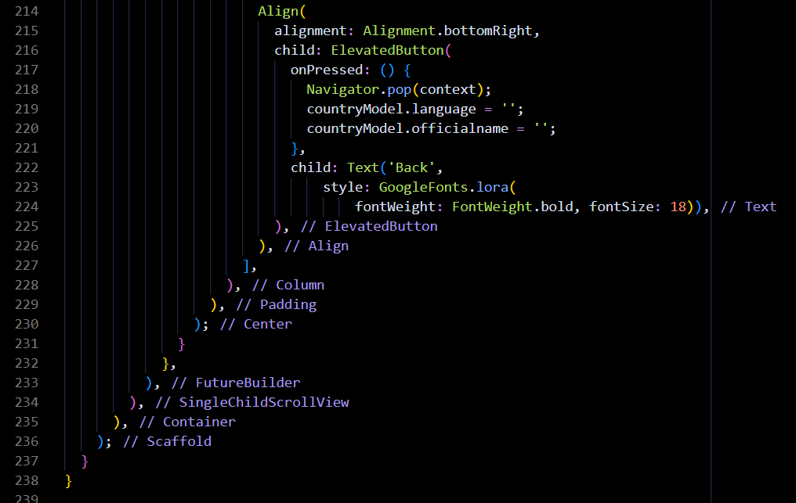

Slide 19
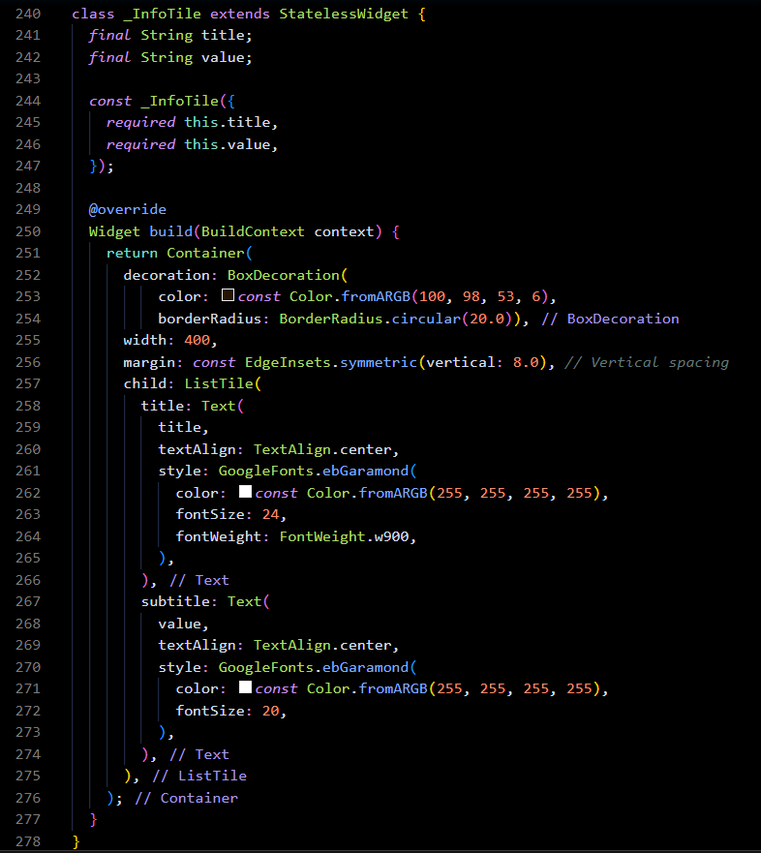

Slide 20
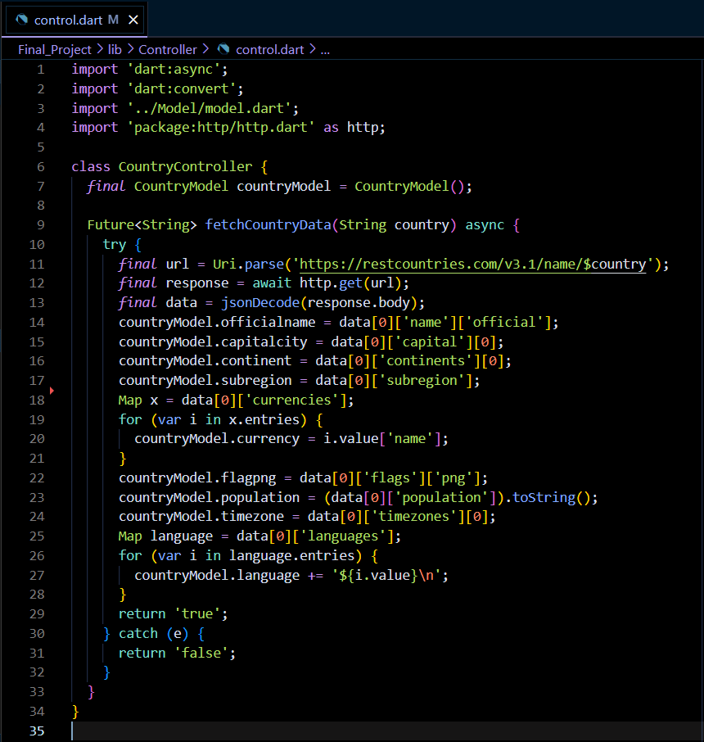

Slide 21
THANK YOU!
Presentation by: Tejas MH

