Slide 1
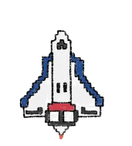
Subject: Python for Computational Problem Solving (PCPS)
Subject Code: UE23CS151A
MINI PROJECT
SEMESTER 1
SPACE FIGHTERS
Prerana M P | Tejas M S | Tejas Mysore Harish | Varsha Nadig

Slide 2
TABLE OF CONTENTS
01
02
03
04
05
Problem Statement
Introduction
Division of Work
Modules and Functionalities
Code
06
Snapshots
07
Learnings from the Project
08
Conclusion and Bibliography

Slide 3
01. Problem Statement
To develop a captivating and user-friendly space shooter game that combines simplicity with excitement. The challenge is to create an immersive experience with intuitive controls, vibrant graphics, and an addictive progression system, catering to both casual and avid gamers.

Slide 4
02.
INTRODUCTION

Slide 5
The menu has 4 options:
Start Game
Rules
Leader board
End Game
When ‘Start Game’ is selected, the user is asked to enter their name. After that, the game loop begins. The aim of the game is to shoot the asteroids before it hits Earth.
If the bullet hits the asteroid, it disappears. Else it travels to the edge of the screen and then disappears. The scores of the players along with their time can be checked in the ‘Leaderboards.’ Clicking on ‘Rules’ displays the rules of the game. When ‘End Game’ is selected, there is a popup which asks the user, if they are sure of their choice. If ‘No’ is selected, it takes you back to the menu. If ‘Yes’ is selected, the menu closes.
Space Fighters
Synopsis

Slide 6
03. Division of Work
Tejas M S
Tejas Mysore Harish
classes asteroid and missile and fn maindraw
SQL and while loop in the game
Prerana M P
Varsha Nadig
Tkinter and initializing of all variables objects
Tkinter and class rocket
Documentation

Slide 7
04. Modules and Functionalities

Slide 8
Game.py
class | function | description
Rocket | __init__(self) | Function to assign rocket’s coordinates, velocity, health bar
 | draw(self) | Function to display the image at the x and y coordinates (here y coordinate is constant)
 | attack(self) | When the asteroid has been shot, the cooldown is set back to 3 so that there is a gap between the shots
 | life(self) | Function to draw a shape (for the health bar)
Asteroid | __init__(self,name) | Function to assign asteroid’s coordinates, velocity
 | draw(self) | Function to display the relevant image
 | destroy(self) | If the player is within the coordinates of the asteroid, it is terminated and removed from the screen and game
 | kill_earth(self)
Missile | __init__(self,px,py) | Function to assign asteroid’s coordinates, velocity
 | Movebull(self,i) | Function to assign velocity of the bullet
 | delete(self,i) | Function to delete the bullet if it hits the edge of the screen

Slide 9
SQL_Scoring.py
class | function | description
 | run_game(name) | function called in menu.py to establish connection with SQL, sort and insert scores
 | insertion_sort_scores(lst) | sort the scores from highest to lowest using insertion sort algorithm
 | bubble_sort_time(lst) | sort the scores, if equal, based on time taken to complete, in increasing order using bubble sort algorithm
Menu.py
class | function | description
 | startgame() | function to start game
 | win() | function to print message if user wins
 | lose() | function to print message if user loses
 | retrieve_input() | function to retrieve data on the outcome of the game

Slide 10
class | function | description
 | rules() | function to bring up rules menu
 | leaderboard() | function to show leaderboard stored in SQL table
 | endgame() | function to ask for confirmation and quit the game
 | end() | function that quits the game after confirmation is provided

Slide 11
04. Code
Menu.py
#importing necessary modules
from tkinter import *
import mysql.connector as m
from tkinter import ttk
import SQL_Scoring
root=Tk() #creating a window
root.geometry("800x600") #setting window dimensions
root.title("Main Menu") #giving it a title
root.configure(background = '#000000') #giving it a color
Label(root, text = "Space Fighters", font = ('Comic Sans MS', 48), bg = '#000000', fg = '#ffffff').pack(anchor=CENTER)
#---------------------------------------------------------------------------
def startgame(): #function to start game
win1 = Tk()
win1.geometry('400x400')
win1.grid()
win1.title("Start Game")
win1.configure(bg = '#ff636f')

Slide 12
def win(): #function to be executed if user wins
winn = Tk()
winn.geometry('300x300')
winn.grid()
winn.title("Victory!")
winn.configure(bg = '#ff636f')
Label(winn, text = 'Congratulations!!! \nYou win!🥳🥳🥳', font = ("Comic Sans MS", 14), border = 3, bg = '#ff636f').place(x = 50, y = 50)
Button(winn, text = "Back", font = ("Comic Sans MS", 14), command = winn.destroy).place(x = 200, y = 200)
def lose(): #function to be executed if user loses
lose = Tk()
lose.geometry('300x300')
lose.grid()
lose.title("Defeat")
lose.configure(bg = '#ff636f')
Label(lose, text = 'You Lose 😕 \nBetter Luck Next Time.', font = ("Comic Sans MS", 14), border = 3, bg = '#ff636f').place(x = 50, y = 50)
Button(lose, text = "Back", font = ("Comic Sans MS", 14), command = lose.destroy).place(x = 200, y = 200)
def retrieve_input(): #function to retrieve data on the outcome of the game
name = textBox.get("1.0", "end-1c")
win1.destroy()
result = SQL_Scoring.run_game(name)
if result == 'win':
win()
elif result == 'lose':
lose()

Slide 13
Label(win1, text = "Enter name:", font = ('Comic Sans MS', 16), bg = '#ff636f').place(x = 70, y = 150)
textBox = Text(win1, height = 1, width = 10, font = ('Comic Sans MS',12))
textBox.place(x = 200, y = 155)
buttonCommit = Button(win1, height = 1, width = 10, text = "Enter", font = ('Comic Sans MS', 12), command = lambda:retrieve_input())
buttonCommit.place(x = 150, y = 200)
Button(win1, text = "Back", font = ("Comic Sans MS", 14), command = win1.destroy).place(x = 300, y = 300)
#---------------------------------------------------------------------------
def rules(): #function to bring up rules menu
win2 = Tk()
win2.geometry("600x500")
win2.grid()
win2.title("Rules")
win2.configure(bg = '#ff636f')
Label(win2, text= '''Rules\n
1. Use arrow keys to move and space to shoot. \n
2. To destroy the asteroid, align the rocketship with the\n asteroid and press space.\n
3. The planet has 100 health. Every asteroid strike does 25 damage.\n
4. For the first 30 seconds, an asteroid will strike every 4 seconds. \nAfter 30 seconds,an asteroid will strike every 3 seconds.\n After 60 seconds, an asteroid will strike every 2 seconds.\n
5. The game lasts 2 minutes. \nProtect the planet from total destruction! \n''',
font = ("Comic Sans MS", 14), border = 3, bg = '#ff636f').pack(anchor = CENTER)

Slide 14
Button(win2, text= "Back", font=("Comic Sans MS",14), command=win2.destroy, bg="#cdcdcd", fg='black').place(x = 500, y = 400)
#---------------------------------------------------------------------------
def leaderboard(): #function to show leaderboard stored in SQL table
win3 = Tk()
win3.geometry('1000x400')
win3.grid()
win3.title("Leaderboard")
win3.configure(bg = '#ff636f')
tree = ttk.Treeview(win3,column = ('c1','c2','c3','c4'), show = 'headings') #tree with column headings
tree.column('#1',anchor = CENTER)
tree.heading('#1', text = 'Rank')
tree.column('#2',anchor = CENTER)
tree.heading('#2', text = 'Name')
tree.column('#3',anchor = CENTER)
tree.heading('#3', text = 'Score')
tree.column('#4',anchor = CENTER)
tree.heading('#4', text = 'Time')
tree.pack()

Slide 15
con = m.connect(host = 'localhost', username = 'root', passwd = 'fab4', db = 'project') #connector object establishing connection to SQL
mycursor = con.cursor() #creating cursor object
query = 'select * from space_fighters' #query to select all values from leaderboard
mycursor.execute(query) #executing query and storing values returned in cursor object
rows = mycursor.fetchall() #retrieving values from cursor object and storing in a variable
for row in rows:
tree.insert("", END, values = row)
con.close()
Button(win3, text= "Back", font=("Comic Sans MS",14), command=win3.destroy, bg="#cdcdcd", fg='black').place(x = 900, y = 300)
#---------------------------------------------------------------------------
def endgame(): #function to ask for confirmation and quit the game
win4 = Tk()
win4.geometry("400x200")
win4.grid()
win4.title("End Game")
win4.configure(bg = '#ff636f')
def end(): #function that quits the game after confirmation is provided
root.destroy()
win4.destroy()

Slide 16
Label(win4, text = "Are you sure you want to exit?", font = ("Comic Sans MS", 18), bg = '#ff636f').place(x = 20, y = 30)
Button(win4, text = "Yes", font = ("Comic Sans MS", 14), command = end, border = 3).place(x = 250, y = 100)
Button(win4, text = "No", font = ("Comic Sans MS", 14), command = win4.destroy, border = 3).place(x = 300, y = 100)
#---------------------------------------------------------------------------
#placing all the buttons on the screen
Startgame = Button(root, text = "Start Game", font = ('Comic Sans MS', 16), command = startgame, padx = 20 , pady = 20, bg = '#c0ae39', fg = '#000000')
Startgame.pack()
Rules = Button(root, text = "Rules", font = ('Comic Sans MS', 16), command = rules, padx = 20 , pady = 20, bg = '#c0ae39', fg = '#000000')
Rules.pack()
Leaderboard = Button(root, text = "Leaderboard", font = ('Comic Sans MS', 16), command = leaderboard, padx = 20 , pady = 20, bg = '#c0ae39', fg = '#000000')
Leaderboard.pack()
Endgame = Button(root, text = "End Game", font = ('Comic Sans MS', 16), command = endgame, padx = 20 , pady = 20, bg = '#c0ae39', fg = '#000000')
Endgame.pack()
root.mainloop()

Slide 17
game.py
def game_loop():
#importing necessary modules
import pygame
import random
#initializing pygame and fonts
pygame.init()
pygame.font.init()
#creating the screen
screen = pygame.display.set_mode((1200,800))
pygame.display.set_caption("Space Fighters")
#importing images
rocketship = pygame.image.load('images/fighter.png').convert_alpha()
asteroid_img = pygame.image.load('images/fireball_1.png').convert_alpha()
missile_img = pygame.image.load('images/Bullet.png').convert_alpha()
bg = pygame.image.load('images/bg.jpg')
#setting a font to be used to display text on screen
font = pygame.font.SysFont('Comic Sans MS', 25)
health_text = font.render('Health: ', False, (0, 0, 0), (122,122,122))

Slide 18
class rocket(object):
def __init__(self):
'''These variables are initialized to all objects of this class. The values are independent
of other objects of the same class.'''
self.x = random.randrange(200,900) #rocket's co-ordinates
self.y = 600
self.vel = 10 #rocket velocity
self.health = 100 #earth's health
self.shoot_cooldown = 0 #variable to allow only one missile to be fired every 3 iterations
def draw(self): #fn called in maindraw
screen.blit(rocketship, (self.x, self.y)) #displays the image on the screen at the x&y coordinates
def shoot(self): #fn called every time space is pressed
# case that missile has just been shot, the cooldown is set back to 3 so there is a gap between shots.(makes the animation smoother)
if self.shoot_cooldown == 0:
self.shoot_cooldown = 3
missile(self.x, self.y) #assigning initialization variables to a missile
def life(self): #fn called in maindraw
#draw a shape (screen, color, shape(x,y,length, width))
pygame.draw.rect(screen, (0, 0, 0), pygame.Rect(100, 45, 100, 20))

Slide 19
if self.health == 100:
color = (0, 255, 0) #green
pygame.draw.rect(screen, color, pygame.Rect(100, 45, self.health, 20))
elif self.health == 75:
color = (255, 255, 0) #yellow
pygame.draw.rect(screen,color, pygame.Rect(100, 45, self.health, 20))
elif self.health == 50:
color = (255, 165, 0) #orange
pygame.draw.rect(screen,color, pygame.Rect(100, 45, self.health, 20))
elif self.health == 25:
color = (255, 0, 0) #red
pygame.draw.rect(screen,color, pygame.Rect(100, 45, self.health, 20))
elif self.health == 0:
color = (0, 0, 0) #black
pygame.draw.rect(screen,color, pygame.Rect(100, 45, self.health, 20))
#---------------------------------------------------------------------------
class asteroid(object):
def __init__(self,name):

Slide 20
self.name = name #asteroid's name = asteroid+no
self.x = random.randint(100,900) #asteroid's starting co-ordinates
self.y = 20
self.vely = 5 #asteroid's velocity
def draw(self): #fn called in maindraw()
nonlocal screen
#since the function draw() is within another function game_loop(), to access variables defined in game_loop, we use nonlocal and not global.
self.destroy()
self.kill_earth()
screen.blit(asteroid_img, (self.x, self.y))
self.y += self.vely
def destroy(self): #fn called in draw()
nonlocal score, running_dict, missile_list_iterable
#if the missile is within the coordinates of the asteroid, asteroid is terminated and is removed from the screen and game.
#since we need to check for all missiles, we use a for loop
for x in missile.missile_list:
if (self.x < x[0] < self.x + 100) and (self.y < x[1] < self.y + 120):
#setting the value of asteroid key to None so it cannot be called/ drawn in the game again.
running_dict [self.name] = None
#100 points increment per kill.
score += 100
missile.missile_list.remove(x) #the missile is removed from the list and iterable value is reduced by 1 to prevent index out of range error.

Slide 21
missile_list_iterable -= 1
def kill_earth(self): #fn called in draw()
if self.y > 550: #if the asteroid has crossed this y coordinate, then the asteroid will strike earth and so earth loses health
millenium_falcon.health -=25
running_dict[self.name] = None #asteroid value is set to None and wont be drawn in the game again.
#---------------------------------------------------------------------------
class missile(object):
missile_list = [] #list of missiles to be fired
vel = 30 #missile velocity
def __init__(self,px, py):
#checking if the missile list has less than 5 missiles, proceeding to move missile.
if len(self.missile_list) < 5:
#the missile is appended into missile list and queued for firing. The +48 is so that it animation looks like missile is coming from under the rocket.
self.missile_list.append([px + 48 ,py + 80])
else:
#more than 5 missiles are not allowed to have a smoother animation.
self.missile_list.pop()

Slide 22
def movebull(self,i): #fn called in maindraw()
#i is a missile in missile list. i[1] is the y coordinate which reduces as missile is moving upwards.
i[1] -= self.vel
missile.delete(self,i)
def delete(self,i): #fn called in delete()
nonlocal missile_list_iterable
#if missile hits the edges, it is deleted
if i[0] > 1200 or i[1] > 800 or i[1] < 0 or i[0] < 0:
self.missile_list.remove(i)
missile_list_iterable -=1
#---------------------------------------------------------------------------
#initializing all the objects
millenium_falcon = rocket()
asteroid0 = asteroid('asteroid0')
running_dict = {'asteroid0':asteroid0} #asteroids to be drawn on screen
not_running_dict = {} #asteroids to be drawn on screen in the future
#creating required number of asteroids
for val in range(1,35):
x = 'asteroid{}'.format(val)
not_running_dict[x] = asteroid(x)

Slide 23
def maindraw(): #draws all objects on screen, called in while loop as this needs to run infinitely till the game is stopped.
screen.blit(bg, (0,0)) #draws the screen background
for asteroid in running_dict:
if running_dict[asteroid] != None:
running_dict[asteroid].draw()
millenium_falcon.draw()
screen.blit(health_text, (0,40))
rocket.life(millenium_falcon)
score_text = font.render('Score: {}'.format(score), False, (0, 0, 0),(122,122,122))
screen.blit(score_text, (0,0))
timelabel = font.render("Time - {} s".format(seconds), False, (0,0,0), (122,122,122))
screen.blit(timelabel, (1050,0))
if len(missile.missile_list) != 0:
i = missile.missile_list[missile_list_iterable]
screen.blit(missile_img, (i[0], i[1]))
missile.movebull(missile,i)
pygame.display.update() #updates screen to show all objects
clock = pygame.time.Clock()
score = 0
milliseconds = 0
seconds = 0

Slide 24
new_asteroid_timer = 0 #time after which new asteroid is displayed on the screen
missile_list_iterable = 0 #iterable to iterate through missile_list
running = True #flag variable to start the game loop
#---------------------------------------------------------------------------
while running: #game loop
clock.tick(32) #32 ms delay for better accuracy
for event in pygame.event.get():
if event.type == pygame.QUIT: #if game is closed
running = False
if millenium_falcon.health == 0: #if the earth has no health
running = False
if seconds >= 65: #if the earth survives the attack for the duration of the game
running = False
keys = pygame.key.get_pressed() #dictionary of all keys on keyboard
if keys [pygame.K_LEFT] or keys [pygame.K_a] : #when the left arrow key or 'a' is pressed,
millenium_falcon.x -= millenium_falcon.vel #rocket moves left with velocity = 10
elif keys [pygame.K_RIGHT] or keys [pygame.K_d]:
millenium_falcon.x += millenium_falcon.vel

Slide 25
if keys[pygame.K_SPACE]: #when space is pressed, the shoot fn is called
millenium_falcon.shoot()
millenium_falcon.shoot_cooldown -= 1
if missile_list_iterable < len(missile.missile_list) - 1: #so that index does not go out of range
missile_list_iterable += 1 #increment iterable
else:
missile_list_iterable = 0 #reset to 0 if it is out of range
milliseconds += clock.tick_busy_loop(150)
if milliseconds > 150:
seconds += 1 #increment time
new_asteroid_timer += 1 #variable for adding new player on screen
milliseconds -= 150
if seconds < 25:
if new_asteroid_timer == 3:
#every 3 seconds an asteroid is drawn onto the screen
new_asteroid_timer = 0 #reset timer to 0
x = not_running_dict.popitem() #remove them from not_running_dict
running_dict [x[0]] = x[1] #and add to running_dict
elif 25 <= seconds <= 45:
if new_asteroid_timer == 2:
#every 2 seconds an asteroid is drawn onto the screen
new_asteroid_timer = 0

Slide 26
x = not_running_dict.popitem()
running_dict [x[0]] = x[1]
elif new_asteroid_timer > 2: #in case the variable reached a limit from the previous block that isn't checked by
new_asteroid_timer = 2 #this block, the variable is set back to a number that is within this block's limit
elif 45 <= seconds <= 60:
if new_asteroid_timer == 1:
#every second an asteroid is drawn onto the screen
new_asteroid_timer = 0
x = not_running_dict.popitem()
running_dict [x[0]] = x[1]
elif new_asteroid_timer > 1:
new_asteroid_timer = 1
#boundary condn: so that rocket does not go out of bounds
if millenium_falcon.x <= 0 :
millenium_falcon.x = 0
elif millenium_falcon.x >= 1080:
millenium_falcon.x = 1080
screen.fill((0,0,0))
maindraw() #all draw functions are called here
pygame.quit() #closes pygame
return score, seconds

Slide 27
SQL_Scoring.py
from game import game_loop
import mysql.connector as m
from sorts import *
if __name__ != '__main__':
def run_game(name): #fn called in menu.py
con = m.connect(host = 'localhost', username = 'root', passwd = 'F@tlady0194', db = 'project')
score, time = game_loop() #run the game and store the returned values
player = [100, name, score , time]
if con.is_connected():
mycursor = con.cursor()
query1 = 'select * from space_fighters'
mycursor.execute(query1)
result = mycursor.fetchall() #returns result as tuples nested in a list
lst = []
if len(result) != 0: #if players data exists
for i in range(len(result)):
a = list(result[i]) #convert result tuples into lists
lst.append(a)
lst.append(player) #append player data
insertion_sort_scores(lst) #sort player ranking based on score
bubble_sort_time(lst) #based on time if their scores are equal

Slide 28
for i in range(len(lst)): #using index posn as iterable i,
lst[i][0] = i+1 #change rank to i+1 since indexing starts from 0
lst[i] = tuple(lst[i]) #convert nested lists back to nested tuples
if len(lst) > 5:
lst.pop()
elif len(lst) == 0: #if no player data exists
lst.append(player)
lst[0][0] = 1 #change rank to 1
lst[0] = tuple(lst[0]) #convert nested list to nested tuple
query2 = 'delete from space_fighters' #delete existing data, since data may have changed after last play
mycursor.execute(query2)
con.commit()
query3 = 'insert into space_fighters values (%s,%s,%s,%s)' #insert new data into sql table
mycursor.executemany(query3, lst)
con.commit()
con.close()
if time == 65: #return score to decide which window should be displayed - win or lose
return 'win'
else:
return 'lose'

Slide 29
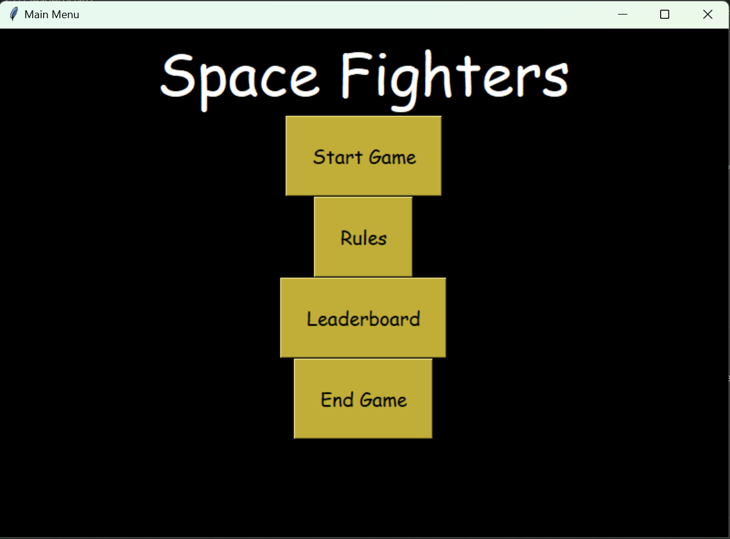
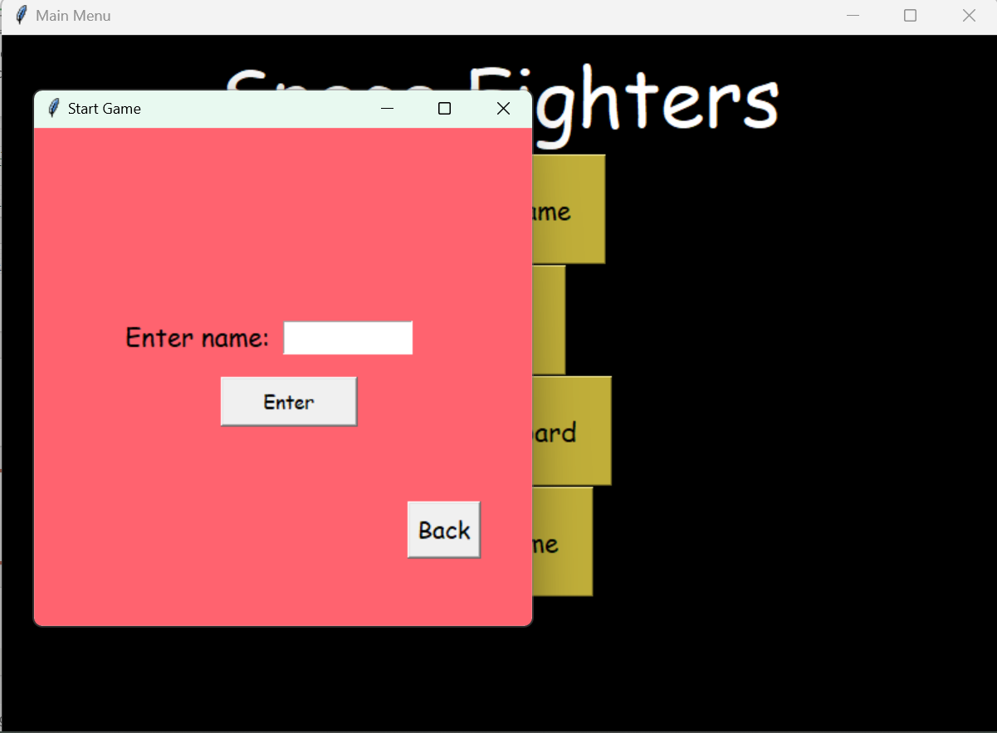
05. Snapshots

Slide 30
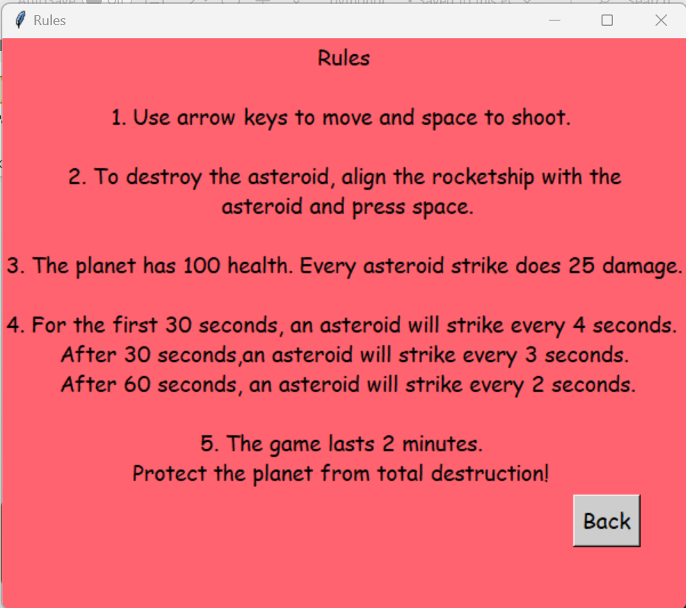
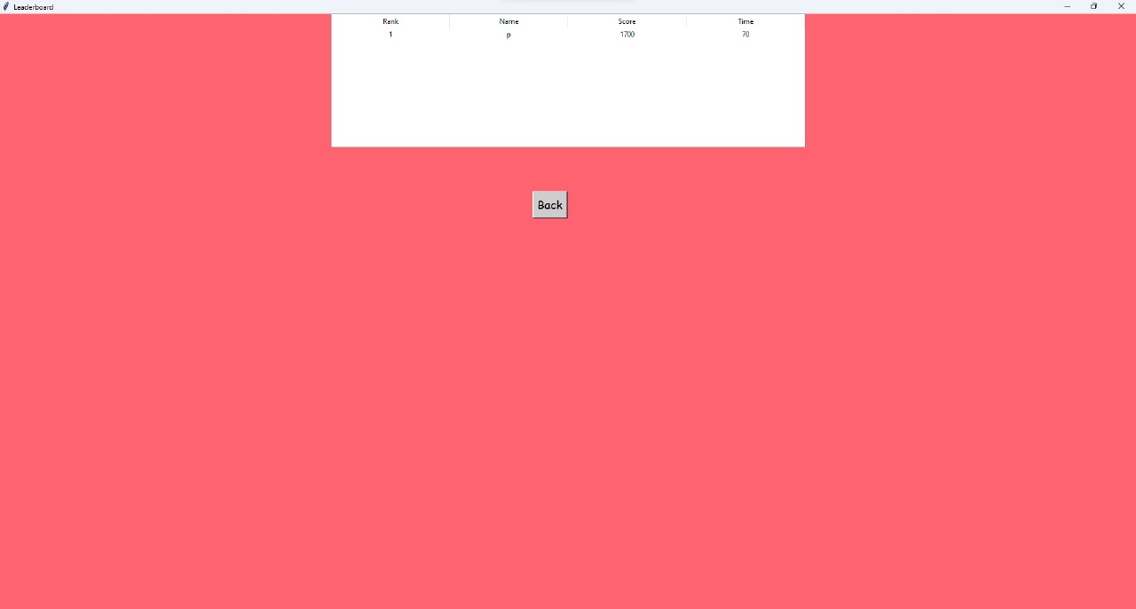

Slide 31
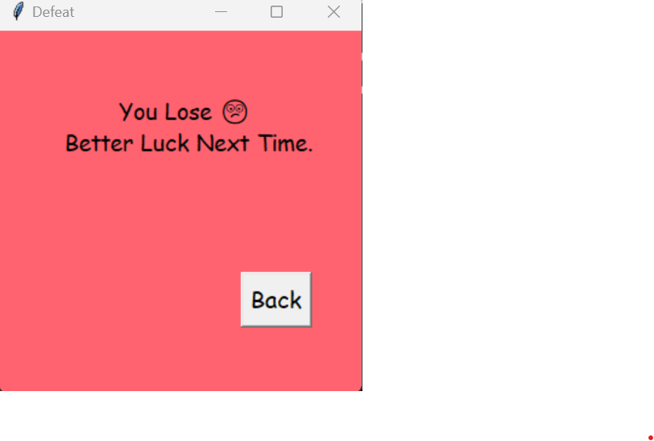
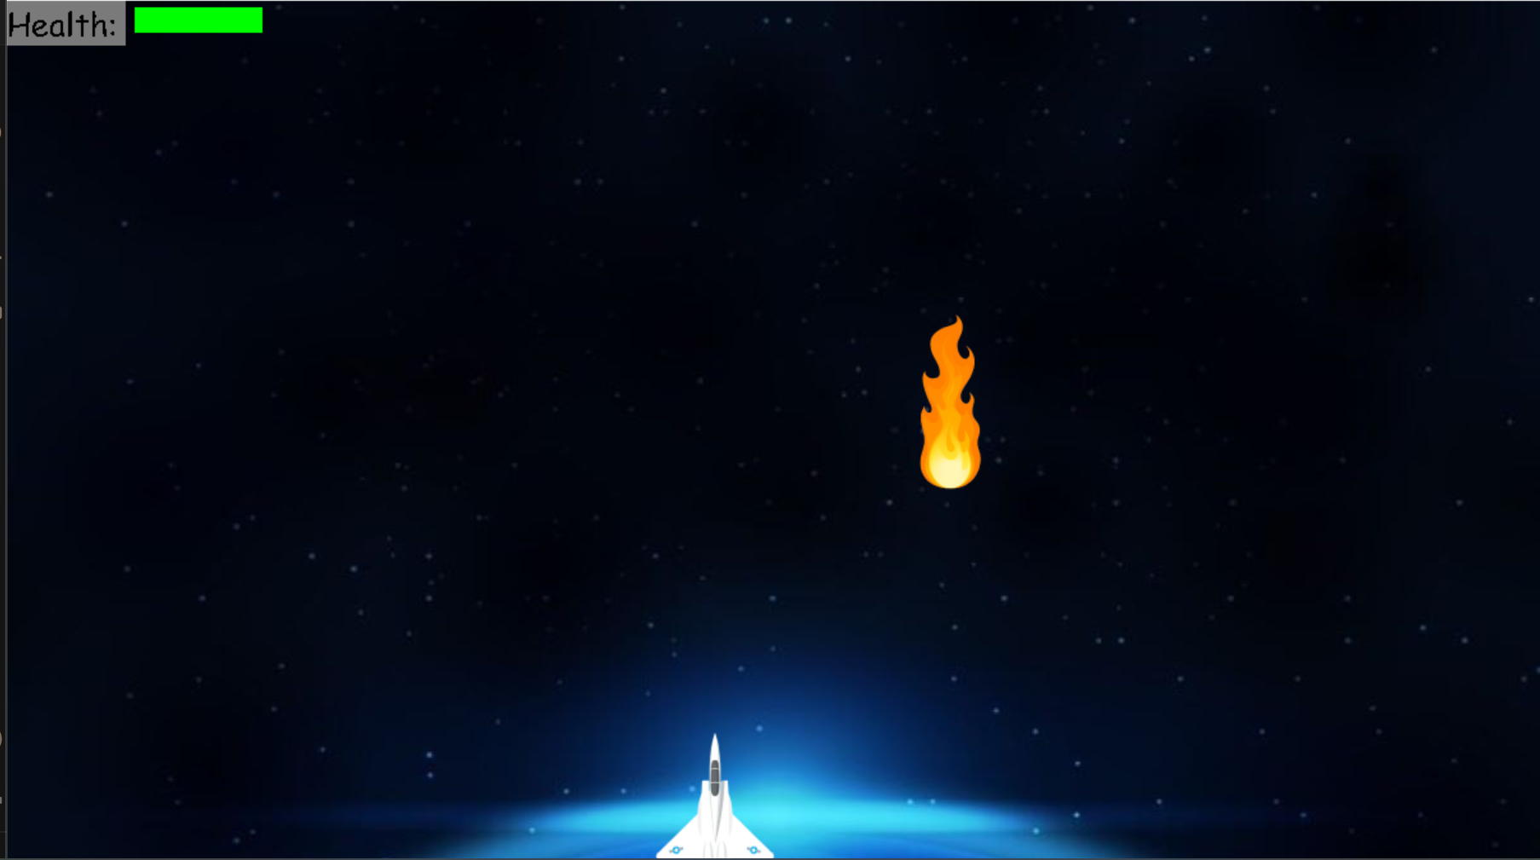
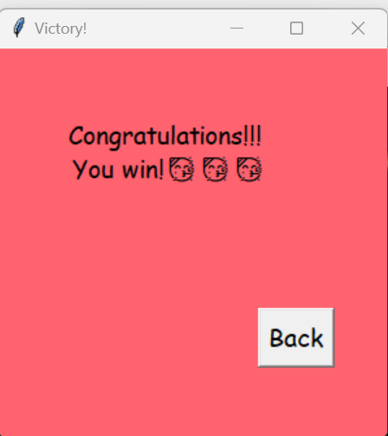

Slide 32
Learning from this Project
This project not only provided a platform for creativity and expression but also served as a valuable learning experience for understanding game design principles. Through this project, we've delved into essential concepts such as player controls, enemy AI, weapons systems, and more. Broadly, the insights gained are:
Code Structure and Organization: Understand how the code is structured and organized. This includes the use of modules, classes, and directories.
Game Loop Implementation:
Documentation and Comments: Observe how the code is documented, including comments and docstrings.
Graphics and Visual Effects: Learn about animations, and other visual effects that contribute to the overall gaming experience.

Slide 33
Conclusion and Future Work
In conclusion, the Python space fighter game we've created is a testament to the exciting possibilities of game development. This project not only marks an accomplishment in Python game development but also serves as a stepping stone for further exploration and innovation in the vast and ever-evolving world of game design. In the future, we can improve this project by improving graphics, adding new maps, making the game smoother and adding extra obstacles.
Bibliography
Tech with Tim
Coding with Russ
Stack Overflow
Geeks for Geeks
Python Tutor

Slide 34
THANK YOU

