Slide 1








BRACT’ VISHWAKARMA INSTITUTE OF TECHNOLOGY.
STUDENT ACTIVITY
BY

Slide 2


CONTENTS
NEP & Student Activities.
Domain Work & Strength Allocation
Domain wise Activities Chart.
Modules (M1 & M2)
Transparency precautions, Certification, reporting & Implementation.
NGO’s Collaboration & MOU’S
Case Studies
References

Slide 3

NEP & STUDENT ACTIVITES
Holistic and Multidisciplinary Education.
Flexible and Experimental Learning.
Ethical and Social Responsibility.
Inclusivity and Equality.
Financial Independence for student.

Slide 4
DOMAINS OF WORK & STRENGTH ALLOCATION
Domain | Strength Allocation (approximation)
Education, Awareness and Empowerment. | 400
Health and Wellbeing | 200
Community Development and Social Support | 300
Environmental Sustainability and Cleanliness | 800
Social Dialogue, Collaboration and Advocacy. | 200

Slide 5
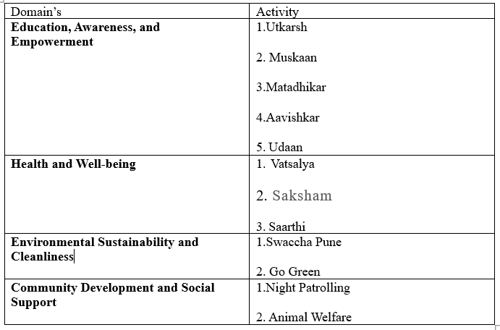
DOMAINWISE ACTIVITY (NON CERTIAN)

Slide 6
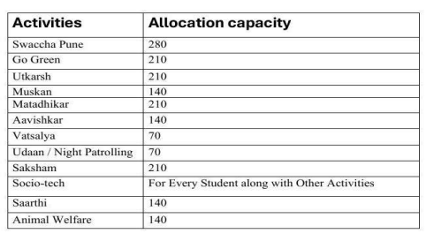
ALLOCATION CHART (NON CERTIAN)

Slide 7
Note - Activities conducted by SW&D may not be fixed but the Domains are fixed. Activities may differ from time to time as per the requirement.

Slide 8
MODULES
Student activities are divided in two modules to create ease and to make process more efficient, reliable and more output driven. Both module would be implemented simultaneously.
For Example :- If {61 Divisions}; Then {(For 31 divisions -> M1)&& (For 30 divisions -> M2)}
Both the Modules will be Operated Simultaneously.

Slide 9
MODULE 1 CONTENTS
A. Ground Work in the domain allotted to their division.
B. Circular Activities provided by SPPU, AICTE, NSS & BCUD
C. All the activities planned by the team within the domain are allotted to the division.

Slide 10
MODULE 1 ASSESMENT CRITERIA
Mid semester review:(By Faculty)
a. mid semester ppt presentation of their work in provided format.
End Semester review:(BY Faculty)
a. End semester ppt presentation and report submission in provided format
(Format of Presentation will be provided to the students . All the report filling process is digitalized since 2021 by SW&D Volunteers are mailed with their reports and activity certificates once activities are completed.)
.

Slide 11
MODULE 1 ASSESMENT CRITERIA
INTERNALS (This data would be Provided by the team on the basis of the following with Digital Transparency)
Support and Assistance (Attendance).
Community Outreach (Behaviour towards community).
Social Awareness & Communication.
Data Collection (geotagged Photos, Surveys etc.)
Social Media Activism (Awareness through Social Media)

Slide 12
MODULE 2 CONTENTS
a. Yoga/ Physical activities.
b. Entrepreneurship development lectures / procedures.
c. Implementation of Socio-tech(ideation or implementation of socially viable project)
d. Project Development (socio tech0) as an model entrepreneur.
e. Other student activities conducted by other clubs and committee ( Provided by Certificate from the concerning club authority).

Slide 13
MODULE 2 ASSESMENT CRITERIA
Mid semester review:(By Faculty)
a. mid semester ppt presentation of their work in provided format.
End Semester review:(BY Faculty)
a. End semester ppt presentation and report submission in provided format
(Format of Presentation will be provided to the students . All the report filling process is digitalized since 2021 by SW&D Volunteers are mailed with their reports and activity certificates once activities are completed.)
.

Slide 14
MODULE 2 ASSESMENT CRITERIA
INTERNALS (This data would be Provided by the team on the basis of the following with Digital Transparency)
Support and Assistance (Attendance).
Community Outreach (Behaviour towards community).
Social Awareness & Communication.
Data Collection (geotagged Photos, Surveys etc.)
Social Media Activism (Awareness through Social Media)

Slide 15
TRANSPARENCY PRECAUTIONS, CERTIFICATION, REPORTING & IMPLEMENTATION.
All the Process such as report filling attendance and all the process which involves the ethical considerations of a team member have been digitalized since 2021

Slide 16
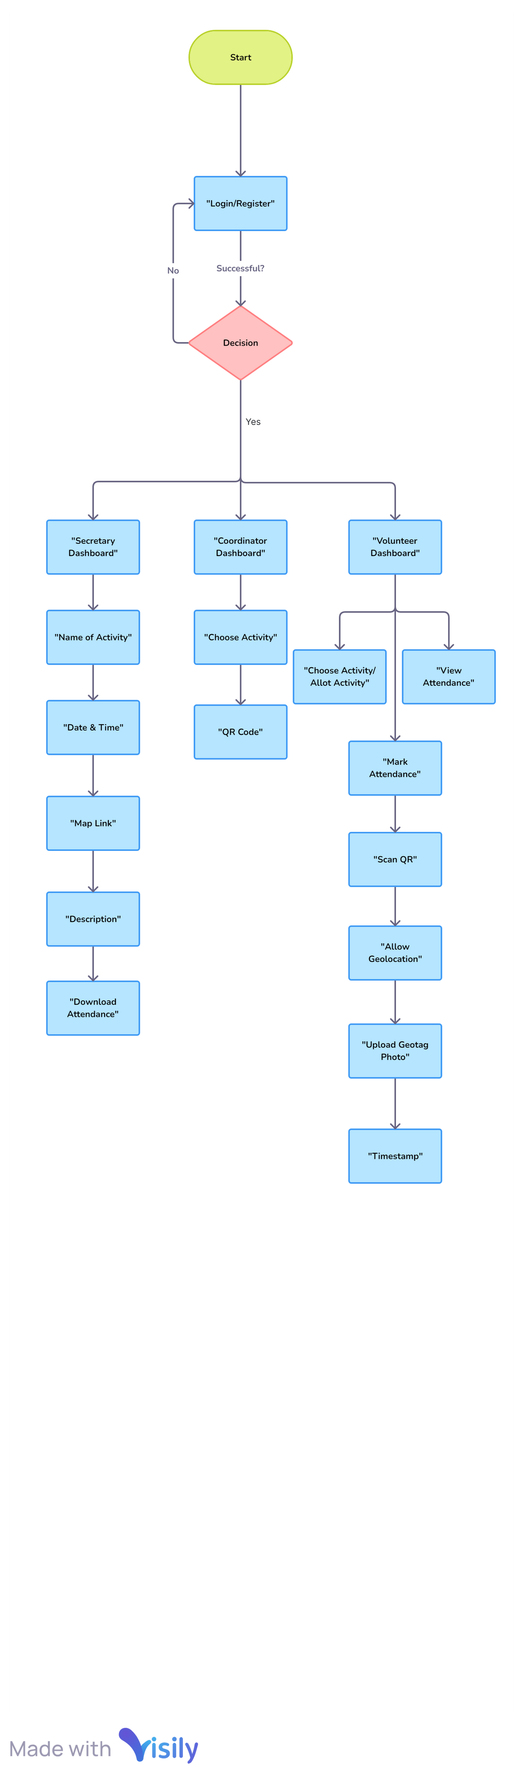
a. Transparency Precautions
Smart Attendance Monitoring System Flow Diagram (QR Based)
Copyright © 2024 SW&D, VIT PUNE.

Slide 17

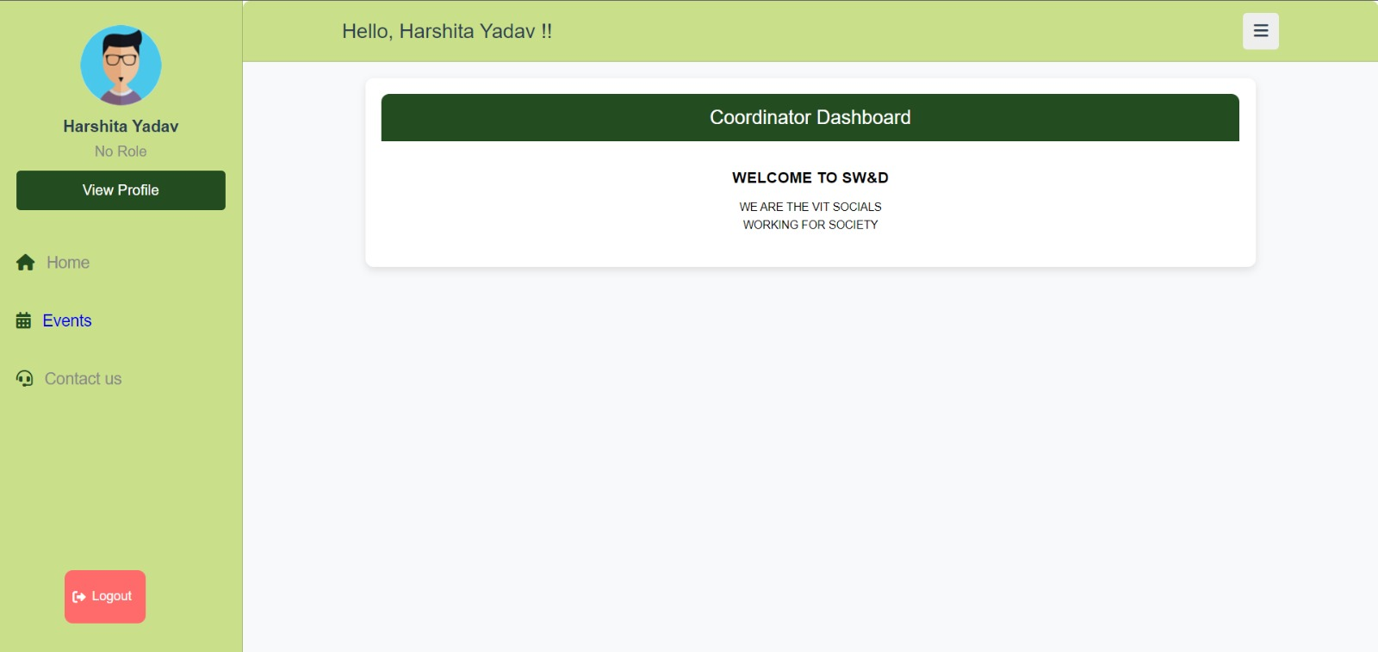
ATTENDACE SYSTEM
Copyright © 2024 SW&D, VIT PUNE.

Slide 18
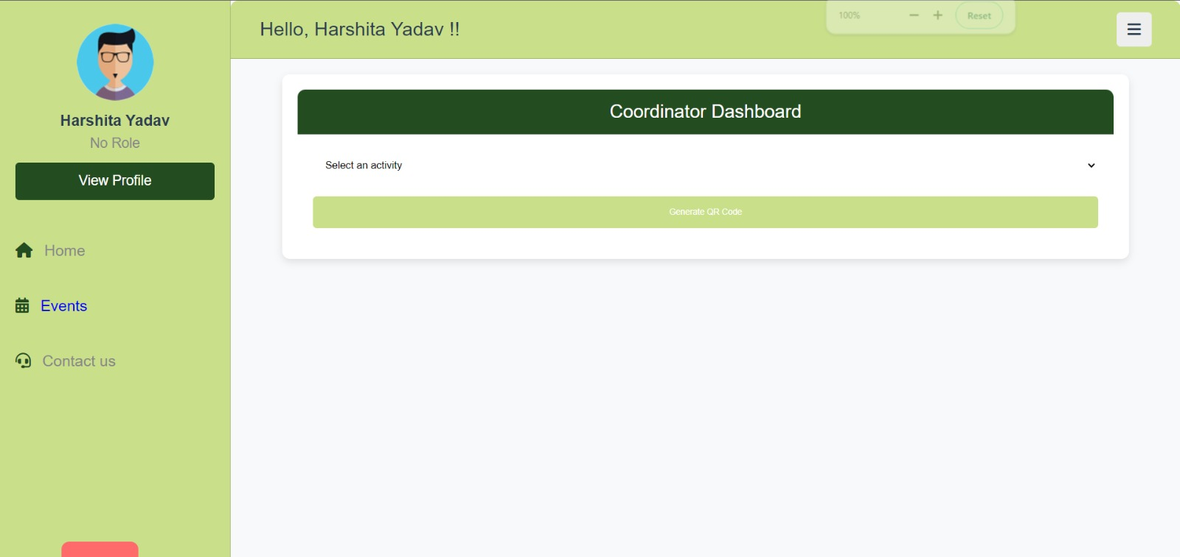
Copyright © 2024 SW&D, VIT PUNE.

Slide 19
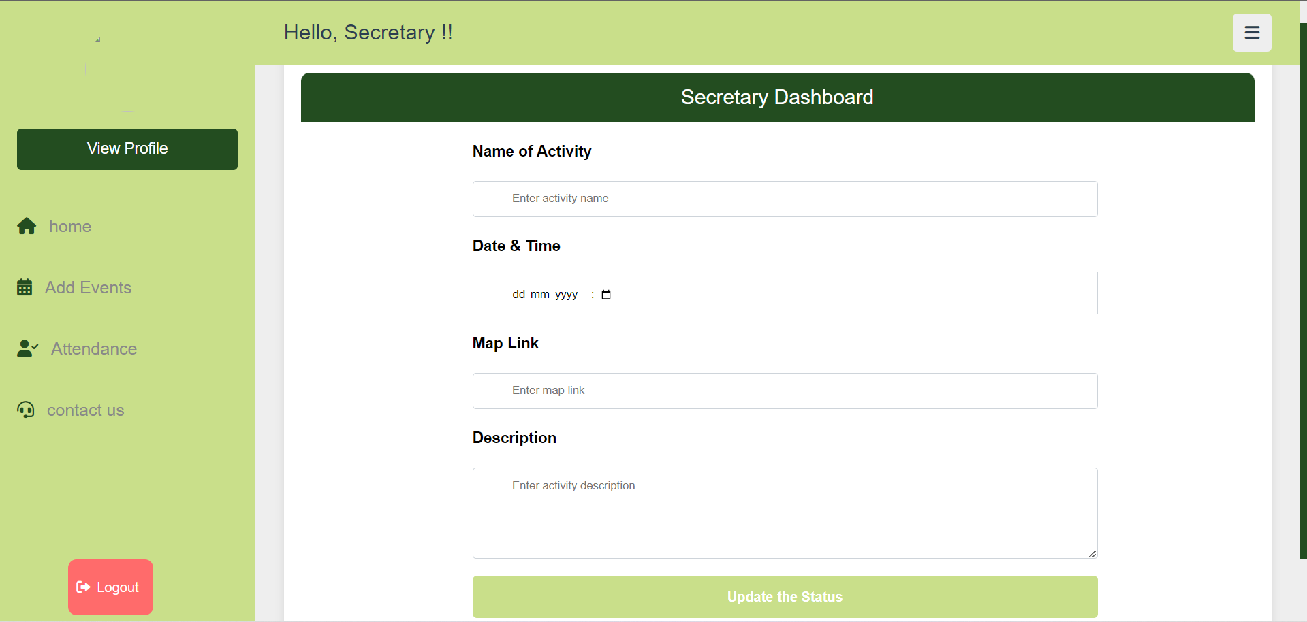
Copyright © 2024 SW&D, VIT PUNE.

Slide 20
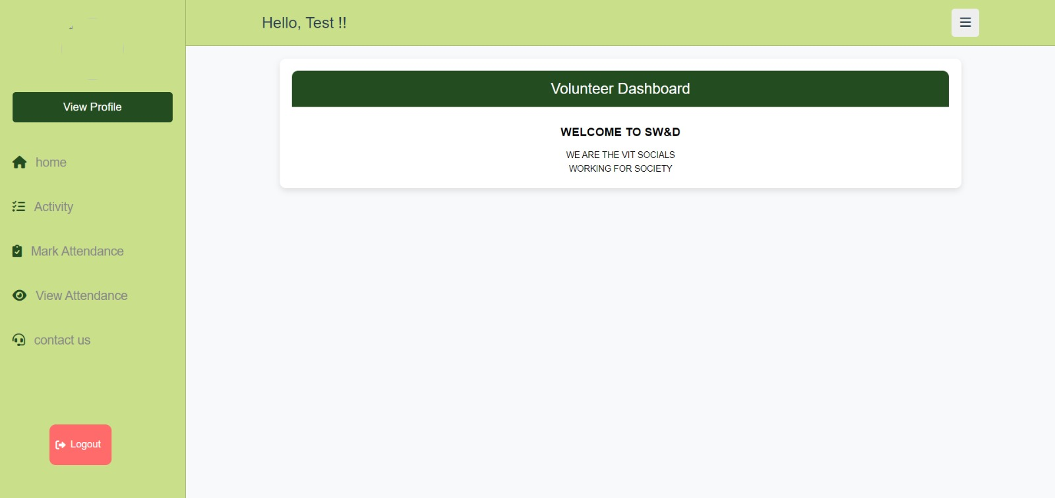
Copyright © 2024 SW&D, VIT PUNE.

Slide 21
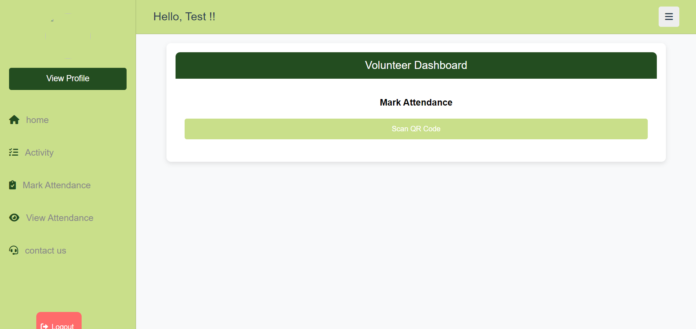
Copyright © 2024 SW&D, VIT PUNE.

Slide 22
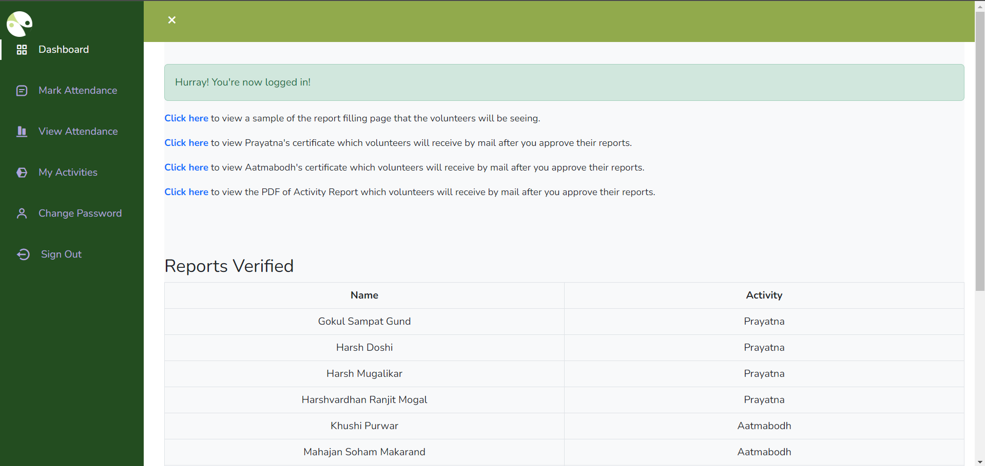
REPORT FILLING
Copyright © 2024 SW&D, VIT PUNE.

Slide 23
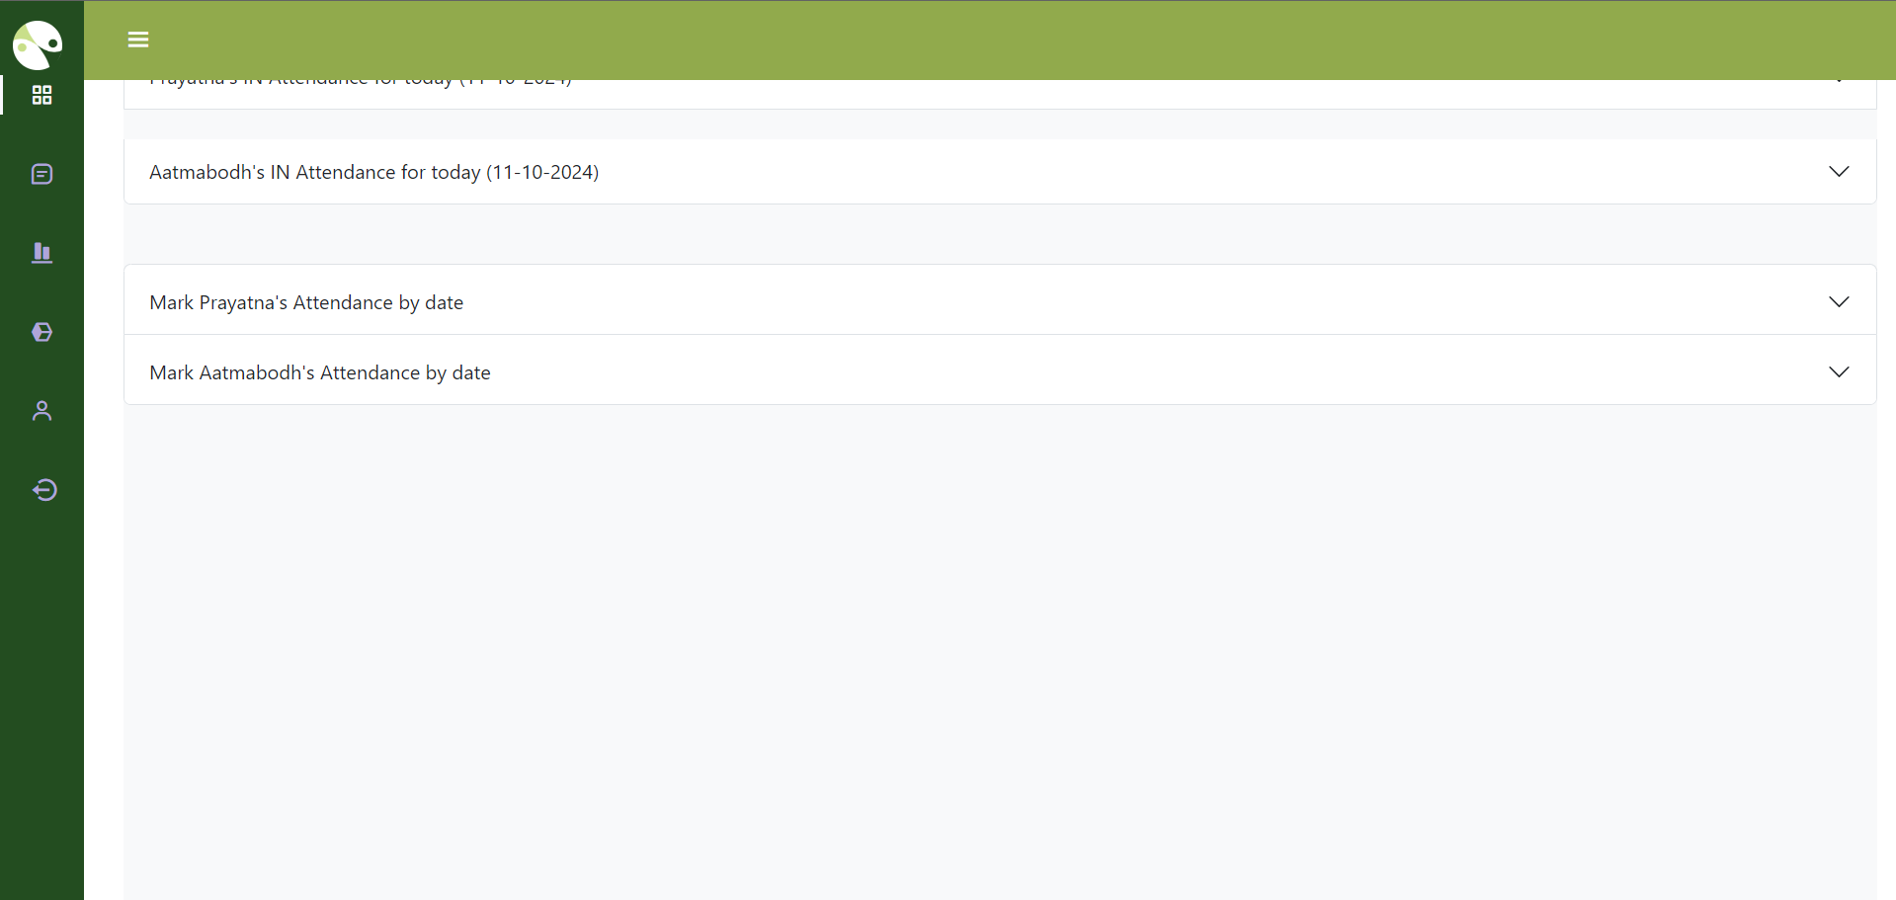
Copyright © 2024 SW&D, VIT PUNE.

Slide 24
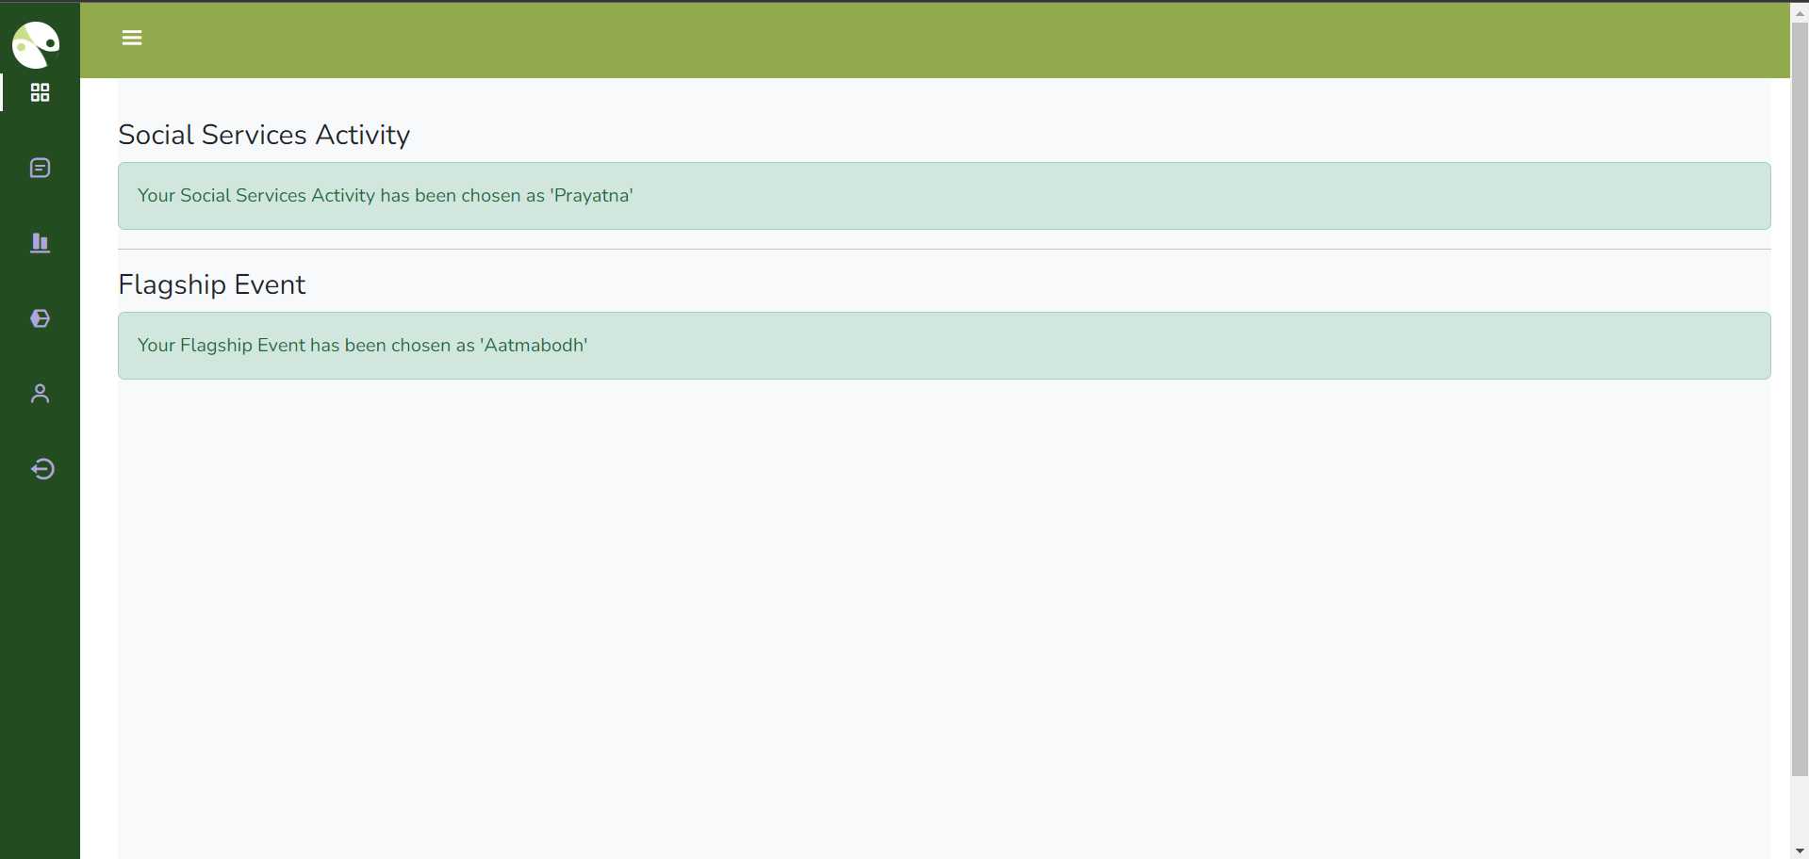
Copyright © 2024 SW&D, VIT PUNE.

Slide 25
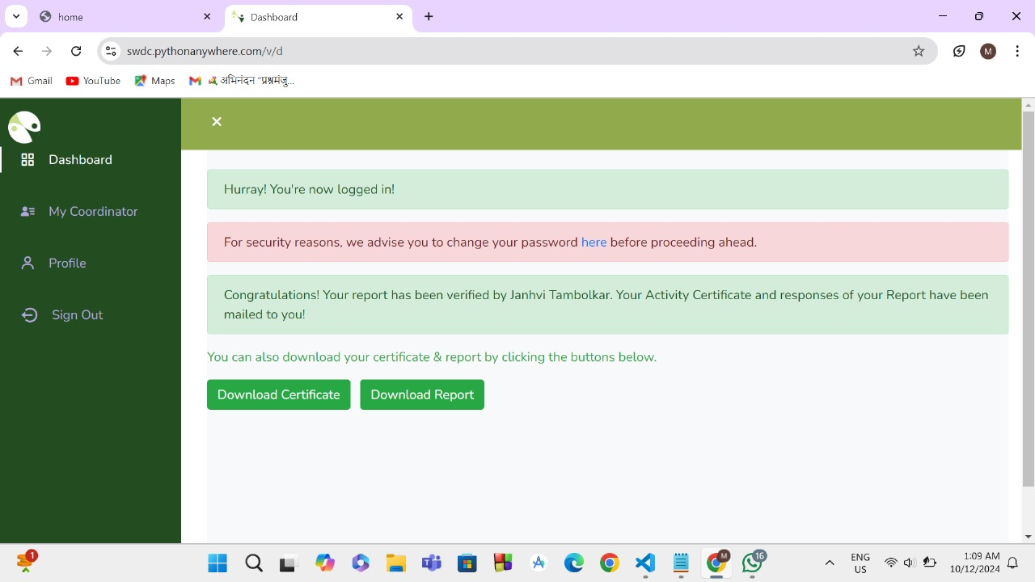
Copyright © 2024 SW&D, VIT PUNE.

Slide 26
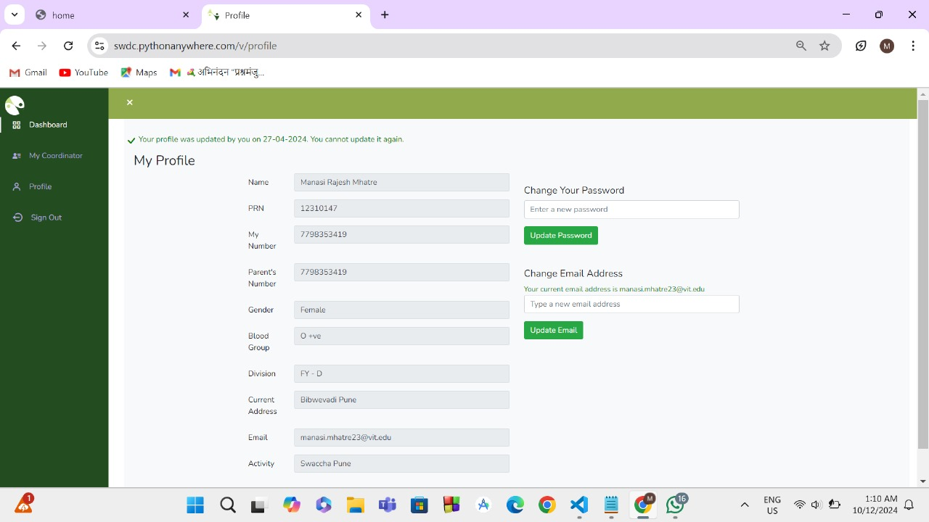
Copyright © 2024 SW&D, VIT PUNE.

Slide 27

b. Model Certificate

Slide 28
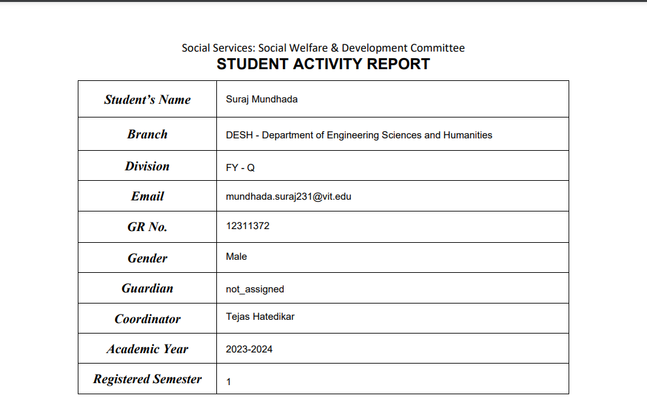
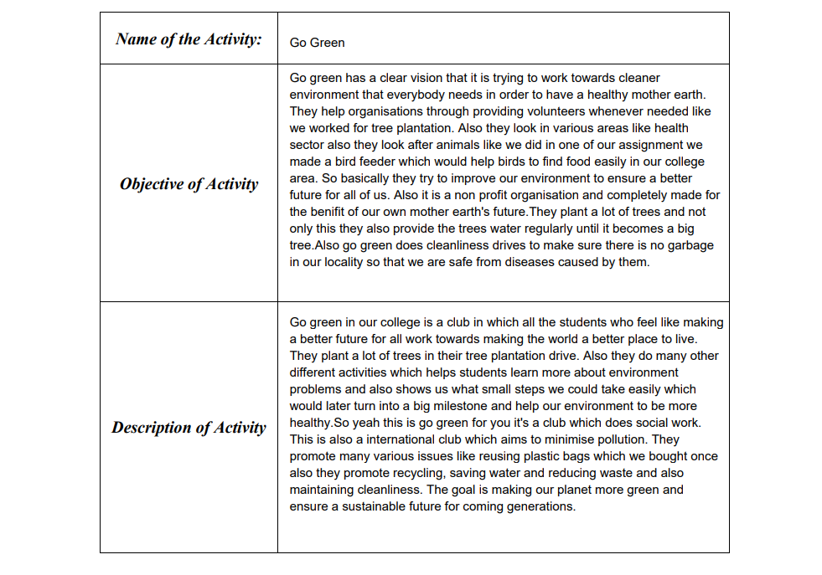
b. Model Report with format

Slide 29
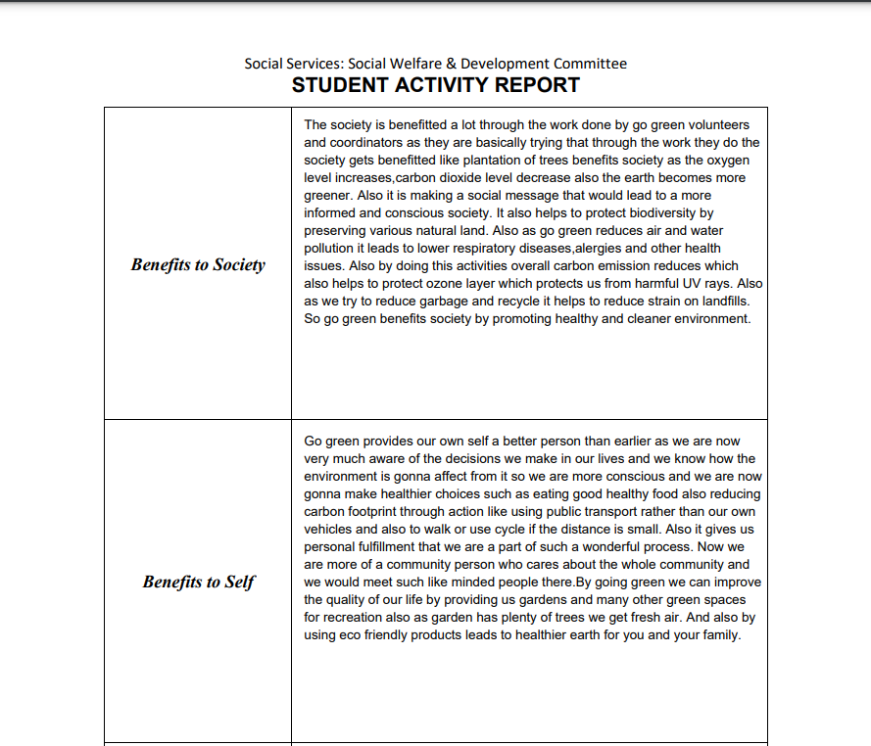
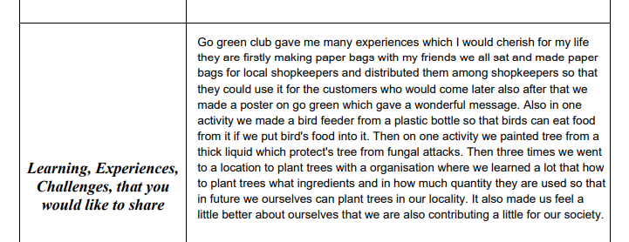
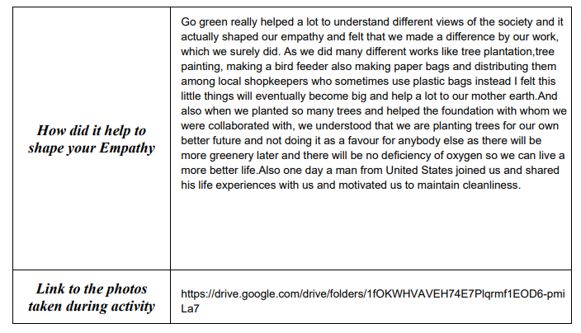

Slide 30
NGO COLLABORATION AND MOU’S*
I Volunteer*
Pune Plogers*
Bhumi Foundation*
Aanandvan Foundation
Poona Geriatric Care Center
Anaprem Vastigruh
Mukhbadhir Adhar School
Ayodhya Charitable Trust
Spacace India Foundation
Janseva Foundation*
St Mary Orphanage
Love Care Society
13. Inklab Jayate
14. AFMC
15.Sasson Hospital
16. NAAM Foundation*
17.Paani Foundation*
18.UniCef
19.Deepsthamb Foundation*
20.Swachaa
21.ISHA Foundation
22.Rudra Enviormental solutions
23.PCMC
24.And Many More

Slide 31
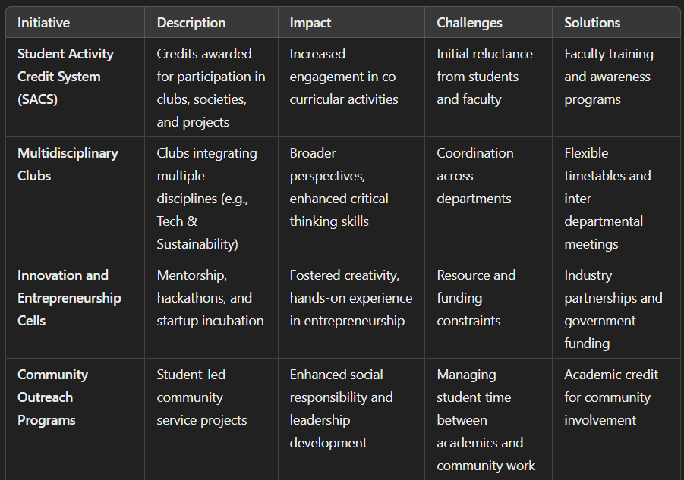
CASE STUDY

Slide 32
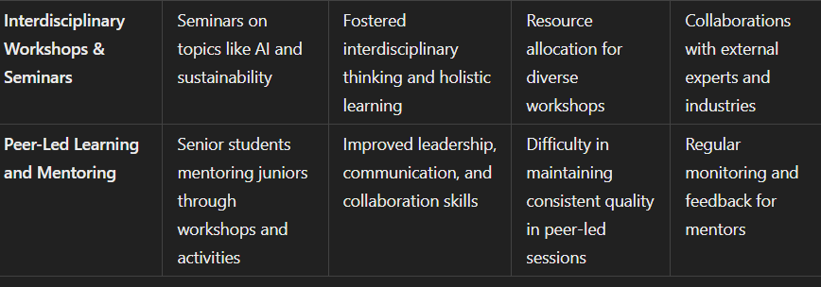
CASE STUDY

Slide 33
REFERENCES
National Education Policy 2020 (Revised 2024)
Ministry of Youth Affairs & Sports.(Active)
NSS,BCUD,AICTE & SPPU Circulars (Active)
NEP Implementation Phase 2 : Higher Education (by SW&DC)
YEWS UNICEFs Program's (Active)
Government of India Vision 2047 (Active)

Slide 34
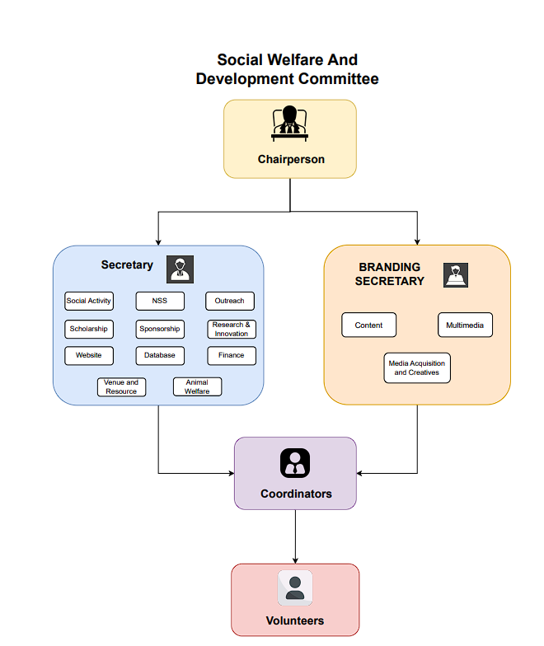
SW&D ORGANIZATIONAL CHART

Slide 35
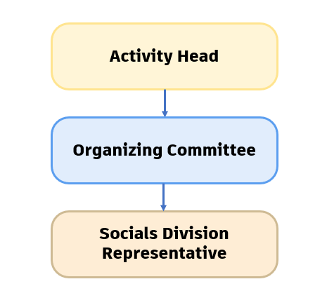
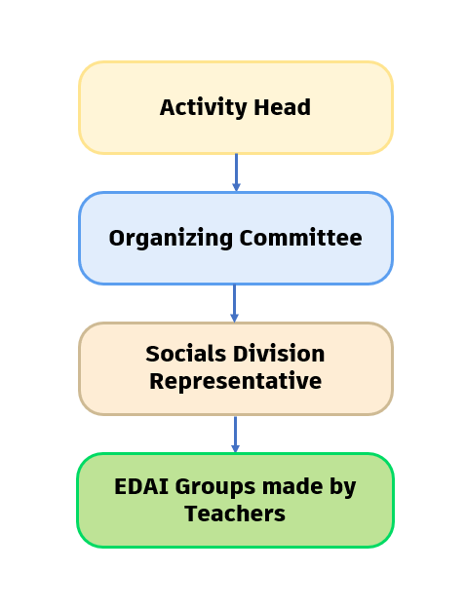
FY ORGANIZATIONAL CHART
These representatives will be the POC for their respective divisions and SW&D

Slide 36
THANK
YOU
Copyright © 2024 SW&D (NSS A65), VIT PUNE.

