Slide 1
Human-Centered Agentic Framework for Machine Learning Modeling in Finance
Notes:
Introduce motivation: AI agents are powerful, but finance demands trust and human accountability.

Slide 2
Challenges in Financial ML Modeling
Complex ML pipelines
AutoML lacks transparency
Hallucination & data leakage risks
Notes:
Explain why AutoML and autonomous agents can be dangerous in regulated finance.

Slide 3
Human-Centered Agentic Modeling
Multi-agent collaboration
Human as orchestrator
Judge agent as oversight
Notes:
Core idea: AI assists, humans decide. Judge agent acts as a third eye.

Slide 4
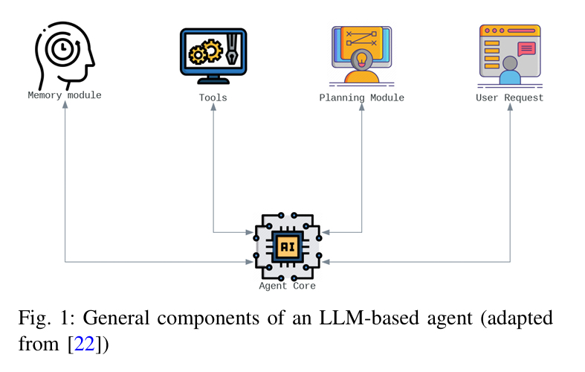
Agentic System Architecture
Agent core (LLM, persona)
Memory modules
Tools & planning
Notes:
Describe agent structure: memory, tools, planning like real ML teams.

Slide 5
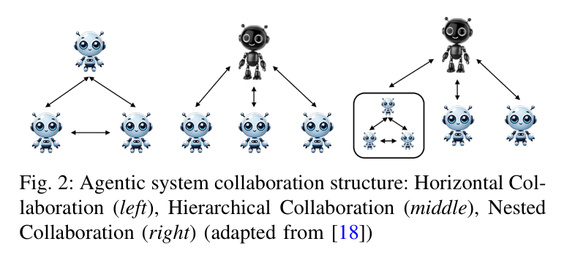
Agent Collaboration Strategies
Horizontal
Hierarchical
Nested
Notes:
Explain flexible collaboration styles depending on task complexity.

Slide 6
Modeling Crew Roles
• Data & EDA
• Feature engineering
• Training & evaluation
• Documentation
Notes:
Each agent has a clear role to reduce hallucination.

Slide 7
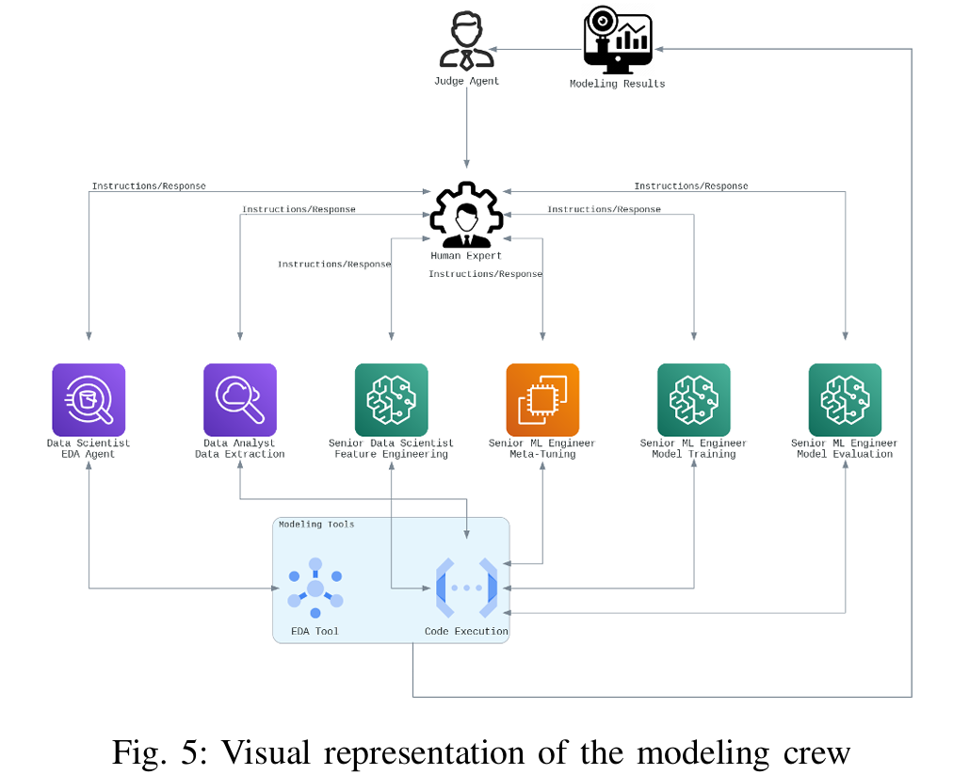
Modeling Crew Roles
Notes:
Each agent has a clear role to reduce hallucination.

Slide 8

Human-in-the-Loop (HITL)
• Human feedback
• Error correction
• Auditability
Notes:
Human oversight ensures reliability and compliance.

Slide 9
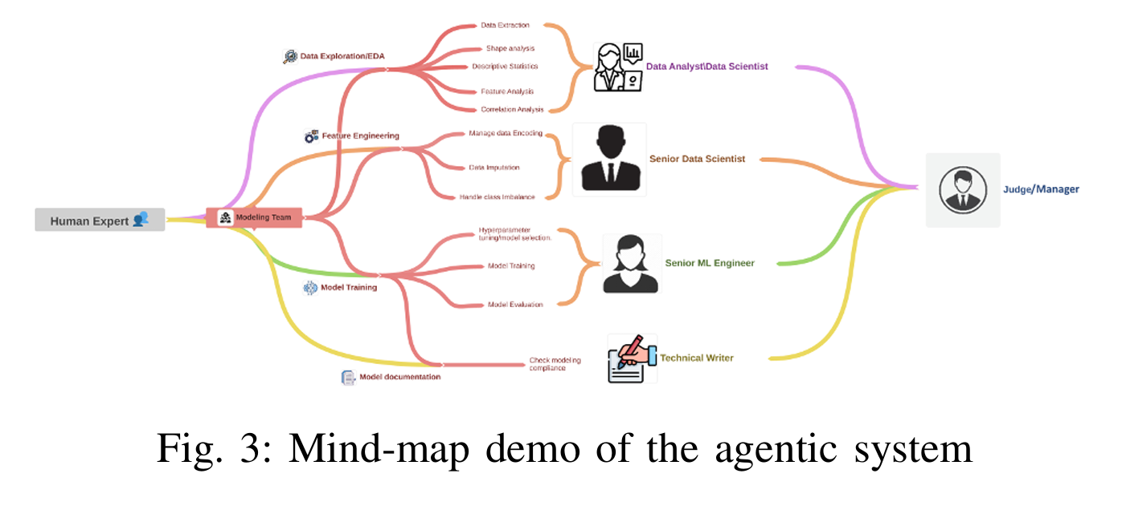
Human-in-the-Loop (HITL)
Notes:
Human oversight ensures reliability and compliance.

Slide 10
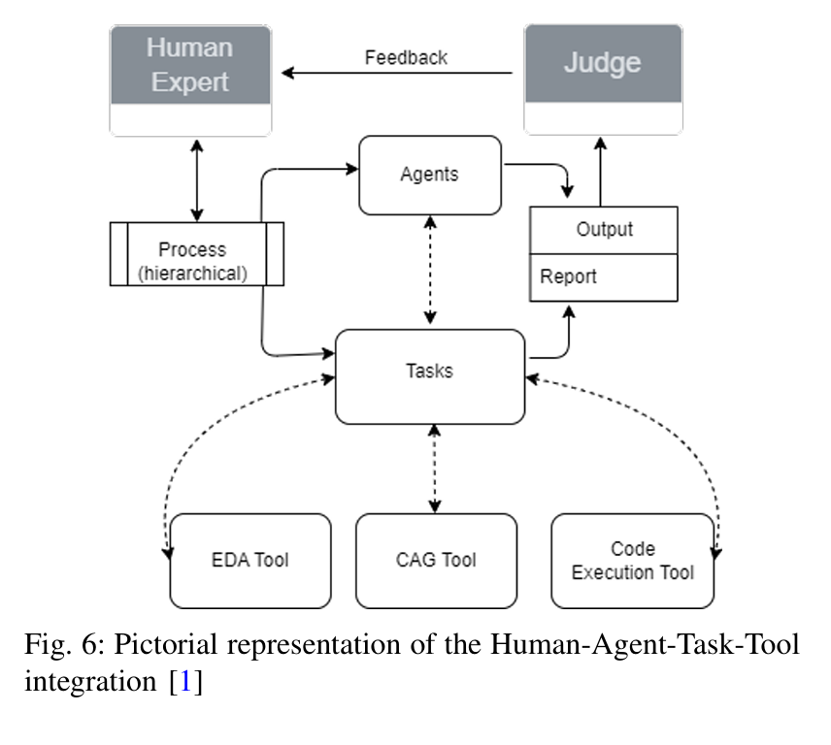
Human-in-the-Loop (HITL)
Notes:
Human oversight ensures reliability and compliance.

Slide 11
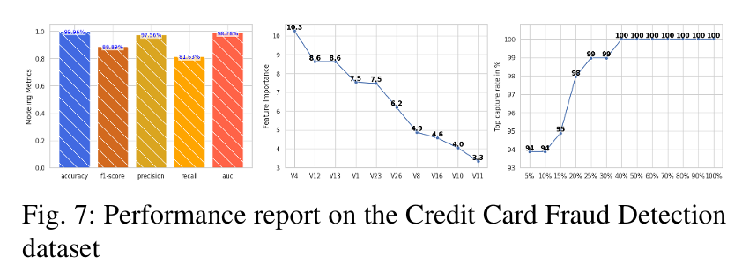
Experiment: Fraud Detection
Highly imbalanced data
Recall 81.6%
F1-score 88.9%
Notes:
Agentic model outperforms AutoML in recall and F1.

Slide 12
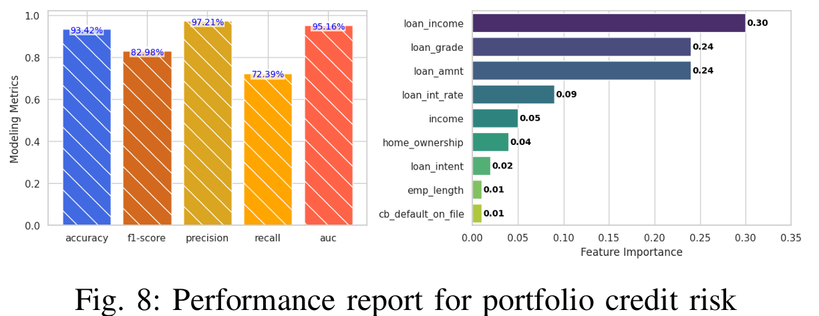
Experiment: Credit Risk
Comparable accuracy
No data leakage
Stronger rigor
Notes:
Agentic system avoids common methodological flaws.

Slide 13
Key Takeaways
Agentic AI needs guardrails
HITL reduces risk
Trustworthy AI wins
Notes:
Conclusion: Human-centered AI is essential in finance.

