Slide 1
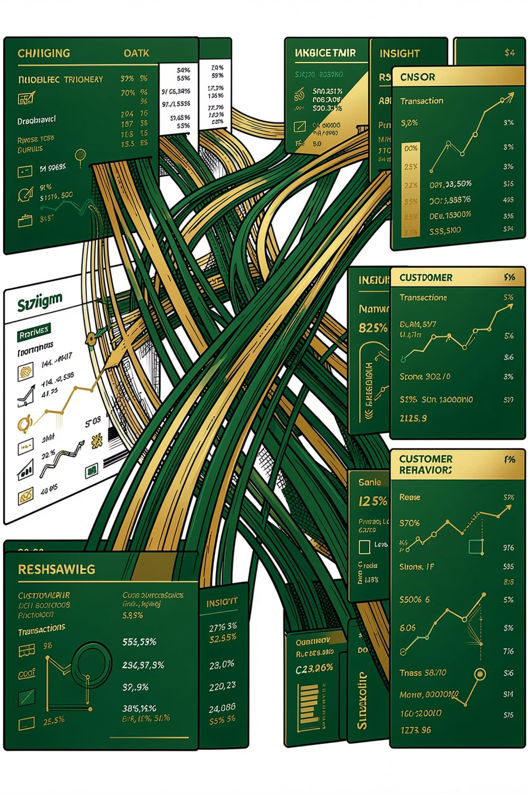
Customer Shopping Behavior Analysis
3,900 purchases across product categories — uncovering spending patterns, segments, and preferences.

Slide 2
DATASET
The Data Foundation
3,900
18
Total Purchases
Columns
$59.76
3.75
Avg Purchase
Avg Rating
Key Features
Demographics: Age, Gender, Location, Subscription
Purchase: Item, Category, Amount, Season, Size, Color
Behavior: Discount, Promo, Previous Purchases, Frequency
Missing Data: 37 values in Review Rating — imputed with category median.

Slide 3

METHODOLOGY
From Python to PostgreSQL
Data Cleaning
Feature Engineering
Load to PostgreSQL
SQL Analysis
Cleaned in pandas, engineered age groups and frequency, loaded to PostgreSQL for structured SQL analysis.

Slide 4
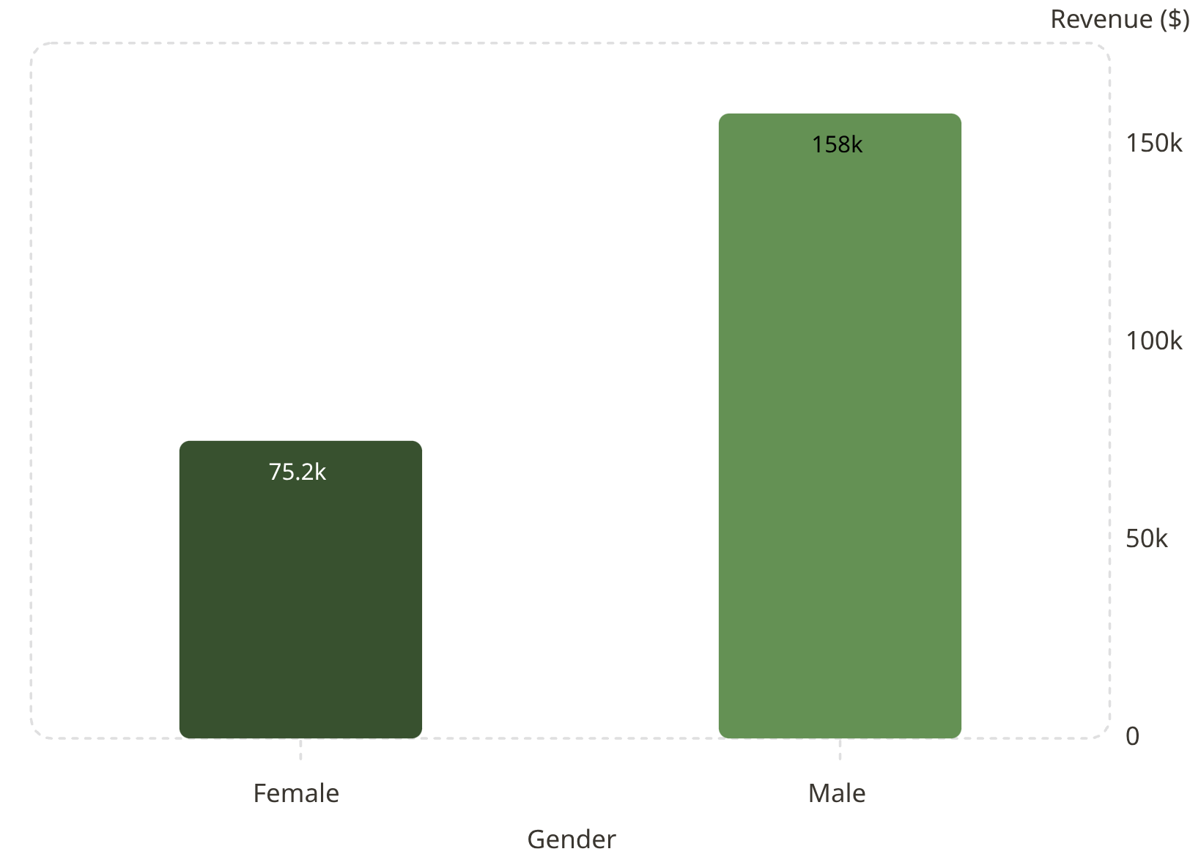
SQL INSIGHTS
Revenue & Spending Patterns
Key Findings
Male revenue 2.1× higher than female
839 high-spending discount users
Express shipping: $60.48 avg vs Standard $58.46

Slide 5
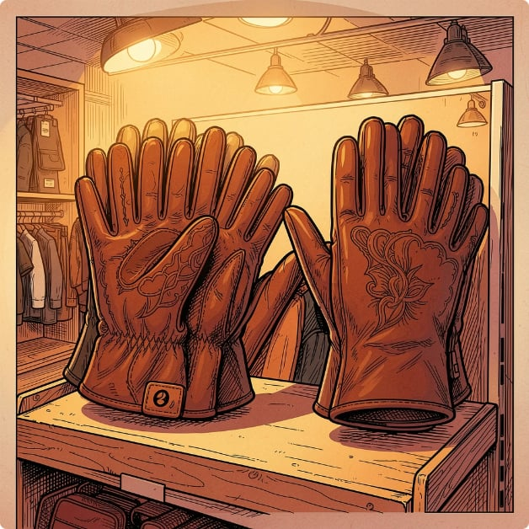
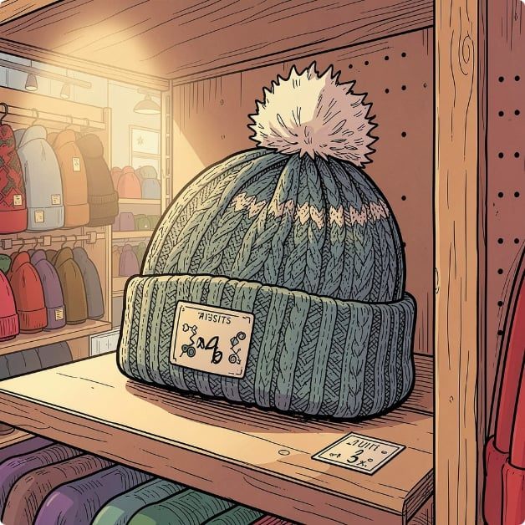
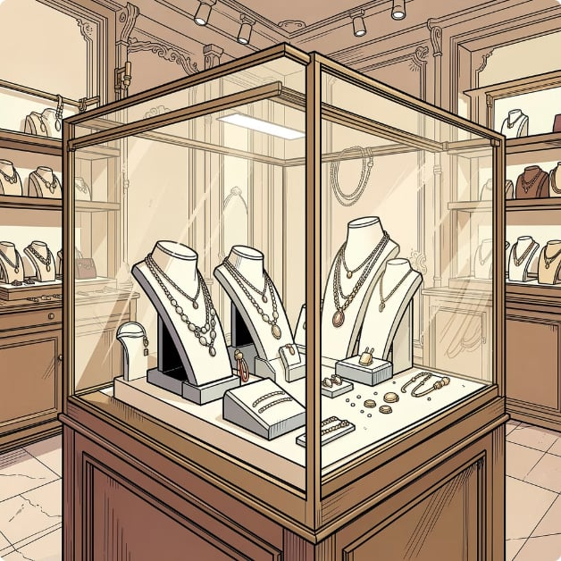
PRODUCTS
Top Products & Discount Dependence
Top Rated: Gloves (3.86)
Most Discounted: Hat (50%)
Top Seller: Jewelry (171)
Sandals, Boots, Hat, Skirt follow
Sneakers, Coat, Sweater, Pants
Blouse & Pants tie in Clothing

Slide 6
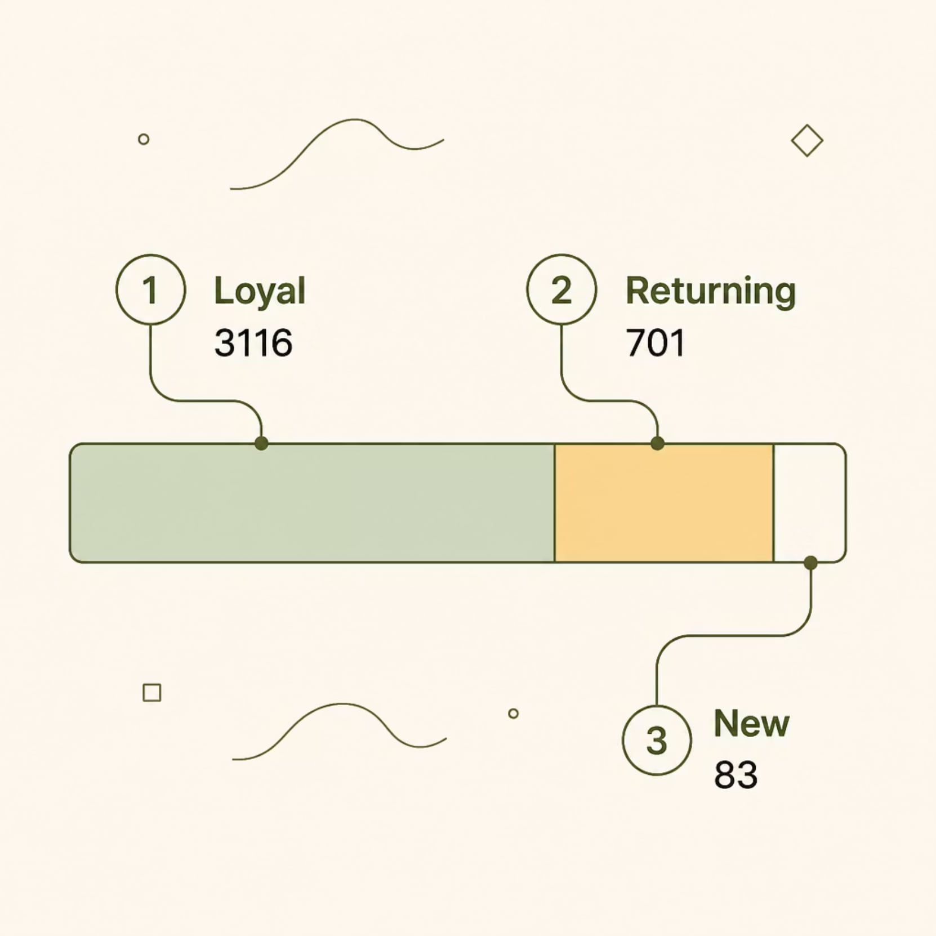
SEGMENTS
Customer Segmentation
Subscription Reality
27% subscribe · 73% do not
2,518 repeat buyers don't subscribe vs 958 who do
Avg spend nearly identical across both groups

Slide 7
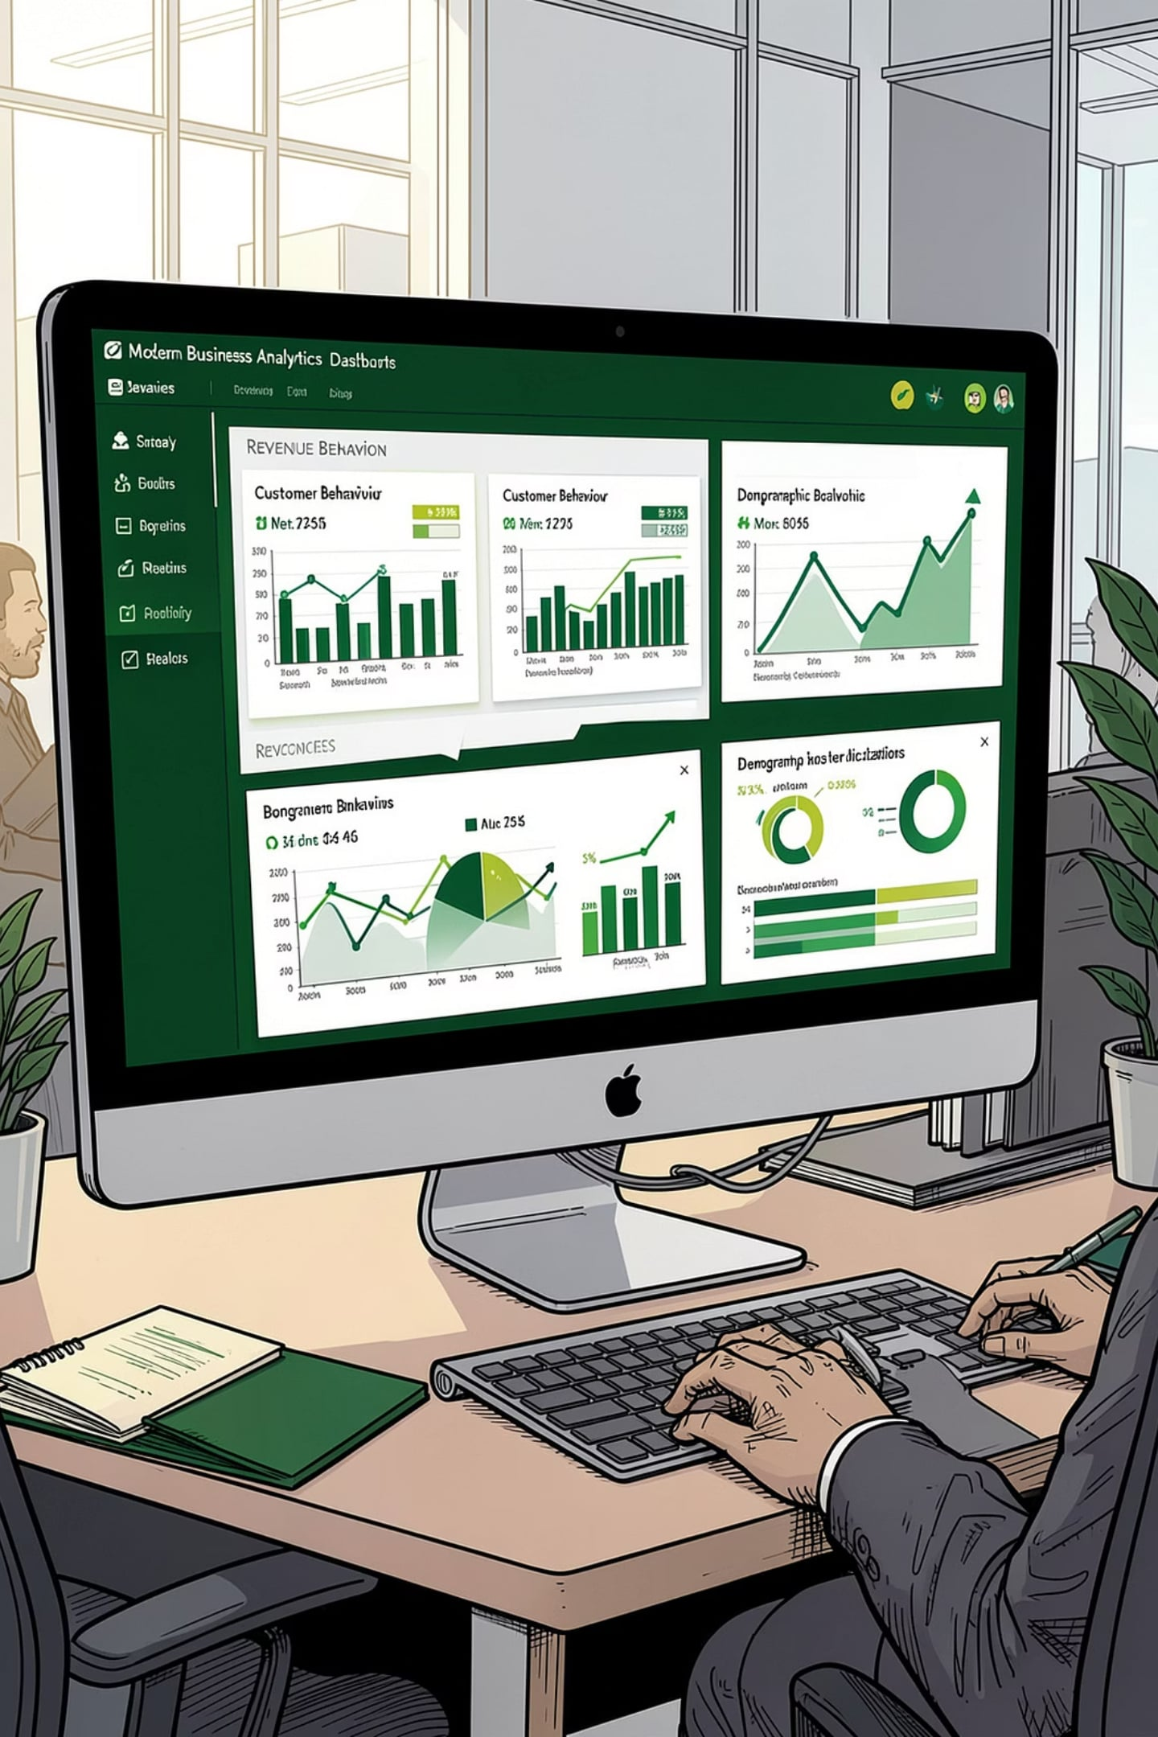
POWER BI
Interactive Dashboard
Filters by subscription, gender, category, and shipping — visualizing 3.9K customers in real time.

Slide 8
STRATEGY
Business Recommendations
Boost Subscriptions
Loyalty Programs
Promote exclusive subscriber benefits
Reward repeat buyers → Loyal segment
Review Discounts
Targeted Marketing
Balance sales boosts with margin control
Focus on high-revenue age groups & express users

