Slide 1
Marketing proposition- FoodAsia “Your food Your choice”
Presented By-
Group 3
Akshay Lodha Anant Shri Panthri Arun Menon Nitin Dhamale Sagar Bhatia Tejashree Pandit
Guided By-
Prof. Norris Bruce

Slide 2
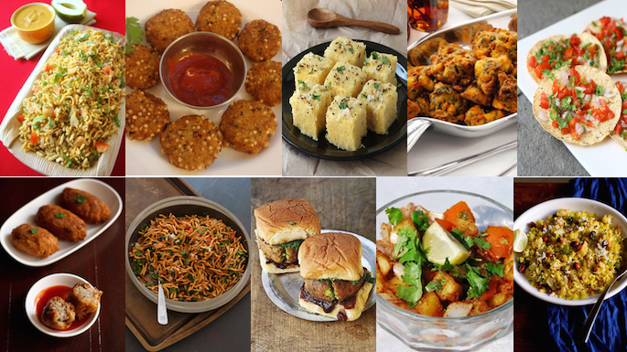
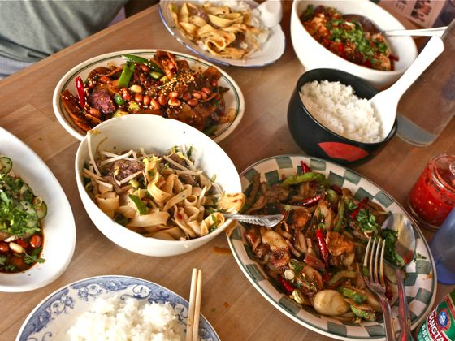
Executive summary
PROBLEM BRIEF
Market of Food truck on Campus
-Dearth of options for Asian Cuisine
-Product placement & price
DESCRIPTION
-Introduction
-Problem Definition
-Situation Analysis
-Market Segmentation
-Targeting & Positioning
-Market Potential
-Marketing Plan
ISSUES
- Licenses Issue
- University Regulation
- Government Regulation
- Competition Landscape
- Dallas Weather
CONCLUSION
&
RECOMMENDATIONS
Image Source: http://www.india.com/food-2/10-quick-must-try-indian-snack-recipes-394168/
https://www.beitchaverim.com/first-candle-chinese-food-and-movie.html

Slide 3
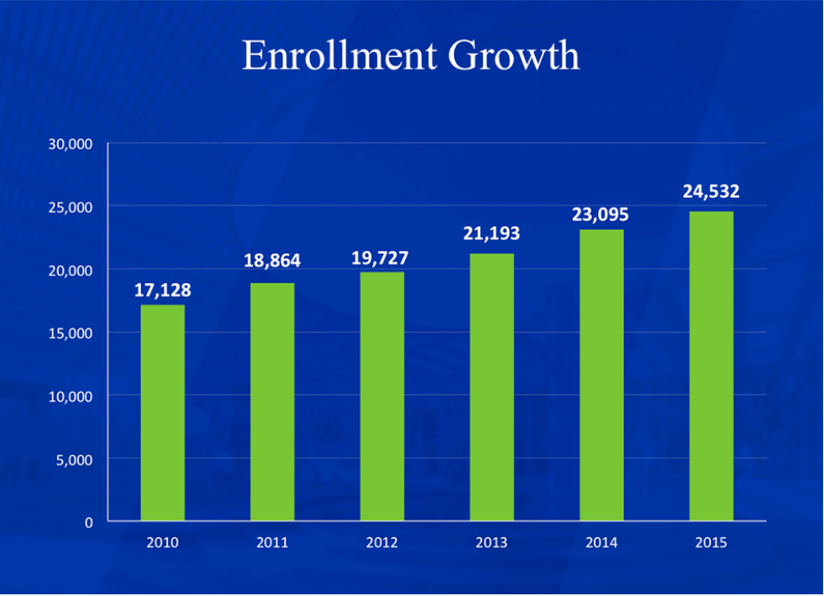
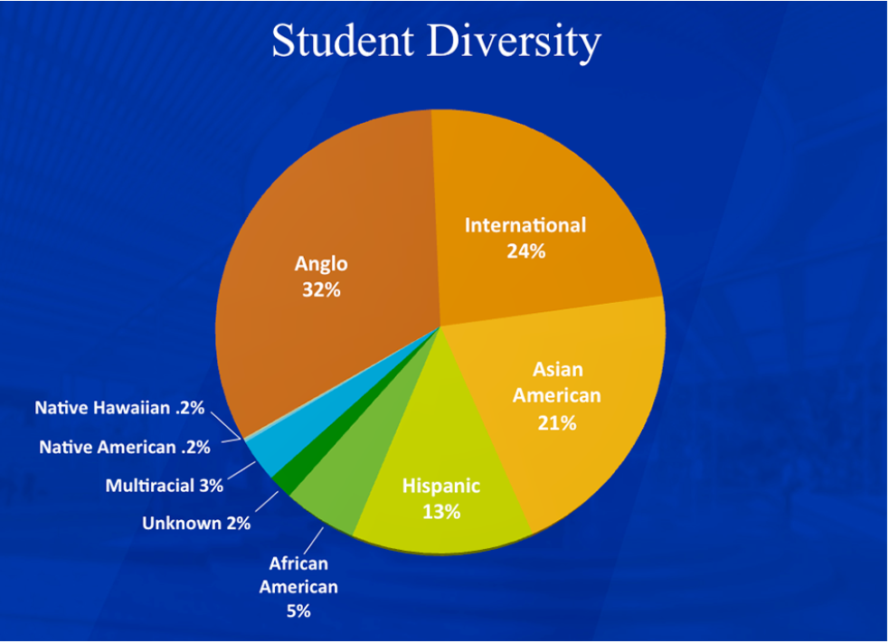
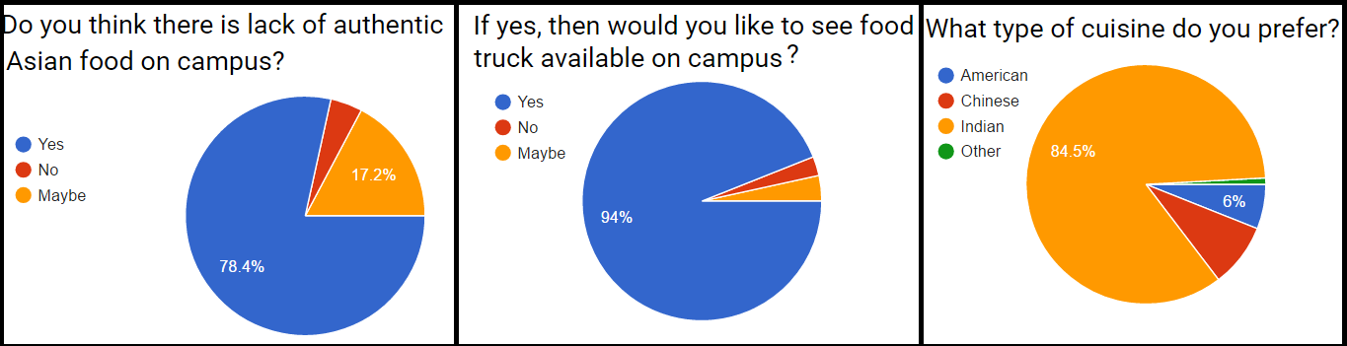
SITUATION analysis
Student Demographics
UTD
Survey Results
Survey Link

Slide 4

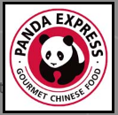

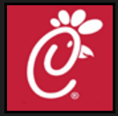
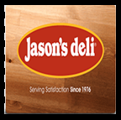
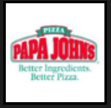
Situation analysis CONTD..
Options available on UTD campus
IHOP
Panda Express
The Pub
Chick-fil-A
Jason’s Deli
Papa John’s

Slide 5

Problem description
Most international students coming to UTD miss their ethnic food.
As per our observations, there is a lack of availability of Asian cuisine/ fast food on university campus
Through surveys and constant one on one interviews our team came up with the idea of launching a food truck ‘FoodAsia’ that can solve this problem.

Slide 6



STRENGTH S (+)
One of its kind- First mover advantage
Can operate at different time of the day
Food truck can serve different locations on campus
Can provide authentic Asian food on campus at affordable prices
WEAKNESSES (–)
Initial Cost and breakeven point is after longer duration
Difficult to acquire initial customer to create a buzz- High Acquisition cost
Lack of seating arrangement can be a turn-off for few customers
OPPORTUNITIES (+)
No competition in near future
Demand of Asian food is high on campus
Margins in food industry are high- Can be leveraged for promotional cost
THREATS (–)
Government Regulations
Unpredictable weather of the city
Licensing Policy for food truck on campus

Slide 7
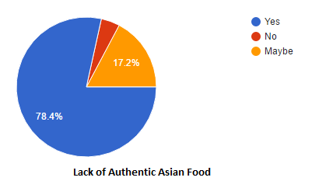
Market segmentation
Division of broad market into smaller, relatively homogeneous groups by similar needs
Market Segmented- 3 Divisions:
Asian Students
American Citizen of Asian Origin
Others

Slide 8
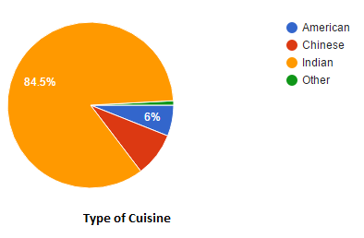
Market Targeting
Process of evaluating each market segment’s and deciding how many and which one to target
Single Segment & Product Concentration
Student
Asian Food
Target Segment
Geographic - International Students
Demographic – Budgeted Income

Slide 9
Market positioning
“For students and staff members at UTD who prefer eating Asian food, FoodAsia, is a food-truck that unlike Panda Express, provides mobile food services by reaching out to customers at an affordable price.”
Competition Landscape
4 P’s for FoodAsia is in place

Slide 10
Potential Market (dollars, profits & sales)
EQUIPMENT | COST $
Truck | 30,000
Truck servicing | 300
Power Backup | 800
Fire Extinguisher | 300
Food Utensils | 2000
Plates/Napkins | 300
Uniform | 500
Licensing | 600
Miscellaneous | 3000
Total | 38,000

Slide 11
Potential Market (dollars, profits & sales)
MONTHLY MAINTENANCE | COST $
Fuel | 500
Cutlery | 300
Commissary | 500
Repairs/Servicing | 500
Labour cost | 1000
Raw Material | 500

Slide 12
Potential Market (dollars, profits & sales)
REVENUE MODEL
Student of Asian Origin | 4950
Target Size of Customer | 40%
Customer served Per day | 2000
Average Order Price | 5
Average Profit /Order | 1.5
Monthly Revenue | 10000

Slide 13
BREAKEVEN ANALYSIS

Slide 14

LOGO & TAGLINE

Slide 15
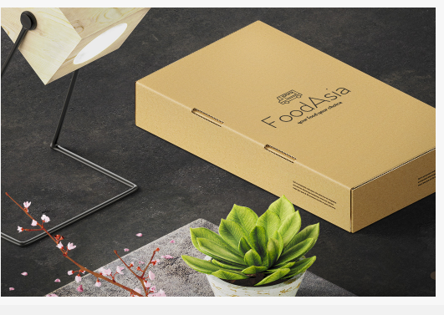
Marketing Plan
Product
Food items that we will be offering to customers
Indian cuisine & Chinese cuisine
Packaging and Labelling
Reference: http://images.mentalfloss.com/sites/default/files/styles/insert_main_wide_image/public/aziz-ansari-1-600x800.gif

Slide 16
Marketing Plan
Promotion
Collaborate with Unibees
Distributing Flyers, radio announcement
Social Medias like Facebook, Instagram and twitter
FoodAsia Website
Place
Food truck is mobile based on the hotspot
Near to students service building
Near to Plinth

Slide 17
Marketing Plan
Price:
Item price distribution:
Menu List | Cost Price $ | Sell price $ | Profit $
Vada Pav | 1.5 | 2.5 | 1
Dabeli | 1.5 | 2.5 | 1
Idli Sambhar | 3 | 4.5 | 1.5
Misal Pav | 2.5 | 3.5 | 1
Rice and Dal Curry | 5 | 6 | 1
Paneer 65 | 4 | 5.5 | 1.5
Noodle-Chicken | 3.5 | 5 | 1.5
Noodle-Veggie | 4 | 5 | 1
Dumplings | 4 | 5 | 1
Spring Roll | 4 | 5 | 1
Bakery Tea | 1 | 1.5 | 0.5

Slide 18
Conclusion & recomendation
Marketing plan to target student missing home cuisine
Budgeted Menu- student pocket friendly
Effective positioning of product
Future Promotional
Addition of extra food trucks
Weekend off campus delivery
Integration with comet card
Discounts on special days with special menu
Offers and deals

Slide 19


