Slide 1
AI TECHNICAL MOCK RECRUITER RECRUITING SUITE
AI Mock Interview Platform
A local RAG-powered, speech-enabled simulation platform for engineering candidates
🚀 Launch Live App on Hugging Face | 💻 Access Source Code on GitHub

Slide 2
HACKATHON DELIVERABLE
The Problem & The Solution
THE RECRUITING GAPS
• Static Standard Prep: Standard question pools fail to evaluate actual resume claims, engineering stacks, or candidates' projects.
• No Conversational Pressure: Typing code or text responses lacks the behavioral friction of a live spoken interview panel.
• Lack of Detailed Feedback: Feedback is generic and doesn't map exact model responses to optimal answers or study guides.
• Data Privacy & Costs: Uploading sensitive resumes to external API services poses corporate compliance risks and mounts monthly bills.
THE RAG RECRUITER SOLUTION
• Contextual RAG Core: Ingests PDF/DOCX resumes, creating local ChromaDB vectors to prompt context-specific recruiting questions.
• Speech rec/generation loop: Custom micro-audio canvas record module (Whisper STT) and Edge TTS voice output mimic live pacing.
• Actionable Assessment: Renders interactive charts showing candidate score breakdowns in technical accuracy, style, and relevance.
• Headless PDF Report: Compiles feedback summaries, strengths, weaknesses, and study syllabus into a printable PDF.

Slide 3
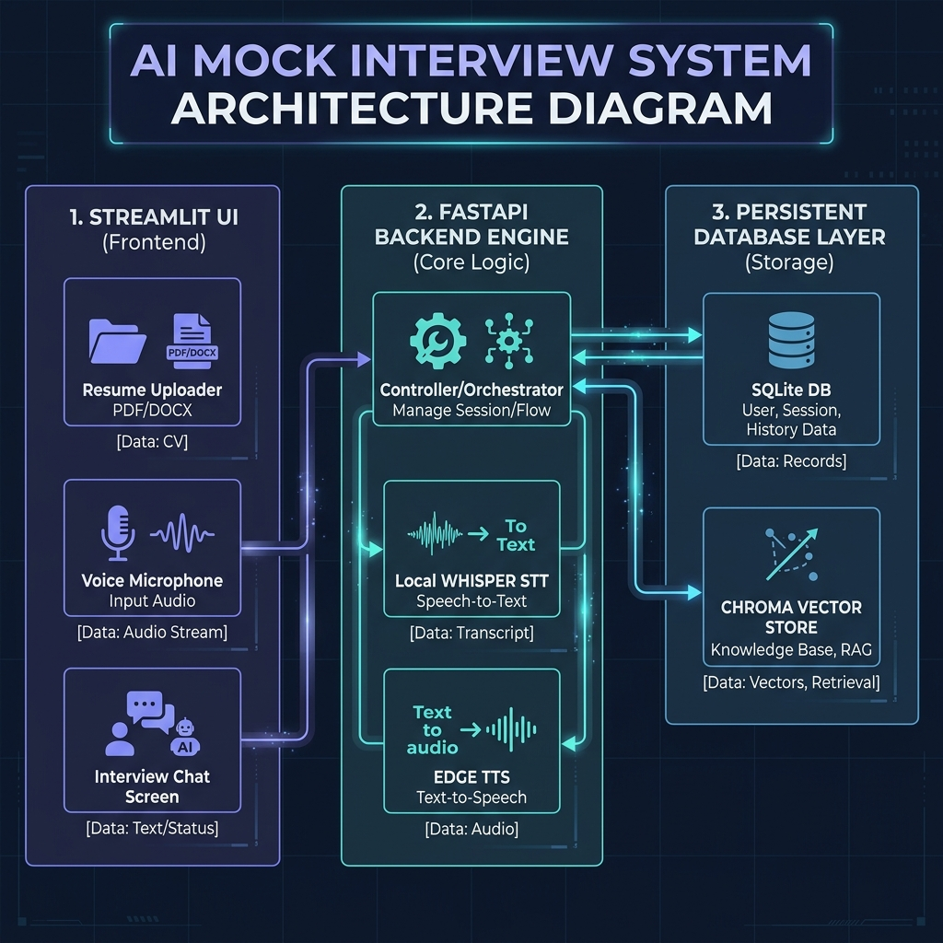
HACKATHON DELIVERABLE
System Architecture & Data Flow
DATA PIPELINE FLOW
• Resume Parsing: Text chunks are extracted from PDF/DOCX/TXT files, embedded (all-MiniLM-L6-v2), and stored locally in ChromaDB.
• FastAPI State Gateway: Manages session variables, retrieves resume profiles, runs evaluations, and mounts static paths.
• Microphone STT: Custom browser microphone recorder sends chunks to local Whisper Tiny model for latency-free offline transcripts.
• Nginx Proxy routing: Port 7860 handles HTTP requests (/api), streams audio (/static/audio), and opens Streamlit WebSockets.
🔗 Click Here to Launch HF Space | 🔗 View GitHub

Slide 4
HACKATHON DELIVERABLE
Tech Stack & Rationale Comparison
COMPONENT LAYER | CHOSEN TECHNOLOGY | RATIONALE vs ALTERNATIVES
Frontend Interface | Streamlit (Slate Dark Theme) | Fast UI building in pure Python. Houses bi-directional custom components for audio recordings and web analytics; beats React development overhead for mockups.
Backend API Gateway | FastAPI (Uvicorn) | Full async/await integration handles multiple parallel text-to-speech requests and Whisper audio uploads seamlessly; out-performs synchronous Flask.
RAG Vector Database | ChromaDB (Local Persistent) | 100% serverless and offline. Avoids network latency, paid Pinecone storage costs, and keeps resume embeddings completely private.
Recruiting Audio Pipeline | Edge TTS & Local Whisper Tiny | Edge TTS synthesis provides natural neural voices for free; local Whisper transcription model runs locally in container with zero API rate limits.

Slide 5
HACKATHON DELIVERABLE
Platform Features & Resiliency
ROBUST PARSING CORE
• Multi-Format Reader: Handles PDF, DOCX, and TXT resume files natively.
• Built-in DOCX Parser: Uses Python zipfile/XML structures to parse Word documents without external API dependancies.
• SQLite Persistence: Saves profiles, sessions, and conversation history on-disk.
UI ENHANCEMENTS
• Canvas Waveform Visualizer: Dynamic waveform charts drawn in browser via custom Streamlit Javascript components.
• Matplotlib Breakdown Charts: Headless canvas drawing translates scoring arrays into bar visuals.
• Detailed Error Outputs: Feeds raw API failure strings directly to UI for diagnostic clarity.
FAILOVER RESILIENCY
• Gemini-to-Groq Failovers: Switches automatically to Groq LLaMA-3.3-70B if Gemini triggers rate-limit (429) errors.
• JSON Boundary Cleaners: Regex boundary isolators parse structured outputs reliably.
• Secure Docker Settings: Runs under non-root UID 1000 with Nginx folders mapped to /tmp.

Slide 6
HACKATHON DELIVERABLE
Hackathon Deliverables & Live Links
LIVE DEPLOYMENT
👉 CLICK HERE TO OPEN HUGGING FACE SPACE
Runs on CPU Basic tier with secure Nginx routing and Supervisord management.
LOCAL RUN INSTRUCTIONS (TERMINAL)
# Clone the Repository
git clone https://github.com/tejashri-del098/AI-Mock-Interview-Platform.git
cd AI-Mock-Interview-Platform
# Install dependencies
pip install -r requirements.txt
# Run FastAPI Backend Server (Terminal 1)
uvicorn app.api.main:app --reload --port 8000
# Run Streamlit Frontend dashboard (Terminal 2)
streamlit run app/ui/app.py
GITHUB REPOSITORY
👉 CLICK HERE TO VIEW CODE ON GITHUB
Fully open source repository containing pipeline tests and actions workflow.

