Slide 1


SEED X
A farmer’s harvest should not lose value before it reaches the buyer.
Better Farming Starts with Better Connections.
CodeStorm Hackathon · Agriculture, FoodTech & Rural Development
Created & Developed by Tejash Shastri and Shaurya
Live demo

Slide 2
THE PROBLEM
The value gap is real
Estimated share of the consumer rupee that reaches the farmer
Farmer
33%
36%
37%
Traders & intermediaries
Tomato
Onion
Potato
Transport & storage
Roughly two-thirds of what a consumer pays for these vegetables is estimated to go beyond the farm gate.
Retailer
Consumer
Price rises at every hand-off
Source: RBI Working Paper 08/2024 (3 Oct 2024), "Vegetables Inflation in India: A Study of Tomato, Onion and Potato"; figures also cited in a Rajya Sabha answer (29 Nov 2024). Estimates from specific value-chain studies, not a universal figure for every crop, state or transaction.

Slide 3
ROOT CAUSE
The problem is not just selling. It is coordination
01
02
Today
Too few buyers in view
Small lots are hard to find
Farm A
✕
Farmers may not see enough competing buyer demand.
Buyers struggle to find suitable local supply and small lots.
Farm B
✕
Farm C
✕
03
04
Fragmented pickups
Perishables lose value fast
3 trips · 3 small sales · no shared view of demand
Separate trips for small orders can raise per-unit logistics cost.
Handling, transport and storage risks hit produce every day it waits.
Context: Govt. of India / NABCONS post-harvest loss study (PIB, MoFPI, 1 Aug 2025) assessed losses across 54 crops at stages including collection, grading, packaging, transport and storage. SEED X is software; it does not build cold-chain infrastructure.

Slide 4
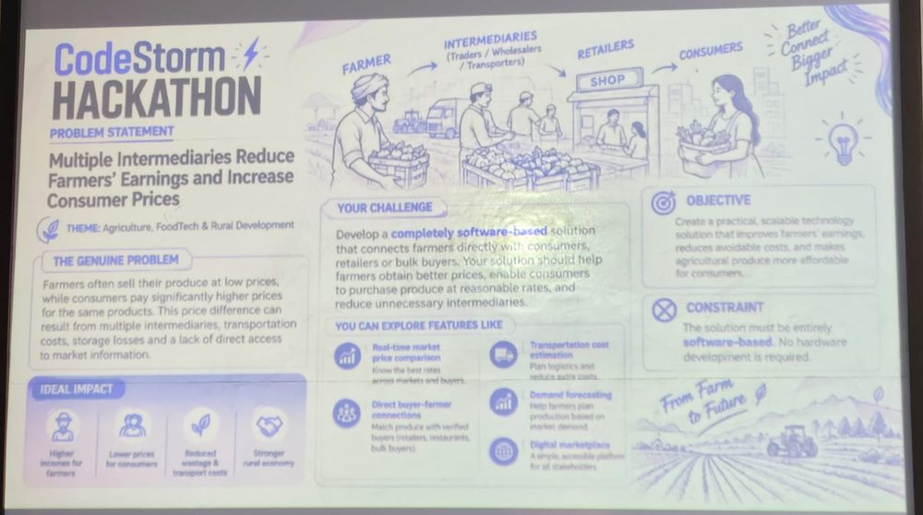
THE SOLUTION
One software workflow from harvest to buyer
1
2
3
4
5
6
Farmer lists available harvest
Buyers post requirements or make offers
SEED X checks crop, grade, quantity, location and timing
ClusterCart compares pooled vs separate delivery
NetBack shows farmer net and buyer landed cost
Order, stock and delivery events tracked
Supporting services
Crop & inventory
My Clients / My Suppliers
Notifications
Seed store
Mandi prices
Govt. schemes
10 languages
Software-only. No new hardware required.
Official challenge: "Multiple Intermediaries Reduce Farmers’ Earnings and Increase Consumer Prices"

Slide 5
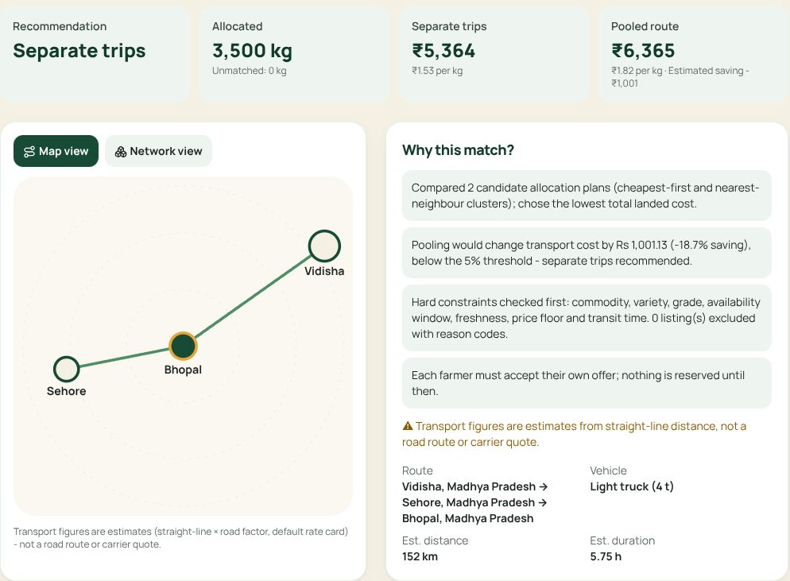
SPECIAL FEATURE · CLUSTERCART
Many farms. Many buyers. One smarter allocation
Illustrative scenario
Farm 1
80 kg
Hostel
70 kg
Engine
checks
Farm 2
60 kg
crop · grade
quantity
distance
freshness
time windows
transport cost
Restaurant
90 kg
Farm 3
100 kg
Retailer
80 kg
240 kg supply = 240 kg demand. Pool only if the route is feasible and the estimated cost is lower; otherwise recommend separate trips.
Live run on demo data: pooling would cost 18.7% more, so the engine said NO and recommended separate trips. It explains every decision.
Rule-based, explainable optimisation, not AI. Transport figures are estimates (straight-line distance × road factor, default rate card), not carrier quotes. Each farmer accepts their own offer.

Slide 6
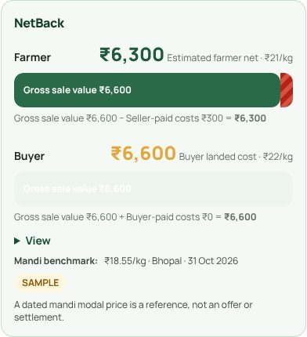
NETBACK INTELLIGENCE
A higher offer is not always a better deal
Illustrative example · farmer side
Buyer compares landed cost
₹2,500
− ₹200
− ₹50
₹2,250
Sale value
+ buyer-paid costs
= landed cost
Buyer-paid costs are never deducted from farmer net.
Farmers compare net proceeds. Buyers compare landed cost. Both see the same transparent breakdown.
Live app: 300 kg tomatoes at ₹22/kg, seller pays transport → est. farmer net ₹6,300; buyer landed ₹6,600 (demo data, estimated costs)
Accepted sale value
Seller-paid transport
Seller-paid packing
Estimated farmer net
Illustrative numbers. Clearer offers and lower avoidable cost can create a path to better farmer outcomes and more affordable procurement; retail price pass-through is not guaranteed. Money is stored in whole paise.

Slide 7
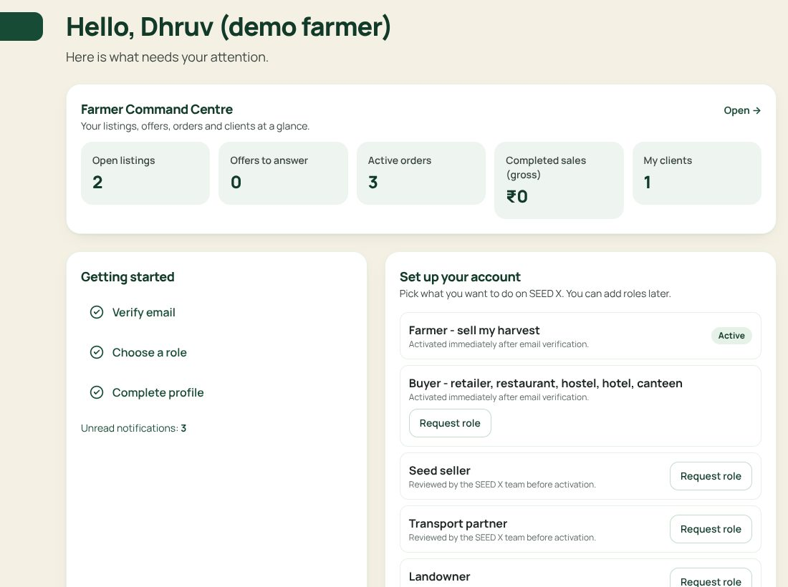
BEYOND A MARKETPLACE
A farmer’s daily business workspace
Manage
Harvest listings, 46-crop catalogue, available / reserved / sold stock that only changes through valid orders
Grow relationships
My Clients for farmers, My Suppliers for buyers: lead → enquiry → active → repeat, private notes
Complete trade
Offers, counter-offers, orders with timeline, logistics assignment, real-time notifications
Find support
Seed store with honest badges, dated mandi prices, official scheme links
All modules shown are working in the live app and covered by automated tests. Screenshot: demo farmer account (synthetic data).

Slide 8
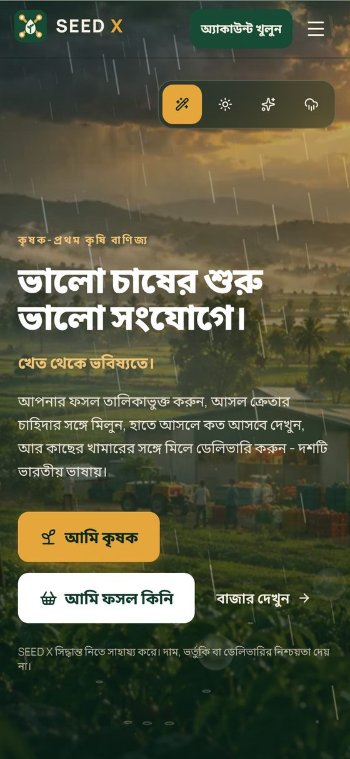
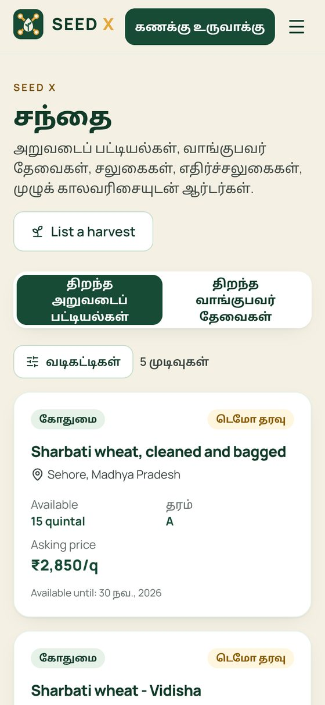
INCLUSION
Designed for the farmer, not for a tech expert
English
हिन्दी
বাংলা
తెలుగు
मराठी
தமிழ்
ગુજરાતી
ಕನ್ನಡ
മലയാളം
ਪੰਜਾਬੀ
Ten languages live today in native scripts; core journeys fully translated, native-speaker review in progress.
Mobile-first, large readable controls
Short guided steps and clear kg / quintal units
Local-language labels, helpful empty and error states
Low-data design: works with 3D and animation off
Assisted onboarding via FPOs / cooperatives as a rollout pathway (not a claimed partnership)
Validation plan: test core tasks with farmers in several languages; measure completion, errors and comprehension.
Context: IAMAI–Kantar "Internet in India 2024": 870 million users (98% of internet users) accessed Indic-language content in 2024. An all-internet-user statistic, not a farmer-specific survey. Screens: Bengali and Tamil, live app.

Slide 9
SECURITY & TRUST
Trust is built into the transaction
Verified accounts
Server-side roles
Proof, not a shield icon
Supabase Auth with email verification before any trading
Roles are trusted records; admin actions need two-factor login (MFA)
✓
DB security tests
141/141
✓
B reads A’s private notes
denied
Row Level Security
No secrets in the browser
✓
2 buyers, last stock
1 winner
Enabled on all 40 tables: each user sees only their own private data
Only the public publishable key ships; secret keys stay server-side
✓
Accept request replayed
same order
✓
User calls admin action
denied
Atomic, idempotent orders
Private files & audit
✓
Upload to other’s folder
denied
Stock reserved in one locked step; replays return the same order
Owner-only upload folders, type/size limits, append-only audit log
✓
Browser + a11y tests
14/14
From the project’s automated pgTAP and Playwright suites, run against the live database on 31 Oct 2026. No system is "unhackable"; these are the specific controls that are configured and tested.

Slide 10
POSITIONING
Complement the ecosystem. Improve the daily workflow
Already exists
Where SEED X focuses
e-NAM
A local farmer workflow linking inventory, buyer demand, multi-party allocation, NetBack, relationships, orders and notifications
Explainable pooled-delivery recommendation with a clear cost comparison, including when not to pool
Mobile-first, ten-language workspace that uses public benchmark data where available
National electronic trading portal linking APMC mandis: price discovery, transparent auctions, payments, logistics module.
AGMARKNET / data.gov.in
Daily mandi minimum, maximum and modal prices.
How it is built
Frontend
Backend
Hosting
Visuals
Vite · React 19 · TypeScript · Tailwind
Supabase Postgres · Auth · RLS · RPCs · Storage · Realtime · Edge Functions
Cloudflare Workers, auto-deploy from GitHub
Canvas 2D weather · Three.js for ClusterCart data only
Sources: enam.gov.in (overview, FAQs incl. logistics); data.gov.in / AGMARKNET current daily mandi prices. SEED X does not claim to be the first digital mandi; it is complementary to public market infrastructure. Entirely software-based.

Slide 11
DEMO · IMPACT · BUSINESS
Prove the journey in 60 seconds
1
Farmer’s tomato listing
Pilot metrics we will measure
Proposed business model
2
Buyer requirement & offer
Farmer net proceeds per kg vs a comparable alternative
Buyer landed cost per kg
Transport cost per kg
Time to match
Order fill and on-time delivery rate
Repeat buyer rate
Unsold / spoiled quantity
Small fee per completed order
paid by buyers; free for farmers to list
3
Run ClusterCart: see its checks
4
NetBack and buyer landed cost
ClusterCart planning
5
for institutional buyers (hostels, canteens, retailers)
Accept: stock, order and notification update
Live: seedxsss.tejash-shastri-rx.workers.dev
Offline backup: SEED_X_Demo_Backup.mp4 (79 s)
Pilot first
one district, one crop cluster, partner FPO
Proposed, not yet validated
SEED X helps shorten the distance between a farmer’s harvest and a fairer market opportunity.
Created & Developed by Tejash Shastri and Shaurya

