Slide 1
GPM EDM Program – High Level overview

Slide 2
Agenda
EDM Overview & Business Significance
High Level Architecture
EDM Process
Extract Process
Response Load
Response Load Data Flow
Point In Time
Pre Monthly
MDM XML Generation
Best Match Selection
INFA Layer
Netview
Standalone Process
GL Adhoc Process
LN Unexpected Address Match
TPA/UDA

Slide 3
EDM Overview & Business Significance
Overview
Model Unclaimed Life Insurance Benefits Act Regulation requires Insurers to proactively determine whether an insured had died in order to make sure insurance benefits are paid
EDM strategic program provides MetLife a consistent and sustainable process for identifying deceased customers by matching against MLDMF and then proactively engage in outreach efforts to beneficiaries and report to state regulators at the completion of these efforts.
Business Driver and Benefits
Compliance with regulation and reduced exposure to regulatory risk and potential fines. EDM is rated as top 3 risk within MetLife.
Business efficiencies: EDM Strategic provides a standard enterprise-wide platform for working on death match cases thereby reducing resources and redundant efforts from different LOB’s
Cross-LOB Transparency on cases being worked
Automation rules saves cost by stopping an annuity payout stream immediately rather than waiting for the case to be worked
IT cost savings by retiring the siloed monthly scheduled contingency mainframe death match process

Slide 4
GPM HUB
EDM Extract In scope Admin System
MLDMF
MLDMF Response File
All the actionable Global in T_PARTY_AGMT_STG table & Global in T_GLB_PARTY_STG table.
Load Death Match in GPM_ORS.C_B_EDM_RESULT
LexisNexis
Lexis Nexis Response File
Extract to be sent to BIOS to fetch suppression
MDM XML
BIOS
Receive Suppression indicators from BIOS
Infa Layer
BIOS tactical file will send through DET
Unsuppressed XMLs
Family Reunion Database
EIP
Case and Task ID will be appended in the strategic intermediate file
MDM HUB
CASE MANAGER
RMT
Case Indicator and Task indicator for tactical BIOS will be fetched from Family Reunion Database and appended in tactical file
Merge
DET
Netview
TO OBTAIN SUPPRESS INDICATOR FROM BIOS
EXTRACT PROCESS
RESPONSE LOAD
PIT LOAD
High Level Architecture
MDM XML GENERATION
INFA LAYER
NETVIEW

Slide 5
EDM Extract Process
MLDMF Extract
FIRST NAME
LAST NAME
SSN
DOB
RMID
Extract Global for
In scope Admin System
GPM HUB
LN Extract
FIRST NAME
LAST NAME
SSN
DOB
ADDRESS
Extract In scope Best Address for Global

Slide 6
Extract Process
Contextual and policy related information for deceased Parties who are eligible for the Payout after death are fetched from the GPM HUB.
These records are then sent to EDM Contingency (MLDMF) and LexisNexis for death match process.
MLDMF extract contains FIRST_NM, LAST_NM, SSN, DOB and LexisNexis extract contains ADDRESS information in addition with all the mentioned attributes.
Job Details and File Layout
LN EDM Extract Process
Maestro StreamName.JobName: BEMD_EDM_EXTRACT_LN
Script invoked: /work/infshared/GPM/Strategic/scripts/EDM/PHII/GPM_STRTGC_EDM_ADHOC_EXTRACT_MAIN.sh LN
ML EDM ETL Extract Process
Maestro StreamName.JobName: BEMD_EDM_EXTR.BEMD_EDM_EXTRACT
Script invoked: /work/infshared/GPM/Strategic/scripts/EDM/PHII/GPM_STRTGC_EDM_ADHOC_EXTRACT_MAIN.sh ML

Slide 7
Response Load
MLDMF Extract
MLDMF Response File
Extract In scope Admin System
Loading Death match in GPM_ORS.C_B_EDM_RESULT Table
GPM HUB
LN Extract
LN Response File

Slide 8
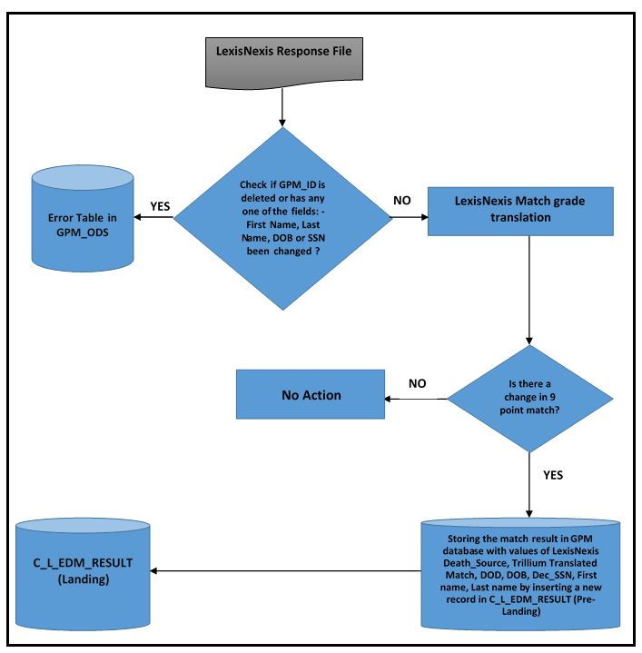
Response Load Data Flow

Slide 9
Response Load
The response file from both EDM Contingency (MLDMF) and LexisNexis is received.
The MLDMF response file contains all the possible matches for the extract records.
LexisNexis response file contains one match per global per cycle.
The MLDMF score is used to lookup Match Pattern in a Business Provided Lookup File whereas LexisNexis DCD Codes is translated into Trillium Match Pattern.
The match records are loaded into GPM.C_B_EDM_RESULT table if any of 9 point match attributes (FIRST_NM, LAST_NM, SSN, DOB, D_FIRST_NM, D_LAST_NM, D_DOB, D_SSN, MATCH_GRADE) changes for an already existing global.
If GPM attributes (GPM ID / PARTY ID) or anyone of the fields: First Name, Last Name, DOB or SSN for any Global got changed between LN Extract and Response Process, then these records will get rejected in the LN response Load.
Job Details and File Layout
Response Load - MLDMF
Maestro StreamName.JobName: BEMD_EDM_RSPN.BEMD_EDM_ETL_RESPONSE_ML
Script invoked: /work/infshared/GPM/Strategic/scripts/EDM/PHII/GPM_STRTGC_EDM_RESPONSE_ML.sh
Response Load - LN
Maestro StreamName.JobName: BEMD_EDM_RSPN.BEMD_EDM_ETL_RESPONSE_LN
Script invoked: /work/infshared/GPM/Strategic/scripts/EDM/PHII/GPM_STRTGC_EDM_RESPONSE_LN.sh
Response Landing Load
Maestro StreamName.JobName: BEMD_EDM_RSPN.BEMD_EDM_ETL_RESPONSE_LAND
Script invoked: /work/infshared/GPM/Strategic/scripts/EDM/PHII/GPM_STRTGC_EDM_RESPONSE_LANDING_LOAD.sh

Slide 10
Point In Time Load
MLDMF Extract
MLDMF Response File
Load Point in Time data in T_PARTY_AGMT_STG table & Global in T_GLB_PARTY_STG table for the Global. It stores contextual level data related to Global Party.
Loading Death match in GPM_ORS.C_B_EDM_RESULT Table
Extract In scope Admin System
GPM HUB
LN Extract
LN Response File

Slide 11
Point In Time Load
Distinct global information from GPM_ORS.C_B_EDM_RESULT are loaded into the PIT table GPM_ODS.T_GLB_PARTY_STG.
Contextual information along with their policies details are stored in GPM_ODS.T_PARTY_AGMT_STG.
Agreement key information for the associated agreements are stored in the GPM_ODS.T_AGMT_KEY_STG.
Job Details and File Layout
EDM ETL PIT
Maestro StreamName.JobName: BEMD_EDM_ETL_PIT.BEMD_EDM_ETL_PIT_LOAD
Script invoked: /work/infshared/GPM/Strategic/scripts/EDM/Phase2/EDM_PH_II_PIT_LOAD.sh

Slide 12
Pre Monthly Process
MLDMF Response File
Loading in GPM_ORS.C_B_EDM_RESULT
Load PIT data
GPM HUB
Existing Globals
PIT information of Existing Globals

Slide 13
Pre Monthly Process
Pre monthly process runs in parallel to PIT, where contextual information for previously sent globals is loaded to find if any new agreement has been added for the particular globals.
In this process, two files are created for old(i.e. already sent globals) and new globals(new matches loaded).
Job Details and File Layout
EDM ETL PRE MONTHLY XML Generation
Maestro StreamName.JobName: BEMD_EDM_ETL_PIT.BEMD_EDM_PRE_MNTHLY_XML_GNRT
Script invoked: /work/infshared/GPM/Strategic/scripts/EDM/Phase2/EDM_PHASE_II_PRE_MNTHLY_XML_GNRT.sh

Slide 14
MDM XML Generation
MDM XML Generation
Best match selection process is the main process in generation of MDM XML file where for a global having multiple matches, best match is selected against the globals.
For the match selected by this process for each global, we will fetch the respective contextual and beneficiary information from PIT tables and other information like phone, email, etc from MDM tables. We then populate them in single XML file.
GPM_ODS.T_EDM_AUDIT table contains all the PARTY_ID with their 9 point matches that are selected for downstream after MDM XML file generation.
Job Details and File Layout
EDM ETL MDM XML Generation
Maestro StreamName.JobName: BEMD_EDM_MDM_XML.BEMD_EDM_MDM_XML_GNRT
Script invoked: /work/infshared/GPM/Strategic/scripts/EDM/Phase2/EDM_PHASE_II_MONTHLY_IO_EXTRACT.sh

Slide 15
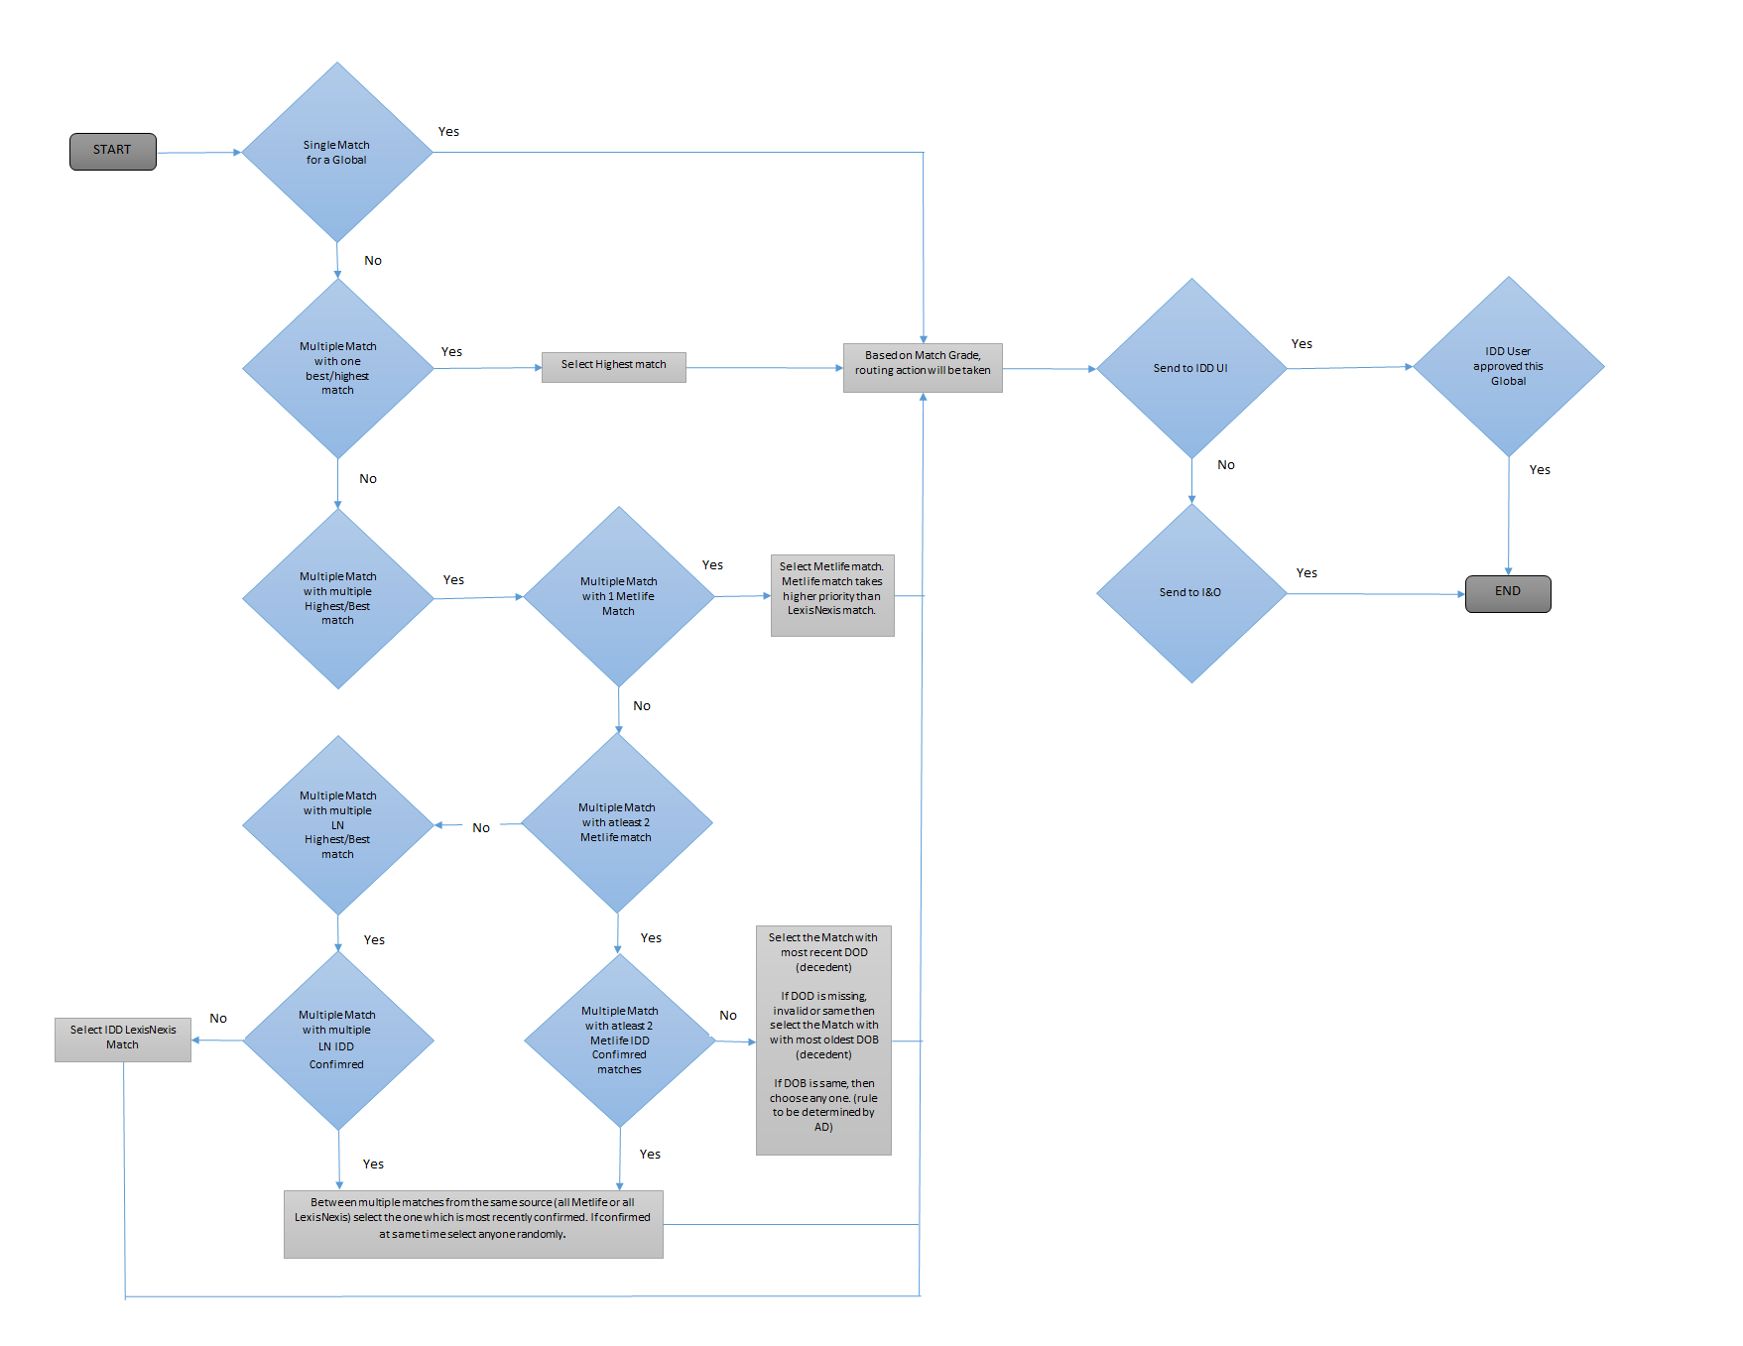
Best Match Selection
Note: In current run LexisNexis Match is prioritized over MLDMF.

Slide 16
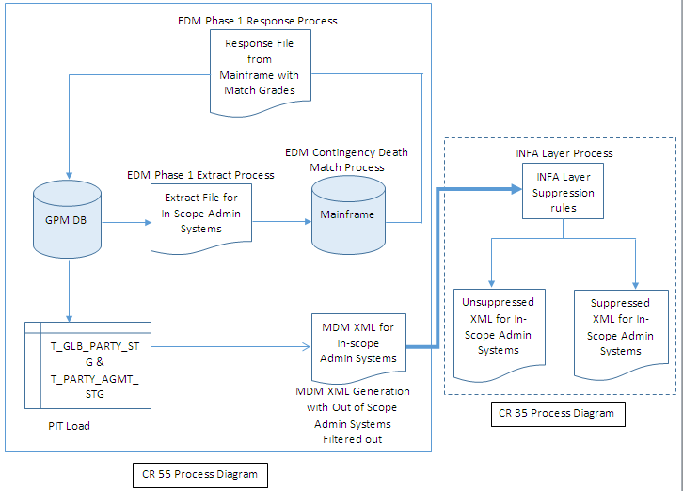
INFA LAYER

Slide 17
INFA LAYER
The Informatica Layer (part of Strategic EDM process) acts as a liaison between EIP and GPM.
The Informatica layer takes XML as input from EDM Phase II and applies certain Suppression logics such as LOB suppression, Role Suppression, etc. according to the business requirements on the data provided by GPM.
The unsuppressed records will be fed as XML to EIP via Message Queue. One Unsuppressed XML per Global record will be created.
The Suppressed records will be stored in GPM server as XML files for future processing.
Job Details and File Layout
EDM ETL Informatica Layer Business suppression Rule
Maestro StreamName.JobName: BEMD_EDM_INFALYR.BEMD_EDM_INFA_LAYER_XML_GNRT
Script invoked: /work/infshared/GPM/Strategic/scripts/INFA_LAYER/INFA_LAYER_MAIN.sh

Slide 18
Netview
Netview
All the Group life globals that have been reported to Case Manager for Group Life Strategic & Tactical process, have to be shared with Netview along with Case & Task details.
Group Life tactical file is used to generate Tactical XMLs which are later shared with Case Manager for Case and Task creation.
This process waits for Case Manager to create cases & tasks for each global that was shared with the Case Manager via EIP for both Strategic & Tactical process.
Once the Case & task is created for each global at the Case manager end, Netview process will be executed to create enriched payload for Strategic process which will be merged with the Tactical Enriched file will be sent to Netview.
Job Details and File Layout
Netview Strategic
Maestro StreamName.JobName: BEMD_EDM_NV_STGC.BEMD_EDM_NETVIEW_MERGE.
Script invoked: /work/infshared/GPM/Strategic/scripts/EDM/GROUP_LIFE/EDM_NETVIEW_MERGE_MAIN.sh

Slide 19
GL Adhoc Process
GL Adhoc Process
Business provides a GL Adhoc Excel file which contains manual Group life death matches.
The GL adhoc file has to be processed to report the Death matches to the Case Manager & EDMA.
Using Excel file as input, XMLs are generated which are shared with the Case Manager for Case & Task creation.
After the successful creation of Case & Task, the final Netview Sweep file is generated & shared with the EDMA.
Job Details and File Layout
GL Adhoc Process
Script invoked: /work/infshared/GPM/Strategic/scripts/EDM/GROUP_LIFE/EDM_ADHOC_DM.sh

Slide 20
LN Unexpected Address Match
Business provides a LN Address match Excel file which contains manual LN Unexpected address matches.
The Excel file is converted to BIOS input format & then shared with BIOS to fetch BIOS Indicators.
The output file provided by BIOS (containing BIOS Indicators) is again shared with the Business to perform suppression on the LN address Match records.
After applying the suppression on LN Address Match records, Business provides the Unsuppressed LN address match records in Excel file having same format as GL Adhoc Excel file.
Using Excel file as input, XMLs are generated which are shared with the Case Manager for Case & Task creation.
After the successful creation of Case & Task, the final Netview Sweep file is generated & shared with the EDMA.
Job Details and File Layout
LN Unexpected Address Match
Script invoked: /work/infshared/GPM/Strategic/scripts/EDM/GROUP_LIFE/EDM_ADHOC_DM_LN.sh

Slide 21
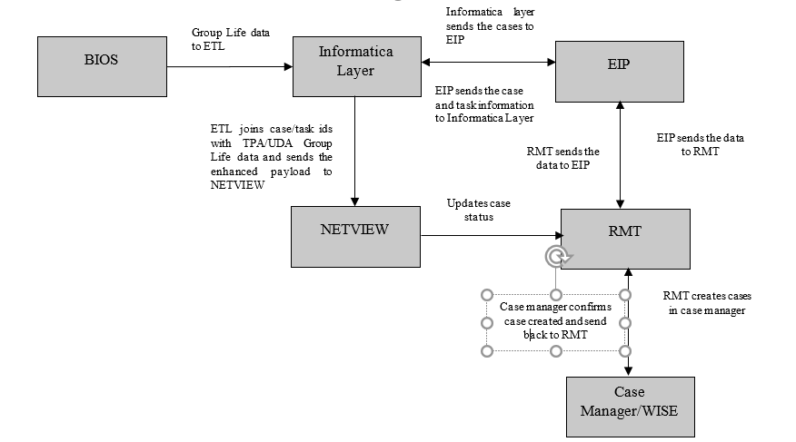
TPA/UDA

Slide 22
TPA/UDA
Independent of the monthly strategic death match, we also perform death matching for User-developed and Third-party applications.
GPM receives a consolidated file with the death matches for these applications from the mainframe
Results files received from Death Match process is sent to Case manager for Case Creation by creating Unsuppressed XMLs. XML schema same as core EDM process
The consolidated results are also split based on file names present in the record and sent to FileNet for archival
Job Details and File Layout
TPA Process
Maestro StreamName.JobName: BEMD_EDM_TPA.BEMD_EDM_TPA_XML_GNRT_MQ
Script invoked: /work/infshared/GPM/Strategic/scripts/EDM/TPA/EDM_TPA_XML_GNRTN.sh
UDA Process
Maestro StreamName.JobName: BEMD_EDM_UDA.BEMD_EDM_UDA_XML_GNRT_MQ
Script invoked: /work/infshared/GPM/Strategic/scripts/EDM/Phase2/EDM_UDA_XML_GNRTN.sh

