Slide 1


PROJECT PRESENTATION ON
HOUSE PRICE PREDICTION
SEM – VI
GUIDE – Prof. Shyamsundar Magar
STUDENTS :
TU4F1920039 / A-44 / TEJAS LILADHAR KOLHE
TU4F1920040 / A-45 / RUSHIKESH LALIT BANDIWADEKAR
TU4F1920053 / A-54 / SANIKA SUNIL PHARANDE
TU4F1920031 / A- 36 / PRANAV SHASHIKANT BULBULE
DEPARTMENT OF INFORMATION TECHNOLOGY

Slide 2
OUTLINE
CONTENTS | PAGE NO.
INTRODUCTION | 3
LITERATURE SURVEY | 5
PROBLEM STATEMENT | 8
SEQUENCE DIAGRAM | 9
FLOW DIAGRAM | 10
PROPOSED METHODOLOGY | 11
TECHNOLOGY USED | 12
CONCLUSION | 13
REFERENCES | 14
DEPARTMENT OF INFORMATION TECHNOLOGY

Slide 3
1. INTRODUCTION
This project, we have built a machine learning model to predict the house prices of an Indian city (Nerul).
This project will very helpful for the real estate market.
Our model can be used by house buyers.
Linear Regression algorithm is used to create a model with a great accuracy score.
DEPARTMENT OF INFORMATION TECHNOLOGY

Slide 4
1. INTRODUCTION CONT’D
House prices increase every year, so there is a need for a system to predict house prices in the future.
House price prediction can help the developer determine the selling price of a house and can help the customer to arrange the right time to purchase a house.
There are three factors that influence the price of a house which include physical conditions, concept and location
DEPARTMENT OF INFORMATION TECHNOLOGY

Slide 5
2. LITERATURE SURVEY
SR NO. | Publication & year | Title | Technologies Used | Features and Advantages | Drawbacks
1 | IEEE 2019 | House Resale Price Prediction Using Classification Algorithms | To Predicting the Housing value prediction exploitation machine Learning Techniques. | Efficient pricing of real estate customers for their priorities and budgets must therefore be predicted. This project efficiently analyzes past industry trends and price ranges to predict future prices. | Presents the Prediction of the possibility of commerce of homes because of the issue of monetary stability.
2 | IEEE 2020 | Housing prices prediction with deep learning:an application for the real estate market in Taiwan | Machine Learning, Python | The purpose of the current study was to predict housing prices based on deep learning algorithms. It shows that the impact of macroeconomic variables on housing prices prediction is | The scale of different features is different. Hence, the higher-value feature will dominate and weaken the impact of lower-valued features of the model.

Slide 6
2. LITERATURE SURVEY CONT’D
SR NO | Publication & year | Title | Technologies Used | Features and Advantages | Drawbacks
3 | IEEE 2020 | Prediction of House Price Based on The Back Propagation Neural Network in The Keras Deep Learning Framework | The Back Propagation Neural Network in The Keras Deep Learning Framework | It can learn and store a large number of input-output mode mappings and do not need to reveal the mathematical equations of the mapping relationship. | This paper selects 12 macro factors with large influence on housing prices in Shanghai, and establishes a 6-layer BP neural network based on the framework of Keras deep learning.
4 | IEEE 2020 | House Price Prediction Approach based on Deep Learning and ARIMA Model | Deep Learning and ARIMA Model | ARIMA (Autoregressive Integrated Moving Average) model is a well-known time series forecasting method. It is assumed that past values of the series plus previous error terms contain information for the purpose of forecasting. | The ARMA model can be used when the time series is stationary, i.e. a more homogeneous mean and variance. But most original time series can't satisfy this condition

Slide 7
2. LITERATURE SURVEY CONT’D
SR NO | Publication & year | Title | Technologies Used | Features and Advantages | Drawbacks
5 | IEEE 2021 | Deep Learning Model for House Price Prediction Using Heterogeneous Data Analysis Along With Joint Self-Attention Mechanism | Google satellite map, spatial transformer network, joint self-attention mechanism | The model can automatically assign weights when given transaction data. | The data limitations of this study should be improved to represent specific features more precisely. For example, the transaction data do not contain precise house addresses, and we cannot obtain complete public facility data. Moreover, we cannot retrieve images of house interiors to consider the interior design of the houses.
6 | IEEE 2021 | Informed Machine Learning | Machine Learning, learning Algorithm, Final Hypothesis. | They present a structured overview of various approaches in this field. They provide a definition and propose a concept for informed machine learning which illustrates its building blocks and distinguishes it from conventional machine learning | Problems can typically be formulated as regression tasks where inputs X have to be mapped to outputs Y

Slide 8
3. PROBLEM STATEMENT
In India, there are multiple real estate classified websites where properties are listed for sell/buy/rent purposes such as 99acres, housing , magicbricks and more.
However, in each of these websites we can see lot of inconsistencies in terms of pricing of an apartment and there are some cases when similar apartments are priced differently and thus there is lot of in-transparency.
Sometimes the consumers may feel the pricing is not justified for a particular listed apartment but there no way to confirm that either.
As earlier, house prices were determined by calculating the acquiring and selling price in locality
DEPARTMENT OF INFORMATION TECHNOLOGY

Slide 9
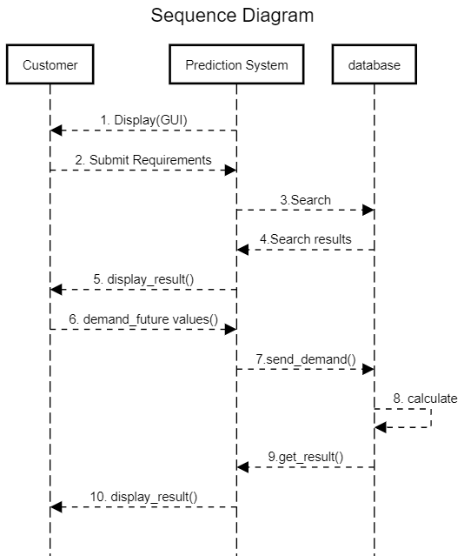
5. SEQUENCE DIAGRAM
DEPARTMENT OF INFORMATION TECHNOLOGY

Slide 10
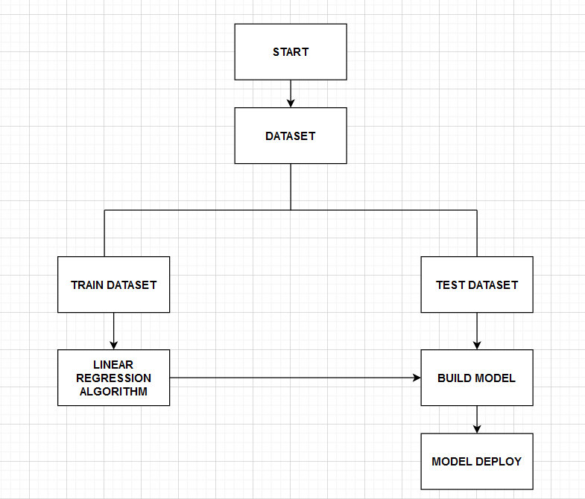
4. FLOW DIAGRAM
DEPARTMENT OF INFORMATION TECHNOLOGY

Slide 11
6. PROPOSED METHODOLOGY
The proposed methodology House Price Prediction aims to detect price of the house using machine learning techniques and algorithms with good accuracy based on required data entered by the user in the front end
In this project we focus on predicting house price by using machine learning algorithm like linear regression
Data is stored in .csv file out of that 80% of data is used for training purpose and remaining 20% is used for testing purpose
Our goal is to develop a model that predict the house prices by considering various parameters
DEPARTMENT OF INFORMATION TECHNOLOGY

Slide 12
7. TECHNOLOGY USED
Software Requirements:
Jupyter Notebook
Pycharm
Visual Studio
Notepad++
Languages:
Python
HTML
CSS
Hardware Requirements:
Processor: Intel Core i3 or higher
Monitor: Min 14’’ colour monitor
RAM: 2GB
Hard Disk: 1TB
Keyboard: Standard 104 keys
Mouse: Serial mouse
DEPARTMENT OF INFORMATION TECHNOLOGY

Slide 13

8. CONCLUSION
Our system that aims to provide a reliable prediction of housing prices based on test data has been developed.
The system makes use of Linear Regression algorithm.
The system will get the user parameter values directly from webpage and projects the output based on the trained data.
The system will satisfy customers by providing accurate output and preventing the risk of investing in the wrong house.

Slide 14
9. REFERENCES
[1] Kaggle competition, https://www.kaggle.com/c/house-prices-advanced-regression-techniques.
[2] Mckinsey report, https://www.mckinsey.com/industries/capital-projects-and-infrastructure/ our-insights/getting-ahead-of-the-market-how-big-data-is-transforming-real-estate.
[3] Zillow zestimate, https://www.zillow.com/blog/zestimate-updates-230614/.
[4] Kam C Chan, Patric H Hendershott, and Anthony B Sanders, Risk and return on real estate: evidence from equity reits, Real Estate Economics 18 (1990), no. 4, 431–452.
[5] T. Chen and C. Guestrin, Xgboost: A scalable tree boosting system, In Proceedings of the 22nd acm sigkdd international conference on knowledge discovery and data mining (2016, August), 785–794.
[6] B. de Ville, Decision trees, Wiley Interdisciplinary Reviews: Computational Statistics 5 (2013), no. 6, 448–455.
DEPARTMENT OF INFORMATION TECHNOLOGY

Slide 15
THANK YOU !
DEPARTMENT OF INFORMATION TECHNOLOGY

