Slide 1

// Software Engineering · IPD Project
contest.py
CodeArena
1
# CodeArena judge loop
2
for p in contest.problems:
Online Coding Contest Platform
3
code = submit(p)
4
verdict = judge(code)
5
board.update(verdict)
Scrum-Based Project Planning & Kanban Board
6
print("Accepted")
Sambhav Tated
Tejas Kute
Accepted · all test cases passed
S
T
I149
I169
Notes:
Introduce the project and the team. CodeArena is an online coding contest platform, and this presentation shows how we planned it using Scrum and tracked it on a Kanban board. Sambhav, I149, and Tejas, I169.

Slide 2









02 · Introduction
What is CodeArena?
An online coding contest platform designed for college students.
PROBLEM
SOLUTION
Large competitive programming platforms can overwhelm beginners.
A simple platform focused on college-level contests and practice.
WHAT STUDENTS CAN DO
Register & build profiles
Solve programming problems
Join coding contests
Submit solutions
System evaluates submissions
View rankings & performance
CodeArena · Sambhav & Tejas
02 / 06
Notes:
The problem: big competitive programming sites can be overwhelming for beginners. Our solution is CodeArena, a simpler platform for college-level contests and practice. Walk the six cards left to right: register, solve, join contests, submit, get evaluated, and see rankings.

Slide 3











03 · Modules
Module-Wise Division of the Project
01
02
03
User Management
Problem Management
Contest Management
Registration · Login · Profile
Problems · Difficulty · Test Cases
Creation · Scheduling · Registration
06
05
04
Leaderboard
Code Evaluation
Code Submission
Scores · Rankings · Submission History
Compilation · Test Cases · Verdict
Code Editor · Language · Submit
07
Admin Dashboard
manages every module
Users
Problems
Contests
Submissions
Green arrows: student flow · Dashed: admin oversight
03 / 06
Notes:
Follow the green arrows: a user registers, browses problems, joins a contest, submits code, the code is evaluated, and the result lands on the leaderboard. The Admin Dashboard sits underneath and manages users, problems, contests and submissions.

Slide 4










04 · Team
Task Assignment to Group Members
S
Sambhav
T
Tejas
I149 · Frontend & Testing
I169 · Backend & Evaluation
User Authentication
Backend APIs
Frontend UI
Database Design
Problem & Contest Pages
Code Submission
Leaderboard Interface
Code Evaluation
Testing
Admin Dashboard
CodeArena · Sambhav & Tejas
04 / 06
Notes:
Work is split by layer. Sambhav owns everything the student sees: authentication, the frontend, problem and contest pages, the leaderboard UI, and testing. Tejas owns the engine: backend APIs, database design, code submission, code evaluation, and the admin dashboard. The same colours mark each person on the Kanban board next.

Slide 5


05 · Planning
Scrum Sprint Plan & Kanban Board
SCRUM SPRINT PLAN
Sprint 1
Done
Sprint 2
In progress
Sprint 3
Planned
Requirements
UI Design
Problem Management
Code Evaluation
Leaderboard
Database Design
Authentication
Contest Management
Admin Dashboard
Testing
Code Submission
KANBAN BOARD · SPRINT 2 SNAPSHOT
S
Sambhav
T
Tejas
BACKLOG
2
TO DO
2
IN PROGRESS
2
TESTING
1
DONE
2
Admin Dashboard
Code Evaluation
Contest Page
Problem API
Login Page
CA-10
T
CA-08
T
CA-06
S
CA-05
T
CA-01
S
Testing
Leaderboard
Code Submission
Database Setup
CA-11
S
CA-09
S
CA-07
T
CA-02
T
CodeArena · Sambhav & Tejas
05 / 06
Notes:
Scrum splits the build into three sprints: foundations first, then problems, contests and submission, then evaluation, leaderboard, admin and testing. The Kanban board is a snapshot mid Sprint 2: Sprint 1 work is done, the Problem API is in testing, and the contest page and code submission are in progress. Each card shows its owner, S for Sambhav and T for Tejas.

Slide 6

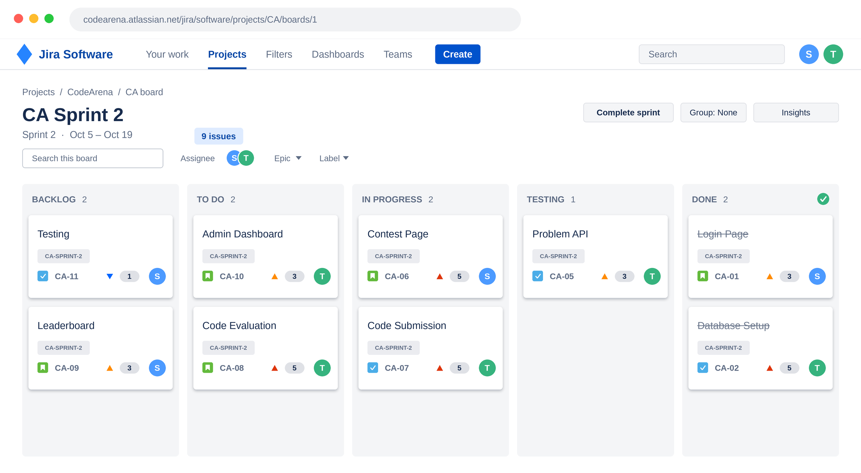
06 · Tool & Conclusion
Kanban Tool Demonstration & Conclusion
Tool Used: JIRA / Miro
CONCLUSION
CodeArena provides a structured platform for college coding contests.
Scrum divides development into manageable sprints.
Kanban helps track tasks and team responsibilities.
The approach improves collaboration and project visibility.
Thank You
Questions?
CodeArena · Sambhav (I149) & Tejas (I169)
06 / 06
Notes:
Show the real board in JIRA or Miro here, pointing out the same five columns. Then wrap up with the four takeaways, thank the audience, and invite questions.

