Slide 1
D.Y. Patil College of Engineering, Akurdi, Pune
Department : Computer Science
Year : TE
Topic : Blood Bank Management

Slide 2
INTRODUCTION :
The main aim of this project is to save lives of people by providing blood.
Our project Online Blood Bank system using Flask is developed so that users can view the information of blood banks and volunteer donors.
This application we are developing helps to select the nearby bloodbanks, donors .
This application reduces the time to a greater extent that is searching for the required blood through blood banks.
Thus this website provides the required information in less time and also helps in quicker decision making

Slide 3
AIMS & OBJECTIVES
To facilitate the search process for needy people and make it easier than before.
To reduce the data entry process.
Some blood types are rare so the system can find the required donors with the required blood type easily from the huge database .

Slide 4
PROBLEM STATEMENT
The major problem in old Blood banking systems was that, they don’t follow the actual needs of users.
Traditional blood banking systems were developed by 1 or 2 perspective.
Tracking the database was complicated when the details are maintained manually.
There was shortage and sometimes unavailability of rare blood groups due to less modules i.e. patient and donors.

Slide 5
Website purpose:
So here we have developed a website where the citizens will be able to know blood available in blood bank.
A better idea is to use the application which is very popular with people too.
This website is providing each entity the facility to approach nearby blood donors so that it will become much easier to search rare blood groups in the hour of need.
This website maintains record of all doners and their blood group .

Slide 6
Website design:
First of all we will add donors.
After adding donors .The data will be stored in database.
Now will be able to se the donors with their name , mobile number,blood group,email.
We can also update ,delete the inserted records.

Slide 7
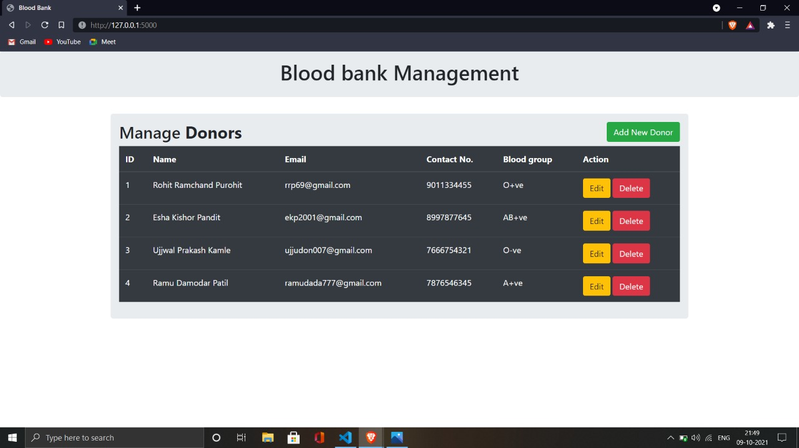
Home page - Home page will be used to add donour
.

Slide 8
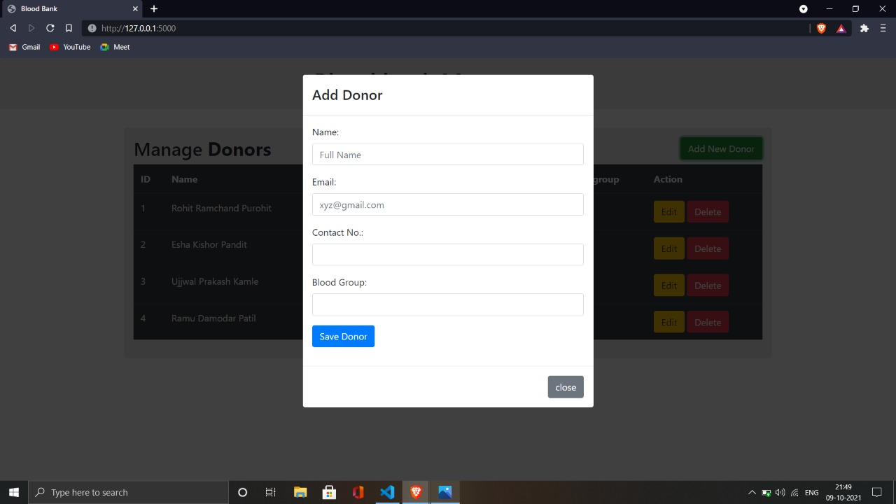

Slide 9
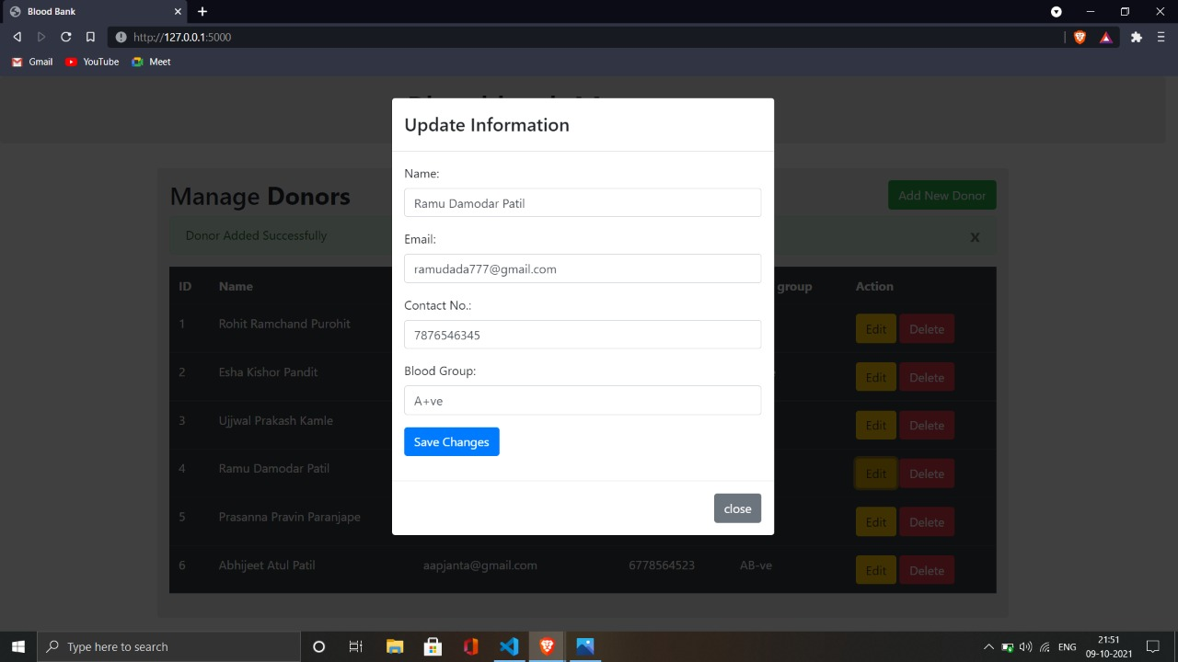

Slide 10
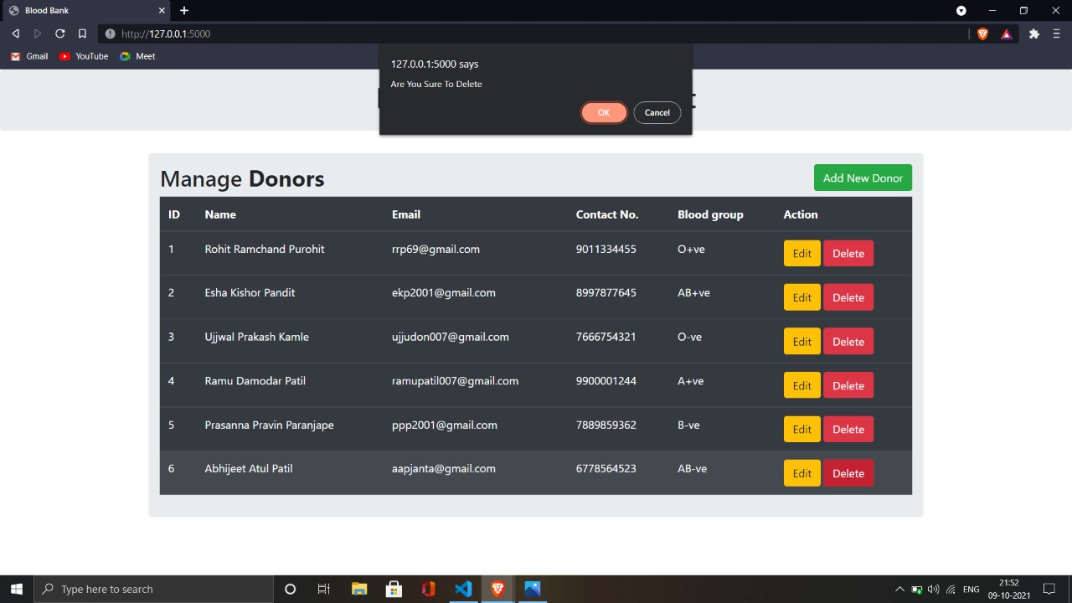

Slide 11
Project tools
HTML
JavaScript
CSS
Flask
SQL
Python

Slide 12
FLASK
It was developed by Armin Ronacher.
Flask is an framework of python from which we can make webpages.
It is designed to make getting started quick and easy, with the ability to scale up to complex applications.

Slide 13
Conclusion
This website will help to know information of blood and blood donors.
Proposed website will be better than any existing system based blood bank management.
This helps nearby hospital to know blood present in blood bank.

Slide 14
References
www.youtube.com
www.wikipedia.com

Slide 15
….Thank you …..

