Slide 1

CG_TEAM_JVQRE
JIO Artificial intelligence
Code Gladiators 2019 Finals
Prepared by Tejas Magia

Slide 2
Executive Summary
Smart Parking solution - "Identify available parking spots from parking lot camera images“
The model should take an image as input and return all detected parking slots in the image.
Each detection result from the model should be a list of 5 (cx,cy,v,c,p) values:
First two should represent the centre coordinates cx, cy of the detected parking slot
Third value should represent the vehicle occupancy v in the parking slot.It should be 1 if the vehicle is present in the parking slot and 0 otherwise.
Fourth value should represent the color_code c (0-8 values for White-0, Silver-1, Black-2, Grey-3, Blue-4, Red-5, Brown-6, Green-7, Others-8)
Fifth value should represent the pose p (0 for front facing i.e front of the car is looking at the camera, 1 for back, back of the car is looking at the camera )

Slide 3
Problem at hand
Manual car parking increases car emissions in urban centers by increasing the need for people to needlessly circle city blocks searching for parking. It also increase traffic in cities because of in appropriate parking and finally it increases the daily stress associated with parking woes.

Slide 4
Solution
Need a smart car parking system which shows empty car park slots for car drivers to park in a given parking area.
Implementation:
Developed a system which uses Deep learning image classification model (Yolo_v3, Keras) with object detection technique.
Demo purpose created website which shows current status of car parking area and total count of empty and occupied slots

Slide 5
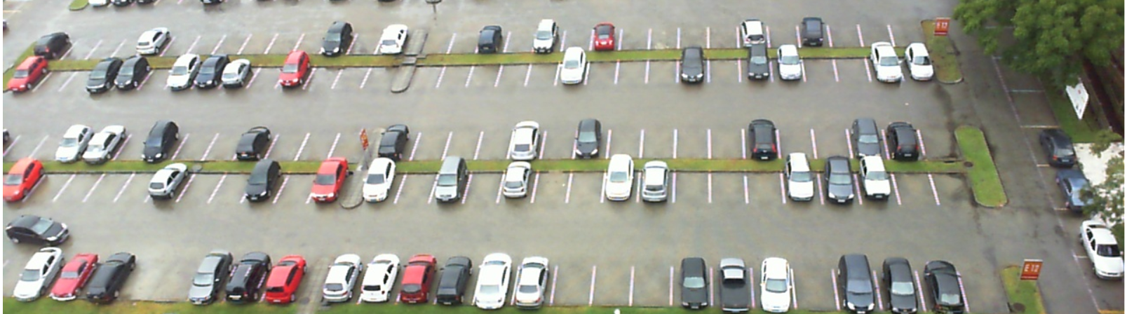
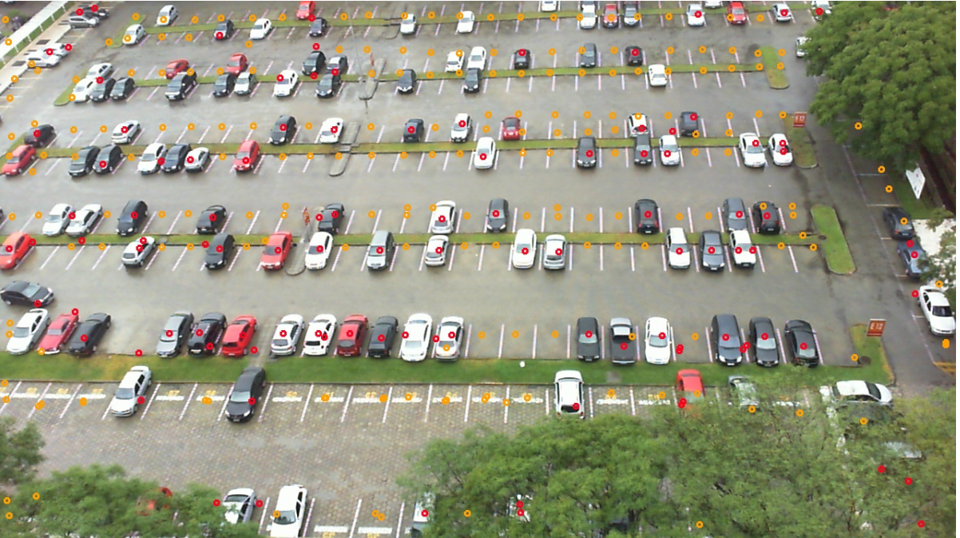
Prototype
The trained model using Yolo has 90% accuracy using threshold and overlapping mechanism.
Before
After

Slide 6
Approach
Used Yolo v3 model and PUCPR dataset train the model
Trained my model using Cross entropy classifier and Sigmoid as the activation
Using trained model collected all the slots for Fully car parked image and similarly predict occupied car slot for interference
Using IOU (intersection over union) and NMS(non maximum suppression) able to find empty slots for inference image
Min and max values of X,Y helps in finding the centroid
Also, width and height helps in identify Pose of car parked

Slide 7
Technology Stack
Keras
Tensorflow, Tensorboard
Yolo v3
OpenCv 3 for labelling

Slide 8
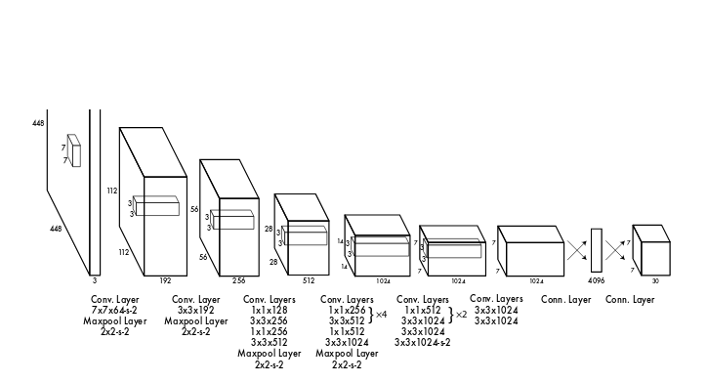
Yolo v3 Architecture

Slide 9
Why our team is the best!
Used latest research models like Yolo v3 for car parking image classification
The trained image detection predicts empty slots in less than 30 seconds
Color detection predicts Red, Green colors
For more accurate Pose need to create a model with 3 different type of car pose so that it can classify Pose correctly
During the implementation learned several image classification libraries and new models
My existing approach in predicting image can be extended so that annotation dependency can be removed

Slide 10
Associated attachments/ files
Github link for all weights, h5 and pkl files needed for running the project: https://github.com/tejasmagia/CarParkingDetection_Contest
Other source code files present with Submission including Solution explanation and PPT.

Slide 11
Appendix

Slide 12
Challenges
Color detection was challenging task as color for 20-30 pixcel imgae was not coming accurate. Tried Historogram, K-means, Standard deviation all are not giving correct prediction for White/silver colors.
I couldn’t find Car front, backend and side view images which can help me classify car parking pose. To overcome this used simple mathematical formula to predict vertical and side way parking pose.

Slide 13
Possible Improvements
Need to implement Color detection using progressive Learning technique.
Implemented Webcam and video files but need to test and validate the results
Current model is only trained on one Car parking area which means if car parking areas increase then the model trained and accuracy may not be guaranteed hence change model from Yolo v3 to Singleshot Detection (m2Det), Mask R-CNN, ResNet & Inception v3 model for better performance and accuracy,
Implement Website/mobile/web service app which can show current parking status i.e. total number of empty and car parked count
If car park area has multiple cameras then we can implement car park number plate detection and mapped exact location of each car parked

Slide 14
Thank you
Any Queries?

