Slide 1

CG_TEAM_JVQRE
JIO Artificial intelligence
Code Gladiators 2019
Prepared by Tejas Magia

Slide 2
Executive Summary
Smart Parking solution - "Identify available parking spots from parking lot camera images"

Slide 3
Problem at hand
Manual car parking increases car emissions in urban centers by increasing the need for people to needlessly circle city blocks searching for parking. It also increase traffic in cities because of in appropriate parking and finally it increases the daily stress associated with parking woes.

Slide 4
Solution
Need a smart car parking system which shows empty car park slots for car drivers to park in a given parking area.
Implementation:
Developed a system which uses Deep learning image classification model (Yolo_v3, Keras, Darkflow) with object detection technique.

Slide 5
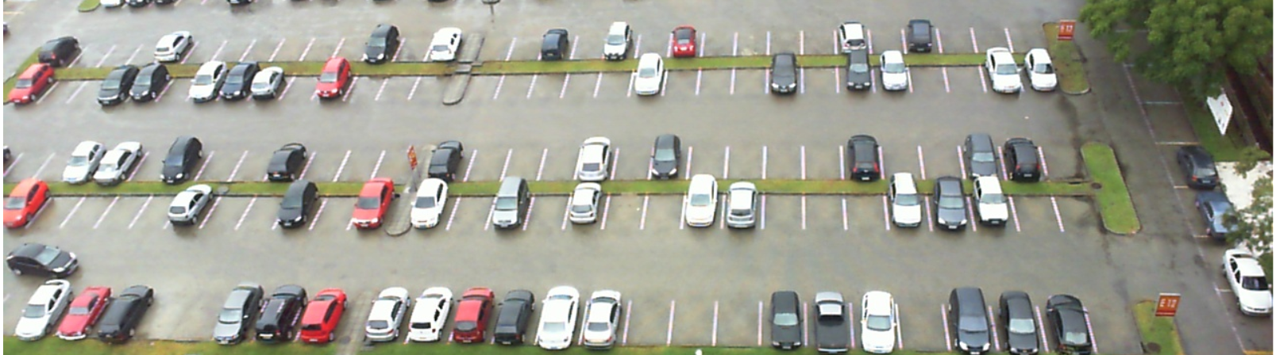
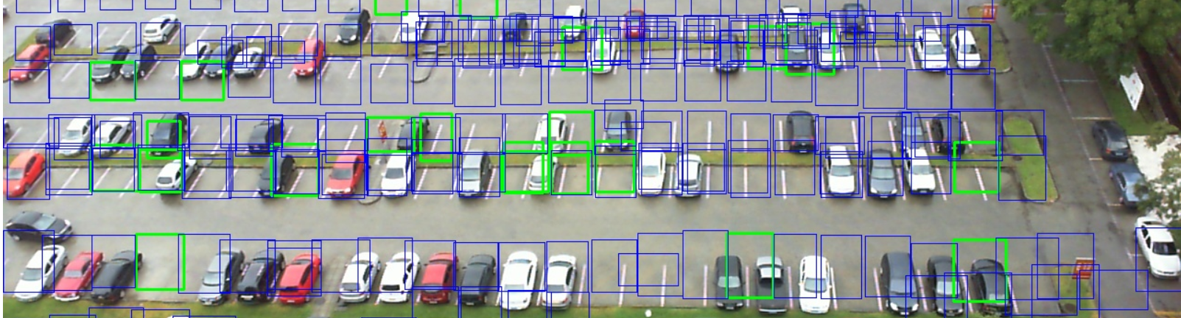
Prototype
The trained model using Yolo has 70% accuracy which needs to be improved to 90% using threshold and overlapping mechanism.
Before
After

Slide 6
Approach
Used Yolo v3 model and PUCPR dataset train the model
Trained my model using Cross entropy classifier and Sigmoid as the activation
The trained model identifies actual car parked slot for fully occupied car parked image and semi occupied predicted image
Fully car parked image provides Array of each slot in x,y coordinate values.
Using coordinate information & Darkflow.TFNet model to detect which slot contains empty or parked car in predicted image.

Slide 7
Technology Stack
Keras
Tensorflow, Tensorboard
Yolo v3
OpenCv 3 for labelling
Darkflow TFNet of Yolo v1 weights
Convolutional Neural Networks

Slide 8
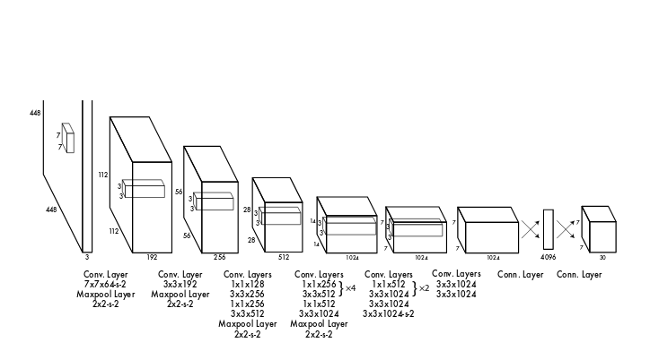
Yolo v3 Architecture

Slide 9
Why our team is the best!
Used latest research models like Yolo v3 and Darkflow for car parking image classification
During the implementation learned several image classification libraries and new models
My model needs initial Car park annotation and images. Plus it needs fully car parked image and annotation which helps in predicting real time empty car park slots

Slide 10
Associated attachments/ files
Github link for all weights, h5 and pkl files needed for running the project: https://github.com/tejasmagia/CarParkingDetection_Contest
Other source code files present with Submission including Solution explanation and PPT.

Slide 11
Appendix

Slide 12
Challenges
Image classification between empty and car parked slot was easy but to generate total empty slot for a predicted image was difficult.
To overcome this, I have generated fully car parked slots co-ordinates using full car parked image. It will help me getting position of each car slot in car park area and then cropping each slot of predicted image to predict whether car present or not. Using this approach help me indentify total empty slots.

Slide 13
Possible Improvements
Need to increase model accuracy because current model doesn’t have high accuracy.
Current model is only trained on one Car parking area which means if car parking areas increase then the model trained and accuracy may not be guaranteed hence change model from Yolo v3 to Mask R-CNN, ResNet & Inception v3 model for better performance and accuracy,
Need to implement same model for Webcam and video files
Implement Website/mobile/web service app which can show current parking status i.e. total number of empty and car parked count
If car park area has multiple cameras then we can implement car park number plate detection and mapped exact location of each car parked

Slide 14
Thank you
Any Queries?

