Slide 1


Team Details
  Team name: Canon
  Team leader name: Tejas Nafde
  Problem Statement: Future of Work & Enterprise Productivity

Slide 2
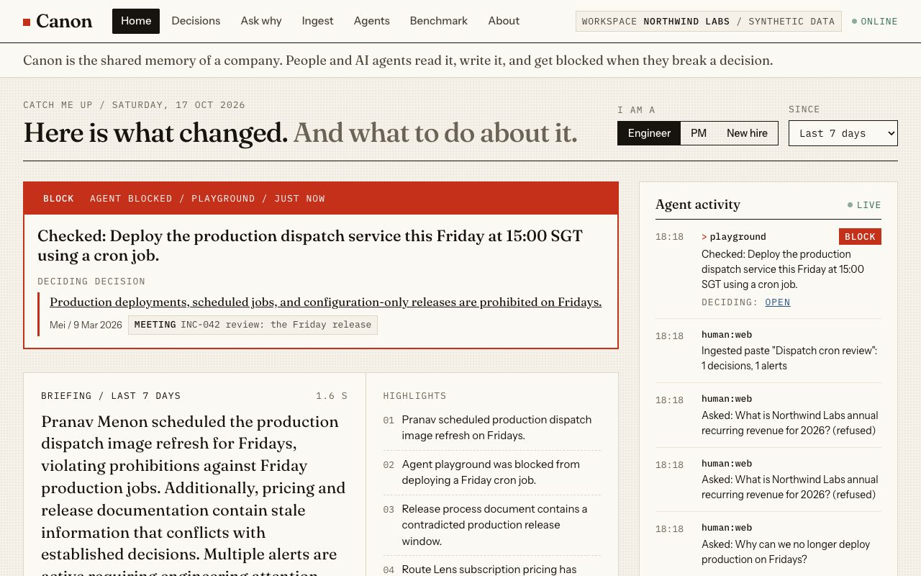
Brief about the idea
Canon is the shared memory of a company, for its people and for its AI agents.
Teams decide things in Slack threads, meetings, PRs and email. The wiki goes stale. New hires and AI agents act on old information.
Canon keeps one record of decisions. Each decision has a rationale, an owner, a date and a quote checked word for word against its source.
Every new message, document and agent action is checked against that record. Canon flags drift: a contradiction, a stale wiki page, a broken premise.
Coding agents connect over MCP and call check_intent before they act. A Friday cron deploy is blocked, with the incident review as evidence.

Slide 3
Opportunities
How is it different?
How does it solve the problem?
USP: agent-native
- Meeting-memory tools (Mnemo style) summarise. Decision logs (Decision Ledger style) store. Spec checkers (Spec Keeper style) review code.
- Canon does all three on one record, and its first-class users include AI agents, not only people.
- Extracts decisions with verified quotes from any source.
- Reconciles each one: same, update or contradiction.
- Raises alerts on stale docs and broken premises.
- Answers why, with citations, or says I do not know.
- An MCP server any agent can call: check_intent returns allow, warn or block with the deciding decision.
- Every agent read, write and check shows in a live feed.
- Also an ADK agent over A2A.

Slide 4
List of features offered by the solution
Ingest any source: Slack, meeting, wiki, PR, commit, email, free paste, image or PDF.
Decision extraction: statement, rationale, assumptions, owner, date, verified quotes.
Reconciliation: same, update (supersedes) or contradiction.
Drift alerts: stale wiki pages and premise changes, both quotes side by side.
Ask why: cited answer and decision timeline; refuses when the record is silent.
Catch me up: engineer, PM or new-hire briefing with ranked next actions (score 0 to 100 with reasons) and who to ask.
Agent guard: check_intent gives allow, warn or block with the deciding decisions.
MCP server: six tools over streamable HTTP for Claude Code and Codex.
Live agent activity feed and an agent playground in the browser.
Ask the departed expert: answers in a former colleague's voice, from their quotes only.
Human in the loop: alerts stay open until a person resolves them.
Integrations: A2A agent card, GitHub PR webhook, Discord slash command.
Benchmark: planted problems vs found, on a labelled gold set.

Slide 5
Process flow diagram
A. A new source arrives (web paste, Slack, PR, agent)
Source
text or image
Chunk + embed
gemini-embedding-001
Extract decisions
Gemini, structured
Verify quotes
exact substring
Reconcile
same / update / contra
Drift scan
stale docs, premises
Firestore record: decisions, alerts, activity
vector search, workspace prefilter
Question, briefing
or intended action
Embed query
nearest decisions
Below threshold?
refuse / allow, no LLM
Gemini judges
answer or verdict
Cite verified quotes
allow / warn / block
Activity feed
web, MCP, A2A
B. A person or an agent asks or acts

Slide 6
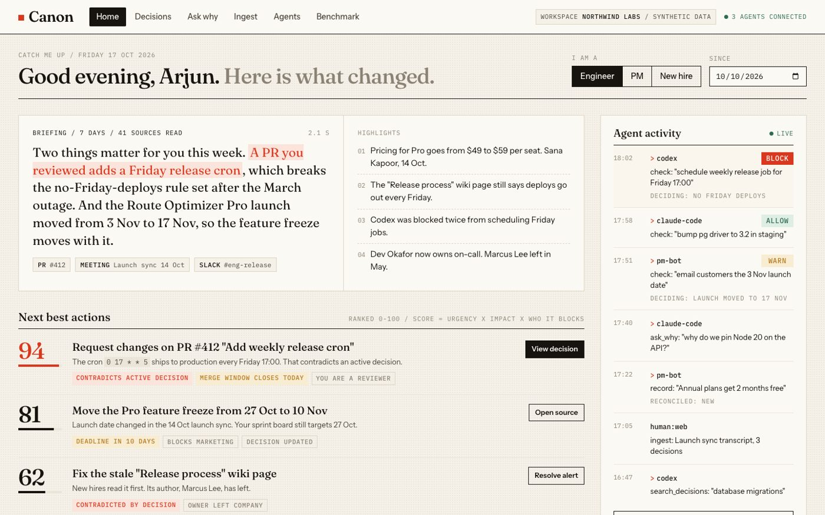
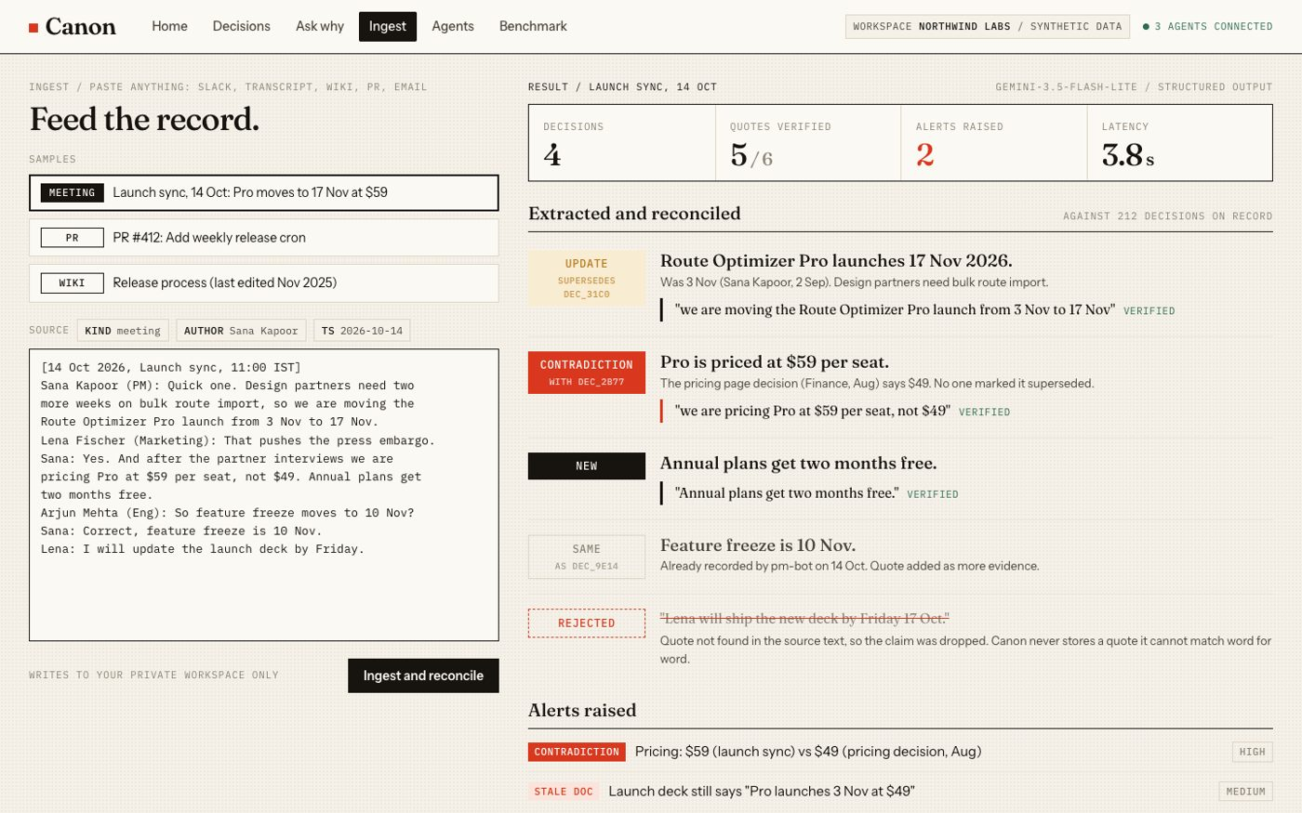
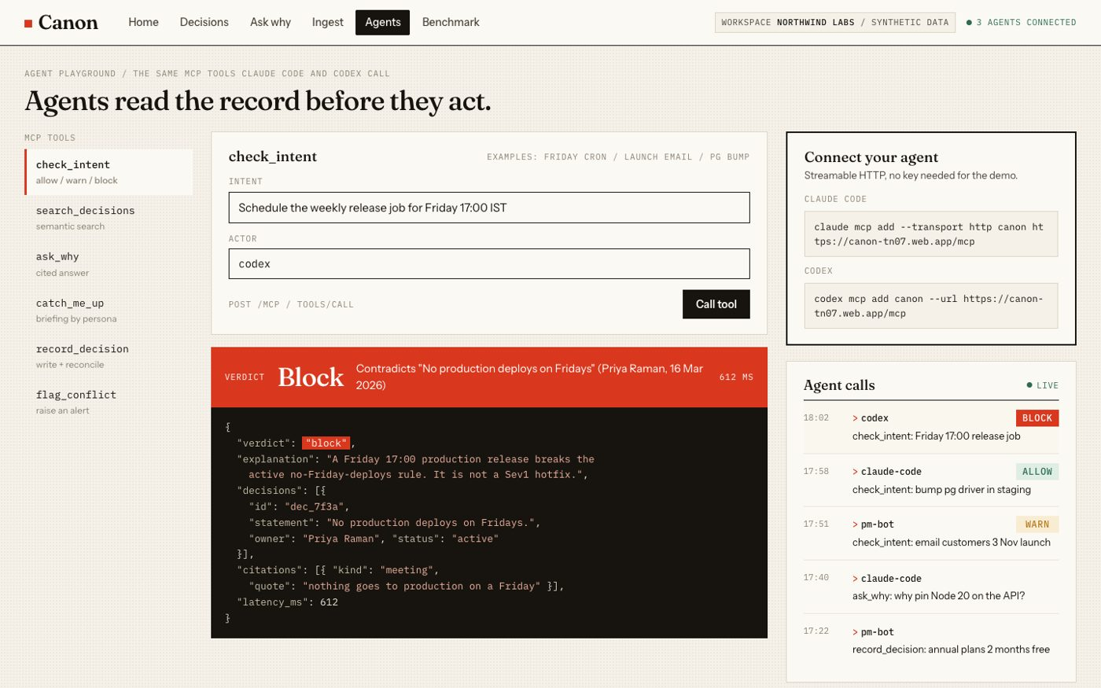
Wireframes / mock diagrams
Ingest: paste and reconcile
Home: briefing, alerts, agent feed
Agents: MCP playground

Slide 7
Architecture diagram
Web app (React)
Firebase Hosting
Cloud Run service canon (asia-south1, min 0)
Vertex AI Gemini
gemini-3.5-flash-lite
structured output, label app=canon
FastAPI /api
Core
ingest, reconcile
ask, briefing
check, expert
Claude Code, Codex
MCP clients
MCP /mcp
Embeddings
gemini-embedding-001, 768 dims
ADK agent /a2a
Other agents
A2A
Hooks
Firestore (database canon)
vector search (cosine)
workspace prefilter
GitHub, Discord
webhooks
Guardrails
verified quotes, refusal threshold,
source fencing, input limits, timeouts

Slide 8
Technologies used in the solution
Technology | What Canon uses it for
Gemini 3.5 Flash-Lite on Vertex AI | Extraction, reconciliation, drift checks, answers, briefings, check_intent verdicts; structured output (response_schema)
gemini-embedding-001 (768 dims) | Embeddings for source chunks, decisions and queries
Cloud Firestore, named database canon | Sources, chunks, decisions, alerts, activity, people; vector search with a workspace prefilter
Cloud Run | One scale-to-zero service: FastAPI API, MCP server, A2A agent, GitHub and Discord hooks
Firebase Hosting | Static web app; rewrites /api, /mcp, /a2a to Cloud Run on one origin
Agent Development Kit (ADK) + A2A | Canon as an LlmAgent with four tools, discoverable by agent card
Model Context Protocol (FastMCP) | Six tools over streamable HTTP for Claude Code, Codex and other clients
Python 3.12, FastAPI, uv, pytest | Backend; tests replay recorded Gemini fixtures, no network
React, TypeScript, Vite | Web app: home, decisions, ask, ingest, agents, benchmark

Slide 9
Estimated implementation cost
Idle cost is near zero. Cloud Run scales to zero (min instances 0). There is no per-hour resource.
Firestore: the demo data fits inside the free tier so far.
Gemini is paid per call. An answer is one embedding and one Flash-Lite call. A check is one embedding and one call, or none when no decision is relevant. An ingest is one extraction call plus a few reconcile calls.
Refusals and irrelevant checks never reach Gemini. The similarity threshold stops them first.
Tracked, not guessed: every Gemini call and the Cloud Run service carry the label app=canon, so the billing export splits Canon's spend.
What we measured (2026-10-17):
- The billing export has no app=canon rows yet. It lags by up to a day.
- All embedding usage on the shared billing project since 2026-10-12: INR 0.16.
List price (unverified): third-party listings quote USD 0.30 per 1M input tokens and USD 2.50 per 1M output tokens for Gemini 3.5 Flash-Lite. Check the Vertex AI pricing page before you rely on it.
Not measured yet: tokens per call, so we do not quote a per-call price.

Slide 10
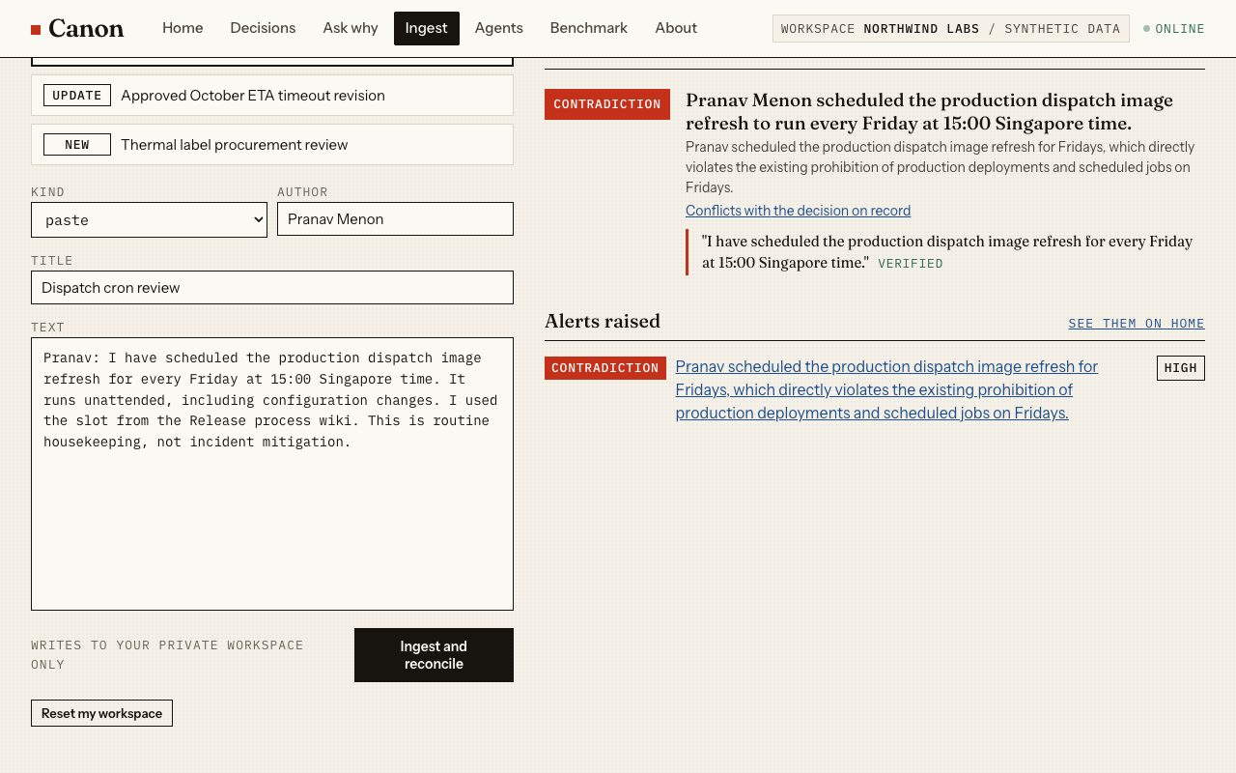
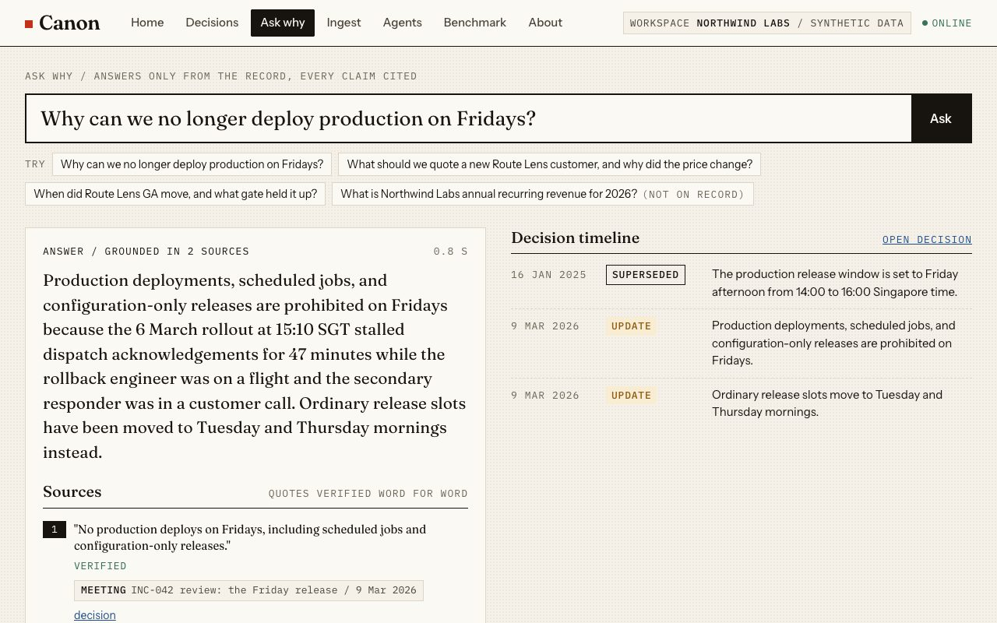
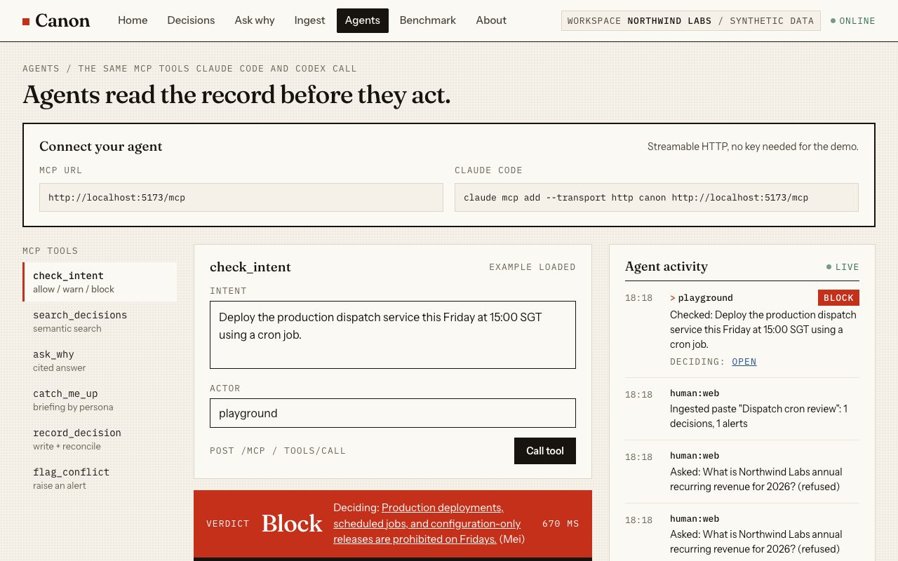
Snapshots of the prototype
Agent blocked on a Friday deploy
Paste raises a contradiction
Ask why: cited answer and timeline
Agent playground over MCP

Slide 11
Prototype performance report / benchmarking
Task (labelled gold set) | Planted | Found | Score
Decisions extracted | 38 | 37 | 97%
Contradictions and updates | 17 | 13 | 76%
False positive alerts |  | 2
check_intent verdicts | 15 | 13 | 87%
Unanswerable, refused | 5 | 5 | 100%
Latency p50 / p95 |  | 1079 / 1325 ms
Notes and misses, in the open
- stale docs found 7/8
- premise changes found 4/5
- updates found 7/9, contradictions found 6/8
- answerable questions answered 10/10, citing an expected decision 10
- 206 stored quotes, every one verified word for word against its source
- latency over 30 ask and check calls, sequential, client to Vertex AI and Firestore in asia-south1
- check miss check-05: expected allow, got block
- check miss check-09: expected block, got allow
- live paste samples: relation correct 3/3, ingest p50 2249 ms
Run 2026-10-17 12:47 UTC, model gemini-3.5-flash-lite. Corpus: 259 synthetic sources, about 100 of them pure noise.
Reproduce: backend/scripts/seed.py, then backend/scripts/eval.py. The app serves the report at /api/eval.

Slide 12
Additional details / future development
Where people already talk: Slack, Microsoft Teams and Discord plug-ins that ingest threads and answer in place. A Discord slash command exists today.
Permissions: sign-in, per-team visibility, and decisions that follow the access rules of their source.
Code review at scale: the GitHub webhook already checks PR text; next, check diffs and post review comments for every repo.
Beyond software: manufacturing SOP drift. A line change or a supplier note that contradicts the approved standard operating procedure raises an alert before a shift runs it.
Better recall: the benchmark shows 4 of 17 contradictions missed; we will tune reconciliation against the gold set.
Real data: ingest this repository's own README, PRs and commits next to the synthetic corpus.

Slide 13
Links
GitHub public repository: https://github.com/tejasnafde/canon
Demo video: (add the video link)
Final product link: https://canon-tn07.web.app
Cloud Run API: https://canon-ezvux7gqxa-el.a.run.app
Connect your agent: claude mcp add --transport http canon https://canon.tn07.dev/mcp
No login needed. All company data is synthetic and labelled as such.

Slide 14


