Slide 1
OLIST STORE ANALYSIS
GROUP-II MEMBERS
DIKSHANT RAVINDRA VARSALE
MARUTHI KUMAR
MOHAMMED HARIS
TEJAS NAMBIAR
KAVITA HOTAKAR
NAGARATNA ASHOK NAIK
MEMAN SAKIRMAHAMMAD PIRMAHAMMAD

Slide 2
INDEX
KPI 1 WEEKDAY VS WEEKEND PAYMENT STATICS
KPI 2 NUMBER OF ORDERS WITH REVIEW SCORE 5 AND PAYMENT TYPE AS CREDIT CARDS
KPI 3 AVEREAGE NO. OF DAYS TAKEN FOR ORDER DELIVERED CUSTOMER DATE FOR PET SHOP
KPI 4 AVERAGE PRICE AND PAYMENT VALUES FROM CUSTOMERS OF SAU PAULO CITY
KPI 5 RELATIONSHIP BETWEEN SHIPPING DAYS VS REVIEW SCORES
KPI 6 SALES AND PROFIT OF TOP 10 CITIES
KPI 7 REVIEW SCORE DISTRIBUTION
KPI 8 TOP 5 CATEGORIES BY PRICE VALUES
EXCEL DASHBOARD
POWERBI DASHBOARD
TABLEAU DASHBOARD
SQL QUERIES
CONCLUSION
CHALLENGES AND OVERCOME

Slide 3
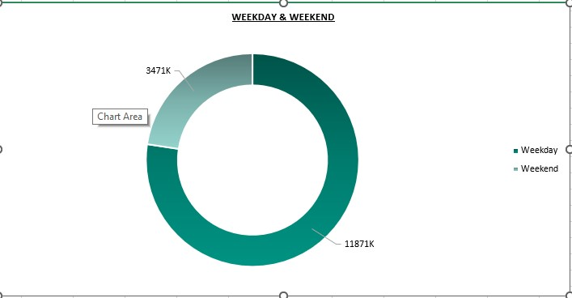
Weekday Vs Weekend Payment Statistics
Compare consumer spending behavior between weekdays and weekends.
Identify revenue contribution (total payment value) from weekdays vs weekends.
Measure transaction volume (number f orders) across weekdays and weekends.

Slide 4
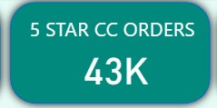
Number of Orders with review score 5 and payment type as credit card.
Measure customer satisfaction by analyzing the count of 5-star reviewed orders paid via credit card.
Understand preferred payment behavior among highly satisfied customers.
Identify the share of credit card payments in driving positive customer experiences.

Slide 5
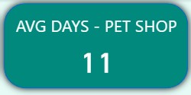
Average number of days taken for order_delivered_customer_date for pet_shop
Evaluate delivery efficiency for pet_shop orders by calculating the average delivery time.
Identify potential delays in the pet_shop category compared to other categories.
Understand customer experience impact by linking delivery speed with satisfaction for pet products.

Slide 6
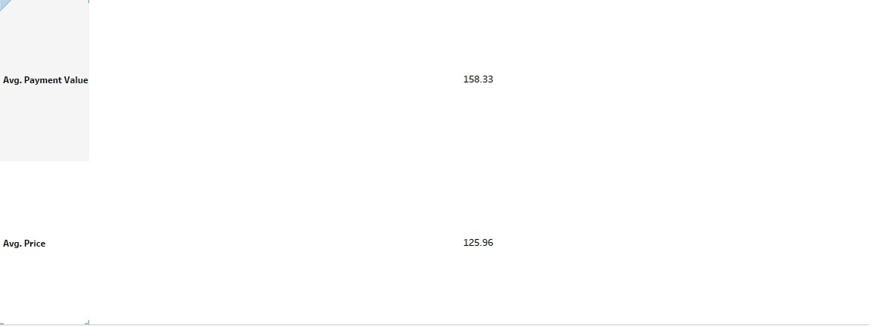
Average price and payment values from customers of sao paulo city
Analyze customer spending behavior in São Paulo by calculating average product prices and payment values.
Identify purchasing power trends specific to São Paulo customers.
Compare price vs payment values to check if additional costs (shipping, fees, installments) affect the final payment.

Slide 7
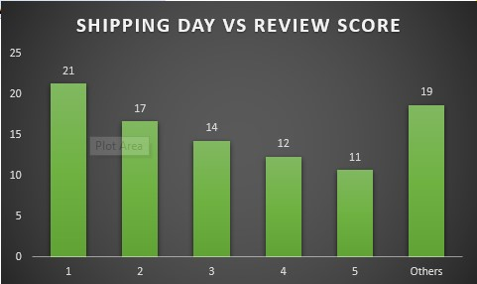
Relationship between shipping days Vs review scores.
Examine the impact of delivery time on customer satisfaction by comparing shipping days with review scores.
Identify patterns (e.g., longer delivery times leading to lower review scores).
Quantify customer expectations regarding delivery speed and how it influences feedback.

Slide 8
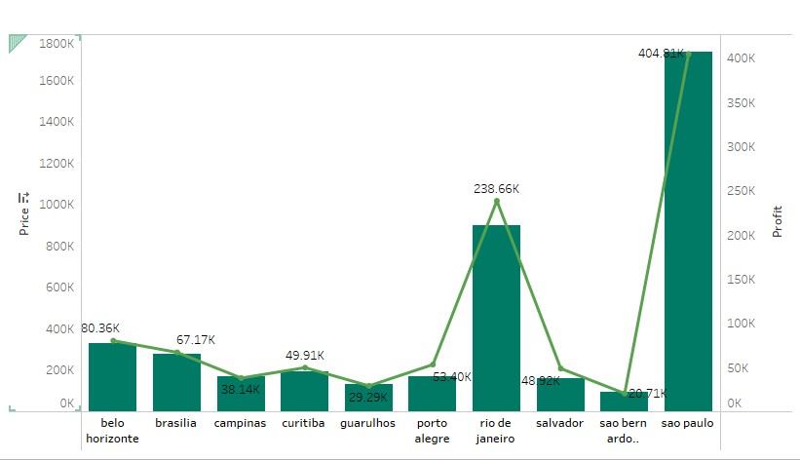
SALES AND PROFIT OF TOP 10 CITIES
Identify the top-performing cities in terms of total sales and profit contribution.
Compare profitability vs revenue to highlight cities that generate high sales but lower profit margins (or vice versa).

Slide 9
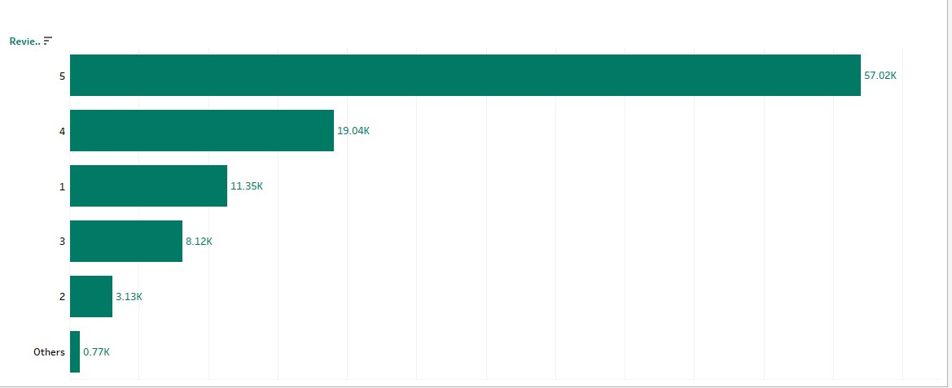
REVIEW SCORE DISTRIBUTION
Understand overall customer satisfaction by analyzing how review scores are distributed.
Identify patterns of positive and negative feedback to gauge service and product quality.

Slide 10
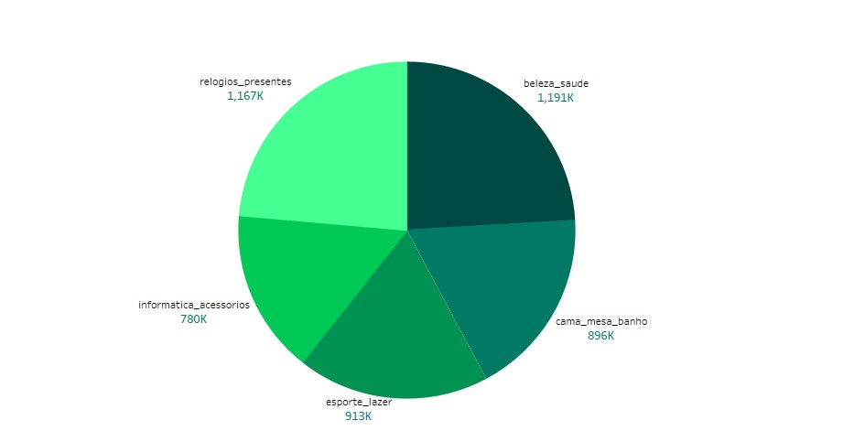
Top 5 categories by price values
Identify the highest-value product categories by analyzing total or average price values.
Understand revenue contribution of each top category to prioritize business focus.

Slide 11
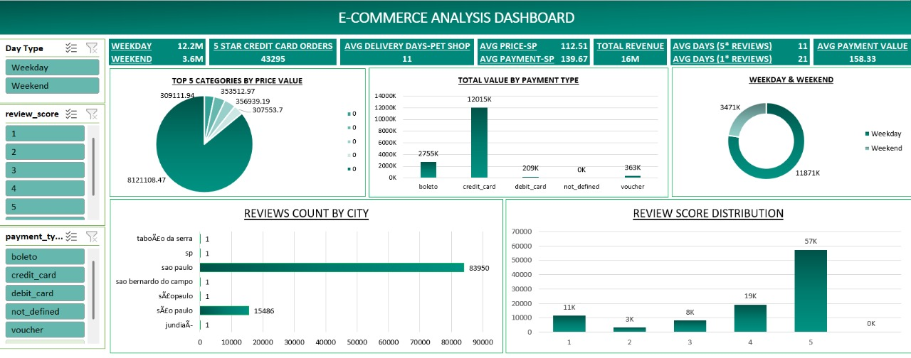
EXCEL DASHBOARD

Slide 12
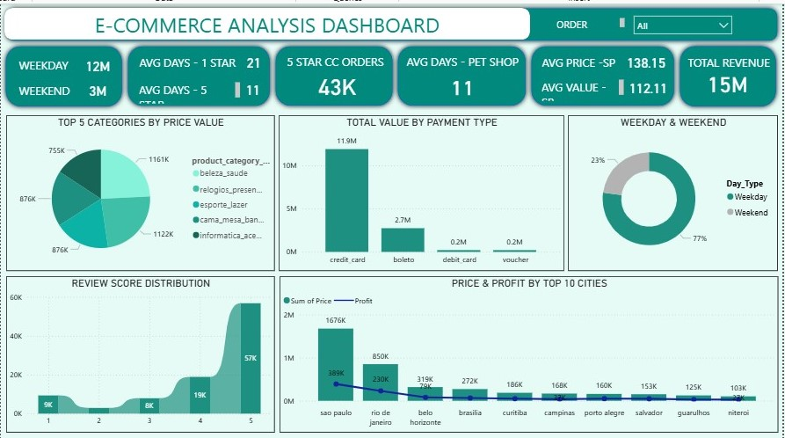
POWERBI DASHBOARD

Slide 13
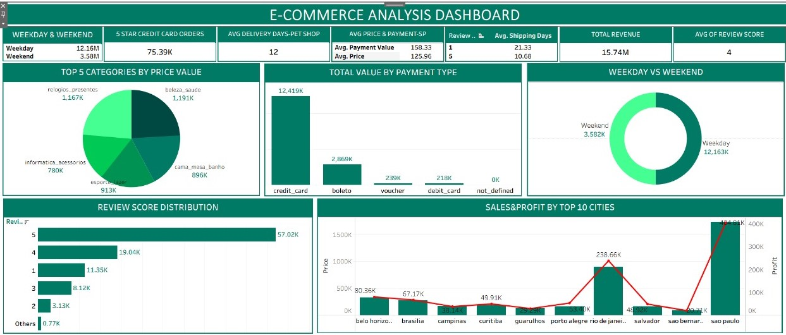
TABLEAU DASHBOARD

Slide 14
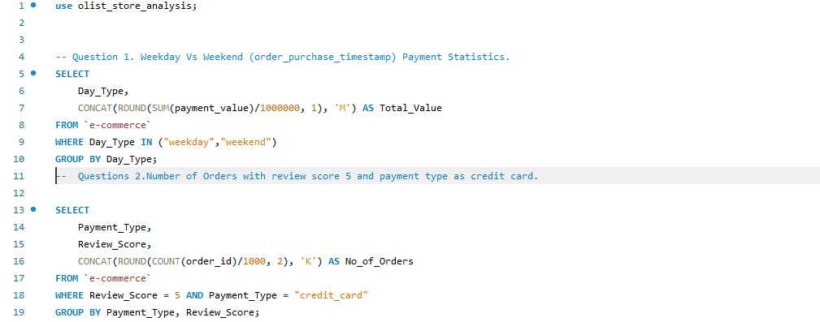
SQL QUERIES

Slide 15
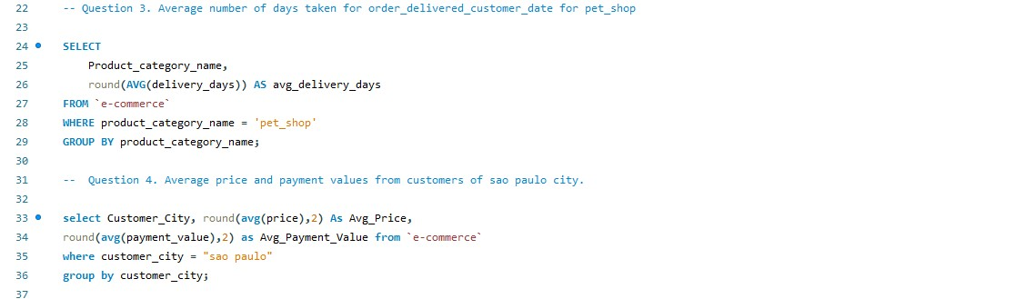

Slide 16
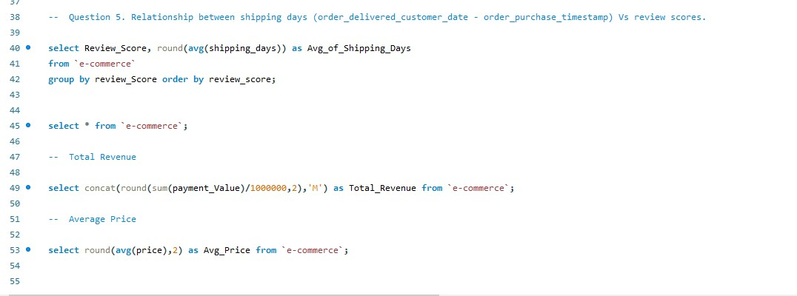

Slide 17
CONCLUSION
According to the data, Olist E-commerce has about 99,440 orders. With about 89,940 orders being delivered, the company has a 90% delivery success rate. ✔ Their average product rating is 4.09 stars, with product categories going as high as 4.67 stars and as low as 2.5 stars. 1 Star reviews are on third place in the review score distribution ranking which likely indicates that there could be problems with product quality in some product categories ✔ It helps in understanding the spending patterns of customers in sao paulo city .it also helps Olist in identifying high value customers and creating targeted marketing campaigns. ✔ The analysis of payment statistics based on weekday vs. weekend provides an understanding of the buying behavior of customers. and can also help Olist to improve their weekend sales and plan promotions accordingly.

Slide 18
CHALENGES AND OVERCOME
CHALLENGES
Difficulty importing large dataset into MySQL due to errors like 1290 and 1146.
Difficulty in creating clear and meaningful pivot tables .
Interpreting the relationship between delivery time and customer review scores.
Too many categories in data
Understanding the project scope or objectives at the start.
OVERCOME
Researched the error, modified MySQL configuration file and enabled local data loading to import data successfully.
Experimented with different pivot configurations, used calculated fields and added visual charts for better data presentation.
Conducted correlation analysis and visualized trends, discovering that delayed deliveries often led to lower review scores.
Grouped similar categories and focused on top performing once.
Planned tasks in stages, reviewed results regularly, and ensured all insights aligned with project objectives.

Slide 19

P1005 Ecommerce

