Slide 1
Tender Management System
Project members:-
SHASHI RAJ --- 16/IT/14
AYUSH VIKAS --- 16/IT/49
DEEPSIKHA --- 16/IT/47
AHANA GUCHAIT --16/CS/135
MANJUSHA BARMAN--16/CS/89

Slide 2
Abstract:
Project developed to enable the vendors to get all the tender details online and provide facility to submit the tender.
Provides a system which will reduce the extra cost which involves for this entire process like:-
Advertising
Document processing
Getting confirmation results.
Vendors can save a lot of time. This application makes the evaluation process to complete within the assigned date.
Different vendors with provides different Bids among which some selected bids can be approved

Slide 3
Existing System:
This Tender Management System works need to be completed manually.
Contractors need to submit their documents by visiting the office or centers on time.
Contractors has to bid for particular tender on time by applying forms and needs to wait for approval reply.
The Admin Needs to post the Projects or contracts as a poster or advertisements regularly.
It takes long time to access tenders or vendors data accessing.
Not much secure.

Slide 4
Proposed System:
User Needs to Have a Network Connection.
New User needs to register as new vendor in the website.
Contractors can login and bid for some existing tenders.
They need to login using their login-id and password which they used while registration
To reduce paper work, data which are available online, using this final decision can be taken by the administration and can contact directly to such suppliers.
More data security.
Easy to access the tenders and vendors data.

Slide 5
Software Requirements:
Language : Java
Web technologies : J2EE (JDBC/Servlets/JSP)
Front-end Design : Html, CSS, JSP, Bootstrap
Database: MYSQL
Scripting: JavaScript , CSS
Browser : IE 6.0/ Mozilla/ Chrome
Operating System : Windows/Linux

Slide 6
Hardware Requirements:
Processor : Pentium-IV
RAM : 1GB
Hard disk : 20GB
Monitor : 15” Color monitor
Mouse : Optical mouse

Slide 7
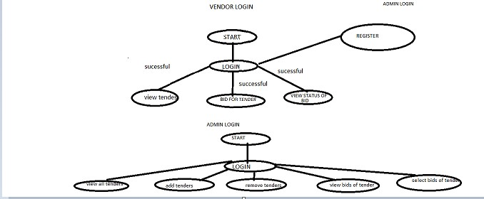
Application Work Flow

Slide 8
Modules: Administrator
Administrator is the master user of this system
Responsible of Admin Includes:
Uploading advertisement documents
Verifying projects and contractors by using their information
Accepting and Rejecting Bids
Maintaining data and confirmation of final report.
Update Notice Board
Make some announcement
Block or unblock some vendors or company

Slide 9
Company
The Company needs to get registered to proceed.
Company can log in with a valid username and password.
Apply or releases new tenders and view the status of the tender.
Make Some announcement.
Change the tender details
Documentations

Slide 10
Vendor
Vendors are the key persons or contractors who looks for new upcoming tenders on the website
Vendors Functionality include:
New Vendors can register
Login using vendor-id and password
View and update their profile
See the new open tenders and their details
Bid for a tender with an amount greater than its base price
See the bid approval or denial status
After the tender status approval they can view and submit the documentation
Vendors can look for the important notice on the notice section

Slide 11
Database Description
Table notice
Field Name | Data Type | Size | Is Null ? | KEY
id | int | 3 | No | Primary Key
title | varchar | 35 | Yes
info | varchar | 300 | Yes
Table tenderstatus
Field Name | Data Type | Size | Is Null ? | KEY
tender-id | varchar | 15 | No | Primary Key
bidder-id | varchar | 15 | Yes
status | varchar | 15 | No
vendor-id | varchar | 15 | Yes

Slide 12
Database contd..
Table tender
Field Name | Data Type | Size | Is Null ? | KEY
tid | varchar | 15 | No | Primary Key
tname | varchar | 40 | Yes
ttype | varchar | 20 | Yes
tprice | int | 11 | Yes
tdesc | varchar | 300 | Yes
tdeadline | date |  | Yes
tloc | varchar | 70 | Yes

Slide 13
Database contd..
Table vendor
Field Name | Data Type | Size | Is Null ? | KEY
vid | varchar | 15 | No | Primary Key
password | varchar | 20 | Yes
vname | varchar | 30 | Yes
vmob | int | 12 | Yes
vemail | varchar | 40 | Yes
company | varchar | 20 | Yes
address | varchar | 100 | Yes

Slide 14
Web pages Screenshots

Slide 15
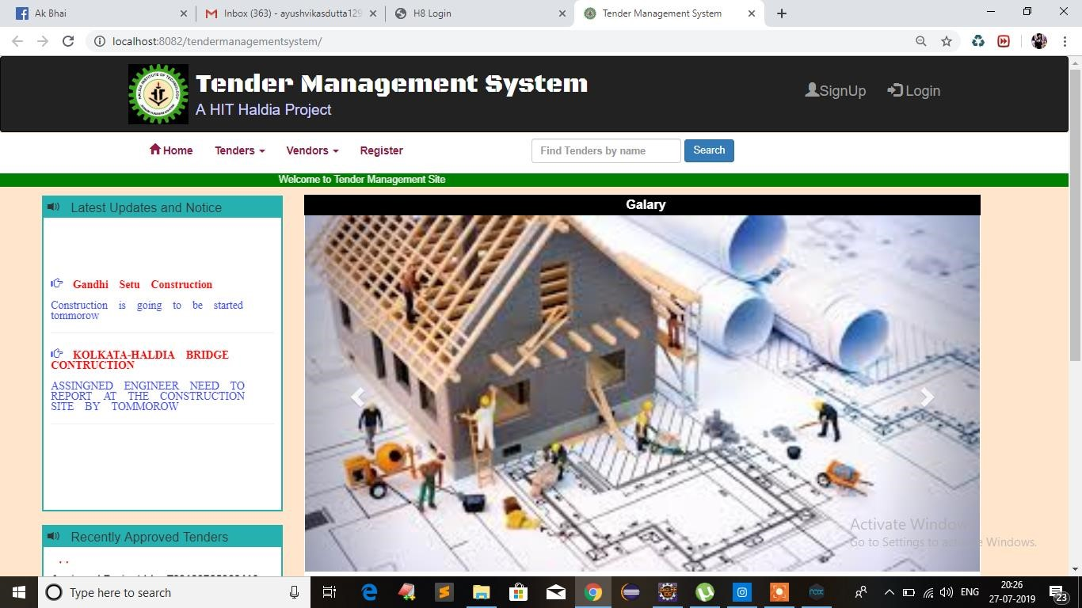

Slide 16
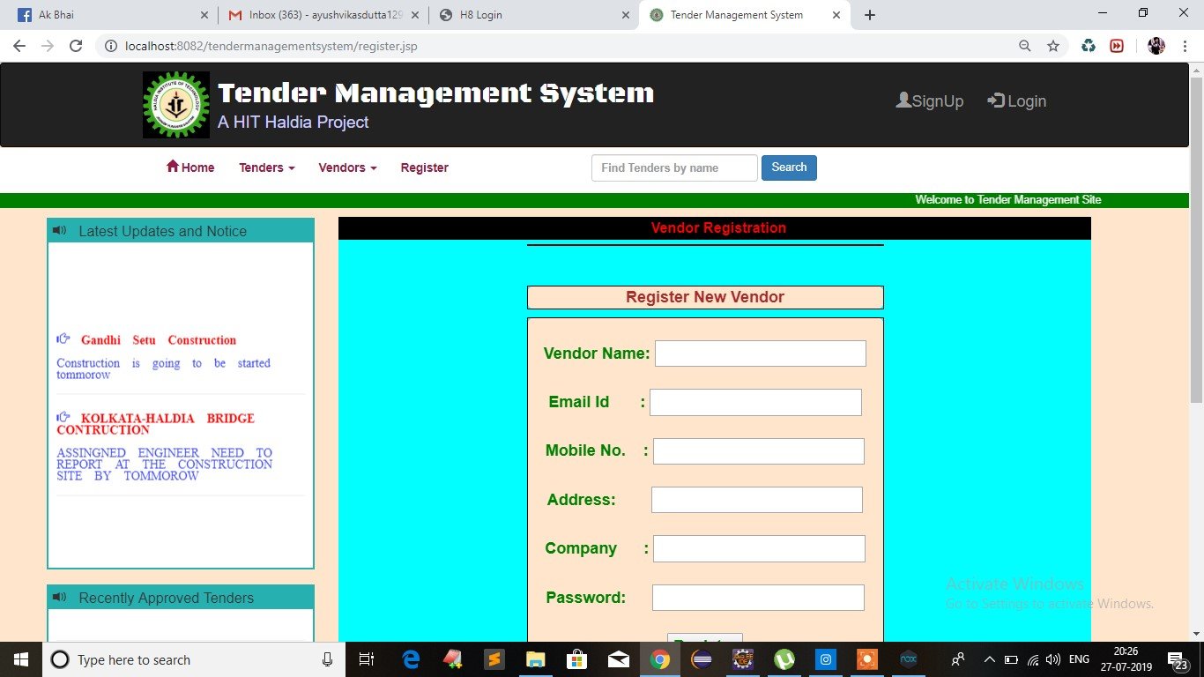

Slide 17
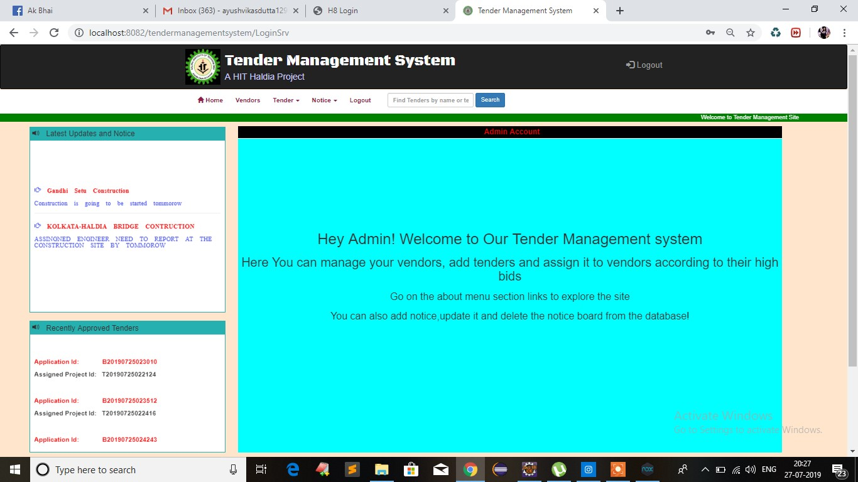

Slide 18
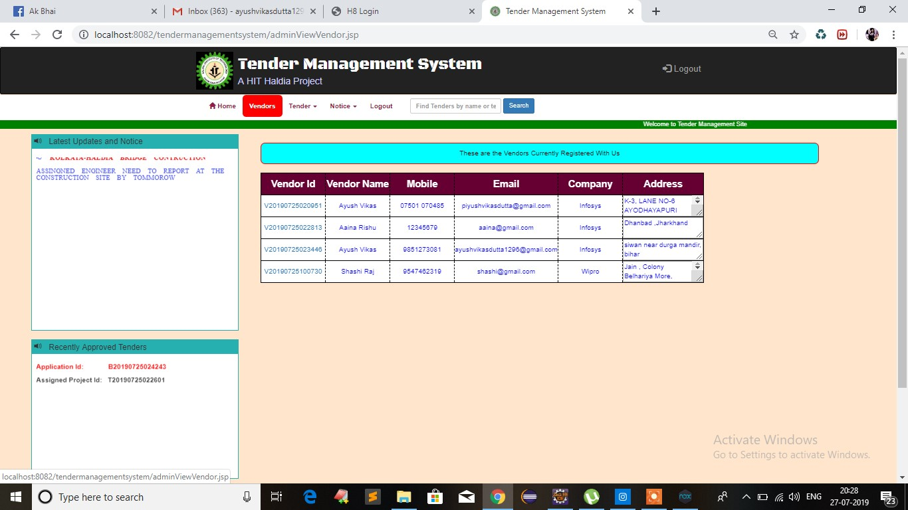

Slide 19
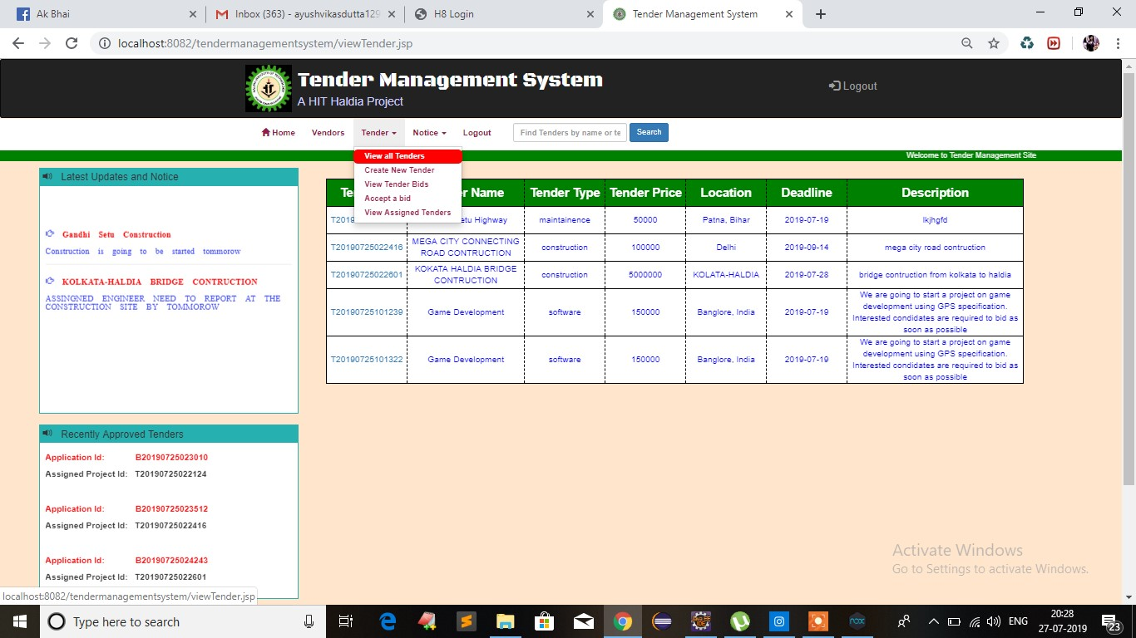

Slide 20
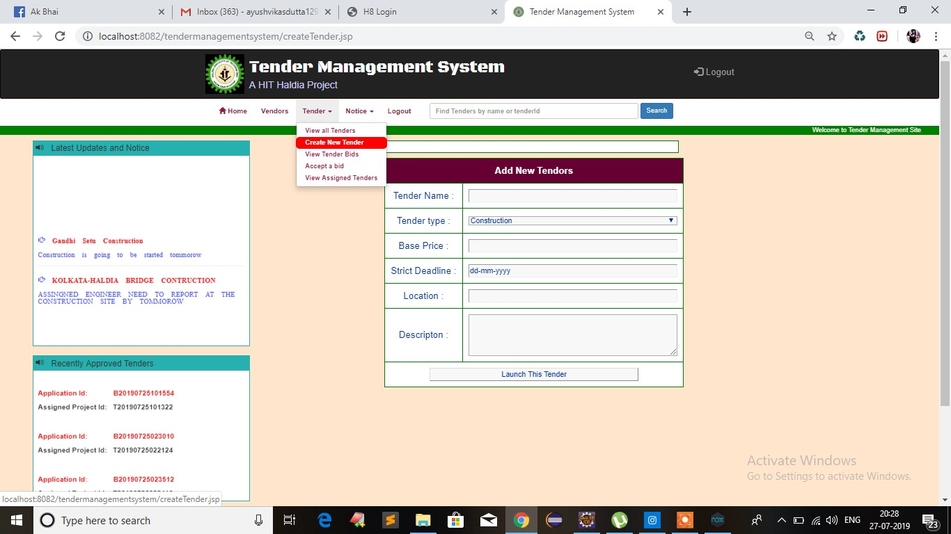

Slide 21
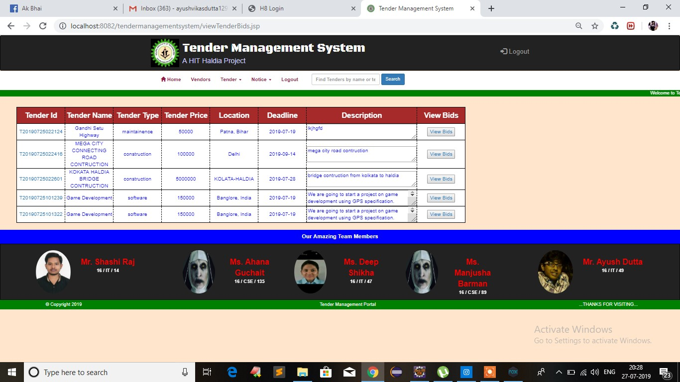

Slide 22
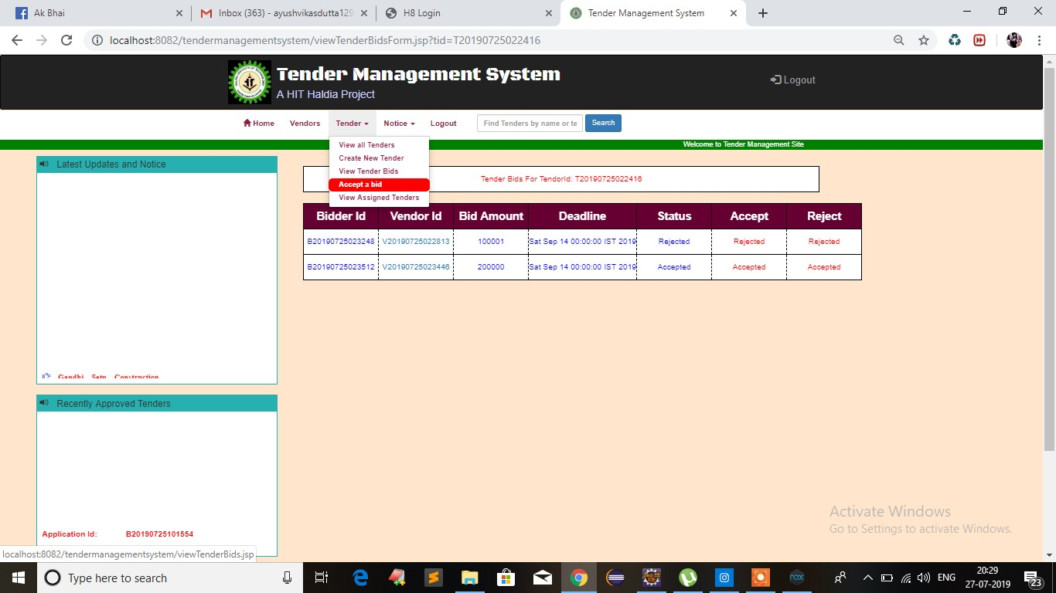

Slide 23
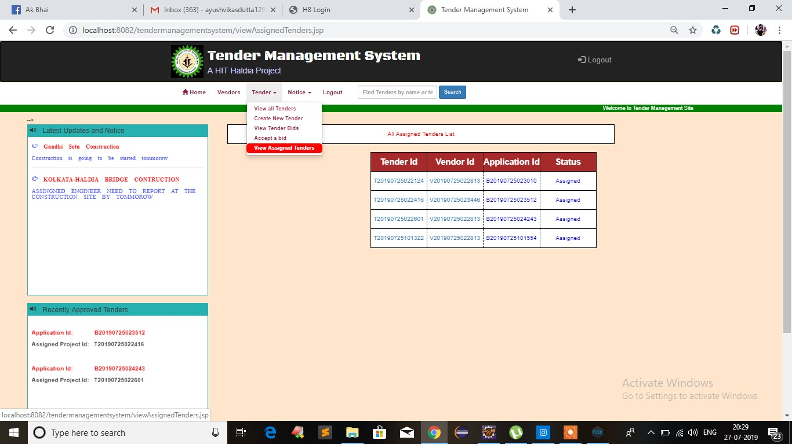

Slide 24
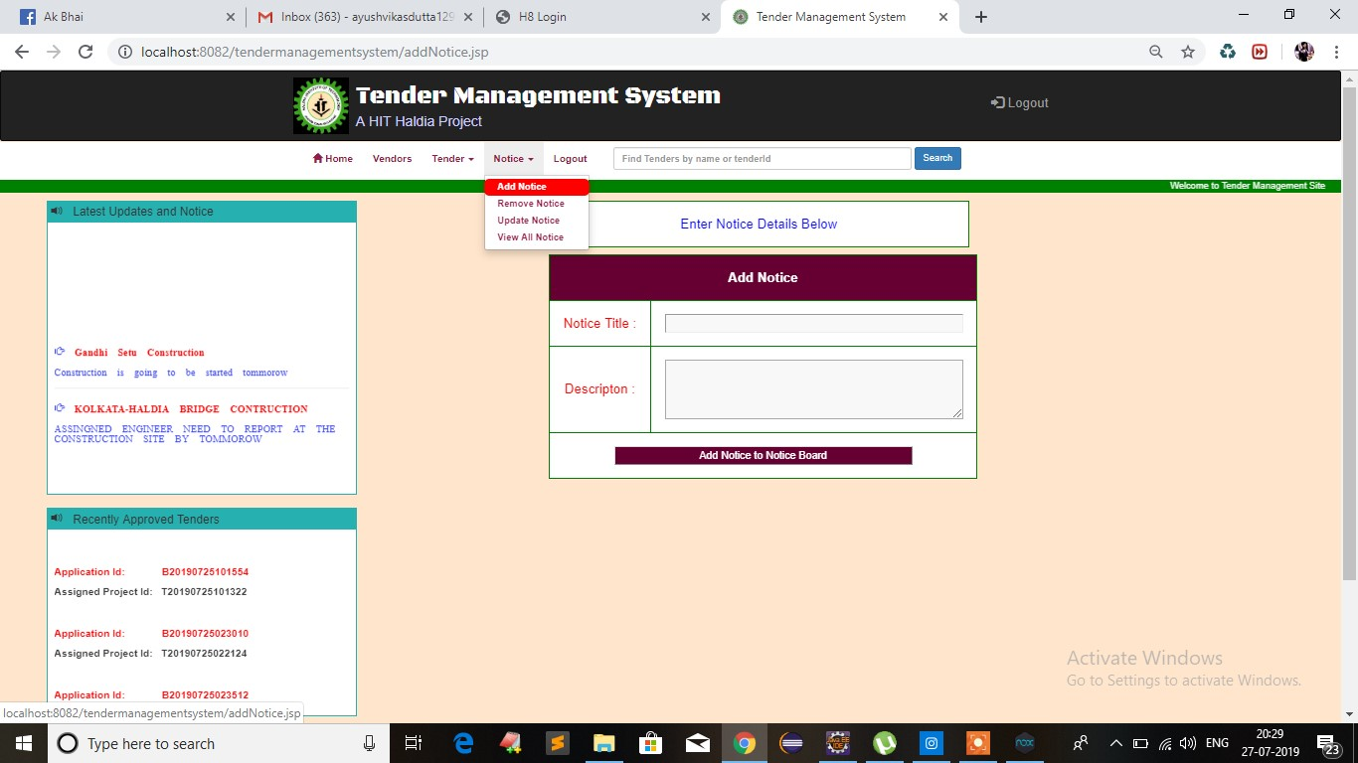

Slide 25
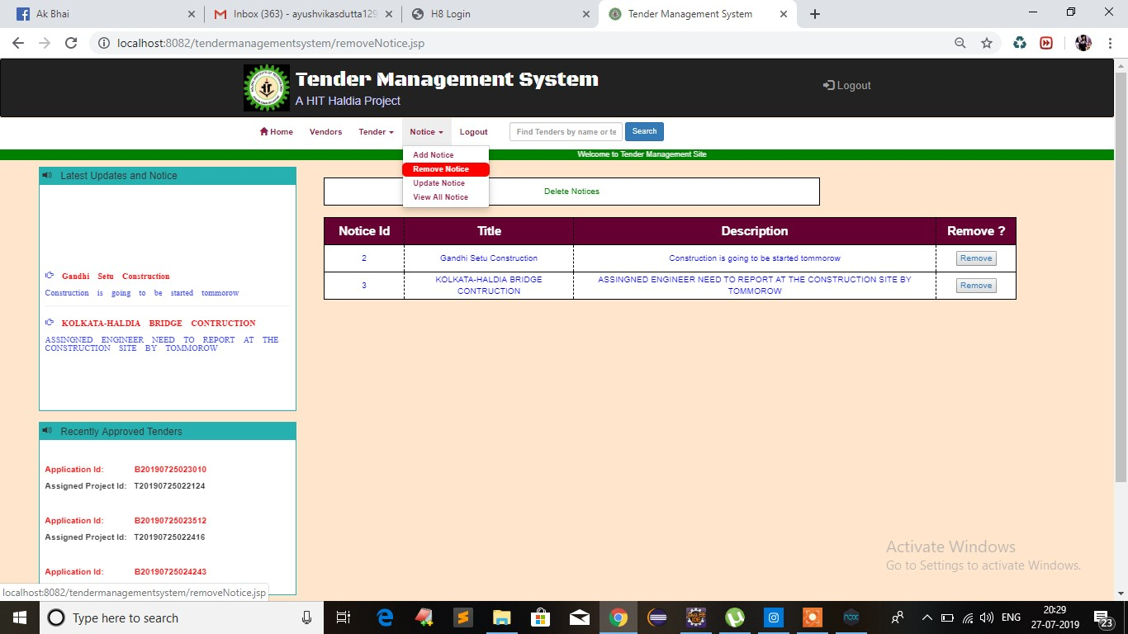

Slide 26
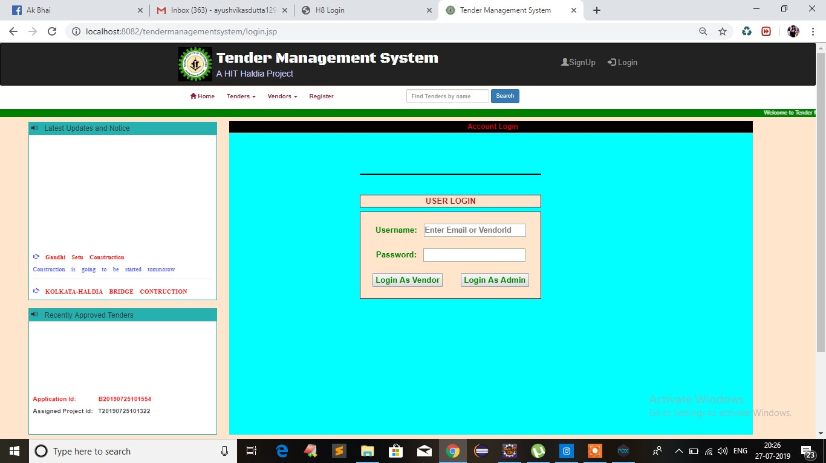

Slide 27
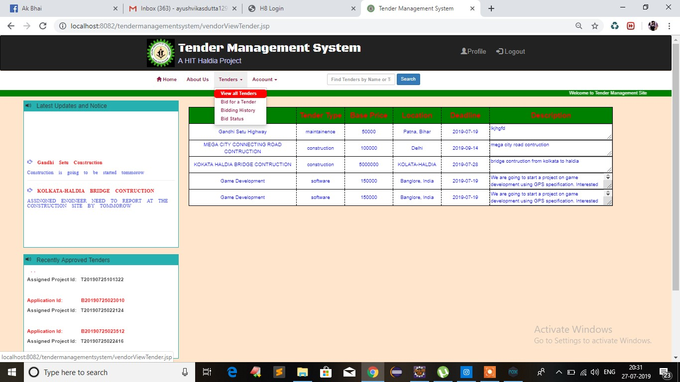

Slide 28
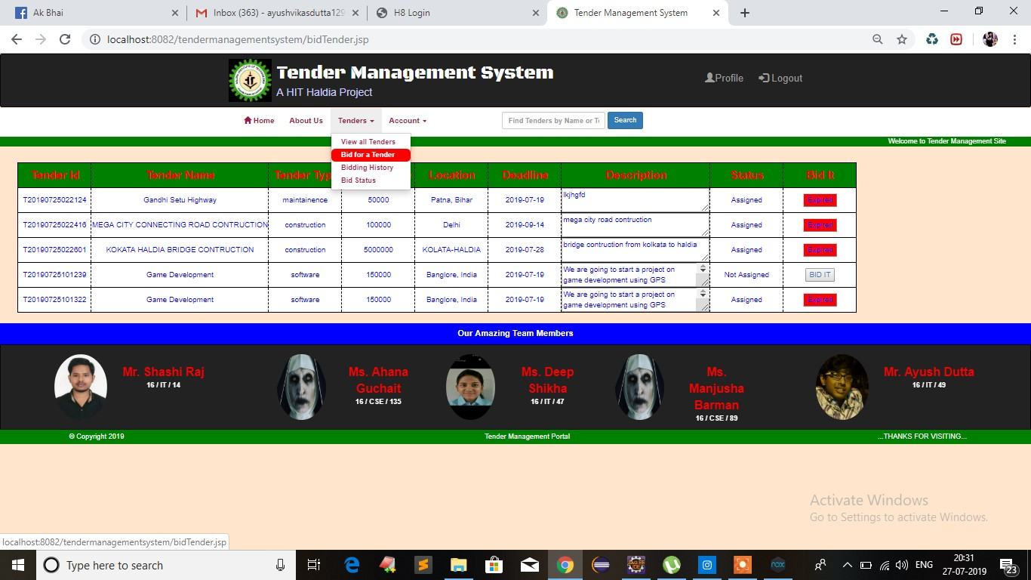

Slide 29
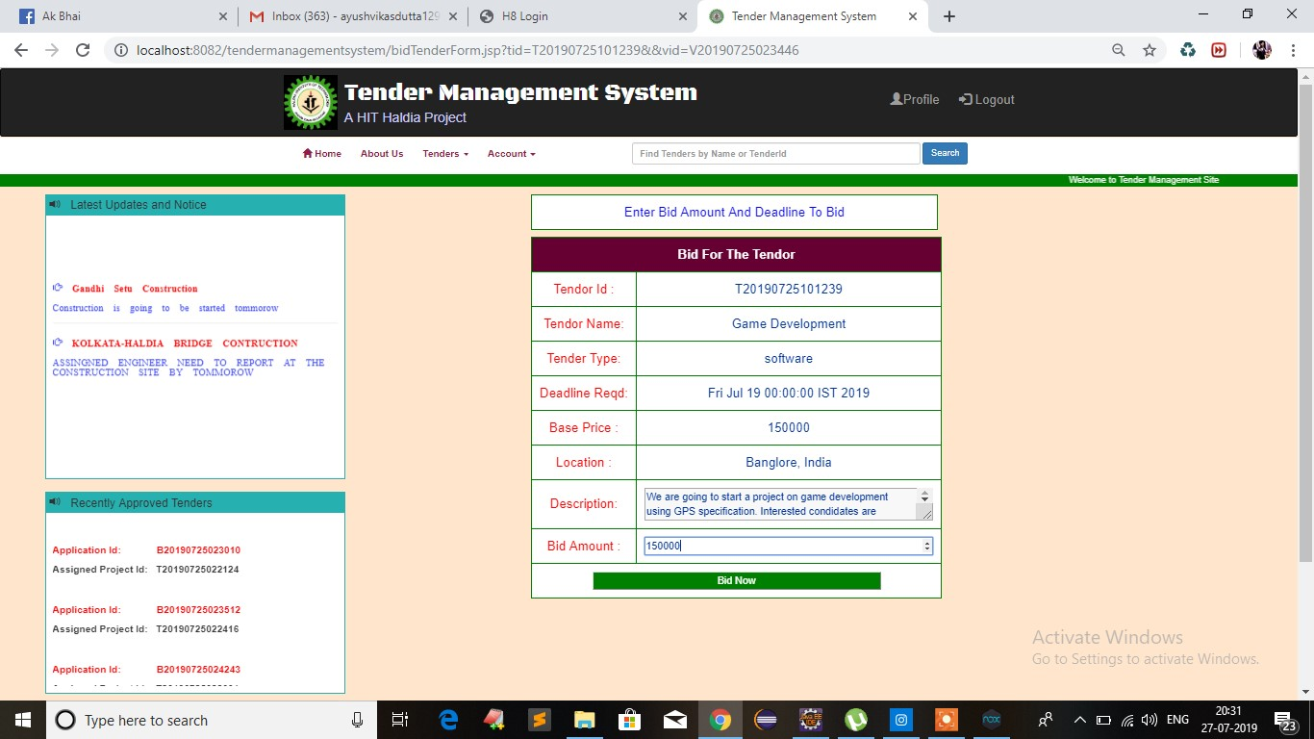

Slide 30
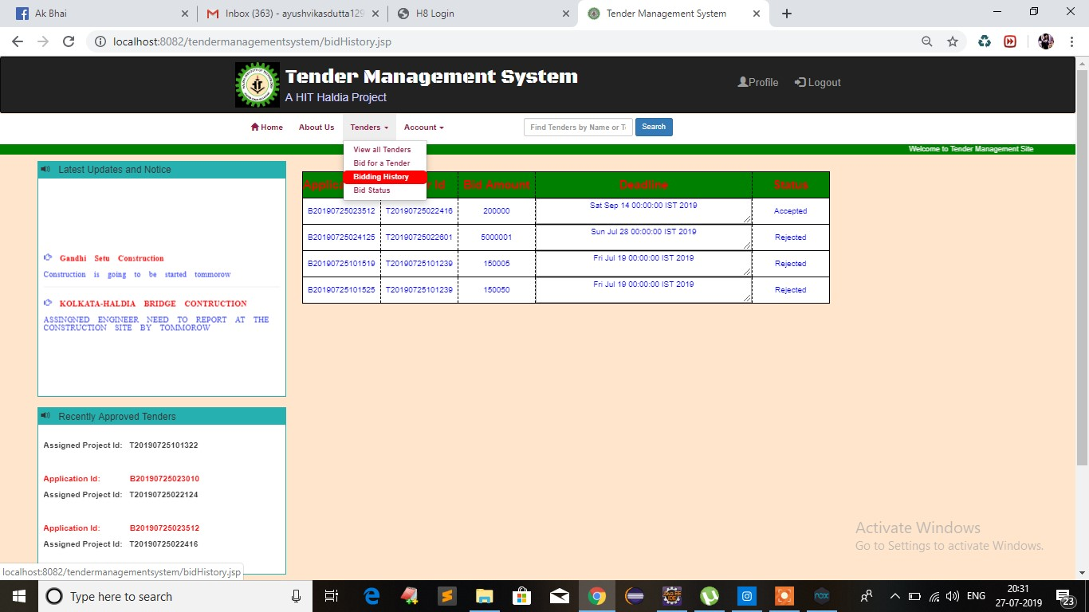

Slide 31
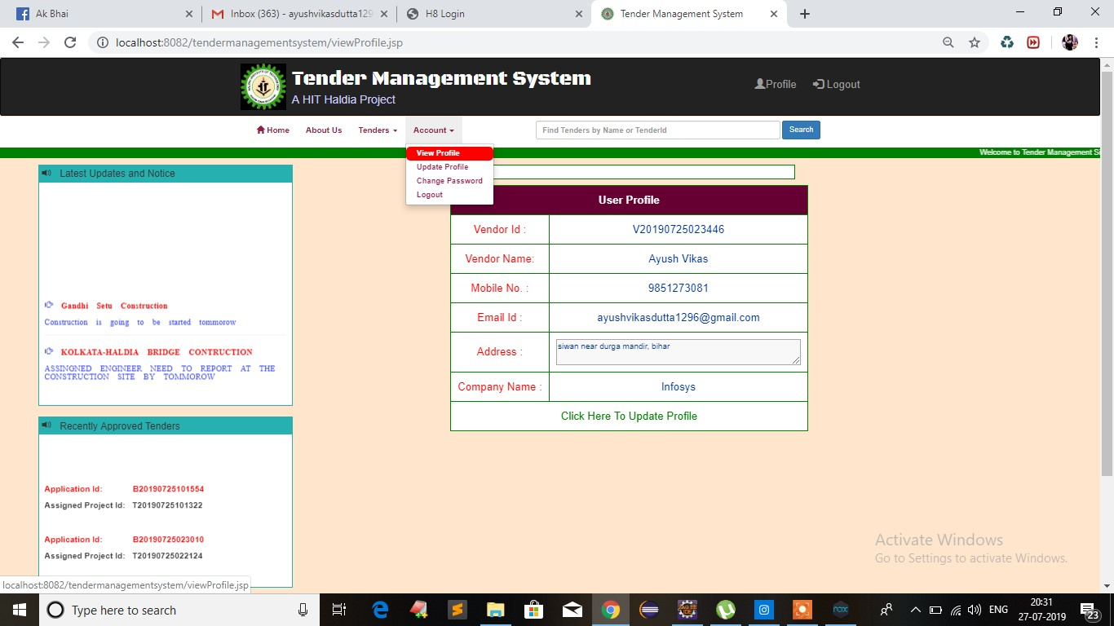

Slide 32
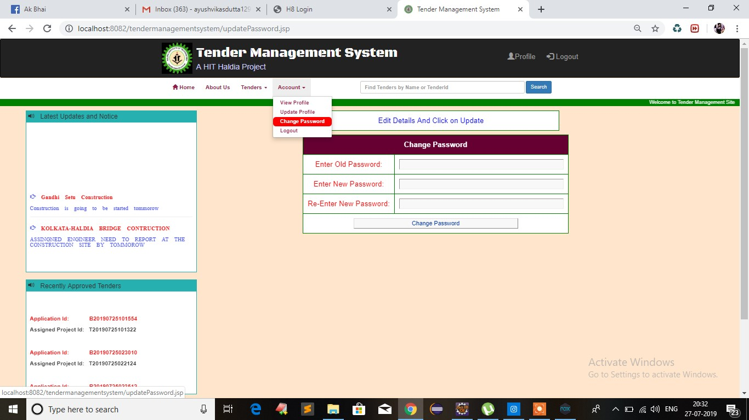

Slide 34
Conclusion
Our Project Tender management System Successfully Created a user friendly environment for tender management process.
This Project is flexible and changes can be incorporated easily.
Easy for further Modification
Saves a lot of time by doing most of the processes online
It may leads to increase profit and improve the quality of a company.
Assigns the tenders and project in a well manner and optimal way to the contractors in less time with low cost charges.

Slide 35
thanks

