Slide 1


CookBook
Book that helps you to Cook
Under Guidance of
Prof. Sakshi Sharma
Prof. Ahmad Reza Madabadi
Prof. SilviyaPaskaleva
Submitted by
Tejas Patel - 2091244
Manali Thakkar - 2091131
Sahil Rana - 2091130
HarishBabu Alle - 2091129
Sai Kiran Reddy Kalli - 2091305

Slide 2
Contents
FEATURES INCLUDED IN OUR APPLICATION
SELECTION OF FEATURES
SOME FEATURES WE EXCLUDED
TECHNOLOGIES USED
WHY WE CHOSE PARTICULAR TECHNOLOGIES?
DIVISION OF WORK
COVID 19 AND ITS IMPACT
DIFFICULTIES THAT WE OVERCOME
WHAT WENT EASIER
ARE THERE ANY DECISIONS TO REGRET?
GITHUB CONFLICTS

Slide 3
FEATURES INCLUDED IN OUR APPLICATION
User Authentication
Password Reset
Discover Recipes
Add Recipes
Update Recipes
Remove Recipes
Review Recipes
Favourite Recipe List
Last Visited Recipe List
Manage User Profile

Slide 4
SELECTION OF FEATURES
Basic Functionalities
Features that makes things easier
Necessary Features
Attractive Features
Reference of existing applications

Slide 5
SOME FEATURES WE EXCLUDED
Google Signup
Notifications
Limited data content of User Profile
Update recipe/profile image
See profile of other users/chefs
Comments on recipe

Slide 6
TECHNOLOGIES
USED
Android Studio
Firebase
Adobe XD
Looka (Logo Maker Website)
Lucid Chart
Github
Google Doc
Google Slide
Solid Principles

Slide 7


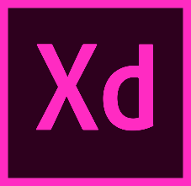
Why we chose particular technologies?
•Android Studio: Android Studio is the official integrated development environment (IDE) for Google's Android operating system, built on JetBrains' IntelliJ IDEA software and designed specifically for Android development.
•Firebase: Firebase is a Backend-as-a-Service (Baas). It is built on Google's infrastructure. Firebase is categorized as a NoSQL database program, which stores data in JSON-like documents. Therefore, it is used as a database in our application.
• Adobe XD: Adobe XD is a powerful tool you can use for your entire designing process. Adobe XD has many plugins and you can use the plugin to help you to convert Adobe XD to Android Studio. Therefore, we used it to design all the layouts of our application.

Slide 8

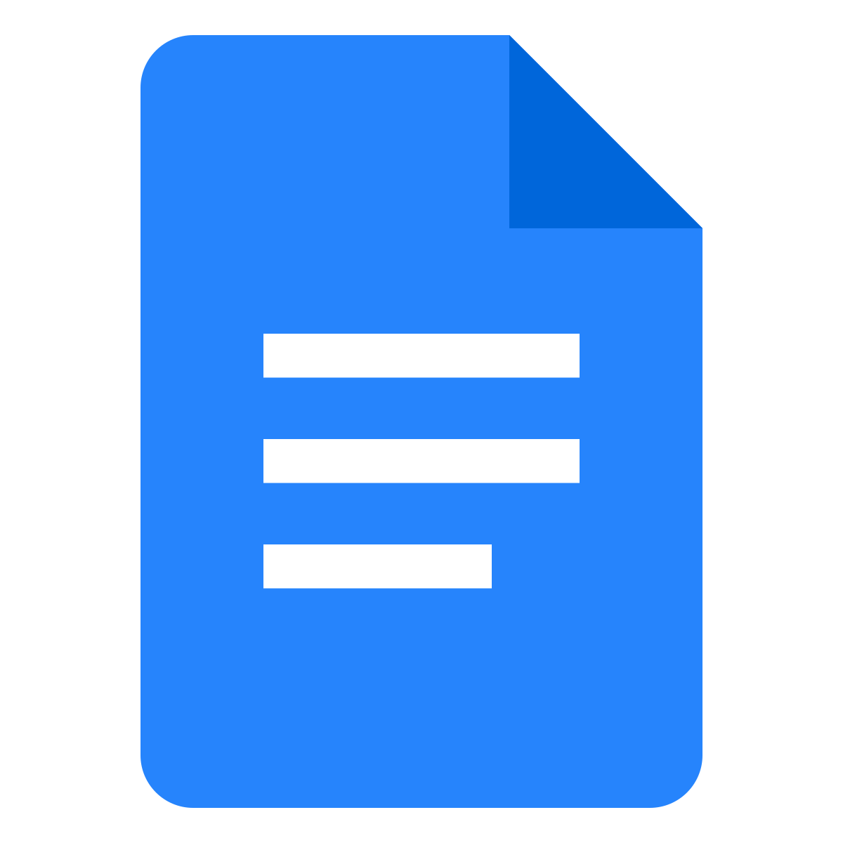



Why we chose particular technologies?
Looka software is powered by AI to create a logo that matches our vision. There is no design skills required to create desired logo.
Lucidchart is a web-based platform that allows users to create and share the charts and UML diagrams.
Github is a web-based platform used for version control. Team members can work on files and easily merge their changes in with the master branch of the project.
Google Docs is an online word processor. Multiple people can work at the same time.
Google Slides is a web-based presentation program.

Slide 9
Division of work
Tejas Patel : Icon/Logo , Manage Recipe Database(CRUD), Introduction, User Stories, User Story Backlogs, Iteration Planning, UML Diagram in documentation
Manali Thakkar : User Authentication, Manage User Database, English to French Conversion, User Stories, UML diagram in documentation
Sahil Rana : Layouts for managing Recipes, Search Recipe Database, Screen flow diagram in documentation
HarishBabu Alle : Splash Screen, Layouts for user authentication, Logic of recipe review, Functional - Non-functional Requirement, UML diagrams, application testing in documentation
Sai Kiran Reddy Kalli : Manage User Database, Attractive Recipe Functionalities, Functional - Non-functional Requirement, UML diagrams, application testing in documentation

Slide 10
COVID 19 AND ITS IMPACT
Initially we were not able to work in virtual environment
Schedule for online meetings were difficult to make
We all suffered due to lack of real time meetings and discussion

Slide 11
DIFFICULTIES THAT WE OVERCOME
Working with Real Time database
Storing image and Image processing
Some functionalities

Slide 12
WHAT WENT EASIER
Documentation
Major part of coding
Logo Designing
Animation Effect

Slide 13
ARE THERE ANY DECISIONS TO REGRET?
Functionalities
Google Signup
Notification

Slide 14
GITHUB CONFLICTS
Initially we forget to pull code before we push our changes to github
Contributor issue

Slide 15
Thank You

