Slide 1

Dissertation Phase-II
On
“IoT Sensor Based Warehouse Monitoring System and Control Interface Implementation”
Walchand College Of Engineering, Sangli
Department Of Electronics Engineering
Academic Year : 2018-19
Semester III
Under the Guidance of:
Mr. S. R. khedkar
Assistant Professor
Presented By:
Tejas S. Patil
(2017MTEEN00029)

Slide 2
Contents
Introduction
Block Diagram of System
Block Diagram of Development Board
Objectives
Work done
Result
Activity Chart
Work to be done

Slide 3
Introduction
Any production or trading is faced with the need to store their reserves or any useful stuff somewhere. This function is performed by warehouses or storages.
With an increase in the number of warehouses, the need for monitoring temperature, humidity, gas etc in such factories has become a thing of great necessity.
Upcoming IoT architectures and wireless sensor networks allow real-time remote monitoring and analysis of a system as well as the possibility to take immediate remedial actions.

Slide 4
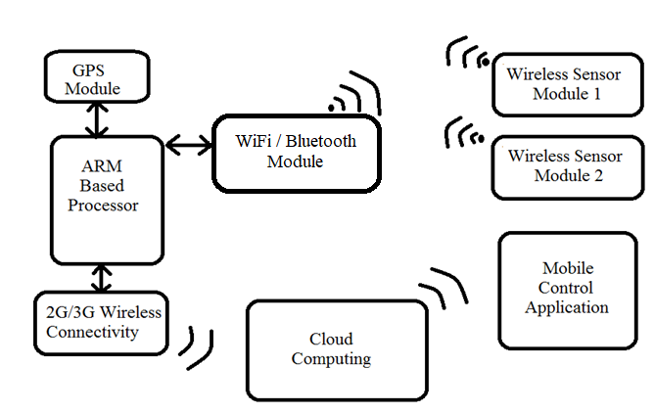
Block Diagram of overall System

Slide 5
Block Diagram of board
USB
VUSB
LiPo
BATTERY
MAX17043
(FUEL GAUGE)
RESET BUTTON
Li+
ARM Based Processor
MODE
BUTTON
VIN
BQ24195
(Power MGMT)
RGB SYSTEM LED
3V3
TPS62291
(3.3V Regulator)
RED STATUS LED
D7 USER LED
DAC
WKP
TX/RX
D0-D7
A0-A7
B0-B7
C0-C7
U-BLOX
(CELLULAR MODULE)
BUFFERS
(1.8< >3.3)
SIM

Slide 6
Objectives
Designing a circuit, PCB layout and assembly of development board for the System.
Board verification, processor development and writing device driver for the system.
Study and development of android studio for APK-UI development and APK-cloud interface.
Cloud based data Analytics Algorithm implementation and result monitor mechanism in APK.
Experiment on Test setup for hardware/ software System and validation of result.

Slide 7
Work Done
Study of Development board.
Understanding of Sensors and Hardware components.
Implementation of sensor interface with Development board.
Study of cloud platform and sending data to cloud.
Controlling sensor with Android Application.
Implementation of data analytics on Excel Sheet and web page.
Designing of Android Studio Application.

Slide 8
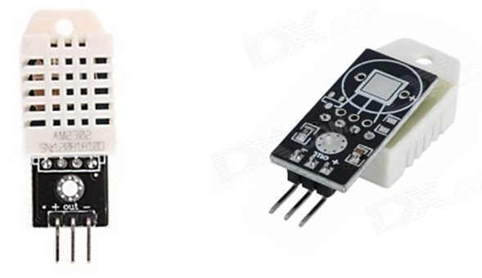
Dht-22 sensor
Low cost.
3 to 5V power and I/O.
2.5mA max current use during conversion (while requesting data).
Good for 0-100% humidity readings with 2-5% accuracy.
Good for -40 to 125°C temperature readings ±0.5°C accuracy.
No more than 0.5 Hz sampling rate (once every 2 seconds).

Slide 9
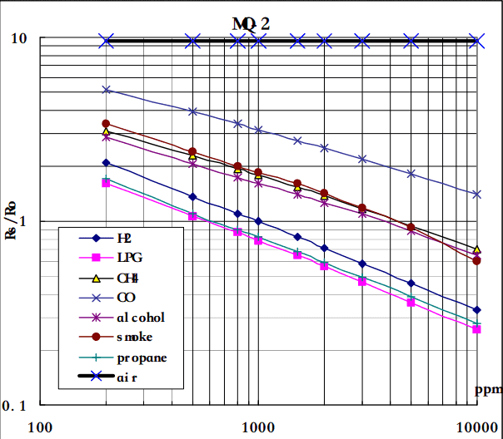
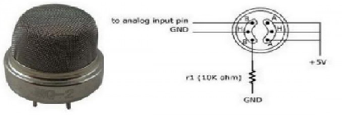
MQ2 sensor
Operating Voltage is +5V.
Can be used to Measure or detect LPG, Alcohol, Propane, Hydrogen, CO and even methane.
Analog and Digital Output Voltage: 0V or 5V (TTL Logic).

Slide 10
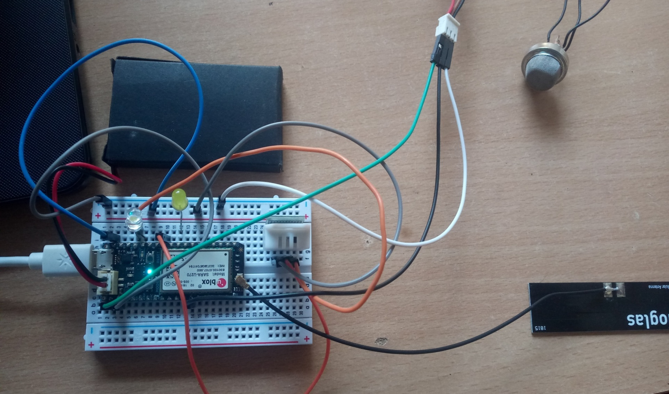
Interfacing of sensor with development board

Slide 11
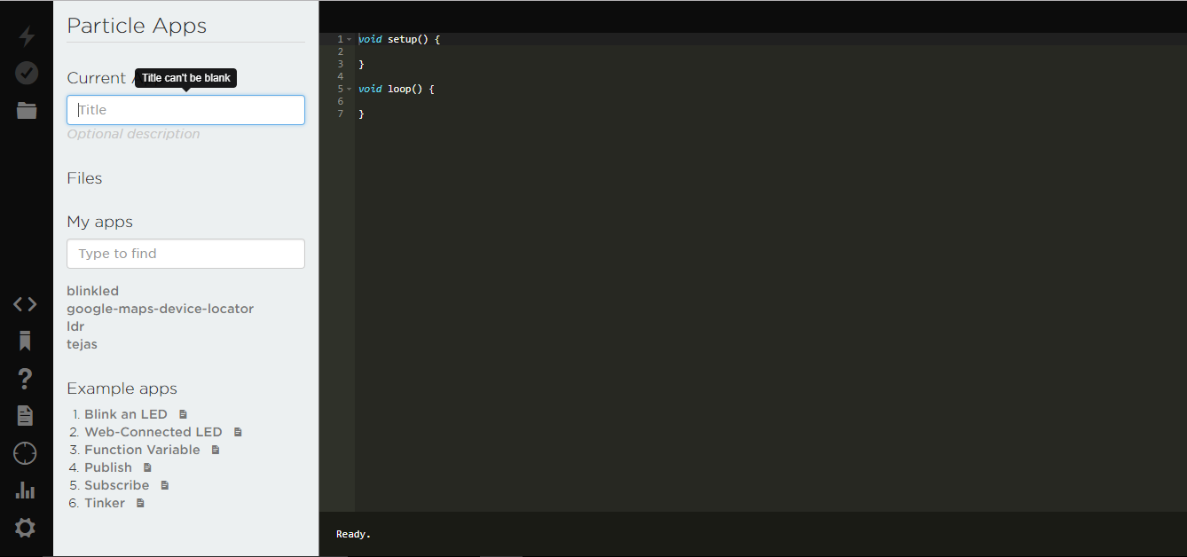
Cloud Computing

Slide 12
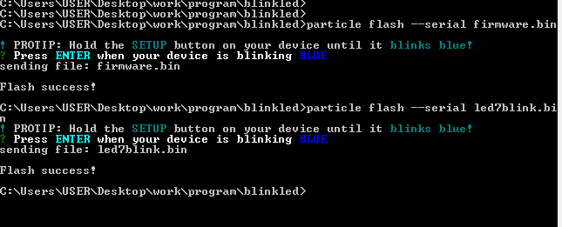
Node.js Command prompt

Slide 13
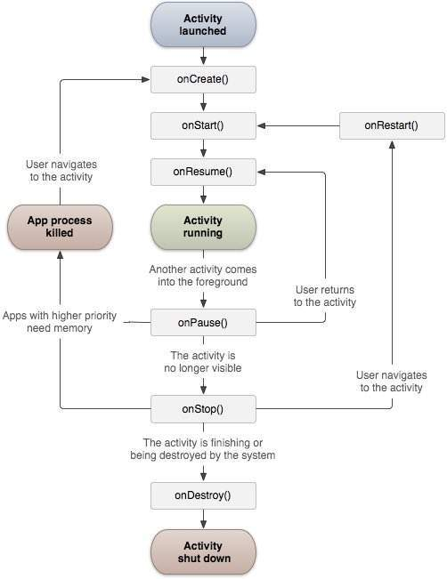
Android Activity life cycle

Slide 14
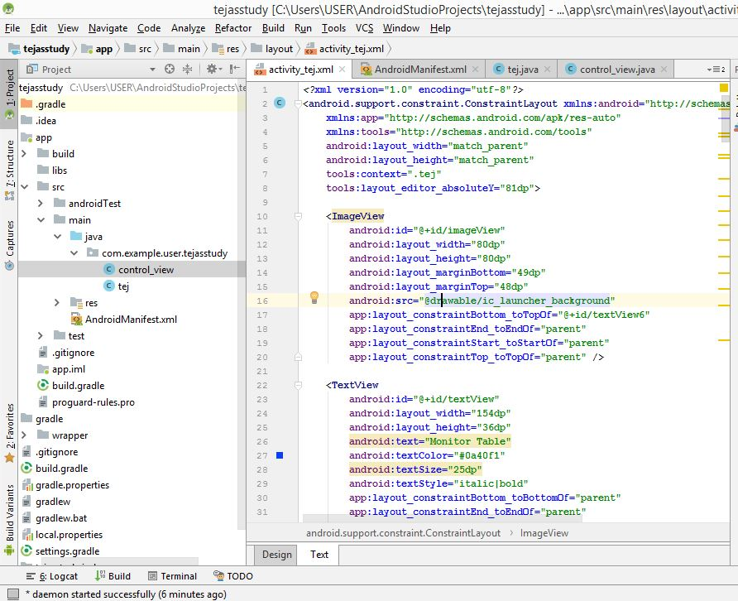
Android IDE

Slide 15
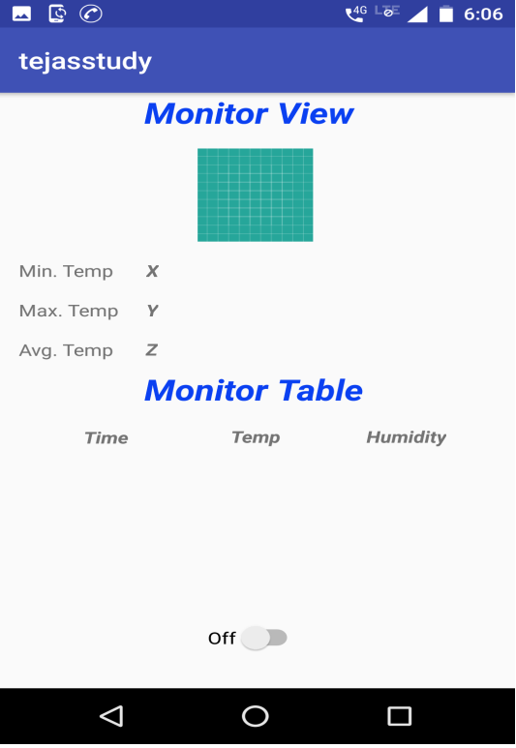
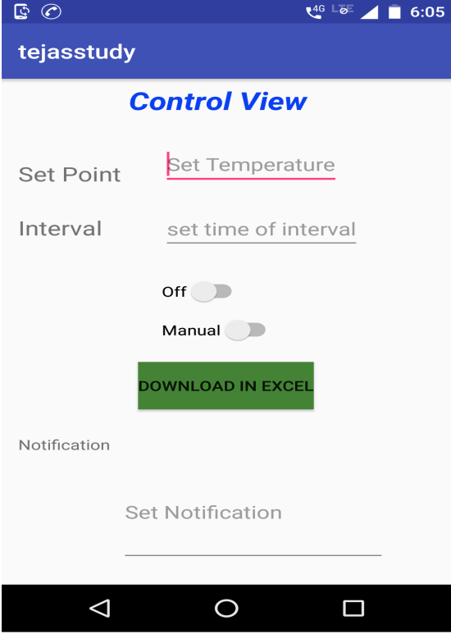
GUI in Android Studio

Slide 16
Results

Slide 17
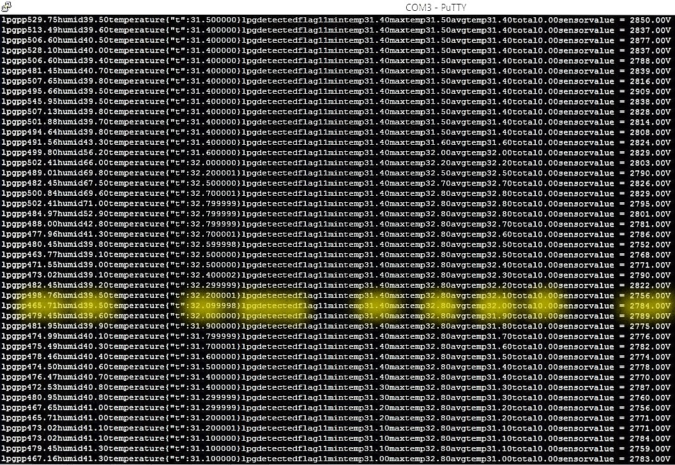
Output on Putty Terminal

Slide 18
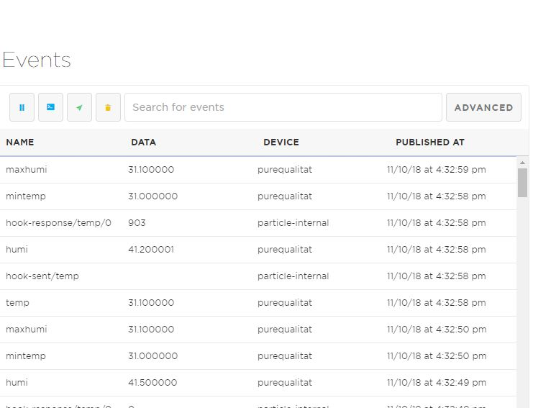
Cloud Console

Slide 19
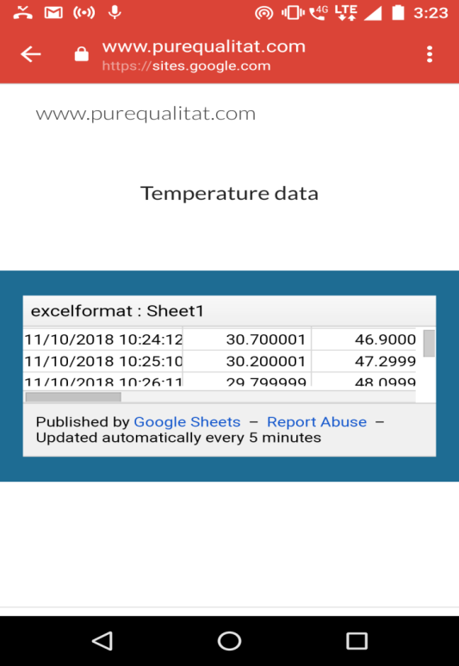
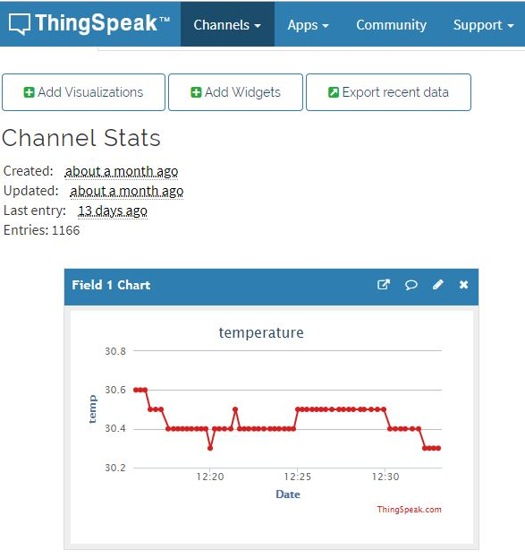
Web Page and ThingSpeak

Slide 20
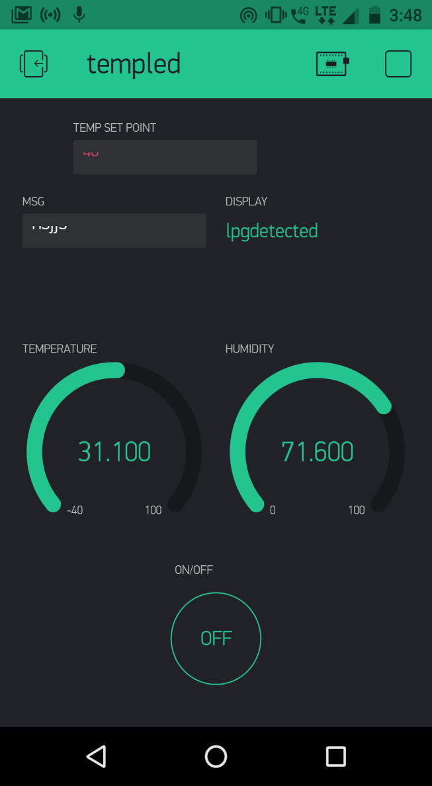
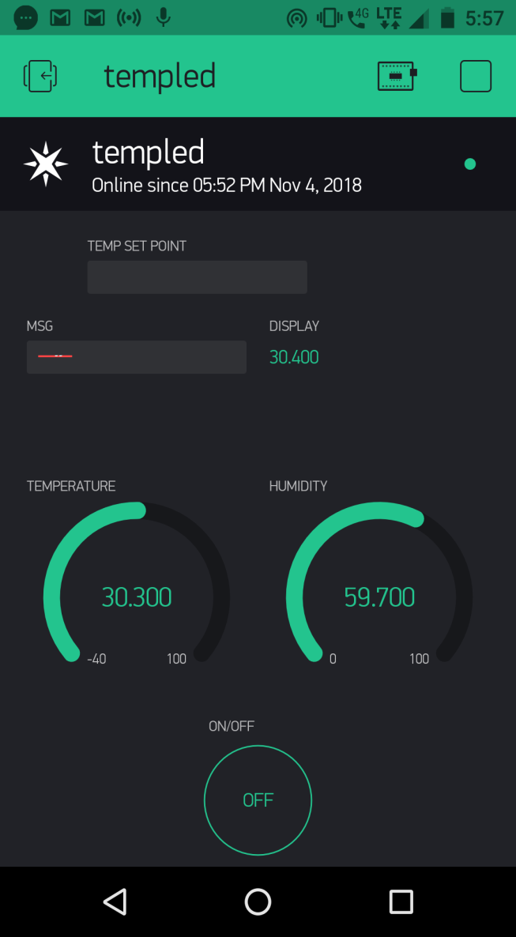
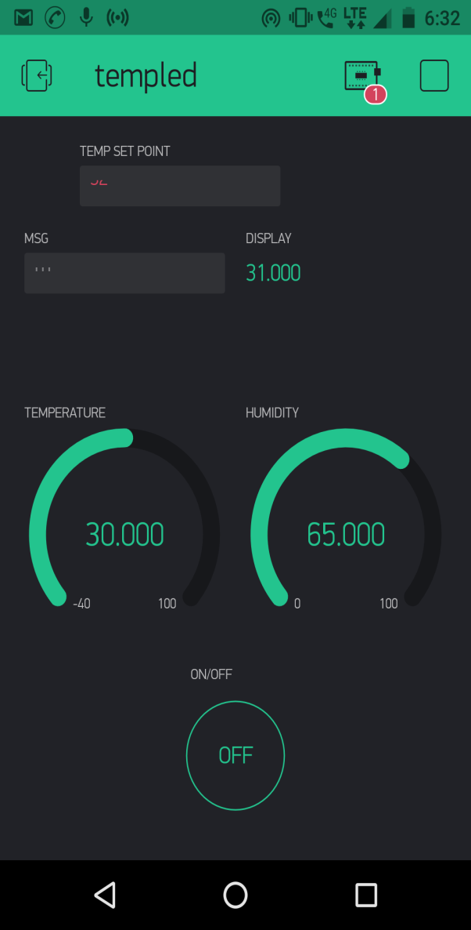
Blynk Application

Slide 21
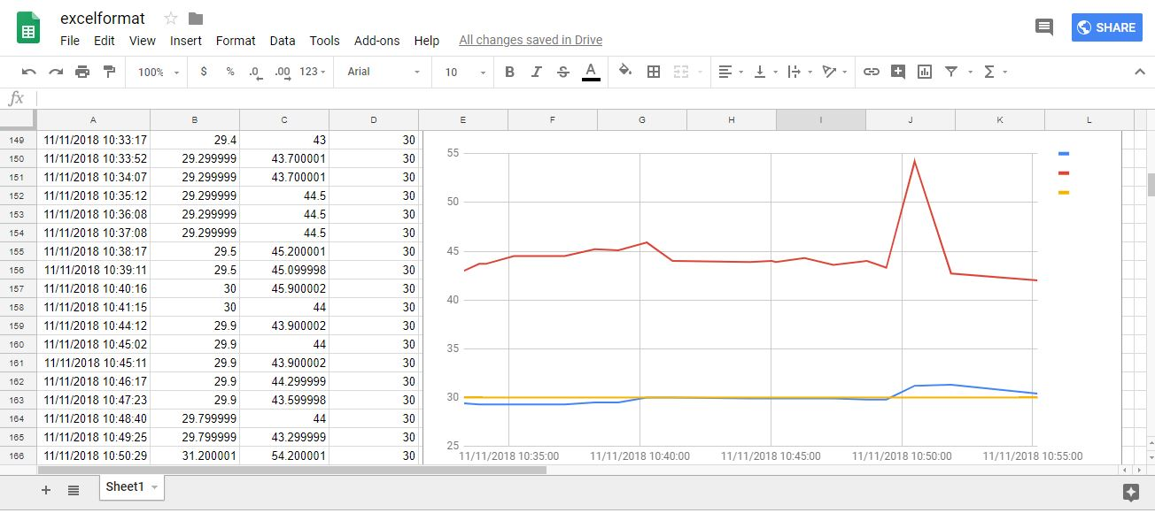
Output on Excel Format

Slide 22
Activity Chart
Work Activity | Jul 18 | Aug 18 | Sep 18 | Oct 18 | Nov 18 | Dec 18 | Jan 19 | Feb 19 | Mar 19 | Apr 19 | May 19
Topic identification
Literature Review
Synopsis preparation
Study of ARM based processor, Wireless Sensor and software requirement
Implement Cloud Computing and Android Application
Implementing Warehouse System
Testing, Documentation and Report writing

Slide 23
Work to be Done
Implementation of PCB Design.
Assembly of components and placement.
Designing wireless sensor for the system.
Implement of cloud computing and Android Application.
Testing of entire system.

Slide 24
ALTIUM
Need for multi layer PCB Design:
Small size.
To increase functionality.
simplified construction and reduced weight.
Higher density of assembly.
useful in high-speed circuit.
Altium Designer
Software for PCB design.
Schematic Capture.
PCB Design.
Library and footprint design.
Multi sheet (Hierarchical) design.

Slide 25
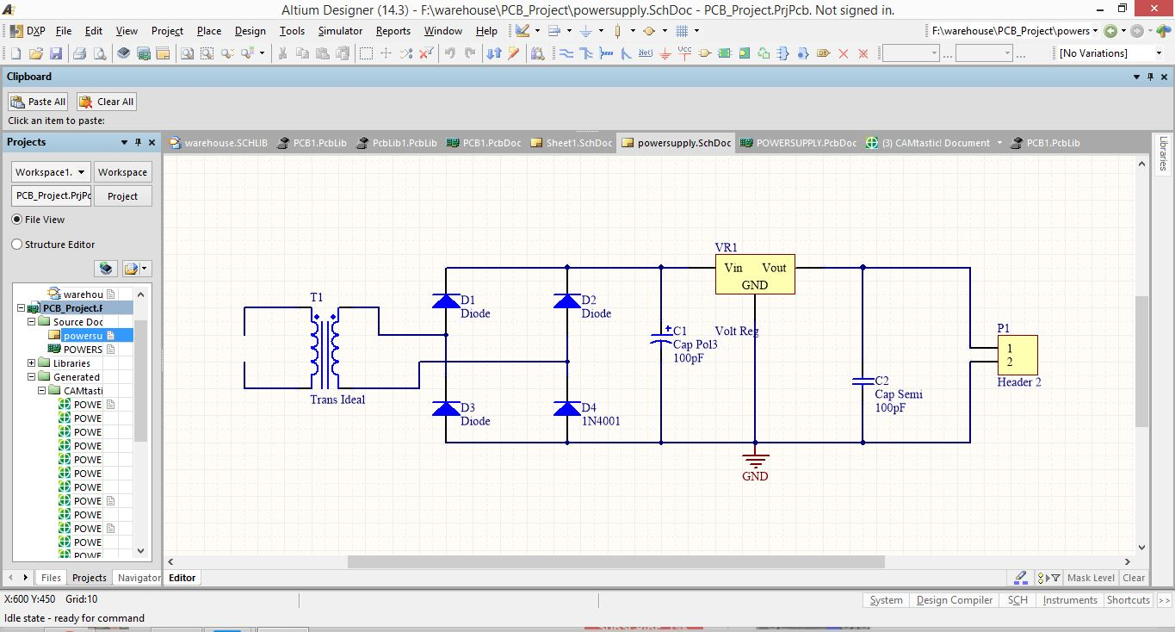
Altium Design
Schematic Capture of Power Supply design

Slide 26
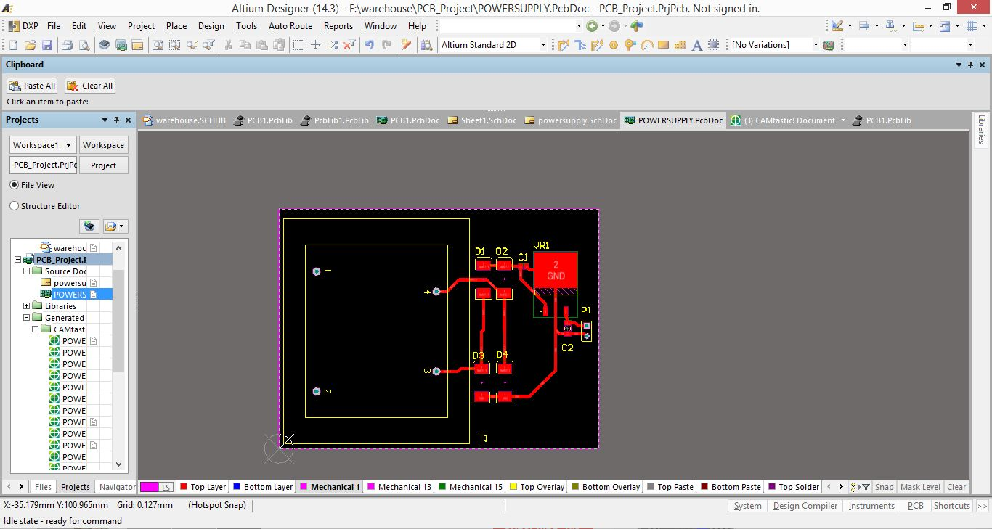
PCB Layout

Slide 27
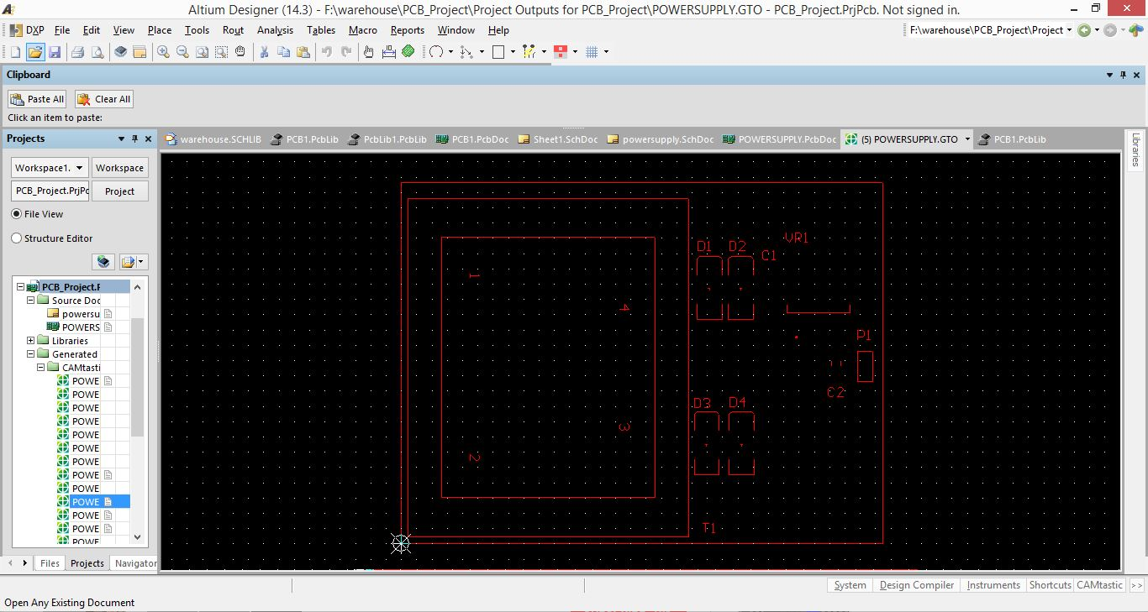
PCB Layout

Slide 28
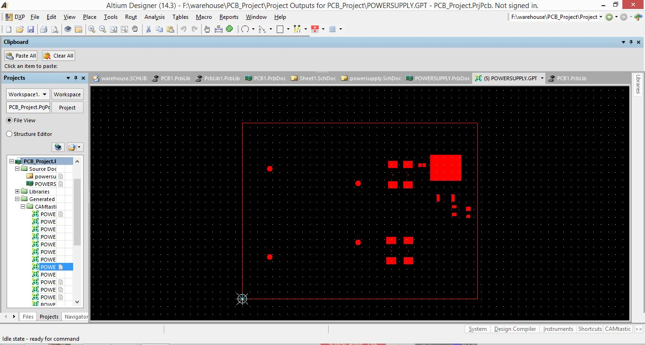
PCB Layout

Slide 29
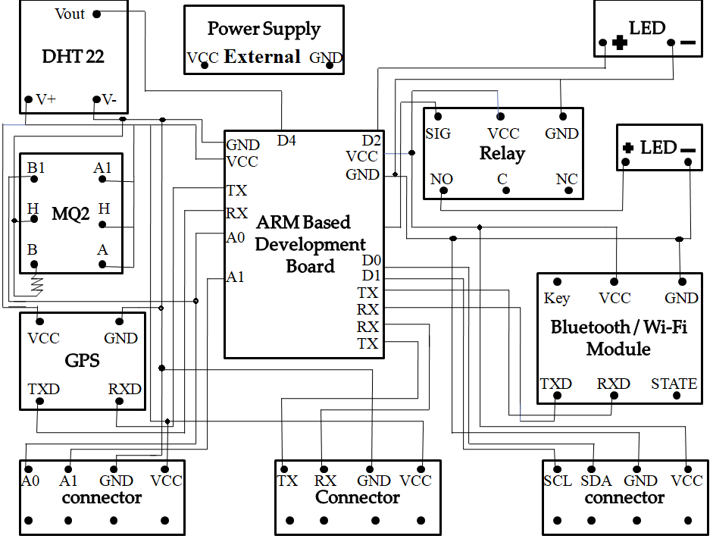
Circuit Diagram

Slide 30
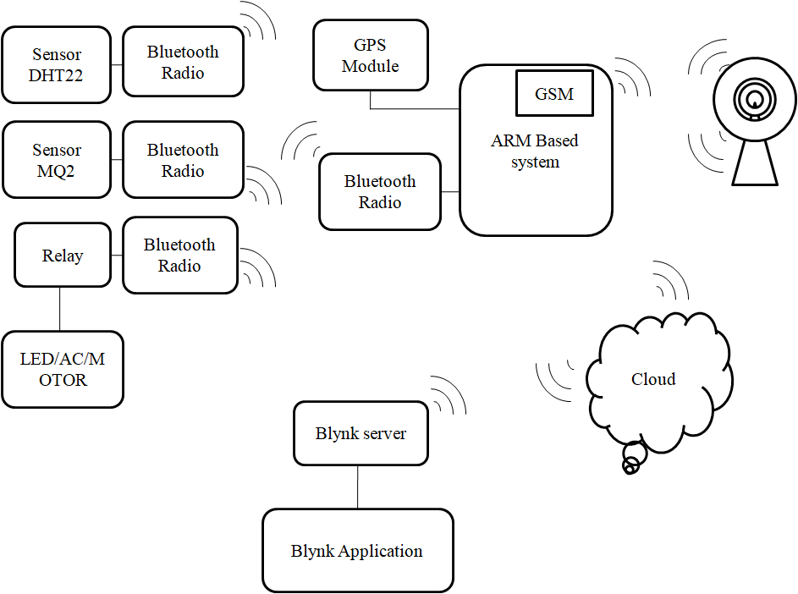
Estimated Block Diagram

Slide 31


