Slide 1



10th IEEE International Conference on Computing, Communication, Control and Automation (ICCUBEA-2026) Tech for Good: Building a Better Digital World
Pimpri Chinchwad Education Trust’s
Pimpri Chinchwad College of Engineering, Pune
Presentation By:
Paper ID: 1201
CipherDocs-AI: Leveraging Vision Language Models for Intelligent Document Verification, Contextual Analysis and Adaptive Security in Blockchain Systems
Dr. Rohini Pise, Ojas Patil, Tejas Pokale, Harshvardhan Nerpagar,, Nisha Chavan Department of Information Technology, Pimpri Chinchwad College of Engineering, Pune
rohini.pise22@pccoepune.org

Slide 2
Introduction & Motivation
Introduction
CipherDocs Baseline Snapshot
Digitization of certificates/records has raised forgery, unauthorized editing and identity-abuse risks across governance, education, healthcare & legal domains.
CipherDocs (baseline) secures documents using Polygon blockchain, SHA-256 hashing, AES-256 encryption and IPFS — but validation stays purely deterministic (h′ = h ? 1 : 0).
Modern forgeries (AI-edited content, re-hashed tampering, deepfakes) demand context-aware, intelligent verification — not just hash matching.
Polygon Amoy testnet: ~$0.001 avg. transaction cost
Verification latency: 150 – 250 ms
Throughput: up to 2,000 TPS
SHA-256 hash + AES-256 encryption + IPFS storage
QR verification, RBAC, ZKP-based lifecycle management
Motivation — Gaps in CipherDocs Baseline
Blockchain Only (Deterministic) | + AI Layer (Contextual)
Binary valid/invalid; no tamper explanation; static encryption for all docs | Multi-class forgery type; natural-language Doc Chat; risk-adaptive encryption
Hash comparison cannot catch forgeries re-hashed after tampering
No semantic interpretation or field-level content validation
Non-technical users struggle with wallets & verification workflows
Uniform AES-256 encryption regardless of document sensitivity/risk

Slide 3
Literature Survey
Paper (Core Tech.) | Limitation Identified | CipherDocs-AI Novelty
Certifier DApp (Ethereum) | High gas fees; needs manual intervention | Polygon-native + AI agent layer automates verification
Systematic Review (Academic Certificates) | Security emphasized over usability; poor UX | Doc Chat: natural-language access for non-technical users
Doc-forgery Detection Review (ML methods) | Traditional methods fail post-compression; no real-time | VLM engine: real-time multi-class forgery classification
IPFS + QR Systems (Decentralized storage) | Static QR; basic verification only | Dynamic trust scoring + behavioral anomaly detection

Slide 4
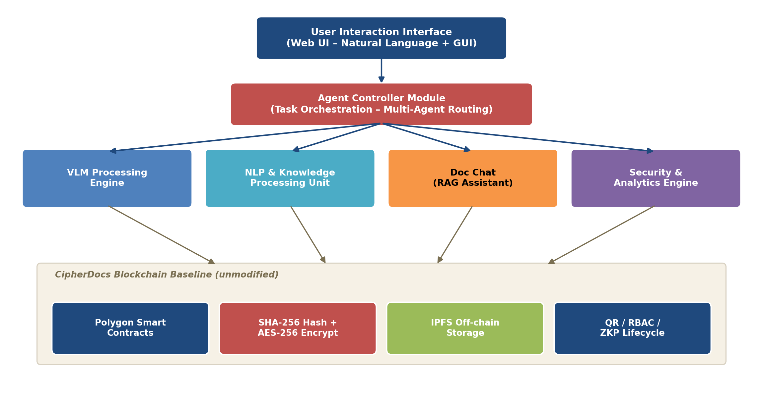
System Design of the AI Layer
The AI layer sits above CipherDocs' blockchain foundation — it augments, never modifies, the deployed smart contracts.

Slide 5
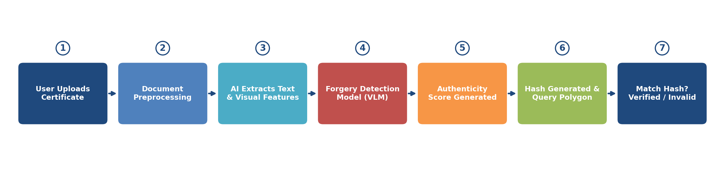
Core AI Modules & Verification Workflow
Key AI Modules
Agent Controller – routes tasks, calls issueCertificate(), verifyCertificate(), revokeCertificate(), checkExpiry() asynchronously.
VLM Engine – multi-class forgery classification: Field Alteration, Font Inconsistency, Layout Manipulation, or Authentic.
Runs only when the deterministic hash check needs contextual interpretation — keeps the blockchain verification pipeline non-blocking.
NLP Unit – text normalization, structured field extraction, smart summarization, semantic search across certificate repositories.
Doc Chat (RAG) – answers natural-language queries (e.g. “Is this certificate still valid?”, “Was this document altered?”) grounded only in verified on-chain data.
Ideal for non-technical, third-party verifiers who need not touch blockchain explorers.
AI-Supported Verification Workflow

Slide 6
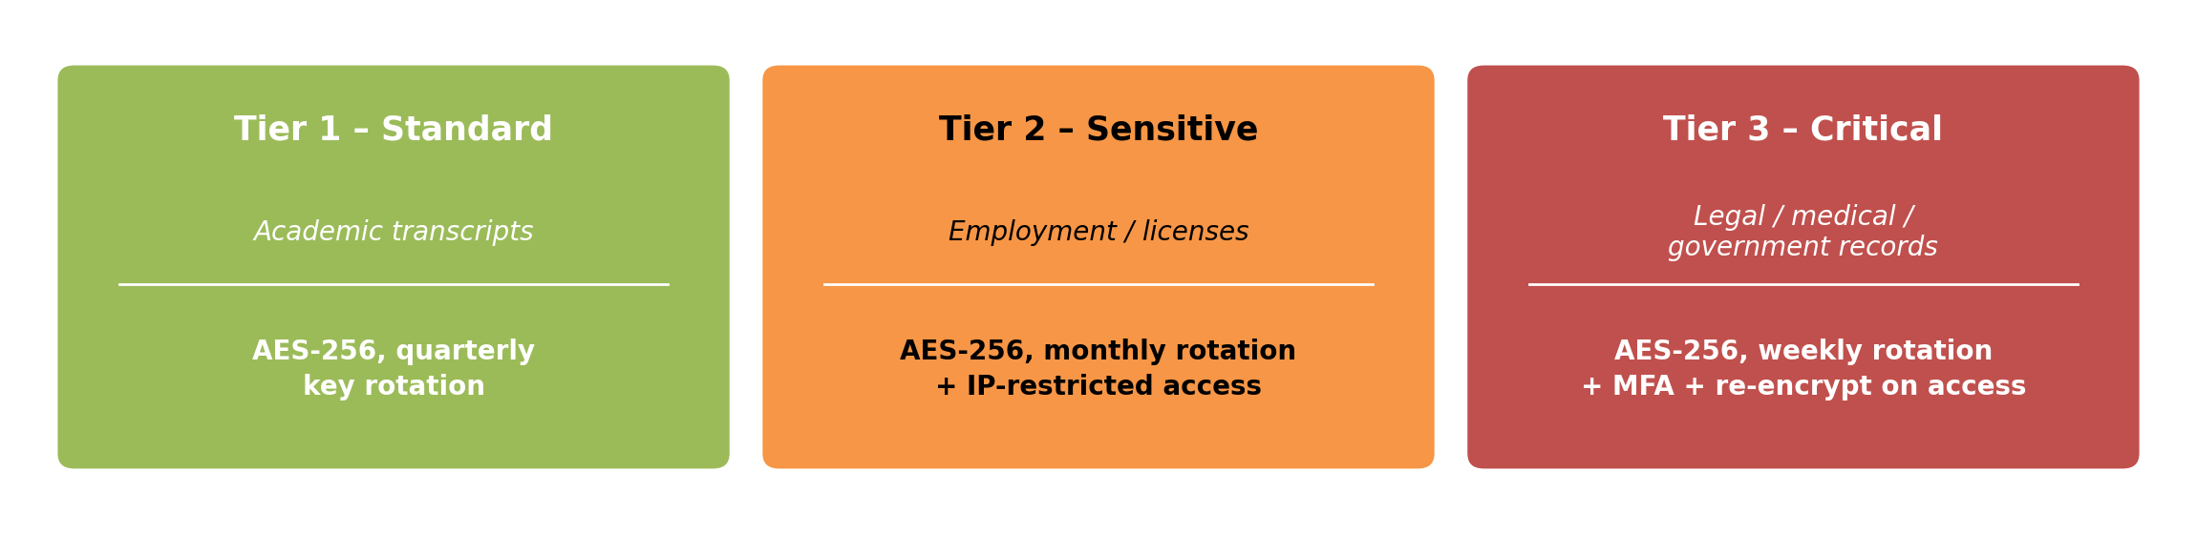
Security & Analytics Engine and Technology Stack
Adaptive Encryption — Risk-Based Tiers
Dynamic Trust Score
Technology Stack
T(issuer) ∈ [0,1] computed from issuance frequency, revocation rate, verification failures & metadata consistency — flags low-trust issuers in real time.
Blockchain (inherited): Polygon, Solidity, SHA-256, AES-256, IPFS, MetaMask/Web3
AI Backend: Python microservices — VLM inference, NLP pipeline, RAG-based Doc Chat
Agent Controller: async message-queue task orchestration
Frontend: Web UI extended with AI Chat & analytics dashboard

Slide 7
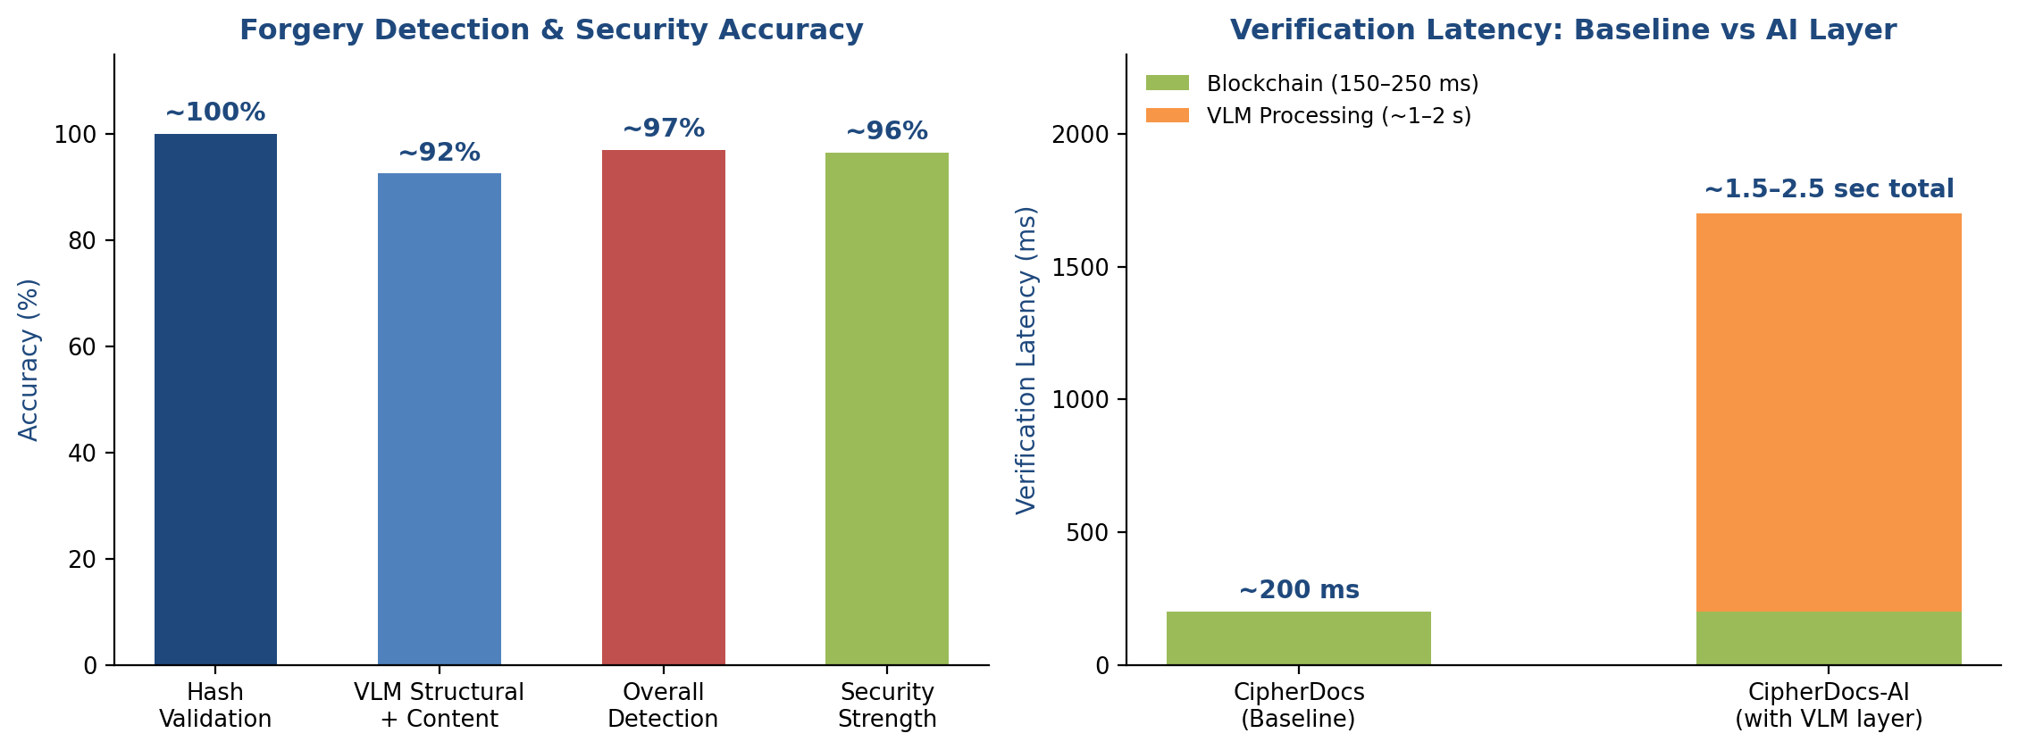
Evaluation & Results, Conclusion and Future Work
Conclusion
Future Work
CipherDocs-AI adds a multi-agent AI layer on top of the unmodified CipherDocs blockchain baseline — dual-layer verification (deterministic + probabilistic trust).
Improves forgery-detection granularity, reduces manual dependence, and greatly improves usability for non-technical stakeholders — with no added on-chain cost.
Lightweight, quantized VLM/NLP models for lower-latency inference
Privacy-preserving AI (secure multi-party computation, differential privacy)
Reinforcement-learning-driven adaptive agent controller
Multilingual & cross-domain document support
AI-assisted Zero-Knowledge Proof generation

Slide 8
Thank You

