Slide 1
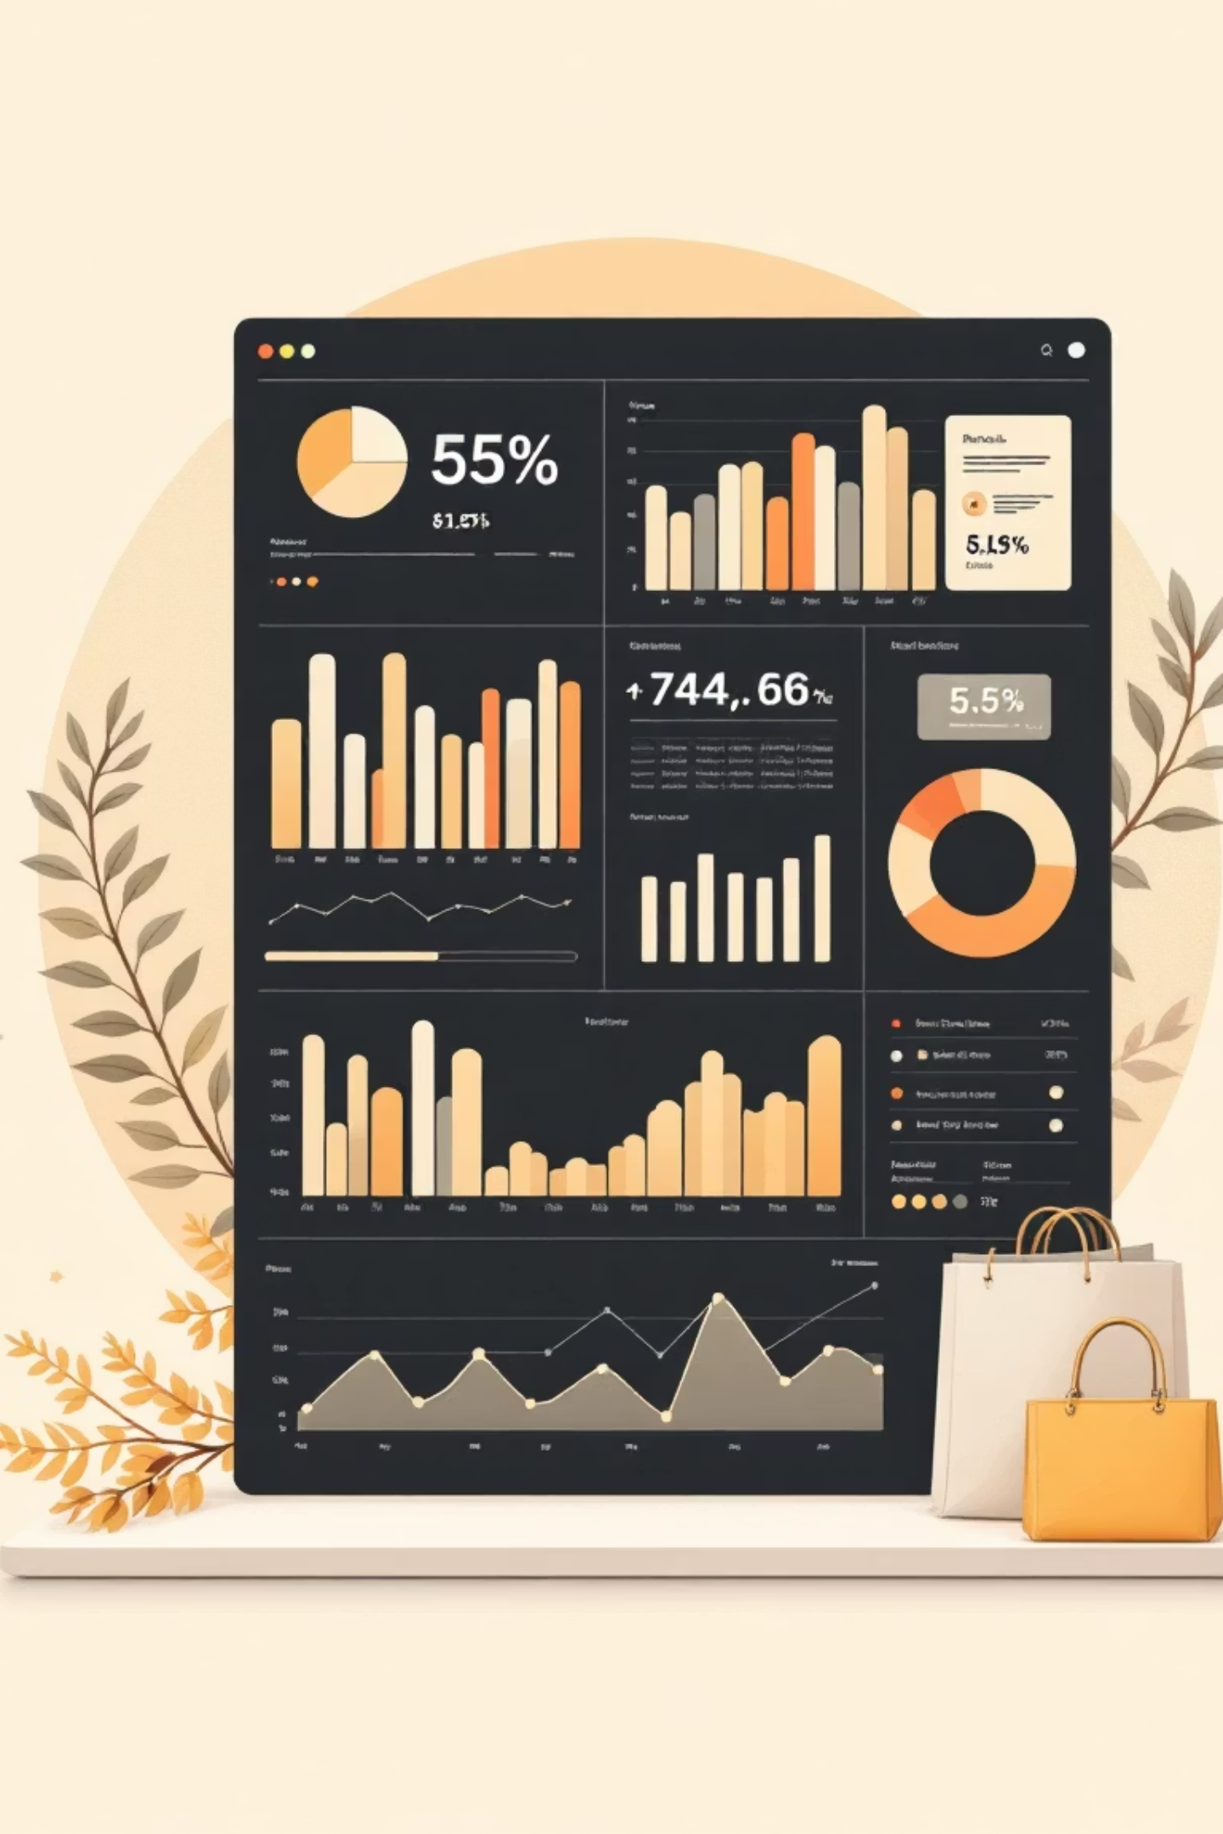
BuyerLens
Customer Shopping Behavior Analytics
By Tejas Rastogi | github.com/tejasrastogileet/BuyerLens
Based on original work by Meghan Gowda B Y

Slide 2

Dataset Overview
3,900
18
37
Total Purchases
Data Columns
Missing Values
Comprehensive transaction data
Customer demographics & behavior
Only in Review Rating column

Slide 3
Data Preparation Process
01
02
03
Data Loading
Initial Exploration
Missing Data Handling
Imported dataset using pandas
Structure check and summary statistics
Imputed Review Rating with median values
04
05
Feature Engineering
SQL Analysis Prep
Created age groups and purchase frequency
Prepared data for MySQL analysis

Slide 4
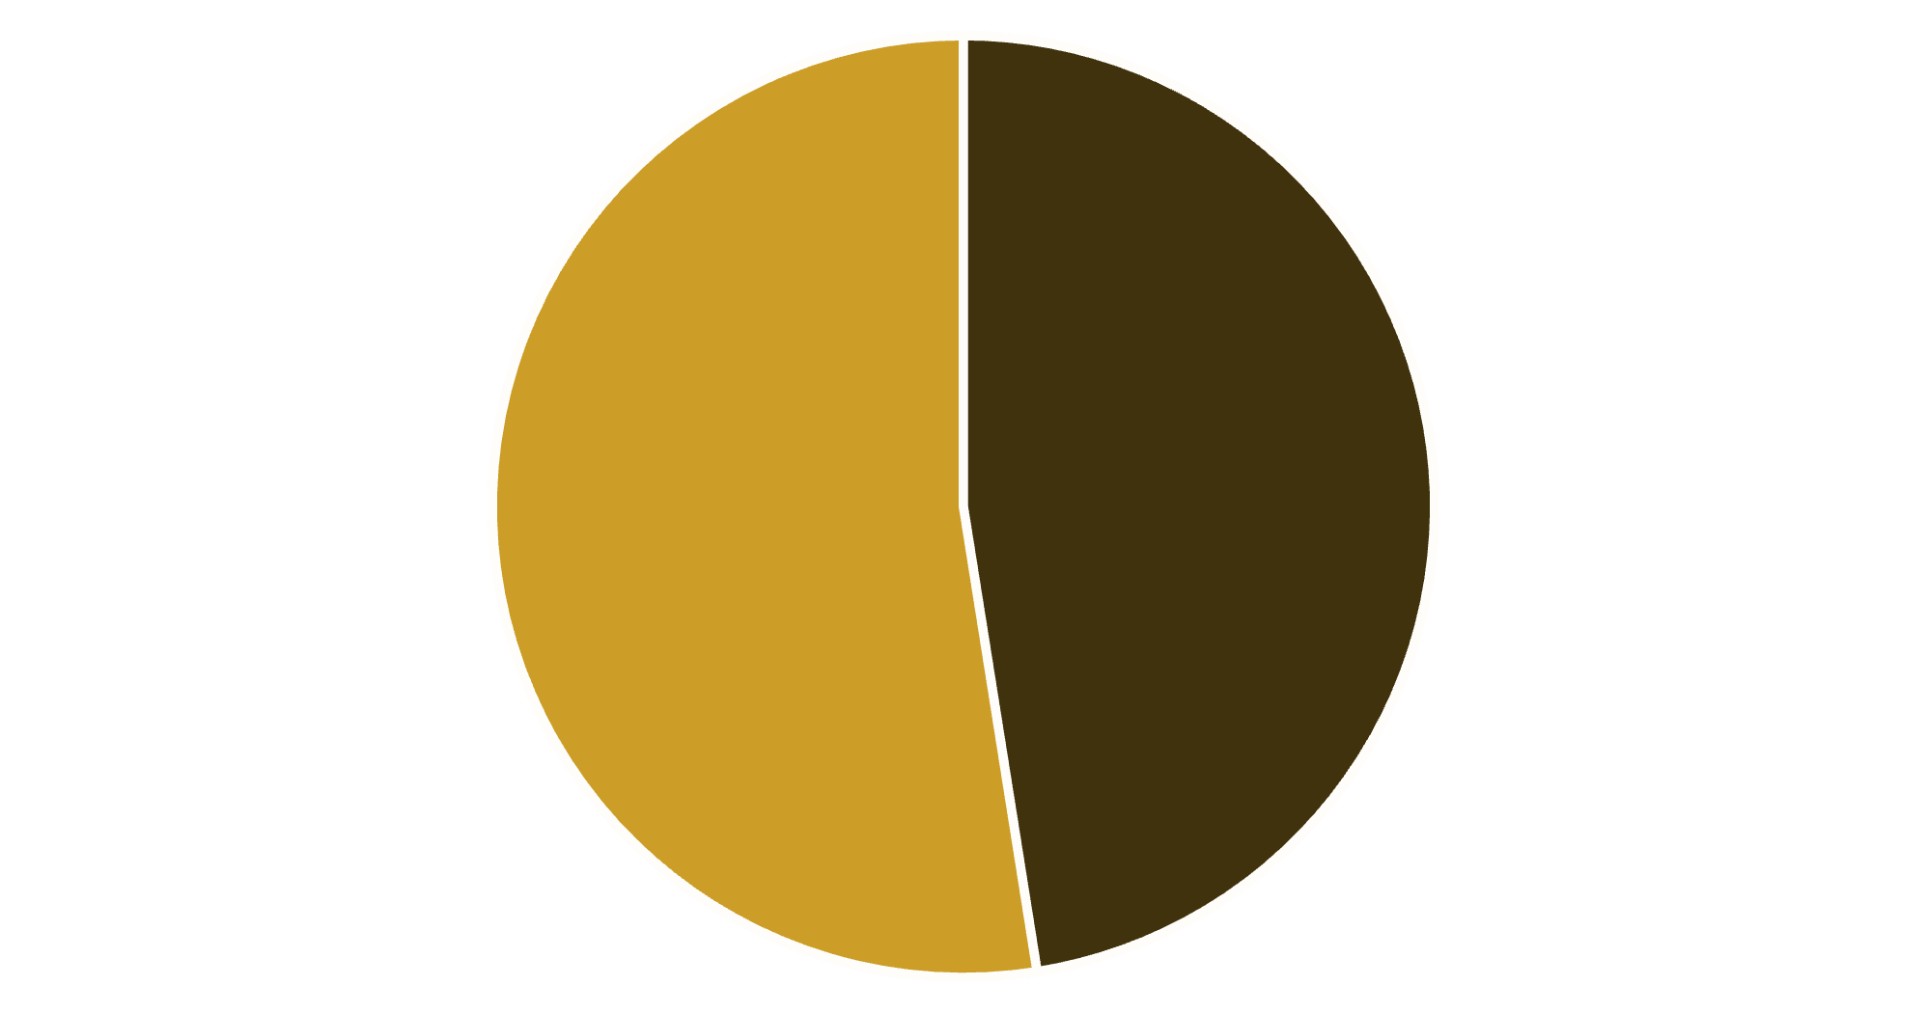

Purchase Amount by Gender
Key Insight
Male purchase amount: $157,890; female: $75,191.
Gender-based marketing strategies could optimize revenue streams
Male
Female

Slide 5

High-Value Discount Users
Customers using discounts while spending above average
Smart Shoppers
High spenders who maximize value with discounts
Strategic Opportunity
Target premium customers with exclusive offers

Slide 6
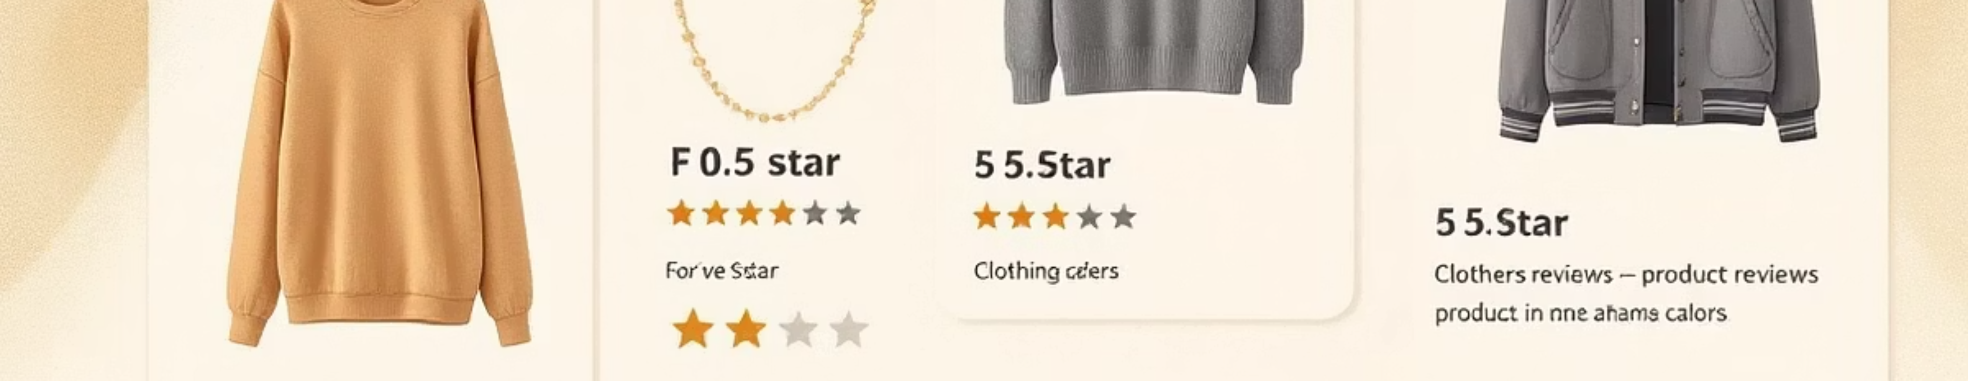


Top-Rated Products
3.86
3.84
3.82
Gloves
Sandals
Boots
Highest average rating
Second-highest average rating
Third-highest average rating

Slide 7

Average Purchase by Shipping Type
Express Shipping
Standard Shipping
$60.48
$58.46
Average purchase amount
Average purchase amount
Express average is $2.02 higher per purchase (3.45%).

Slide 8
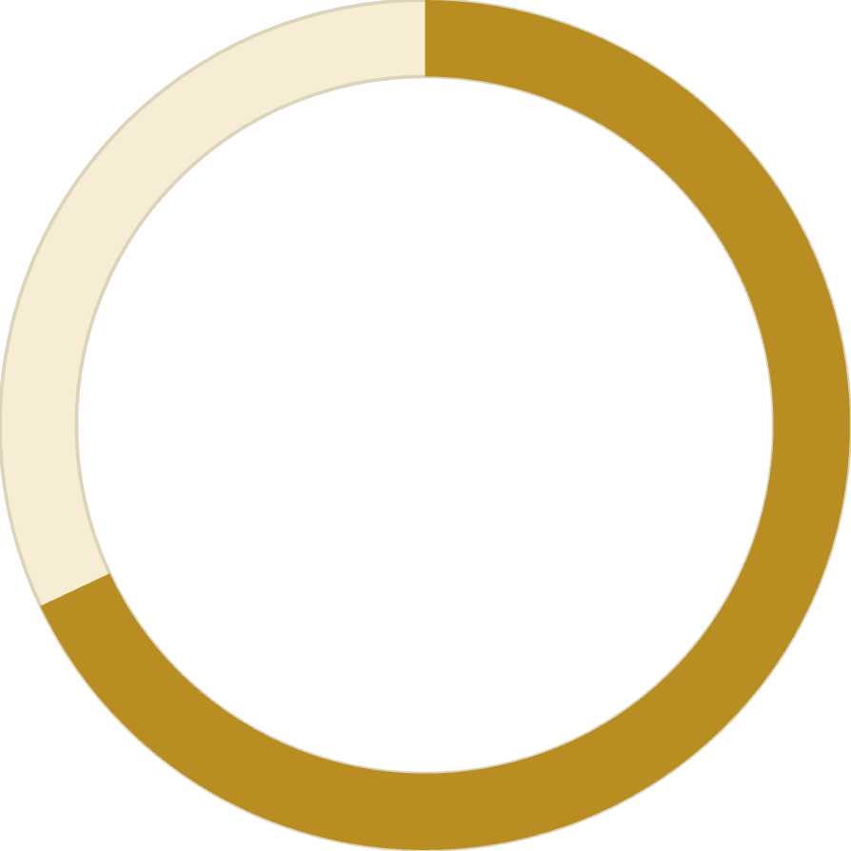
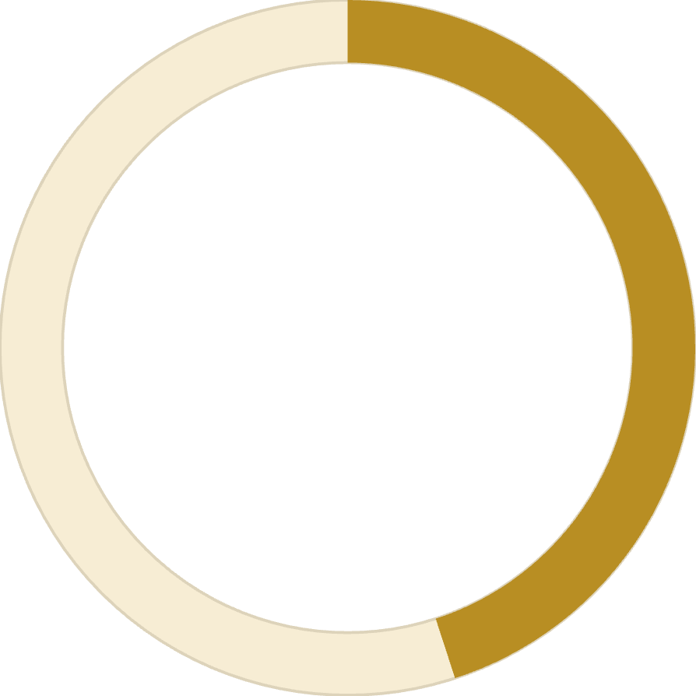
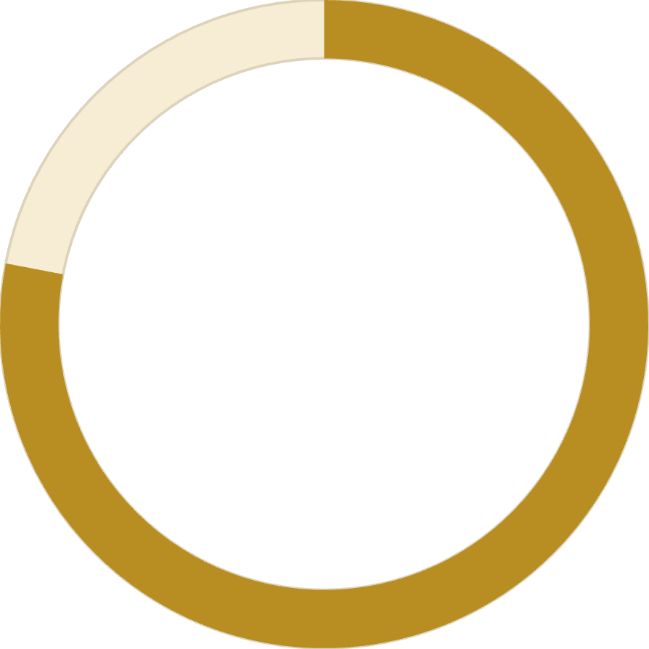
Subscription Summary
$59.49
26.88%
1,053
Average Spend
Purchase Amount Share
Subscriber Records
vs. $59.87 for non-subscribers
of total purchase amount
27.0% of 3,900 purchase records

Slide 9



Customer Segmentation
Loyal
1
79.90% (>10 prior purchases)
Returning
2
17.97% (2-10 prior purchases)
New
3
2.13% (1 prior purchase)
Focus on converting New to Returning, Returning to Loyal

Slide 10





Strategic Recommendations
Boost Subscriptions
Promote exclusive benefits for subscribers
Loyalty Programs
Reward repeat buyers to increase retention
Targeted Marketing
Focus on high-revenue segments and express users
Product Positioning
Highlight top-rated products in campaigns

