Slide 1
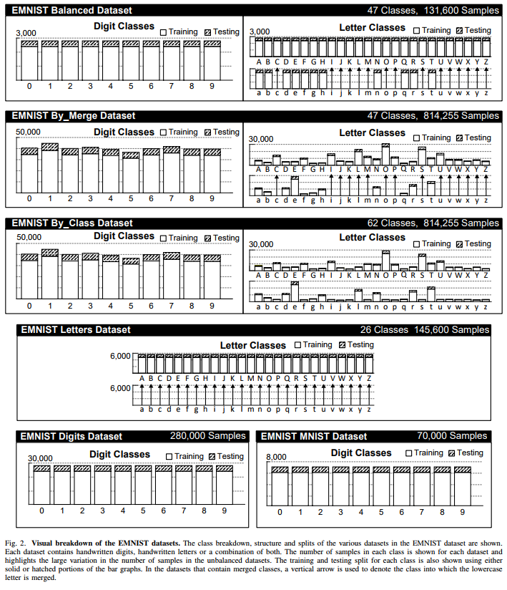
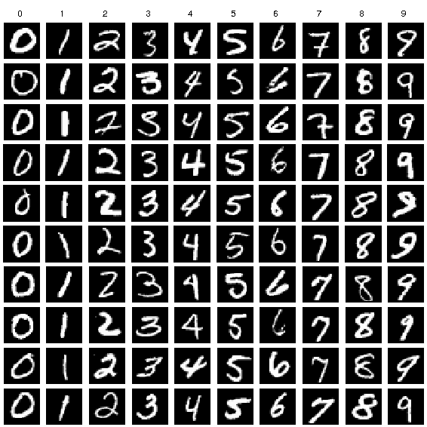
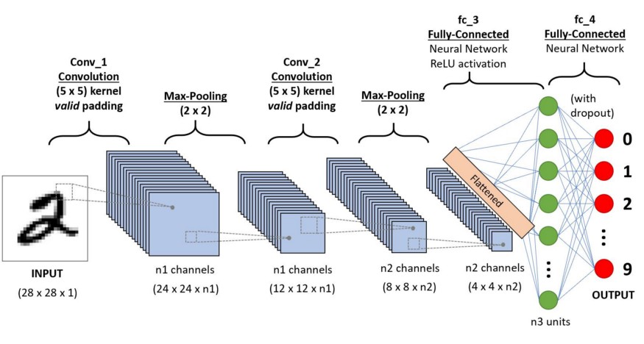
DECIPHERING THE HANDWRITTEN CODE
2103A52041, 2103A52045, 2103A52068-A.YASHASWINI,A.SHRESHTA,S.TEJASREE
INTRODUCTION
The task of classifying handwritten digits using a Convolutional Neural Network(CNN). A Convolution Network has the advantage of extracting and using feature information, improving the recognition of 2D shapes with a high scaling and distortions. We are using MNIST, EMNIST datasets for handwritten digit recognition.
METHODOLOGY
REFERENCES
CONCLUSION
We used Convolutional Neural Network , a type of deep learning network that is used to classify images.
Testing the model:
We have used MNIST and EMNIST dataset to test our model. Because MNIST and EMNIST datasets are those have been utilized extensively for these type of projects. In EMNIST it enables a comparison between various algorithms because it is a database of labelled handwritten digits.
[1] Baldominos, A., Saez, Y., & Isasi, P. (2019). A survey of handwritten character recognition with mnist and emnist. Applied Sciences, 9(15), 3169.
[2] Jain, M., Kaur, G., Quamar, M. P., & Gupta, H. (2021, February). Handwritten digit recognition using CNN. In 2021 International Conference on Innovative Practices in Technology and Management (ICIPTM) (pp. 211-215). IEEE.
[3] Ghosh, M. M. A., & Maghari, A. Y. (2017, October). A comparative study on handwriting digit recognition using neural networks. In 2017 international conference on promising electronic technologies (ICPET) (pp. 77-81). IEEE.
[6] Siddique, F., Sakib, S., & Siddique, M. A. B. (2019, September). Recognition of handwritten digit using convolutional neural network in python with tensorflow and comparison of performance for various hidden layers. In 2019 5th international conference on advances in electrical engineering (ICAEE) (pp. 541-546). IEEE.
We are demonstrating a which can recognize handwritten digit. It can also extended for character recognition because we used EMNIST dataset, it consists both digits and characters. From seeing the results of the experiment, CNN proves to be better. In future we can do application for maths problem using trained models.
DATASET
RESULT
EMNIST Digits: 270,000 characters, 10 balanced classes.
MNIST: 10 classes, each consists 0 to 9 digits.
We got 99.4% accuracy using MNIST dataset.
We got 99.9% accuracy using EMNIST dataset.
OBJECTIVES
* Identify diverse styles of handwritten digits with high efficiency and reliability.
* Investigate the effectiveness of novel CNN architectures, activation functions, and pre-processing techniques in improving recognition performance.
* Evaluate the impact of data augmentation methods and hyper parameter optimization on the performance of CNN models for hand written digits recognition.

