Slide 1

Early Stage lung cancer detection
Presented by - Group-7
M.Kalyani -AP23110011343
K.Teja Sree-AP23110011431
G.Yamini-AP23110011448
G.Mohana Krishna-AP23110011462
R.Lohitha-AP23110011469

Slide 2

PROBLEM STATEMENT
Lung cancer is one of the leading causes of death worldwide.
Early detection using manual analysis is difficult.
Diagnosis of CT scan images is time-consuming.
Human errors may occur during image interpretation.
Doctors need automated tools for faster and accurate diagnosis.

Slide 3
PROJECT OBJECTIVES
Automated Diagnosis
Explainable AI (XAI)
Integrated Deployment
Develop a CNN-based system to classify lung CT scan images into six categories:
• Adenocarcinoma
• Benign
• Large Cell Carcinoma
• Malignant
• Normal
• Squamous Cell Carcinoma
Use Grad-CAM to highlight suspicious tumor regions and explain model predictions visually.
Grad-CAM produces heatmaps that show which regions of the CT scan influenced the model's decision, making AI predictions transparent and interpretable.
Create a Flask-based web application for real-time prediction and report generation.
Users can upload CT scans, receive instant classification results, and view Grad-CAM heatmaps highlighting potential tumor regions.

Slide 4
IMPLEMENTATION
Algorithms & Methods
Tools & Technologies
OpenCV — Image preprocessing and heatmap overlay
CNN — Feature extraction and classification
NumPy — Numerical operations
TensorFlow / Keras — Model training and testing
Flask — Web deployment
Matplotlib — Visualization
Dropout (0.5) — Prevent overfitting
MaxPooling2D — Reducing image dimensions
Grad-CAM — Tumor localization and heatmap generation

Slide 5
Methodology
01
02
03
04
05
Dataset Collection
Collect lung CT images belonging to six classes
Preprocessing
Resize to 128×128×3
Normalize pixels (0–1)
Data augmentation
Model Training
Train CNN model using training dataset and validate performance
Testing
Evaluate model using unseen CT images
Explainability
Apply Grad-CAM to show affected tumor regions
Pipeline Summary: The workflow follows a standard deep learning pipeline — from data collection and preprocessing, through model training and validation, to final testing with Grad-CAM explainability.

Slide 6
WORKING OF THE SYSTEM
Input
Processing
Output
User uploads a CT scan image through the web interface.
Supported formats: JPG, PNG, DICOM
• Image resized & normalized
• CNN model predicts class
• np.argmax() selects highest probability
• Grad-CAM generates heatmap
• Heatmap merged with original
• Predicted cancer type
• Confidence score
• Tumor highlighted region
• Status message (Cancer / Normal

Slide 7
CNN MODEL ARCHITECTURE
CNN Sequential Model
Architecture Purpose
Input Layer: 128 × 128 × 3
Feature Extraction — Conv2D layers detect edges, textures, and tumor boundaries in CT scans.
Dimensionality Reduction — MaxPooling2D reduces spatial dimensions while preserving key features.
Overfitting Prevention — Dropout (0.5) deactivates random neurons to improve generalization.
Classification — Dense + Softmax outputs probabilities for 6 categories.
Conv2D (32 filters) + ReLU
MaxPooling2D
Conv2D (64 filters) + ReLU
MaxPooling2D
Dropout (0.5)
Flatten Layer
Dense (128 units) + ReLU

Slide 8
RESULTS & ACHIEVEMENTS
Achievements
Expected Benefits
Multi-class Classification
Lung CT images classified into six categories
Faster Diagnosis Support
Reduces time for initial screening assessment
Real-time Prediction
Flask web app delivers instant classification results
Grad-CAM Visualization
Correctly highlights suspicious tumor regions
Clinical Decision Support
Helps radiologists in decision making
User-friendly Dashboard
Intuitive web interface for medical professionals
Transparent AI System
Grad-CAM provides visual explanation for predictions

Slide 9
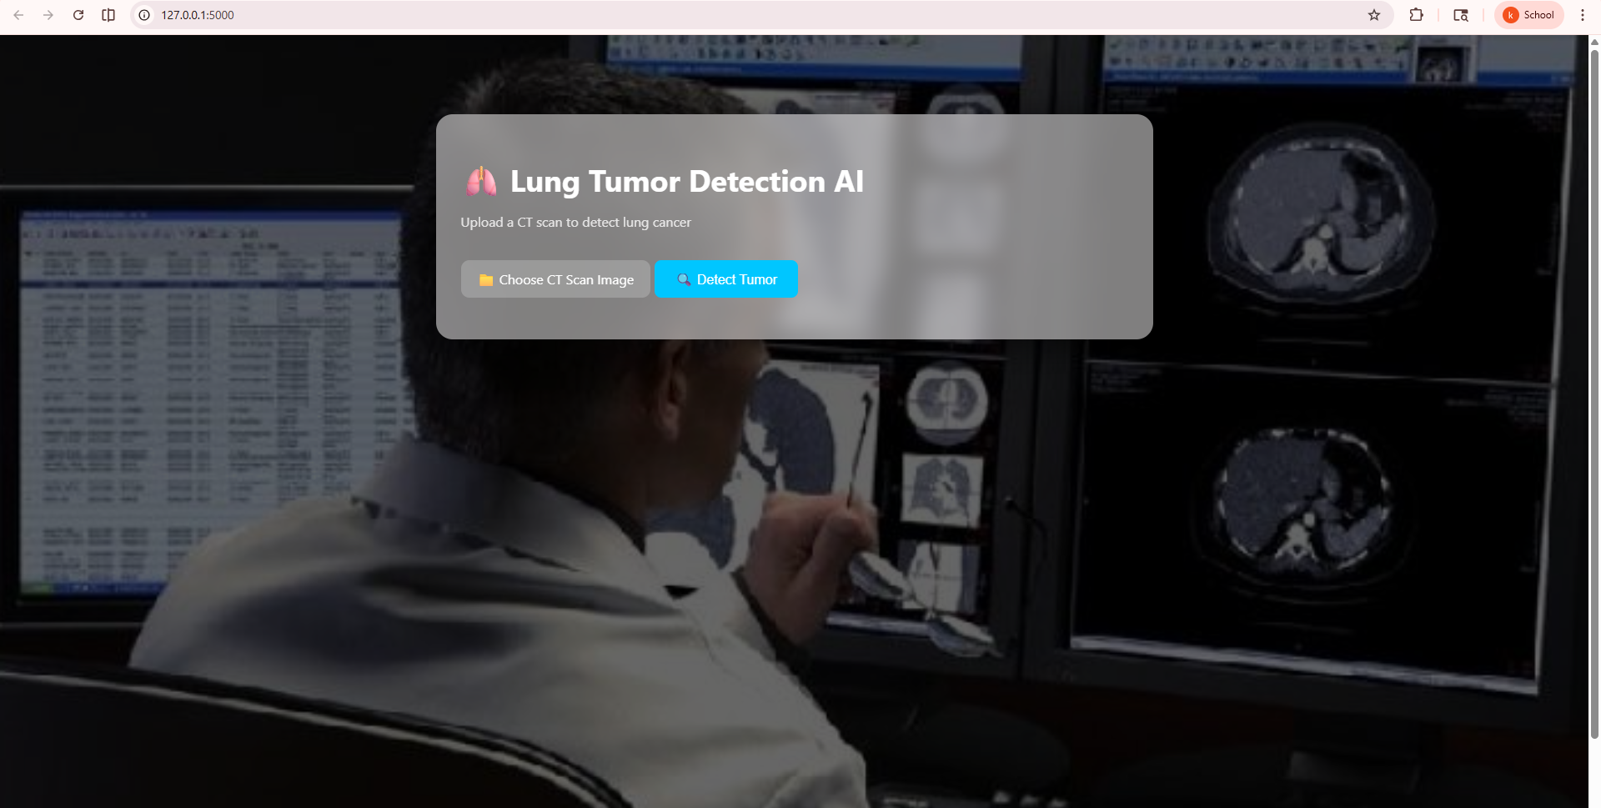
OUTPUTS

Slide 10
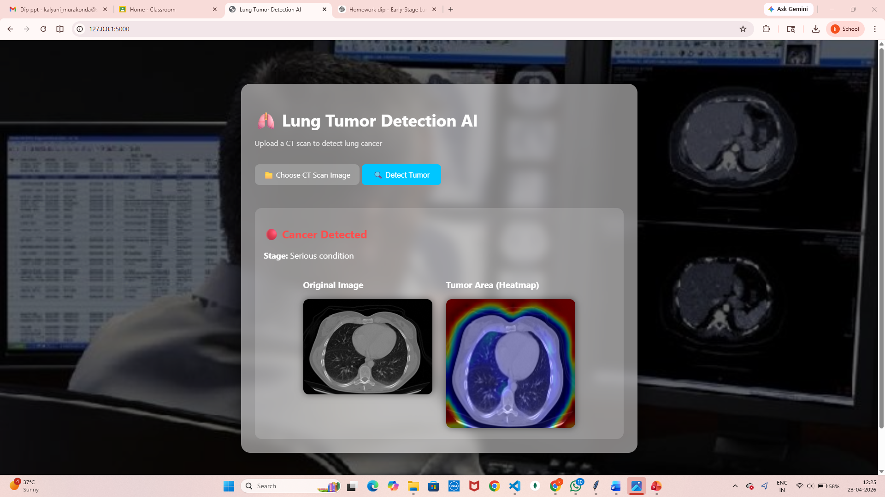
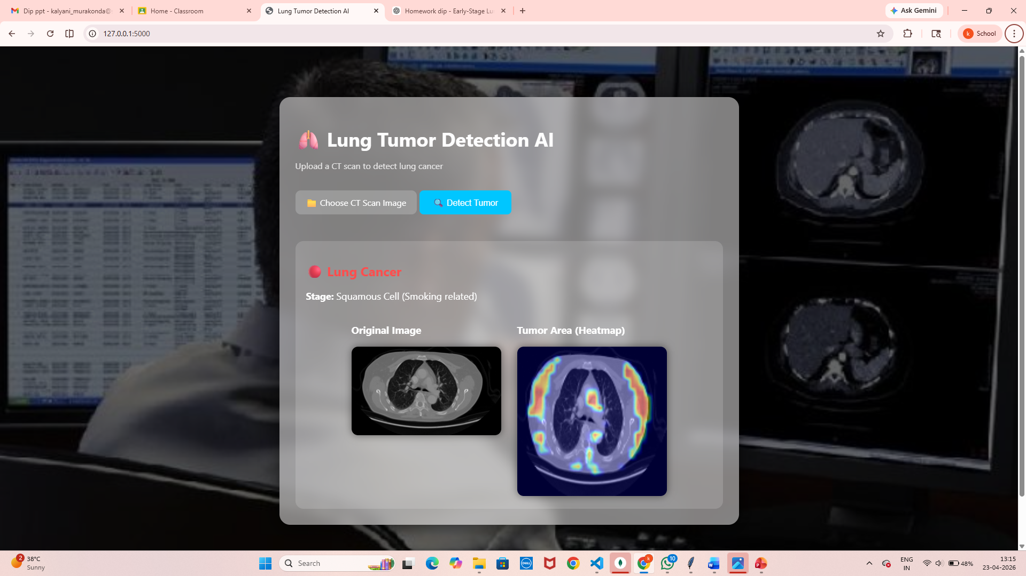

Slide 11
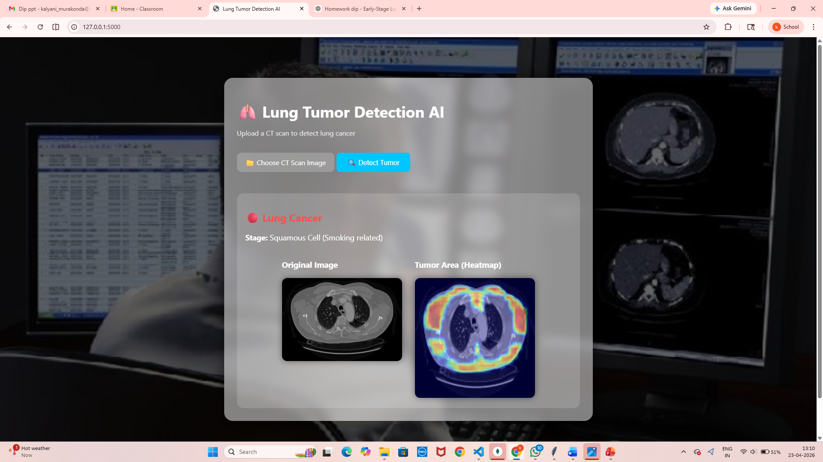
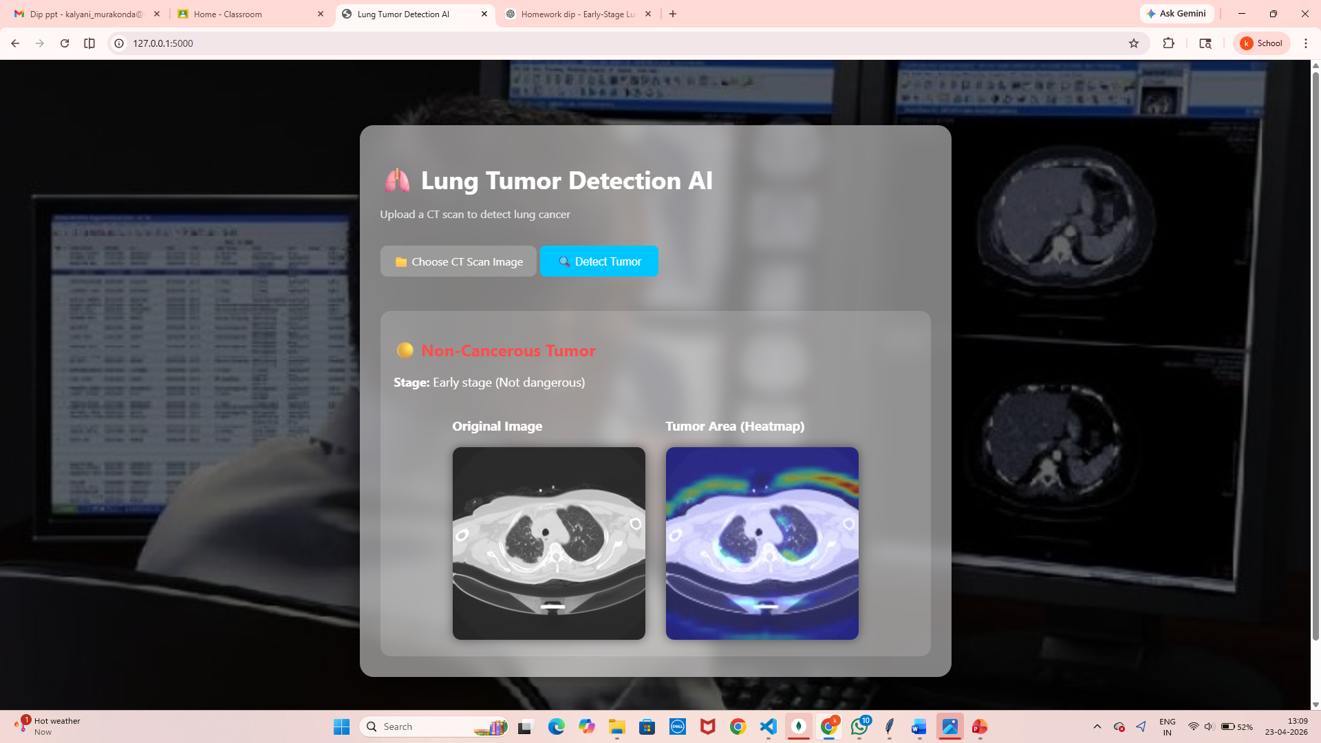

Slide 12
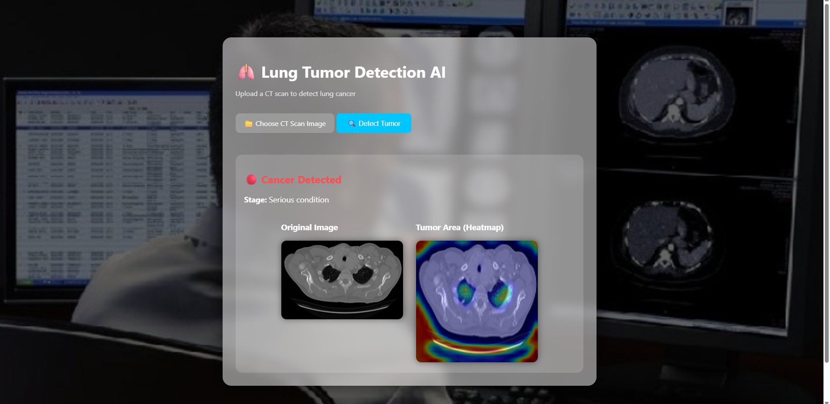

Slide 13
PROJECT TIMELINE
Phase 1
Phase 2
Phase 3
Phase 4
Data Collection
Dataset collection and preprocessing
Model Training
CNN model training and tuning
Current Stage
UI design, testing, review prep
Integration
Grad-CAM + Flask backend development
Current Status: The project has completed data collection, model training, and backend integration. We are now in Phase 4 — finalizing the UI design, conducting system testing, and preparing for this review.

Slide 14
FUTURE SCOPE
Transfer Learning
Cloud Deployment
Multi-view Analysis
Use ResNet50 / EfficientNet pre-trained models for higher classification accuracy.
Deploy on AWS / Google Cloud for remote access and scalability.
Use frontal + lateral CT scans together for comprehensive diagnosis.
Automatic Medical Reports
Higher Accuracy
Generate automatic PDF diagnostic reports with classification results, confidence scores, and Grad-CAM visualizations for medical records.
Use larger datasets and advanced augmentation techniques (rotation, zoom, flip, brightness) to improve model generalization and accuracy.

Slide 15
CONCLUSION
This project presents an effective approach for lung cancer classification and localization using Deep Learning and Grad-CAM.
The model provides accurate predictions, while Grad-CAM highlights important regions for better interpretability.
Integrated with Flask, the system offers real-time analysis and represents a promising step toward faster and smarter healthcare diagnosis.

Slide 16
THANK YOU

