Slide 1




TITLE PAGE
•Problem Statement-AI-Powered Face Recognition Attendance System
•Theme - Education
•Team ID -TEJCYB21
•Team Name (Registered on Website) -Cyber2
•Participant Names -M.Tejasri CH.Manideepa
Y.Harshini. K.Yashaswini
Sri Indu College of Engg & Tech - Cyber Club, Department of Cyber Security
Page 01

Slide 2

AI-POWERED FACE RECOGNITION ATTENDENCE SYSTEM
Cyber2
Proposed Solution:
The sophisticated attendance system utilizes facial recognition technology to automate attendance logging, replacing traditional methods like time cards with a faster, more efficient process that minimizes errors and fraud. Key features include liveness detection to ensure only real individuals are recorded, real-time processing for immediate updates to attendance records, and user data management that adapts to new users, enhancing performance over time. Additionally, the system leverages machine learning to continuously improve its accuracy and efficiency as it processes more data, making it a modern, secure, and user-friendly solution for attendance management.
Sri Indu College of Engg & Tech - Cyber Club, Department of Cyber Security
Page 02

Slide 3
Cyber2
TECHNICAL APPROACH
Key programming language include Python, known for its machine learning capabilities with libraries like :
OpenCV
Tk-tools
Datetime
Numpy
Pillow
Pandas
Times
Sri Indu College of Engg & Tech - Cyber Club, Department of Cyber Security
Page 03

Slide 4
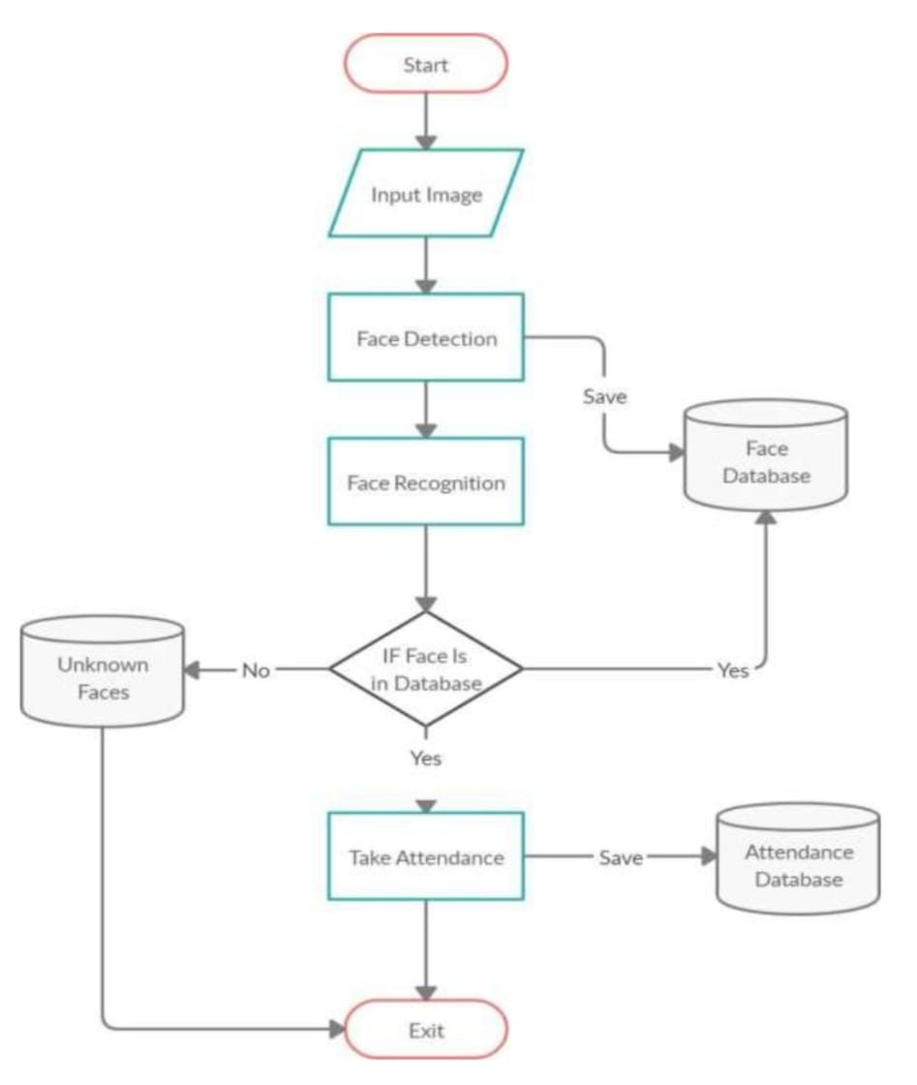
Cyber2
Sri Indu College of Engg & Tech - Cyber Club, Department of Cyber Security

Slide 5
FEASIBILITY AND VIABILITY
Cyber2
Launching a sustainable fashion brand is increasingly feasible due to growing interest in ethical fashion and environmental awareness, especially among eco-conscious millennials and Gen Z. Although initial costs for sustainable materials and ethical production are higher, brands can command premium pricing and better margins if positioned well. Certifications can boost credibility, while regulatory compliance is essential.
Key challenges include high startup costs, strong competition, consumer misconceptions, supply chain risks, and limited brand awareness. To address these, brands can form partnerships to manage costs, highlight unique selling points, run educational marketing campaigns, diversify suppliers, stay updated on regulations, and engage communities through social media. With these strategies, a sustainable fashion brand can successfully compete in this evolving market.
Sri Indu College of Engg & Tech - Cyber Club, Department of Cyber Security
Page 04

Slide 6
IMPACT AND BENEFITS
Cyber2
An AI-powered face recognition attendance system offers a fast, accurate, and contactless way to track attendance, eliminating manual errors and preventing proxy entries. It enhances security, saves time, and reduces administrative workload by automating the process. With real-time monitoring and easy integration with HR or payroll systems, it proves to be a cost-effective and scalable solution for organizations of all sizes.
Sri Indu College of Engg & Tech - Cyber Club, Department of Cyber Security
Page 05

Slide 7
RESEARCH AND REFERENCES
Cyber2
Face Recognition Based Attendance System An AI-based software solution that updates attendance using computer vision, divided into a face scanner module (Python) and a management module (C#).
Real-time Student Class Attendance System Utilizing AI Face Recognition A comprehensive end-to-end system that captures student images post-class and uses AI for real-time attendance marking.
Attendance System With Facial Recognition Using AI This paper outlines a four-phase system: dataset creation, face detection, recognition, and attendance updating, aimed at reducing manual errors and preventing proxy attendance.
AI Based Attendance System using Face Recognition Discusses a system where individual faces are scanned, verified, and matched with an existing dataset to mark attendance, minimizing errors.
Sri Indu College of Engg & Tech - Cyber Club, Department of Cyber Security
Page 06

Slide 8
Cyber2
FUTURE ENHANCEMENTS
Face + PIN Authentication
Voice Feedback
Liveness Detection
Edit/Delete Student Profiles
Sri Indu College of Engg & Tech - Cyber Club, Department of Cyber Security
Page 07

Slide 9
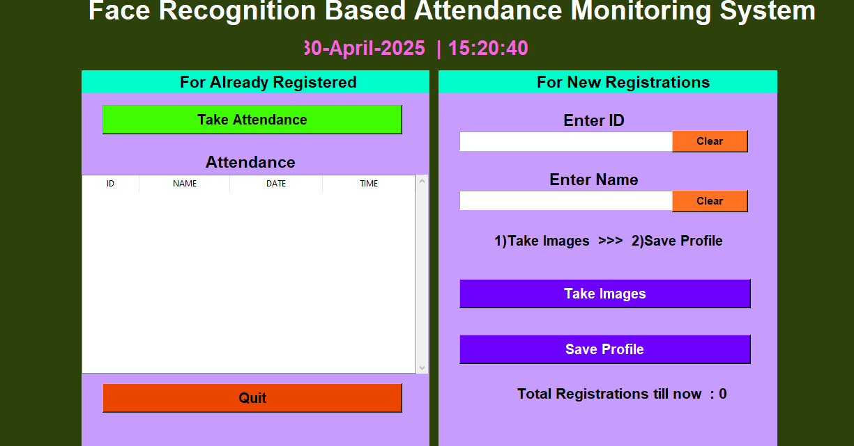
Cyber2
DEMO (IF APPLICABLE)
Sri Indu College of Engg & Tech - Cyber Club, Department of Cyber Security
Page 08

Slide 10
Cyber2
CONCLUSION & THANK YOU
The Face Recognition Attendance System provides a fast, secure, and efficient way to record attendance using computer vision. It reduces manual effort, prevents proxy attendance, and demonstrates the practical use of AI in daily tasks. With future improvements, it can become a complete smart attendance solution.
Thank the organizers and mentors
Sri Indu College of Engg & Tech - Cyber Club, Department of Cyber Security
Page 09

