Slide 1
Competitor Scan
Full report: fragrance and grooming in India, 15 July to 15 October 2026
Denver · BlaBliBlu · Bellavita · indē wild · Secret Alchemist · Beardo · Park Avenue · Engage · Ajmal · EM5 · Fraganote · Plum
Press · Meta ads · Google ads · Instagram · YouTube · Google Trends
Prepared for Mcnroe · October 2026

Slide 2
Agenda
1
Category themes
What the whole category did: Diwali, bundles, oil %, scents, creators, funding
2
Platform by platform
Meta ads, Google ads, Instagram, YouTube, Google Trends
3
Brand by brand
One page per competitor, all 12
4
What it means for Mcnroe
Launch calendar, implications, ongoing tracking

Slide 3
Executive summary
Diwali selling started on 1 October. BlaBliBlu, Denver, Fraganote and Bellavita already run festive offers, mostly free gifts and buy-1-get-1.
“Any 3” bundles set the price frame: 3 perfumes for ₹650 (BlaBliBlu) to ₹1,799 (Ajmal).
Perfume-oil % is the quality claim. Bellavita now claims 40%, against 25% (BlaBliBlu, Secret Alchemist) and 20% (Denver Intense).
Gourmand and oud dominate new launches; fresh, floral and women's have few strong voices.
Beardo is the heaviest Meta advertiser (960 ads). Engage ran the biggest paid YouTube push (24M views) with no press coverage.
Contests and stunts win on Instagram, earning 10 to 40 times normal engagement.
3,387
Meta ads analysed
663
Instagram posts analysed
390
YouTube videos analysed
Sources: Meta Ad Library, Google Ads Transparency Center, Instagram Graph API, YouTube Data API, Google Trends, trade press. Pulled 15 October 2026.

Slide 4
We tracked 12 brands in four groups across six data layers
Group | Brands | Why they matter to Mcnroe
D2C perfume challengers | Bellavita, Fraganote, Secret Alchemist, BlaBliBlu | Digital-first, creator-led, price-value fragrance
Mass deo and fragrance | Denver, Engage, Park Avenue | Big ATL budgets, set mass category codes
Heritage and premium | Ajmal, EM5 | Oud, attar, gifting and premium cues
Grooming and beauty | Beardo, indē wild, Plum | Stretching into fragrance and mists
Layers: press and launches · Meta ads · Google ads · Instagram · YouTube · Google Trends. Window: 15 July to 15 October 2026. Influencer and marketplace tracking were out of scope.

Slide 5
1
Category themes
What the category as a whole did this quarter

Slide 6
Seven moves defined the category this quarter
Theme | What we saw | Brands
Everyone moves to EDP; oil % is the claim | “Long-lasting” is now a number: 20%, 25%, 40% | Denver, BlaBliBlu, Bellavita, Beardo, Park Avenue
Gen Z vibe language | Rizz God, Vibe Collection, #OwnTheVibe, Love Drunk, Old Money, Berry Baddie | Denver, Bellavita, BlaBliBlu
Celebrities at the top, celebrity-investors below | SRK and Ranveer Singh are paid faces; Samantha and Suryakumar Yadav hold equity | Denver, Ajmal, Secret Alchemist, EM5
Women's and unisex expansion | Park Avenue “for Her”, unisex Sports Mode and Love Drunk | Park Avenue, Fraganote, BlaBliBlu
Marketplace events as launch pads | Launches timed to Flipkart Glam Up Fest and Amazon Beautyverse | Beardo, Engage
Funding buys offline reach | Kiosks and stores: 100 kiosks, 170+ stores, 111 stores planned | Fraganote, Ajmal, EM5, BlaBliBlu
Heritage and ritual stories | Champi oil, sandalwood nostalgia, oud, Kashmir | indē wild, Secret Alchemist, Ajmal, EM5

Slide 7

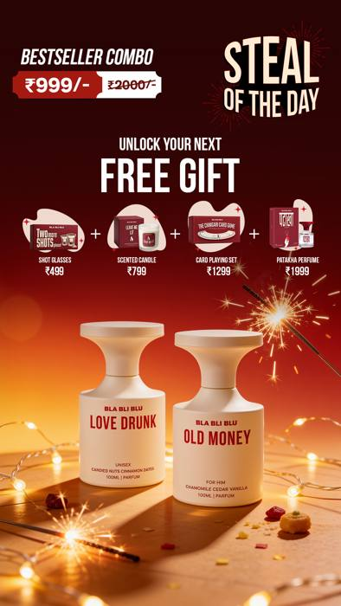
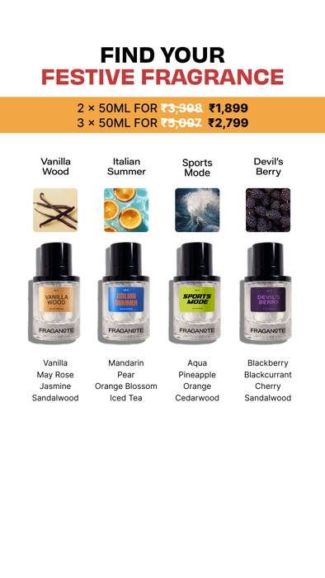
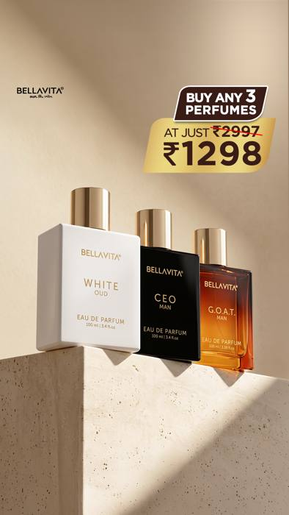
Diwali selling began on 1 October, more than a month before the festival
Denver
Buy 1 get 1 + daily MacBook draw, from 13 Oct
View ad
BlaBliBlu
Diwali House Party sale, free gifts, from 1 Oct
View ad
Fraganote
Festive 50 ml sets, Diwali Edit, from 9 Oct
View ad
Bellavita
Any 3 perfumes for ₹1,298, gifting-ready
View ad
Diwali is on 8 November 2026. Rakhi (August) was the first gifting peak: six brands ran Rakhi gifting. Ads from Meta Ad Library, India.

Slide 8
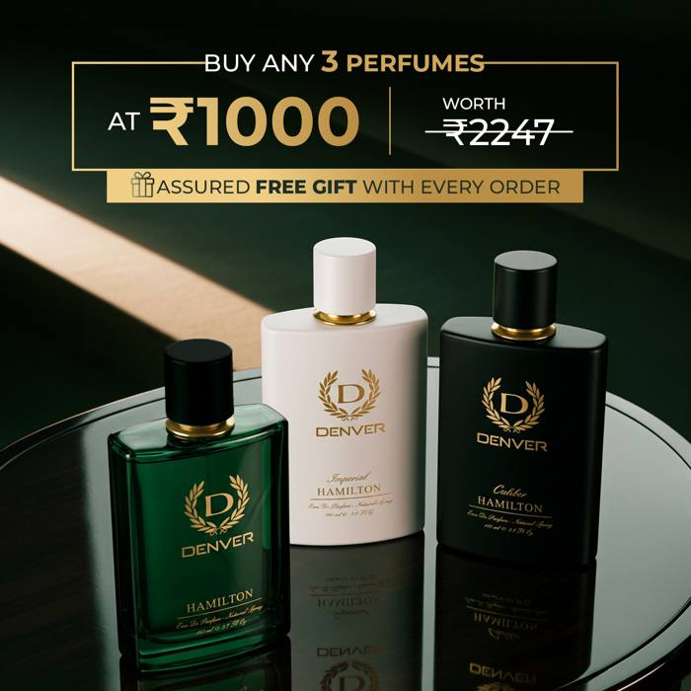
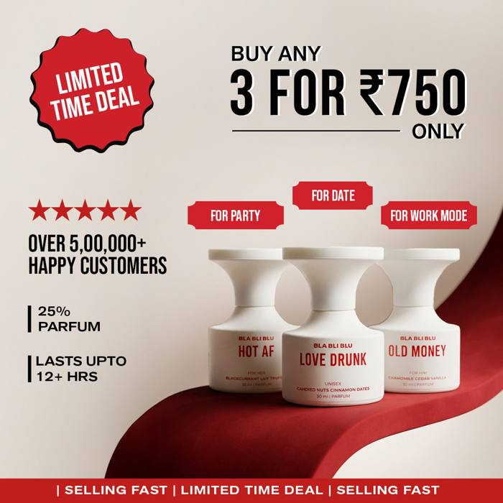
“Any 3” bundles set the price frame: 3 perfumes for ₹650 to ₹1,799
Denver
Any 3 for ₹1,000
View ad
BlaBliBlu
3 for ₹750
View ad
Price of a 3-perfume bundle in Meta ads (₹)
Build-your-own box appears in 6 of 10 advertisers. Beardo sells 4 perfumes for ₹999; Secret Alchemist 2 × 15 ml for ₹1,099.
Offers seen in Meta ads, August to October 2026. BlaBliBlu runs ₹650 and ₹750 versions.

Slide 9
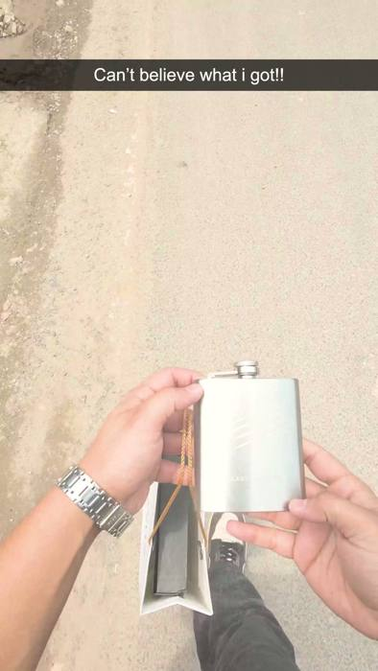
Perfume-oil percentage is the quality claim, and Bellavita now claims 40%
Bellavita Beast Mode
Collector's flask with Oud Supreme, 40% oil
View ad
Perfume-oil concentration claimed in ads and launches
Brand claims, not lab-tested. Sources: Meta Ad Library; Denver launch press releases (June and September 2026).

Slide 10
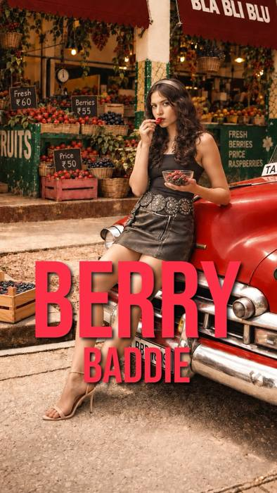
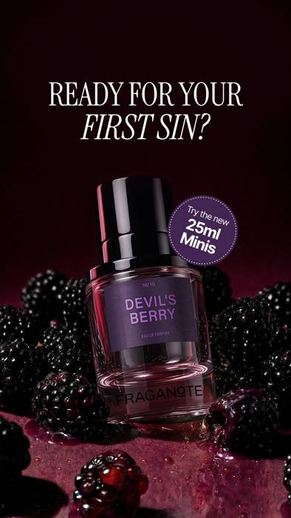
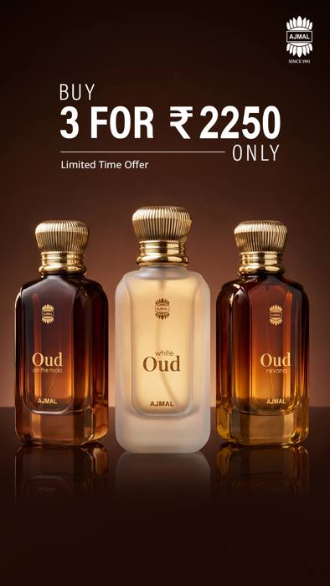
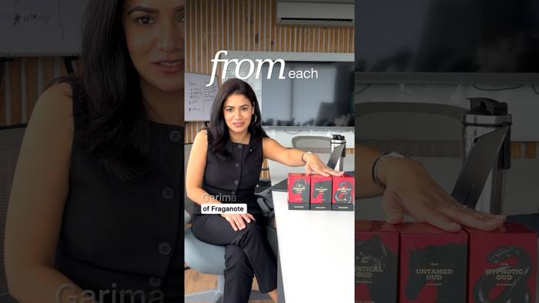
Gourmand and oud are this season's scent stories; fresh and floral are less crowded
BlaBliBlu
4 fruity gourmands, one a day, 21–24 Sep
View post
Fraganote
Devil's Berry and dessert scents, 25 ml minis
View ad
Ajmal
Oud trio: Oud Nirvana, Oud on the Rocks, White Oud
View ad
Fraganote
Oud Collection launch, 17 Jul (570K views)
Watch
Also: Bellavita Gourmand Trend Series at ₹549 (26 Sep). Rising search: “bella vita perfume pistachio” +400%. Secret Alchemist's jasmine and tuberose are the main floral voice.

Slide 11
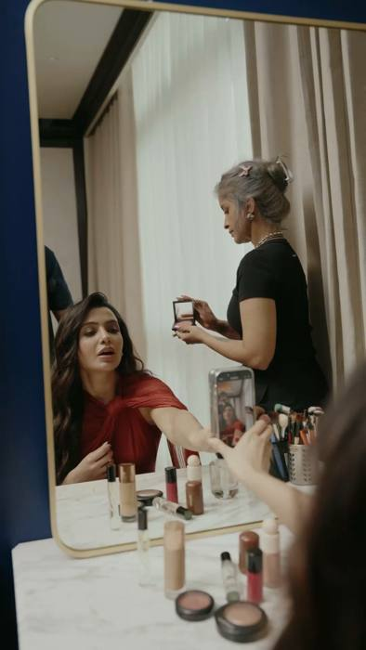
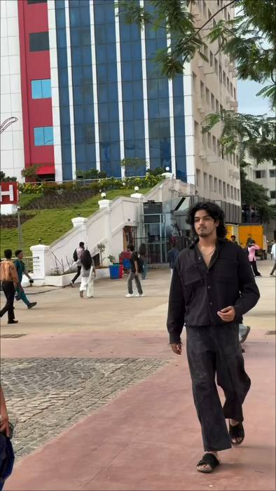
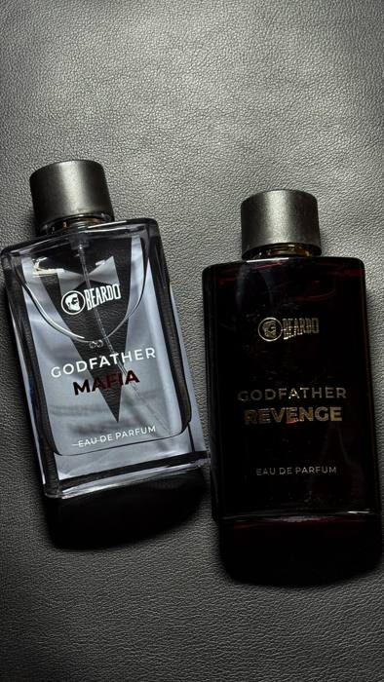
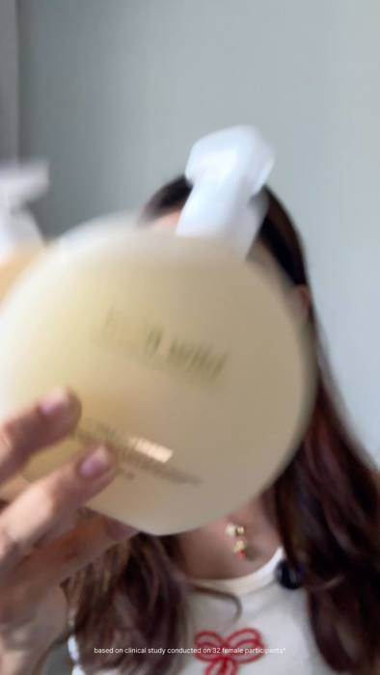
Creators front a large share of paid ads, and quick commerce is a common destination
Secret Alchemist
Half its top ads run from Samantha's handle
View ad
Bellavita
Regional creators post “comment for link” reactions
View ad
Beardo
Creator reviews of Godfather Mafia and Revenge
View ad
indē wild
Most launch ads are creator videos
View ad
Quick commerce: Engage, Beardo (“in 10 minutes”), Secret Alchemist and Plum send ads straight to Blinkit, Zepto or Instamart.

Slide 12
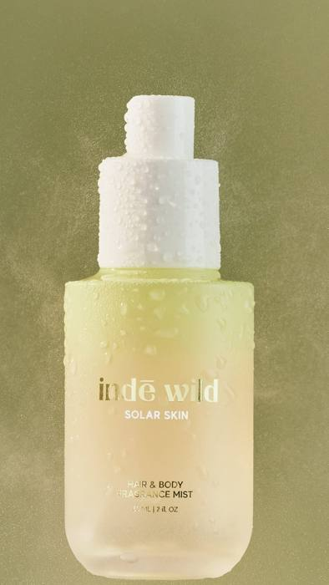
Male-coded brands are crossing into women's and unisex, and indē wild is entering mists
Park Avenue “for Her” (10 Jul): Godrej's first women's EDPs, four variants (Poise, Grace, Verve, Allure), pitched for gifting. Barely visible in ads since.
Fraganote Sports Mode (7 Aug): unisex 50 ml EDP for active lifestyles.
BlaBliBlu: unisex hero scents (Love Drunk) and fruity gourmands aimed at young women.
indē wild hair and body mists (Aug): After Heat and Solar Skin, “odour neutralising, mood-boosting”. A well-funded beauty brand now in the mist segment.
Women-first fragrance voices are few: Secret Alchemist (Samantha, florals) and indē wild.
indē wild Solar Skin mist
Launched August 2026
View post

Slide 13
Funding is going into stores, kiosks and new categories
$3M
Secret Alchemist
Unilever Ventures-led round (Jan); claims 8x growth in FY26; hair perfumes next
$3M
Fraganote
Series A, V3 Ventures (Jun); kiosks in 14 cities, 100 by year-end
₹100 Cr
BlaBliBlu
Annual run-rate within 6 months (Mar); Delhi NCR stores, pan-India next
170+
Ajmal
Exclusive stores targeted by end-2026, tier 2 and 3 focus; first London store (Aug)
50 → 111
EM5
Stores planned; Suryakumar Yadav joined as investor (Feb)
Sources: The Week, Inc42, Retail4Growth, India Retailing, Business Standard (2026). Growth figures are company claims.

Slide 14
Press-visible campaigns and launches, June to October 2026
Date | Brand | Campaign or move | Talent / channel
Oct | indē wild | Champi Clarifying & Detox Shampoo launch (Nykaa) | Rida Tharana
18 Sep | Denver | Rizz God EDP, Gen Z “Vibe Collection”, ₹2,500, 25% oil, D2C only | Press release
Aug | indē wild | Champi hair-oil ritual campaign | Anupama Parameswaran
7 Aug | Fraganote | Sports Mode unisex EDP, 50 ml | Launch
21 Jul | Secret Alchemist | Sandalwood Nostalgia; clean, “step up from mass” | Launch
10 Jul | Park Avenue | Enters women's: “for Her” EDP, 4 variants | Launch
Jun | Fraganote | $3M Series A; 100 kiosks planned | Funding
19–20 Jun | Beardo | Godfather Mafia and Revenge (₹1,700) at Flipkart and Amazon events | Danish Pandor
3 Jun | Denver | Intense EDP, “Success Rules The World” TVC, ₹999, 20% oil | Shah Rukh Khan
Earlier in 2026: Ajmal “Your Unseen Power” with Ranveer Singh on 575+ PVR screens (19 Mar); Bellavita #OwnTheVibe with Raghav Juyal (Jan); Plum BodyLovin' relaunch (Apr).

Slide 15
2
Platform by platform
Meta ads · Google ads · Instagram · YouTube · Google Trends

Slide 16
Beardo ran 960 Meta ads since mid-July, more than twice the next brand
3,387 ads ran across 10 brands; we read the 60 most-seen per brand.
Engage runs only catalogue ads for roll-ons.
Park Avenue and EM5 have no findable Meta advertiser page.
Ads active in India, 15 July to 15 October 2026. Source: Meta Ad Library via Apify.

Slide 17
Meta ads by brand (1 of 2): the biggest advertisers lead with bundles and creators
Brand | Ads | What the top ads push | Offer and format
Beardo | 960 | Perfume combos (Mariner, Whisky Smoke Bourbon ₹499), Godfather reviews; also de-tan, curls, beard, trimmers | 4 perfumes ₹999; 1 in 5 top ads from creators
BlaBliBlu | 429 | Build-your-own 30 ml box, “25%, 12+ hours”; Diwali House Party sale with free gifts; payday hook | 3 for ₹650–750; 38 of top 60 started in Oct
Bellavita | 422 | Beast Mode for Men (40% oil), half of top ads; Gourmand Trend Series ₹549; Vanilluxe | Any 2 ₹899, 3 ₹1,298, 4 ₹1,599; regional creators
Secret Alchemist | 373 | Clean Perfume (IFRA, 25%); Rare Vanilla “one sold every minute”; Rose Oud; hair perfumes; Instamart | Free 10 ml with 100 ml; half of top ads from Samantha
Ajmal | 339 | Oud trio, Cyan, Aristocrat with Ranveer Singh, gift sets | Any 3 ₹1,799; Gold Series ₹899; brand page only

Slide 18
Meta ads by brand (2 of 2): Denver discounts hardest; Engage and Plum sell other categories
Brand | Ads | What the top ads push | Offer and format
Fraganote | 231 | Gourmands (Baked Vanilla, Drunken Cake, Devil's Berry), Oud Collection, 25 ml minis, Rakhi box, Diwali Edit | From ₹999; personalised gift boxes
Denver | 219 | Any 3 perfumes ₹1,000; deo packs ₹599–1,200; Autograph 3 for ₹2,500; Diwali BOGO + MacBook; SRK contest | Deepest discounts; 45 of 60 static images
Plum | 215 | Skincare only: CeraSense barrier care, niacinamide serum, dandruff shampoo on Blinkit | 3 for ₹599
Engage | 127 | Roll-ons only (Amber Fresh, Radiant Glow “skin brightening”, 72-hour), to Blinkit and Zepto | 100% catalogue ads
indē wild | 72 | Champi Clarifying Shampoo (“96 hours oil control”), Dewy Lip Treatment, Sleek Stick | 15–20% off duos; mostly creators

Slide 19
Denver, BlaBliBlu and Fraganote ramped up Google ads in September; Bellavita's are a year old
Brand | Creatives (cap 60) | Median days live | New in September
Denver | 60 | 12 | 40
BlaBliBlu | 60 | 22 | 45
Fraganote | 60 | 20 | 28
Plum | 60 | 35 | 22
Ajmal | 60 | 46 | 14
Secret Alchemist | 60 | 101 | 13
Beardo | 60 | 84 | 2
indē wild | 27 | 16 | 0
EM5 | 15 | 227 | 1
Bellavita | 60 | 348 | 1
Short-lived creatives = testing. Denver's median Google ad ran 12 days.
Bellavita is Meta-only for new work. Beast Mode and Gourmand never reached Google.
Beardo defends search: 48 of 60 are text ads.
Google Ads Transparency Center, India, 15 Jul–15 Oct 2026. Engage and Park Avenue advertise under ITC and Godrej and could not be separated.

Slide 20
Instagram by brand (1 of 2): indē wild and Bellavita post the most
Brand | Followers | Posts (Jul/Aug/Sep/Oct) | Reels | Median eng. | What drove the top posts
indē wild | 267K | 135 (17/54/37/27) | 84% | 0.16% | Dino Morea “interim CEO” (49.7K likes); Sephora UK; summer mists; Bombay Sweet Shop collab
Bellavita | 943K | 90 (15/24/29/22) | 60% | 0.04% | Rakhi post (9.7K likes); product carousels; CEO Man bigger size
Plum | 1.15M | 76 (15/26/25/10) | 67% | 0.03% | BYOB barrier-care launch party; SPF giveaway
Beardo | 808K | 70 (15/22/22/11) | 59% | 0.04% | Rap battle series to brand anthem “Unstoppable” (10.1K likes)
BlaBliBlu | 150K | 69 (12/22/21/14) | 68% | 0.12% | 4 fruity gourmands; Diwali “boring gifts are retiring”; Rakhi giveaway
Secret Alchemist | 144K | 55 (7/23/18/7) | 42% | 0.11% | Gifting Collection (5.2K likes); “four women, one scent”; brand giveaways
Instagram Graph API, every post 15 Jul–15 Oct 2026. Median engagement = (likes + comments) ÷ followers per post.

Slide 21
Instagram by brand (2 of 2): Denver converts followers best; Park Avenue went quiet
Brand | Followers | Posts (Jul/Aug/Sep/Oct) | Reels | Median eng. | What drove the top posts
Denver | 170K | 51 (6/14/19/12) | 43% | 0.30% | SRK-birthday iPhone contest (17.4K likes, 21.9K comments); SRK “scent of success”
Ajmal (India) | 273K | 47 (4/22/11/10) | 62% | 0.10% | First UK store, London (1 Aug); Vogue Wedding Atelier; 75 years; perfumer series
Fraganote | 90K | 37 (7/13/10/7) | 73% | 0.15% | Hypnotic Oud; Sports Mode; Creme Castle collab; 25 ml minis
Engage | 37K | 19 (5/6/5/3) | 74% | 0.11% | Friendship Day post; perfume myths at Amazon Beautyverse; Maracujá range
EM5 | 117K | 8 (2/2/3/1) | 38% | 0.23% | “Kashmir” scent; Inglorious Ginger and The Great Oud; coffee car perfume
Park Avenue | 43K | 6 (1/5/0/0) | 33% | 0.06% | Refreshed EDPs and new-look Euphoria (Aug); silent since 28 Aug
Instagram Graph API, every post 15 Jul–15 Oct 2026.

Slide 22
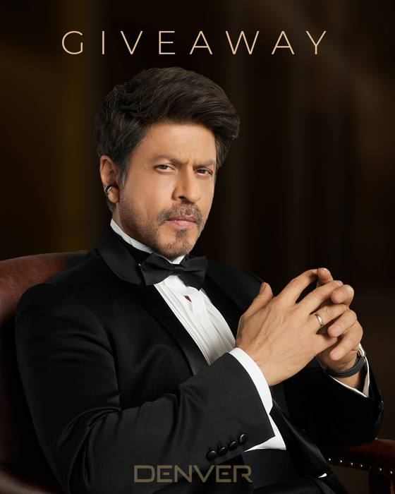
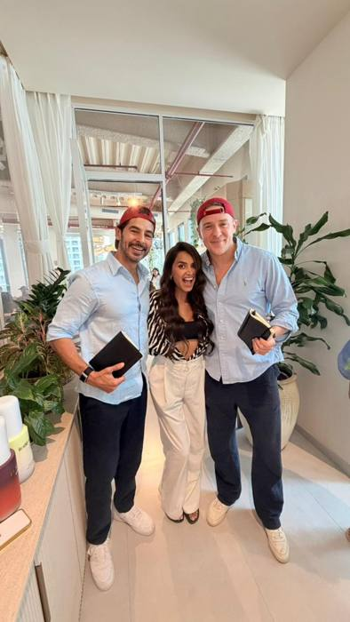
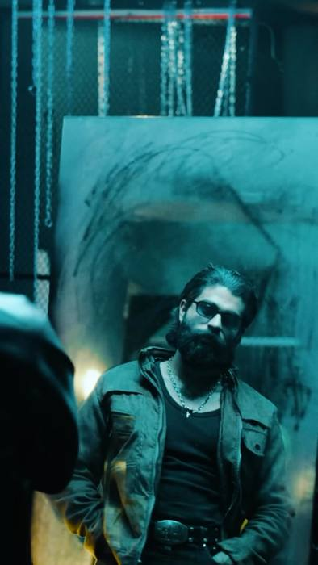
On Instagram, contests and stunts earned 10 to 40 times normal engagement
Denver: SRK-birthday iPhone contest
17.4K likes, 21.9K comments (median post: 457 likes)
View post
indē wild: Dino Morea as “interim CEO”
49.7K likes (median post: 391)
View post
Beardo: brand anthem “Unstoppable”
10.1K likes (median post: 284)
View post
Instagram Graph API. Denver's contest image shows its matching Meta ad creative.

Slide 23
Denver and EM5 get the most engagement per follower; the biggest accounts get the least
Big accounts, low reaction: Bellavita (943K), Plum (1.15M) and Beardo (808K).
Brand collabs are cheap reach: indē wild × Bombay Sweet Shop, Fraganote × Creme Castle, Secret Alchemist × Isharya, Winston, Instamart.
Median (likes + comments) ÷ followers per post. Instagram Graph API, 663 posts.

Slide 24
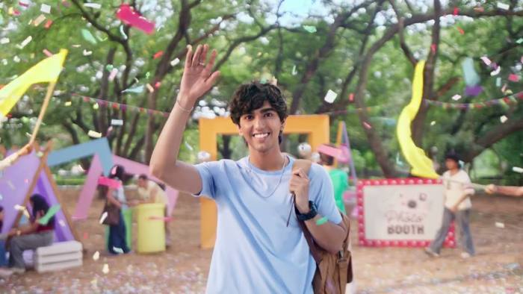
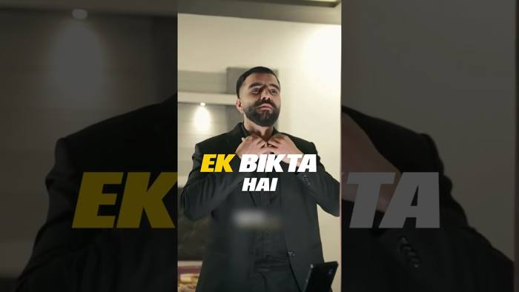
Engage's regional roll-on ads drew 24M YouTube views, more than all others combined
Engage roll-on, Bengali cut
9.4M views, 3 likes: almost all paid
Watch
Beardo Godfather
2.9M views
Watch
YouTube Data API, uploads 1 Jun–15 Oct 2026, views to date.

Slide 25
Most big YouTube view counts are paid; indē wild is the only all-organic channel
Brand | Uploads | Views | Paid share (est.) | What they pushed
Engage | 39 | 24.0M | ~100% | 32 uploads in Sep: roll-on ads in Hindi, Bengali, Kannada; Mini Perfume Spray TVC (Assamese)
Fraganote | 92 | 5.0M | ~73% | Oud Collection, Hypnotic Oud; Rakhi sale (45% off + 3 free minis); Drunken Cake review (750K)
Beardo | 43 | 3.6M | ~15% | “A Godfather perfume is sold every 15 seconds” (2.9M); brand anthem; curls content
Ajmal | 67 | 3.6M | ~42% | Evoke Red gifting films; factory tour; “Authors of Ajmal” perfumer series
BlaBliBlu | 9 | 1.6M | ~95% | “Get 6 perfumes free” sampling offer (1.2M); “It's parfum, not perfume”
indē wild | 99 | 0.9M | 0% | Champi and desi-beauty community shorts
Denver | 20 | 0.8M | ~99% | Intense EDP “Success rules the world” (830K paid); product shorts
Plum / EM5 | 19 / 2 | 0.3M / 0.2M | ~68% / ~79% | Plum: CeraSense skincare. EM5: The Salt, Myself Absolute ₹499
Paid share estimated: videos with 50K+ views and under 0.2% likes plus comments. Quiet since June: Bellavita (last 17 Jan), Secret Alchemist (10 Feb), Park Avenue (Apr 2025).

Slide 26
Beardo and Bellavita lead search interest; Secret Alchemist's doubled
Last Diwali was Bellavita's and Denver's peak week. Expect the same spike now.
Week of 5 July lifted BlaBliBlu, Fraganote and Plum together: a marketplace sale.
Rising: “bella vita pistachio” +400%, “ceo man” +80%, Wild Stone Edge +150%.
Google Trends, India, Jul–Oct average (Bellavita = 100); change vs previous 9 months. Engage (1.5) and Park Avenue (1.3) are under-counted.

Slide 27
3
Brand by brand
One page per competitor: what they launched, advertised and posted

Slide 28
Denver: Shah Rukh Khan at the top, deep bundle discounts underneath
219
Meta ads
40
new Google ads in Sep
0.30%
IG engagement (best)
0.8M
YT views, ~99% paid
44
Search (+11%)
Intense EDP with SRK (3 Jun): “Success Rules The World” TVC, ₹999, 20% oil.
Rizz God (18 Sep): Gen Z “Vibe Collection” EDP, ₹2,500, 25% oil, D2C only.
Meta is all offers: any 3 for ₹1,000, deo packs ₹599–1,200, Diwali buy-1-get-1 + daily MacBook draw.
SRK-birthday contest (Oct): 17.4K likes, 21.9K comments; iPhones as prizes.
Trade: booth at Beautyworld Dubai; Hamilton Intense “SRK collection”.
SRK contest
View post
Diwali BOGO
View ad
Meta = ads active since 15 Jul. IG = Instagram, 15 Jul–15 Oct. YT = YouTube uploads since 1 Jun. Search = Google Trends index (Bellavita = 100).

Slide 29
BlaBliBlu: ₹100 Cr run-rate in 6 months, now pushing gourmands and Diwali gifts
429
Meta ads
45
new Google ads in Sep
150K
IG followers, 69 posts
1.6M
YT views, ~95% paid
16
Search (+45%)
Scale: ₹100 Cr annual run-rate within 6 months (Mar); sub-₹1,000 parfums, 25% oil.
Price hook: build-your-own box, 3 for ₹650–750; “get 6 perfumes free” sampling (1.2M YT views).
Gourmand drop (21–24 Sep): Berry Baddie, Watermelon Buddy, Mango So Goated, Happy Bananana.
Diwali (from 1 Oct): House Party sale with free shot glasses, candle, card game; “boring gifts are retiring” series.
Tone: Hinglish memes and trends; “Ab machega bhaukaal” tease got 251K views.
Gourmand drop
View post
Diwali sale
View ad
Meta = ads active since 15 Jul. IG = Instagram, 15 Jul–15 Oct. YT = YouTube uploads since 1 Jun. Search = Google Trends index (Bellavita = 100).

Slide 30
Bellavita: biggest following and search share, with all new work on Meta
422
Meta ads
348 days
median Google ad age
943K
IG followers, 90 posts
0
YT uploads since Jan
100
Search (index base)
Beast Mode for Men (24 Jun): “40% perfume oil”, half of its top Meta ads; Oud Supreme + flask ₹799.
Gourmand Trend Series (26 Sep): 5 dessert scents at ₹549; Vanilluxe ₹599.
Bundles: any 2 ₹899, 3 ₹1,298, 4 ₹1,599, sold as gifting.
Regional creators (Tamil, Malayalam, Kannada) run “comment for link” reaction ads.
Search: flat (+1%); peaked last Diwali; “pistachio” +400%, “ceo man” +80%.
Any 3 ₹1,298
View ad
Creator ad
View ad
Meta = ads active since 15 Jul. IG = Instagram, 15 Jul–15 Oct. YT = YouTube uploads since 1 Jun. Search = Google Trends index (Bellavita = 100).

Slide 31
indē wild: champi hair care, a global Sephora push and a move into mists
72
Meta ads
27
Google creatives
135
IG posts (most)
0.9M
YT views, all organic
20
Search (−8%)
Global: Sephora US (Mar) and Sephora UK Carnaby store (Jul).
Champi: campaign with Anupama Parameswaran (Aug); Clarifying & Detox Shampoo on Nykaa (30 Sep) with Rida Tharana.
Into fragrance: hair and body mists After Heat and Solar Skin (Aug).
Stunts and collabs: Dino Morea “interim CEO” (49.7K likes); Bombay Sweet Shop Rakhi box; founder birthday sale 29% off.
Ads: mostly creator videos; “96 hours oil control” claim.
Dino Morea stunt
View post
Solar Skin mist
View post
Meta = ads active since 15 Jul. IG = Instagram, 15 Jul–15 Oct. YT = YouTube uploads since 1 Jun. Search = Google Trends index (Bellavita = 100).

Slide 32
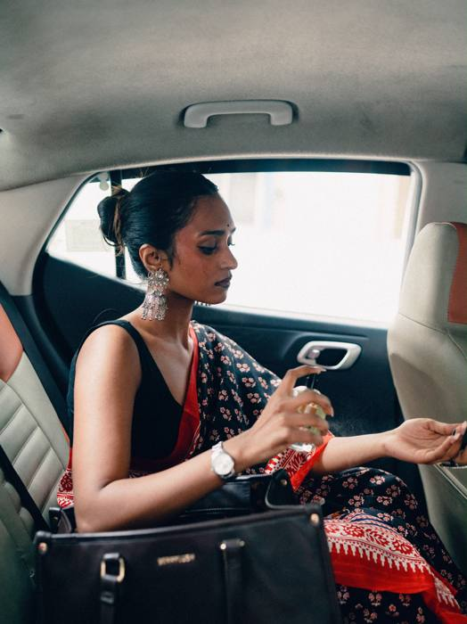
Secret Alchemist: clean, premium, Samantha-led, and search interest doubled
373
Meta ads
101 days
median Google ad age
144K
IG followers, 55 posts
0
YT uploads since Feb
24
Search (+102%)
Funding: $3M led by Unilever Ventures (Jan); claims 8x growth in FY26.
Product: Clean Perfume (IFRA, 25%); Sandalwood Nostalgia (Jul); Rare Vanilla “one sold every minute”; Rose Oud; hair perfumes.
Gifting Collection (6 Aug): pushed through Rakhi; gift boxes from ₹1,299.
Samantha fronts half its top ads; “four women, one scent” series; now on Swiggy Instamart.
Giveaways: with Isharya, Winston and Dyson × Instamart.
Samantha ad
View ad
Four women
View post
Meta = ads active since 15 Jul. IG = Instagram, 15 Jul–15 Oct. YT = YouTube uploads since 1 Jun. Search = Google Trends index (Bellavita = 100).

Slide 33
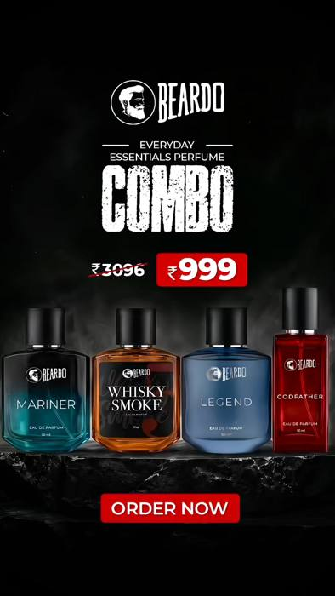
Beardo: the heaviest advertiser, built around the Godfather perfume franchise
960
Meta ads (most)
48 of 60
Google ads are text
808K
IG followers, 70 posts
3.6M
YT views, ~15% paid
215
Search (+23%)
Godfather franchise: film with Danish Pandor (Apr); Mafia and Revenge (₹1,700) at Flipkart Glam Up Fest and Amazon Beautyverse (Jun).
“Sold every 15 seconds”: 2.9M YouTube views.
Brand anthem “Unstoppable” (25 Sep): built from a July rap battle series; 10.1K likes.
Meta: 4 perfumes ₹999, Whisky Smoke Bourbon ₹499; de-tan, curls and beard kits; Blinkit “in 10 minutes”.
Search peaked 4 Oct, highest of the 12 (includes grooming searches).
Brand anthem
View post
4 for ₹999
View ad
Meta = ads active since 15 Jul. IG = Instagram, 15 Jul–15 Oct. YT = YouTube uploads since 1 Jun. Search = Google Trends index (Bellavita = 100).

Slide 34
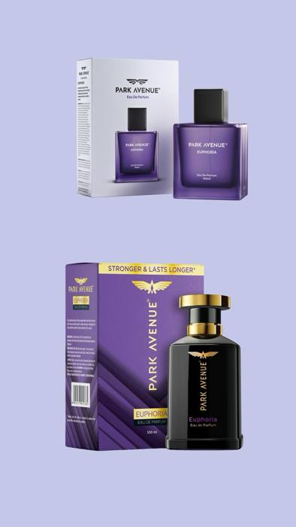
Park Avenue: a women's launch and a refresh in July and August, then silence
—
no Meta page found
—
Google under Godrej
43K
IG followers, 6 posts
0
YT uploads since 2025
1.3
Search (flat)
“for Her” (10 Jul): Godrej's first women's EDPs, four variants (Poise, Grace, Verve, Allure), pitched for gifting.
Refresh (Aug): new-look EDP collection and Euphoria; one boosted reel reached 597K views.
Since 28 Aug: no Instagram posts, no YouTube uploads.
Ads: not separable from Godrej's accounts on Meta or Google.
Read: a big brand with a new women's range and little visible support behind it.
New-look Euphoria
View post
Meta = ads active since 15 Jul. IG = Instagram, 15 Jul–15 Oct. YT = YouTube uploads since 1 Jun. Search = Google Trends index (Bellavita = 100).

Slide 35
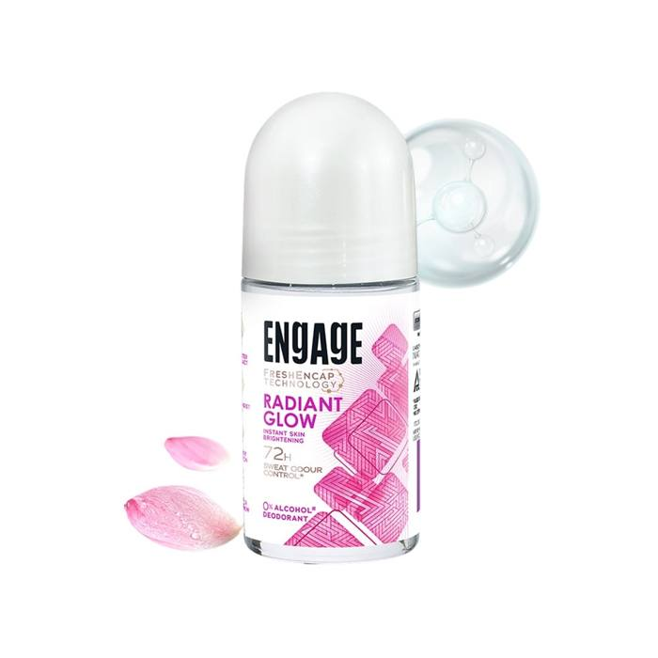
Engage: invisible in the press, but the biggest paid YouTube push
127
Meta ads (all roll-ons)
—
Google under ITC
37K
IG followers, 19 posts
24.0M
YT views, ~100% paid
1.5
Search (under-counted)
YouTube burst (Sep): 32 roll-on ads in Hindi, Bengali and Kannada; one cut reached 9.4M views.
Roll-ons: Radiant Glow “instant skin brightening”, Amber Fresh “72 hours”, FreshEnCap technology.
Meta: 100% catalogue ads linking to Blinkit and Zepto.
Perfume: Mini Perfume Spray TVC (Assamese, Jun); Maracujá range at Amazon Beautyverse; Verona.
Read: the mass player is fighting on deo roll-ons and regional reach, not fine fragrance.
Radiant Glow ad
View ad
9.4M-view cut
Watch
Meta = ads active since 15 Jul. IG = Instagram, 15 Jul–15 Oct. YT = YouTube uploads since 1 Jun. Search = Google Trends index (Bellavita = 100).

Slide 36
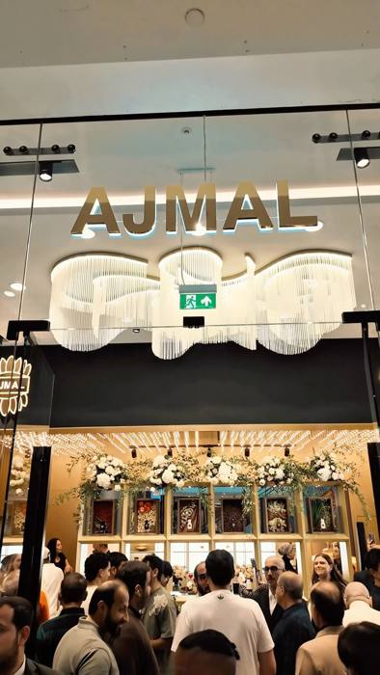
Ajmal: oud heritage, Ranveer Singh and a fast retail expansion
339
Meta ads
46 days
median Google ad age
273K
IG followers, 47 posts
3.6M
YT views, ~42% paid
69
Search (+39%)
Ranveer Singh (Mar): replaced Saif Ali Khan; “Your Unseen Power” on 575+ PVR screens.
Retail: 170+ exclusive stores by end-2026; first UK store, Westfield London (1 Aug).
Experiences: Vogue Wedding Atelier masterclass, Umang, GQ Heroes event scent, AYC Mumbai.
Story: 75 years of Ajmal; “Authors of Ajmal” master-perfumer series.
Meta: oud trio, Cyan; any 3 ₹1,799; Gold Series gift set ₹899.
London store
View post
Oud trio
View ad
Meta = ads active since 15 Jul. IG = Instagram, 15 Jul–15 Oct. YT = YouTube uploads since 1 Jun. Search = Google Trends index (Bellavita = 100).

Slide 37
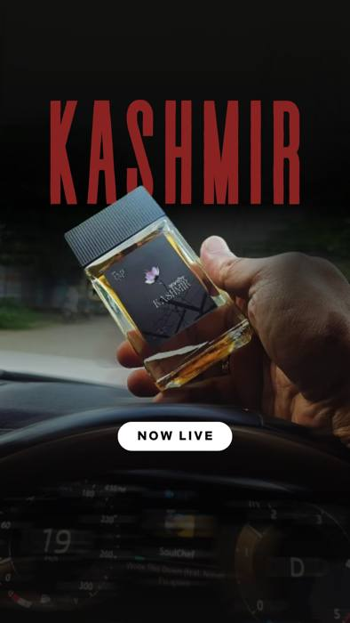
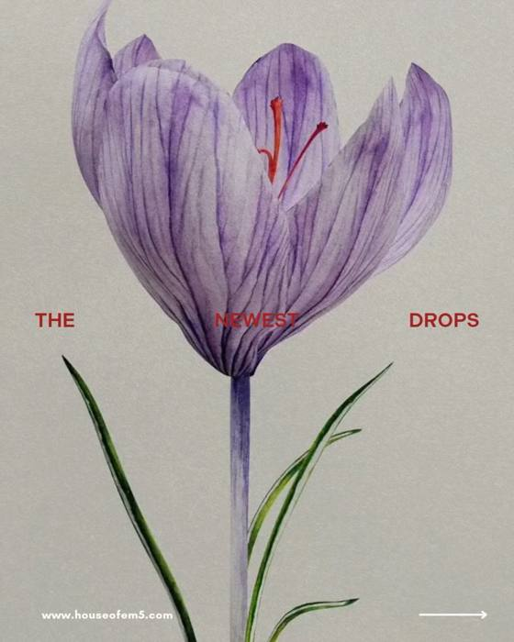
EM5: a small online footprint, a cricket-star investor and story-led scents
—
no Meta page found
15
Google creatives
117K
IG followers, 8 posts
0.2M
YT views
11
Search (+23%)
Suryakumar Yadav (Feb): investor and partner; Kachra Seth parody video.
Retail: about 50 stores, 111 planned; airport sampling; 70–80% of sales online.
Launches: “Kashmir” (Jul–Aug); Inglorious Ginger and The Great Oud (25 Sep); DriveTherapy coffee car perfume (9 Sep).
Price: Myself Absolute EDP at ₹499.
Read: high engagement per follower (0.23%) from very few posts.
Kashmir
View post
New launches
View post
Meta = ads active since 15 Jul. IG = Instagram, 15 Jul–15 Oct. YT = YouTube uploads since 1 Jun. Search = Google Trends index (Bellavita = 100).

Slide 38
Fraganote: the most consistent publisher, built on gourmand and oud
231
Meta ads
28
new Google ads in Sep
90K
IG followers, 37 posts
5.0M
YT views (92 uploads)
12
Search (+15%)
Funding: $3M Series A (Jun); kiosks in 14 cities, 100 by year-end.
Launches: Oud Collection (17 Jul), Hypnotic Oud, Sports Mode (7 Aug), 25 ml minis (18 Sep).
Gourmands: Baked Vanilla, Drunken Cake (750K YT views), Devil's Berry; Creme Castle bonbon collab.
Gifting: Rakhi sale up to 45% off + 3 free minis; Diwali Edit (9 Oct).
Ads: short-lived Google creatives (median 20 days) = constant testing.
25 ml minis
View ad
Oud Collection
Watch
Meta = ads active since 15 Jul. IG = Instagram, 15 Jul–15 Oct. YT = YouTube uploads since 1 Jun. Search = Google Trends index (Bellavita = 100).

Slide 39
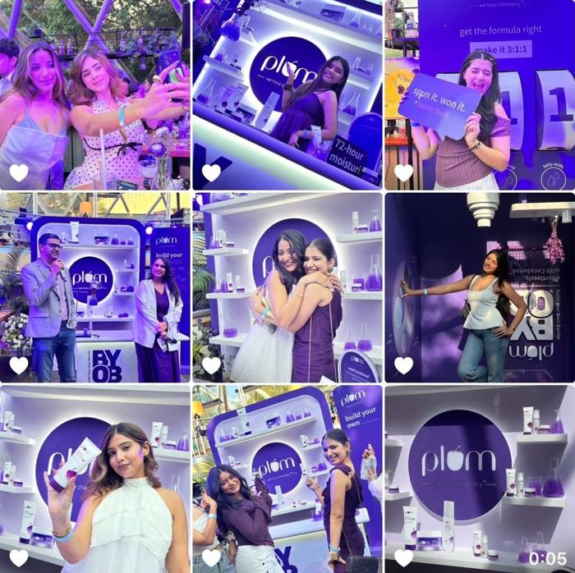
Plum: all skincare this quarter; fragrance sits with BodyLovin'
215
Meta ads (skincare)
60
Google creatives
1.15M
IG followers, 76 posts
0.3M
YT views
6
Search (−37%)
BodyLovin' relaunch (Apr): independent identity, 16 launches, offbeat lip balms; heavy OTT and vernacular YouTube plans.
This quarter: CeraSense barrier care and the “BYOB” Delhi party; niacinamide jelly serum.
Meta: skincare only; 3 for ₹599; dandruff shampoo on Blinkit.
Read: not an active fragrance competitor this quarter; watch BodyLovin' mists.
BYOB party
View post
Meta = ads active since 15 Jul. IG = Instagram, 15 Jul–15 Oct. YT = YouTube uploads since 1 Jun. Search = Google Trends index (Bellavita = 100).

Slide 40
4
What it means for Mcnroe
Launch calendar, implications and how we keep tracking

Slide 41
Competitors launched something almost every week from July to October
July
August
September
October
19 Jul
Fraganote Hypnotic Oud
1 Aug
Ajmal first London store
18 Sep
Denver Rizz God (Gen Z)
1 Oct
BlaBliBlu Diwali sale
Jul
Beardo rap battle series
6 Aug
Secret Alchemist Gifting Collection
18 Sep
Fraganote 25 ml minis
8 Oct
Denver SRK iPhone contest
Jul
indē wild Sephora UK
7 Aug
Fraganote Sports Mode
21–24 Sep
BlaBliBlu 4 gourmands
9 Oct
Fraganote Diwali Edit
8 Aug
Park Avenue new-look EDPs
25 Sep
Beardo anthem “Unstoppable”
13 Oct
Denver Diwali buy 1 get 1
Aug
indē wild hair and body mists
26 Sep
Bellavita Gourmand series
Park Avenue “for Her” launched 10 July, just before the window.

Slide 42
What this means for Mcnroe
1
Lead Diwali with a gifting idea, not a deeper discount. Four brands already run buy-1-get-1 and free-gift offers.
2
State a proof of longevity. Competitors print 20–40% oil; name a concentration or tested hours.
3
Price singles against “any 3 for ₹1,000”. Shoppers see 3-perfume bundles from ₹650 every day.
4
Go where it's less crowded. Fresh and floral scents, and women's, have few strong voices.
5
Use creator-run ads and quick commerce. Both are normal for Secret Alchemist, Bellavita, Beardo and Engage.
6
Plan launches around marketplace events. Flipkart Glam Up Fest, Amazon Beautyverse and festive sales.

Slide 43
Repeating this scan every 3 months costs about $19 in data fees
Layer | Tool | Cost per quarterly scan
Meta ads (all ads) | Apify Facebook Ads Library Scraper | ~$12
Google ads | Apify Google Ads Transparency Scraper | ~$2–3
Instagram (every post) | Instagram Graph API (set up) | Free
YouTube | YouTube Data API | Free
Google Trends | Apify Google Trends Scraper | ~$0.50
Analysis and report | Claude | Existing plan
Total: ~$16 per scan; one Apify Starter month ($19) covers it.
Optional: comment sentiment, ~$15 more per quarter.
Not available anywhere: competitor ad spend and reach.

Slide 44
Appendix: how this scan was made
Layer | Source | Coverage
Meta ads | Meta Ad Library (Apify) | Counts for 10 brands; top 60 ads each read
Google ads | Google Ads Transparency Center (Apify) | Up to 60 creatives per brand
Instagram | Instagram Graph API | All 663 posts, 12 brands
YouTube | YouTube Data API | All 390 uploads since 1 June
Search | Google Trends (Apify) | 12 brands, India, 12 months
Press | Trade press and press releases | Launches, funding, campaigns
Full write-up: Competitor Scan doc Raw data: project repository
Caveats: no source gives competitor ad spend or reach; YouTube paid views are inferred from like rates; brand claims (oil %, growth) are unverified; press-release figures are company claims.

