Slide 1
Competitor Scan
Fragrance and grooming in India, 15 July to 15 October 2026
Denver · BlaBliBlu · Bellavita · indē wild · Secret Alchemist · Beardo · Park Avenue · Engage · Ajmal · EM5 · Fraganote · Plum
Prepared for Mcnroe · October 2026

Slide 2
Executive summary
Diwali selling started on 1 October. BlaBliBlu, Denver, Fraganote and Bellavita already run festive offers on Meta.
“Any 3” bundles set the price frame: 3 perfumes for ₹650 (BlaBliBlu) to ₹1,799 (Ajmal).
Perfume-oil % is the quality claim. Bellavita now claims 40%, against the usual 25%.
Beardo is the heaviest Meta advertiser (960 ads); Engage ran the biggest paid YouTube push (24M views) with no press coverage.
Contests and stunts win on Instagram, earning 10 to 40 times normal engagement.
3,387
Meta ads analysed
663
Instagram posts analysed
390
YouTube videos analysed
Sources: Meta Ad Library, Google Ads Transparency Center, Instagram Graph API, YouTube Data API, Google Trends, trade press. Pulled 15 October 2026.

Slide 3

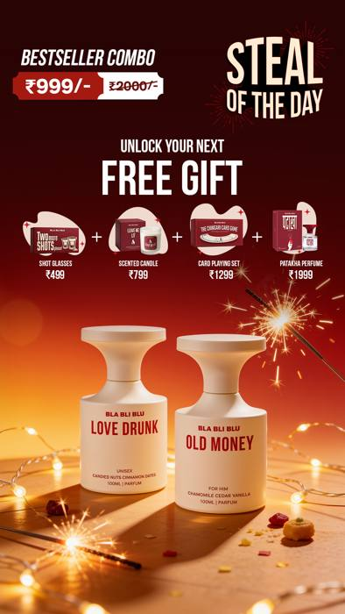
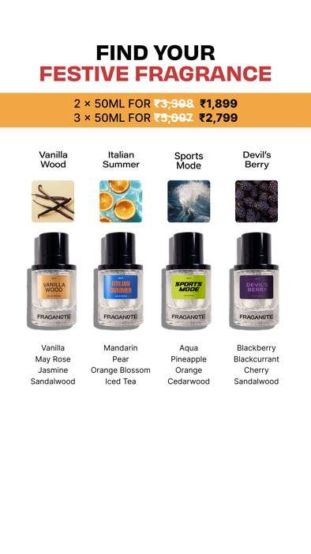
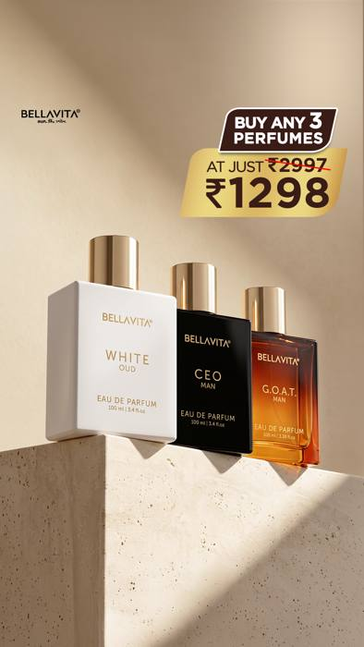
Diwali selling began on 1 October, more than a month before the festival
Denver
Buy 1 get 1 + daily MacBook draw, from 13 Oct
View ad
BlaBliBlu
Diwali House Party sale, free gifts, from 1 Oct
View ad
Fraganote
Festive 50 ml sets, Diwali Edit, from 9 Oct
View ad
Bellavita
Any 3 perfumes for ₹1,298, gifting-ready
View ad
Diwali is on 8 November 2026. Ads from Meta Ad Library, India; click an image to open the ad.

Slide 4
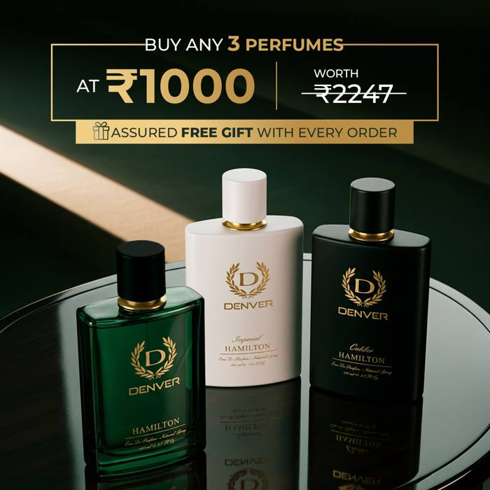
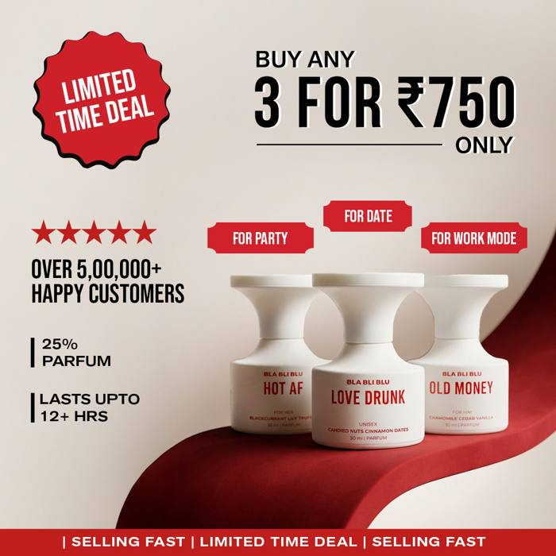
“Any 3” bundles set the price frame: 3 perfumes for ₹650 to ₹1,799
Denver
Any 3 for ₹1,000
View ad
BlaBliBlu
3 for ₹750
View ad
Price of a 3-perfume bundle in Meta ads (₹)
Build-your-own box appears in 6 of 10 advertisers. Beardo sells 4 perfumes for ₹999.
Offers seen in Meta ads, August to October 2026. BlaBliBlu runs ₹650 and ₹750 versions.

Slide 5
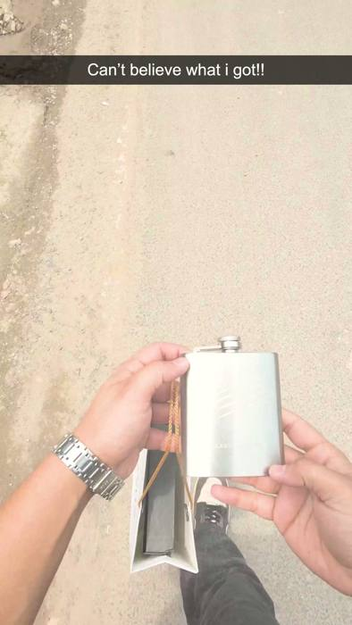
Perfume-oil percentage is the quality claim, and Bellavita now claims 40%
Bellavita Beast Mode
Collector's flask with Oud Supreme, 40% oil
View ad
Perfume-oil concentration claimed in ads and launches
Brand claims, not lab-tested. Sources: Meta Ad Library; Denver launch press releases (June and September 2026).

Slide 6
Beardo ran 960 Meta ads since mid-July, more than twice the next brand
Beardo spreads spend across perfume combos, de-tan, beard and curl kits.
Engage runs only catalogue ads for roll-ons, linking to Blinkit and Zepto.
Park Avenue and EM5 have no findable Meta advertiser page.
Ads active in India, 15 July to 15 October 2026. Source: Meta Ad Library via Apify.

Slide 7
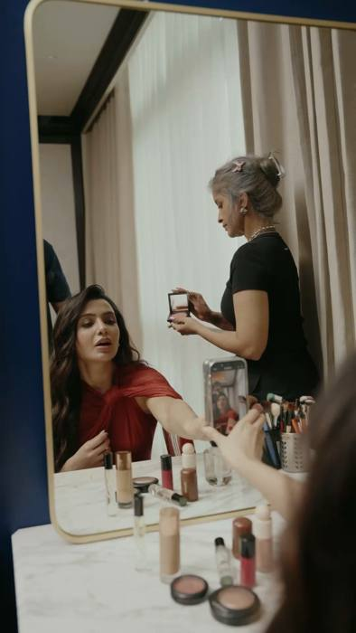
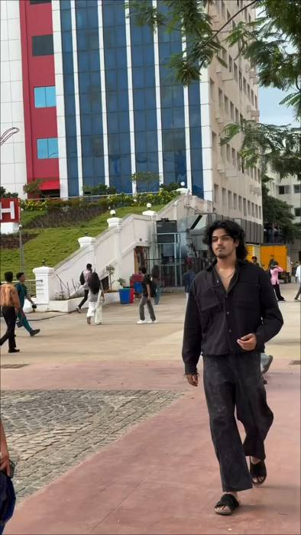
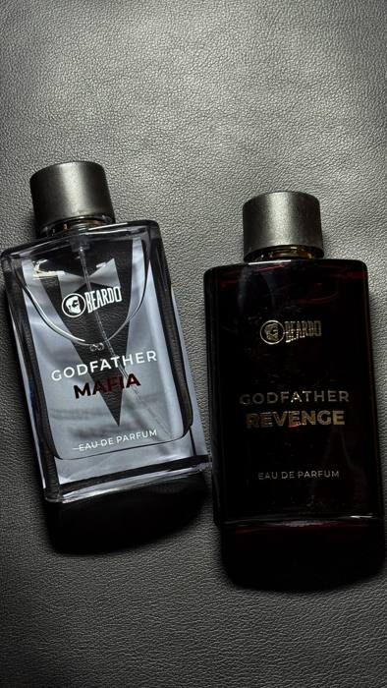
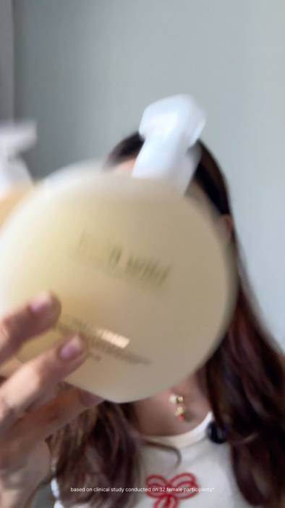
Creators front a large share of paid ads, and quick commerce is a common destination
Secret Alchemist
Half its top ads run from Samantha's handle
View ad
Bellavita
Regional creators post “comment for link” reactions
View ad
Beardo
Creator reviews of Godfather Mafia and Revenge
View ad
indē wild
Most launch ads are creator videos
View ad
Quick commerce: Engage, Beardo, Secret Alchemist and Plum send ads straight to Blinkit, Zepto or Instamart.

Slide 8

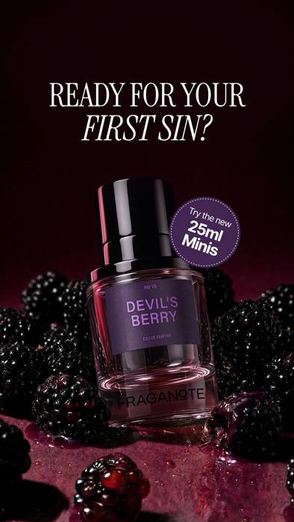
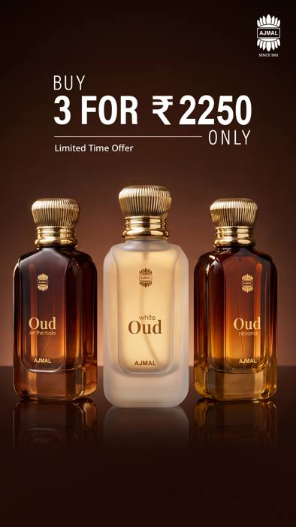
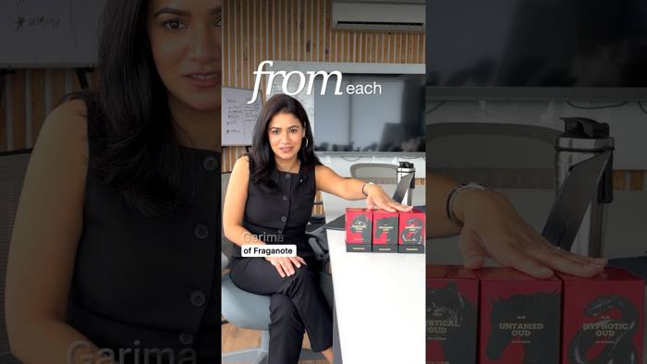
Gourmand and oud are this season's scent stories; fresh and floral are less crowded
BlaBliBlu
4 fruity gourmands, one a day, 21–24 Sep
View post
Fraganote
Devil's Berry and dessert scents, new 25 ml minis
View ad
Ajmal
Oud trio: Oud Nirvana, Oud on the Rocks, White Oud
View ad
Fraganote
Oud Collection launch, 17 Jul (570K views)
Watch
Also: Bellavita's Gourmand Trend Series at ₹549 (26 Sep). Secret Alchemist's jasmine and tuberose are the main floral voice.

Slide 9
Denver, BlaBliBlu and Fraganote ramped up Google ads in September; Bellavita's are a year old
Brand | Creatives (cap 60) | Median days live | New in September
Denver | 60 | 12 | 40
BlaBliBlu | 60 | 22 | 45
Fraganote | 60 | 20 | 28
Plum | 60 | 35 | 22
Ajmal | 60 | 46 | 14
Secret Alchemist | 60 | 101 | 13
Beardo | 60 | 84 | 2
indē wild | 27 | 16 | 0
EM5 | 15 | 227 | 1
Bellavita | 60 | 348 | 1
Short-lived creatives = testing.
Denver's median Google ad ran 12 days; it launched 40 new ones in September.
Bellavita is Meta-only for new work.
Beast Mode and Gourmand never reached its Google ads.
Google Ads Transparency Center, India, ads shown 15 Jul–15 Oct 2026. Engage and Park Avenue advertise under ITC and Godrej and could not be separated.

Slide 10

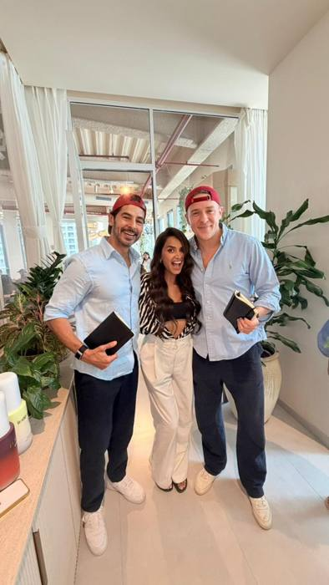

On Instagram, contests and stunts earned 10 to 40 times normal engagement
Denver: SRK-birthday iPhone contest
17.4K likes, 21.9K comments (median post: 457 likes)
View post
indē wild: Dino Morea as “interim CEO”
49.7K likes (median post: 391)
View post
Beardo: brand anthem “Unstoppable”
10.1K likes (median post: 284)
View post
Instagram Graph API (Business Discovery), all posts 15 Jul–15 Oct 2026. Denver's contest image shows its matching Meta ad creative.

Slide 11
Denver and EM5 get the most engagement per follower; the biggest accounts get the least
Median (likes + comments) ÷ followers per post.
Bellavita (943K), Plum (1.15M) and Beardo (808K) post often but convert few followers into reactions.
indē wild posts most: 135 posts in 3 months, 84% reels.
Instagram Graph API, 663 posts from 12 accounts, 15 Jul–15 Oct 2026.

Slide 12
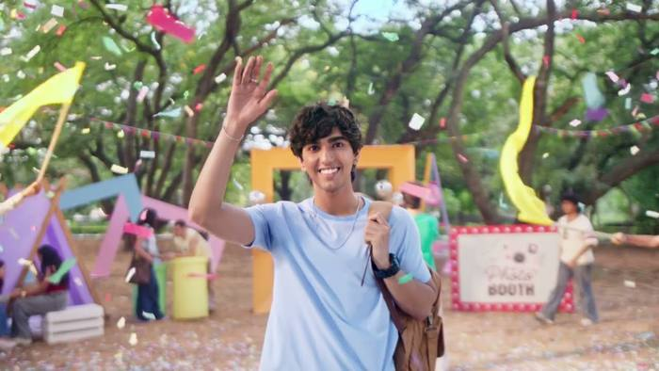
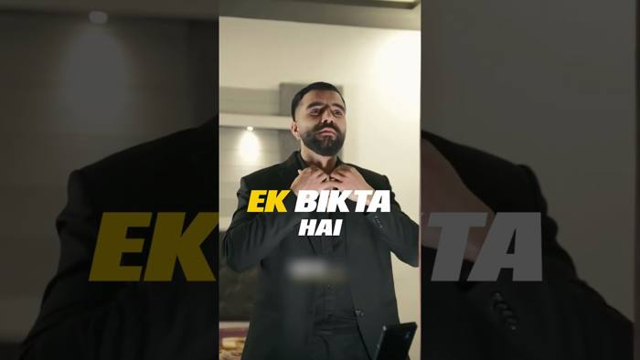
Engage's regional roll-on ads drew 24M YouTube views, more than all others combined
Engage roll-on, Bengali cut
9.4M views, 3 likes: almost all paid
Watch
Beardo Godfather
2.9M views
Watch
YouTube Data API, uploads 1 Jun–15 Oct 2026, views to date. Bellavita, Secret Alchemist and Park Avenue posted nothing since June.

Slide 13
Beardo and Bellavita lead search interest; Secret Alchemist's doubled
Google search interest in India, Jul–Oct (Bellavita = 100); change vs the previous 9 months in brackets.
Last Diwali was Bellavita's and Denver's peak search week. Expect the same spike now.
Google Trends via Apify, India, 12 Oct 2025–14 Oct 2026. Engage and Park Avenue are under-counted (people search the product, not the brand).

Slide 14
Competitors launched something almost every week from July to October
July
August
September
October
19 Jul
Fraganote Hypnotic Oud
1 Aug
Ajmal first London store
18 Sep
Denver Rizz God (Gen Z)
1 Oct
BlaBliBlu Diwali sale
Jul
Beardo rap battle series
6 Aug
Secret Alchemist Gifting Collection
18 Sep
Fraganote 25 ml minis
8 Oct
Denver SRK iPhone contest
7 Aug
Fraganote Sports Mode
21–24 Sep
BlaBliBlu 4 gourmands
9 Oct
Fraganote Diwali Edit
8 Aug
Park Avenue new-look EDPs
25 Sep
Beardo anthem “Unstoppable”
13 Oct
Denver Diwali buy 1 get 1
Aug
indē wild hair and body mists
26 Sep
Bellavita Gourmand series
Sources: Instagram, YouTube, Meta Ad Library and press releases. Park Avenue “for Her” launched 10 July, just before the window.

Slide 15
What this means for Mcnroe
1
Lead Diwali with a gifting idea, not a deeper discount. Four brands already run buy-1-get-1 and free-gift offers.
2
State a proof of longevity. Competitors print 20–40% oil; name a concentration or tested hours.
3
Price singles against “any 3 for ₹1,000”. Shoppers see 3-perfume bundles from ₹650 every day.
4
Go where it's less crowded. Fresh and floral scents, and women's, have few strong voices.
5
Use creator-run ads and quick commerce. Both are now normal for Secret Alchemist, Bellavita, Beardo and Engage.

Slide 16
Appendix: how this scan was made
Layer | Source | Coverage
Meta ads | Meta Ad Library (Apify) | Counts for 10 brands; top 60 ads each read
Google ads | Google Ads Transparency Center (Apify) | Up to 60 creatives per brand
Instagram | Instagram Graph API | All 663 posts, 12 brands
YouTube | YouTube Data API | All 390 uploads since 1 June
Search | Google Trends (Apify) | 12 brands, India, 12 months
Press | Trade press and press releases | Launches, funding, campaigns
Full write-up: Competitor Scan doc Raw data: project repository
Caveats: no source gives competitor ad spend or reach; YouTube paid views are inferred from like rates; brand claims (oil %, growth) are unverified.

