Slide 1

Global Academy of Technology Department of Computer Science and Engineering
Technical Seminar (21CSES84)
Real-Time Plant Disease Dataset Development
and Detection of Plant Disease Using
Deep Learning
Name: TEJAS S
USN:1GA21CS167
Guide
Name of the faculty:Divya SJ
Assistant professor
Dept. of CSE, GAT

Slide 2
Index
Objective
Abstract
Introduction
Technologies Used
Implementation/Issues/Applications
Comparison Results (if any)
Conclusion & Future Scope
Bibliography / References

Slide 3
Objectives
Develop a Real-Time Dataset
Capture Disease Stages
Data Collection and Augmentation
Data Annotation
Model Training and Evaluation
Propose a Custom CNN Model (MRW-CNN)
Future Work and Extension
Model Training and Evaluation
Propose a Custom CNN Model (MRW-CNN)
Future Work and Extension

Slide 4
Abstract
Agriculture is a major industry that provides food and supports the economy.
Plant diseases like blights and fungal infections can cause major crop losses, affecting both food supply and quality.
Identifying plant diseases early is essential to prevent crop damage and reduce yield losses.
Manually detecting plant diseases is time-consuming and difficult for large farms.
This research uses machine learning and image processing to detect plant diseases from leaf images.

Slide 5
Convolutional Neural Networks (CNN) analyze plant leaf images to accurately identify diseases.
Helps farmers by providing quick disease detection and suggesting remedies to protect crops and improve yield​.

Slide 6
Introduction
Agriculture is a key industry that provides food and support the economy
Factors like fungi, bacteria, viruses, extreme weather conditions, and drought contribute to plant diseases.
Early detection of plant diseases is vital to prevent extensive crop damage.
Machine learning methods, particularly using plant images, offer a promising solution for accurate and timely plant disease detection.

Slide 7
Problem Statement
Plant diseases cause major crop losses and are difficult to detect early using traditional manual methods. These methods are slow, inaccurate, and impractical for large farms. There is a need for an automated, cost-effective system to quickly and accurately identify plant diseases. This research aims to develop a system using Convolutional Neural Networks (CNN) to detect plant diseases from leaf images and provide solutions to help farmers reduce crop damage​

Slide 8
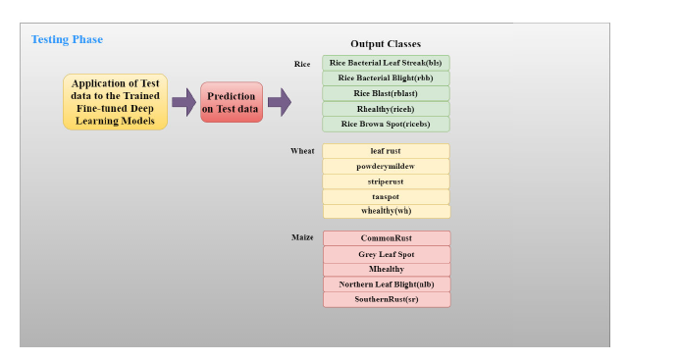
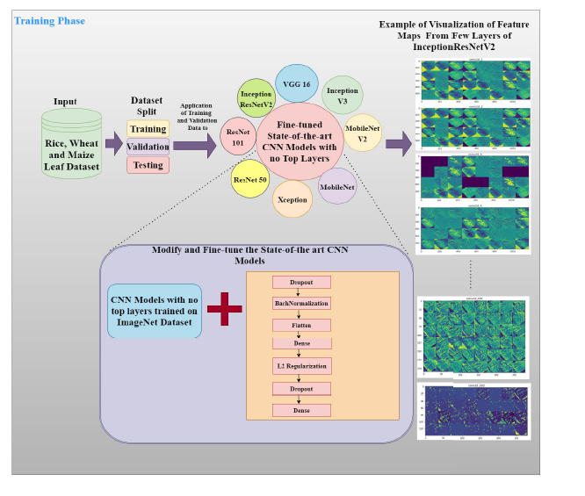
Architecture

Slide 9
Technologies Used
Convolutional Neural Networks (CNN)
Image Processing Techniques
EfficientNet Algorithm
Streamlit Framework
Database Management System
Hyperparameter Tuning
Classification and Segmentation

Slide 10
Implementation
Step 1: Upload an image of a plant leaf.
Step 2: The image is processed to enhance quality.
Step 3: A CNN model (EfficientNet algorithm) analyzes the image.
Step 4: The system identifies the disease (if any) and displays the result.

Slide 11
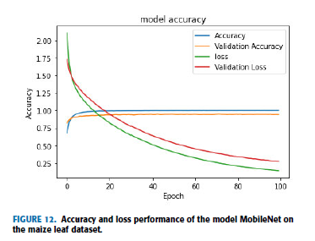
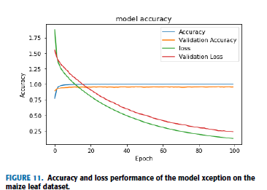
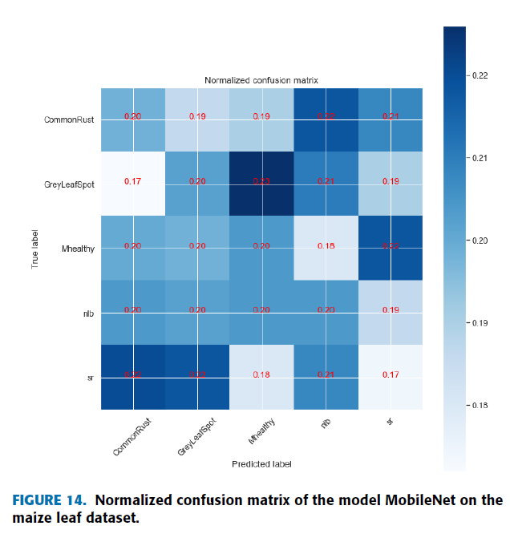
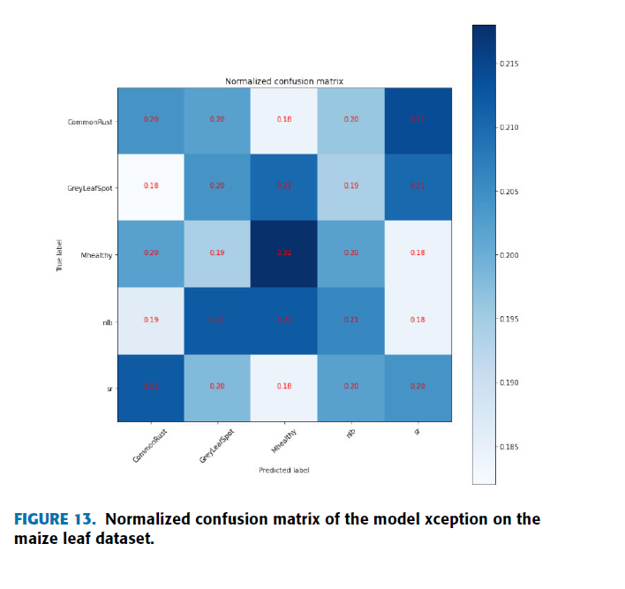
Accuracy and loss performance of maize

Slide 12
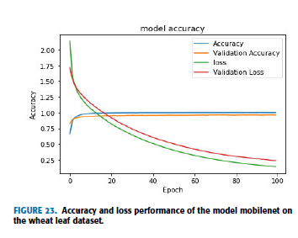
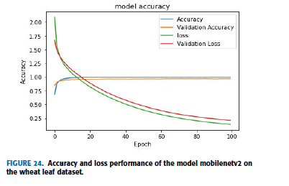
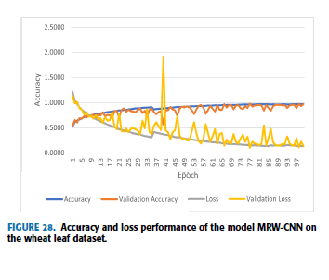
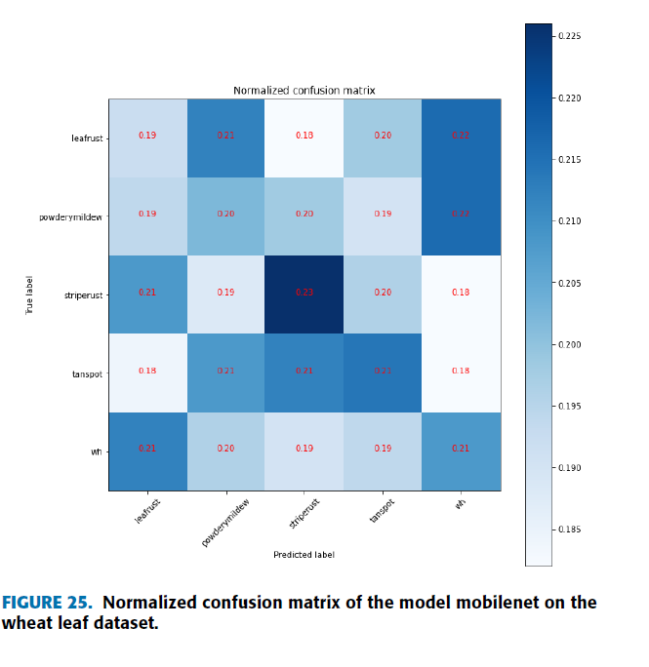
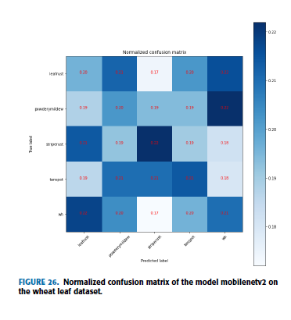
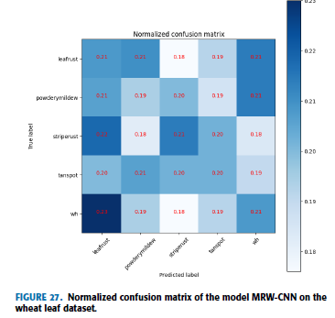
Accuracy and loss performance of wheat

Slide 13
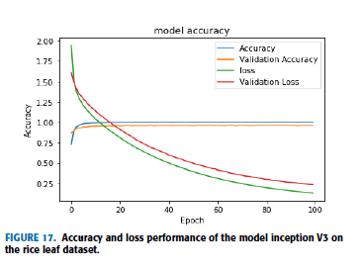
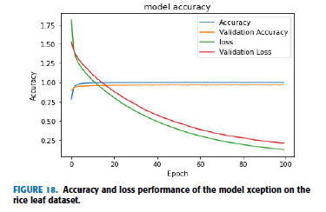
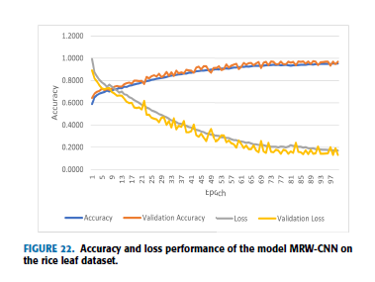
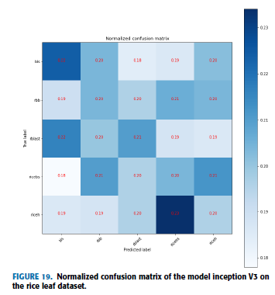
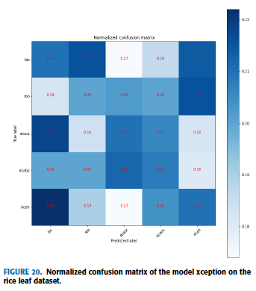
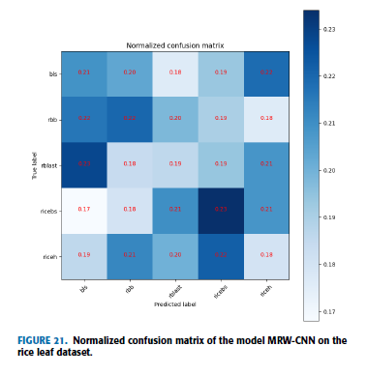
Accuracy and loss performance of rice

Slide 14
Comparison Results
The model was trained using the EfficientNetB0 CNN algorithm.
Training Loss: 0.05%
Validation Loss: 0.02%
Training Accuracy: 95% in the first epoch.
Final Model Accuracy: 98.59% after three epochs with a loss of 0.0308%​.

Slide 15
Conclusion
The study presents a system for detecting plant diseases using images of plant leaves and machine learning. It uses Convolutional Neural Networks (CNN) to quickly and accurately identify whether a plant is healthy or diseased. The system helps farmers by providing early diagnosis and suggesting remedies, reducing crop losses and improving productivity. It is useful for both household gardening and commercial farming, making disease detection easier and more efficient. This system improves food security by enabling early detection and reducing crop damage. With further improvements, it can be expanded to identify more diseases and support a wider range of crops​

Slide 16
Future Scope
Mobile Application Development
Real-Time Disease Detection
Improved Accuracy and Efficiency
Integration with IoT
Better User Interface

Slide 17
Bibliography
[1]Melike Sardogan, Adem Tuncer, Yunus Ozen – "Plant Leaf Disease Detection and Classification based on CNN," IEEE, pp. 382-385, 2020.
[2] Sandeep Kumar, KMVV Prasad, A. Srilekha, T. Suman, B. Pranav Rao, J. Naga Vamshi Krishna – "Leaf Disease Detection and Classification based on Machine Learning," IEEE, pp. 361-365, 2020.
[3] Garima Shrestha, Deepsikha, Majolica Das, Naiwrita Das – "Plant Disease Detection Using CNN," IEEE, 2020.
[4]MAJJI V Appalanaidu, G. Kumaravelan – "A Review of Machine Learning Approaches in Plant Leaf Disease Detection and Classification," IEEE, pp. 716-724, 2021​.
[5]

