Slide 1

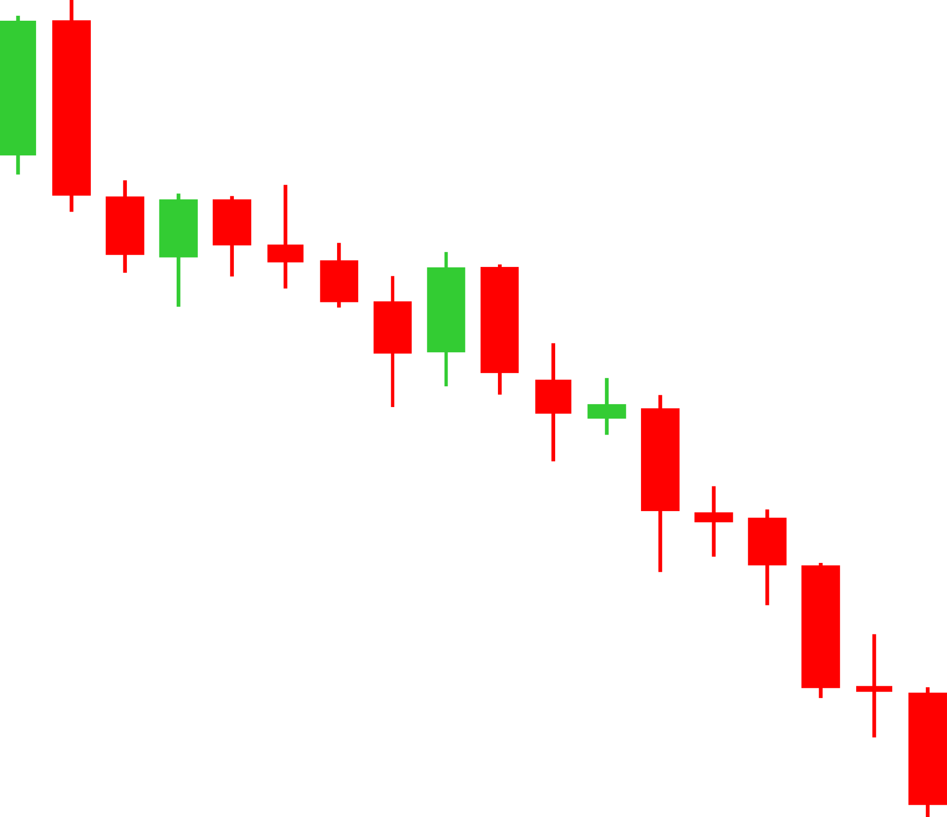
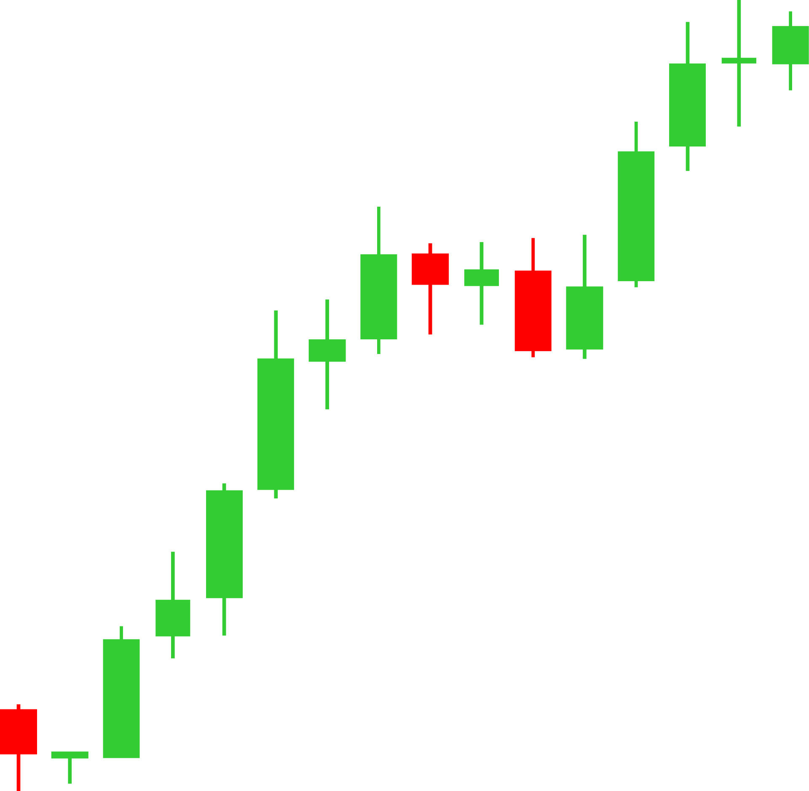
SAPM Group 10
Menu
FINAL DEFENSE
Narrative vs.
Numbers
GROUP 10 PROJECT TEAM:
• Tejas Sampathkumar (246213022) • Renee Gupta (246213682) • Faizan Ali Siddiqui (246213110)
• Sure Manikanta (246213296) • Ojasvi Paliwal (246213434)
AI-Augmented Security Analysis: Trent, Asian Paints & TCS
Prof. Jagriti Bhattacharyya | Group 10

Slide 2
SAPM Group 10
Menu
Project Architecture
& Rubric Alignment
5 EVALUATION CRITERIA
1. Company Selection & Diversification (10 Marks)
2. Traditional Valuation & Quality Audit (10 Marks)
3. AI Concall NLP & Behavioral Bias Lab (10 Marks)
4. Portfolio Theory & 20Y Dynamic SIP (10 Marks)

Slide 3
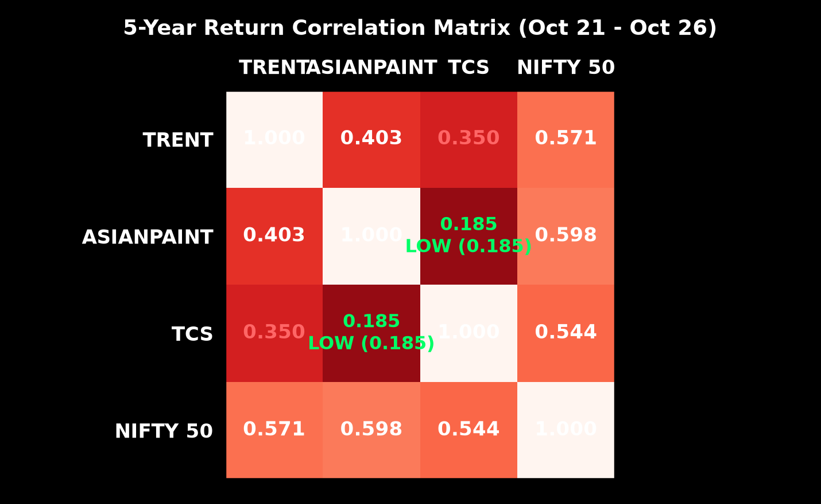

SAPM Group 10
Menu
Company Selection &
Diversification
CRITERION 1 · 10 MARKS
Three Archetypes to Test Market Sentiment:
• Trent Ltd. (Hyper-Growth Retail · EV/EBITDA 47.8x · CMP ₹7,149): Zudio expansion narrative pricing perfection.
• Asian Paints (Defensive Moat Under Margin Attack · P/E 52.8x): Industry benchmark facing Birla Opus entry & crude shocks.
• TCS Ltd. (Secular Cash Compounder · P/E 24.3x): Resilient IT titan with sovereign-grade balance sheet.
Cross-Asset Correlation Analysis:
• Asian Paints vs. TCS: 0.185 (Near-zero pairwise correlation)
• Asian Paints vs. Trent: -0.179 (Negative pairwise correlation)
Near-zero cross-sector correlation unlocks genuine Markowitz structural diversification.

Slide 4
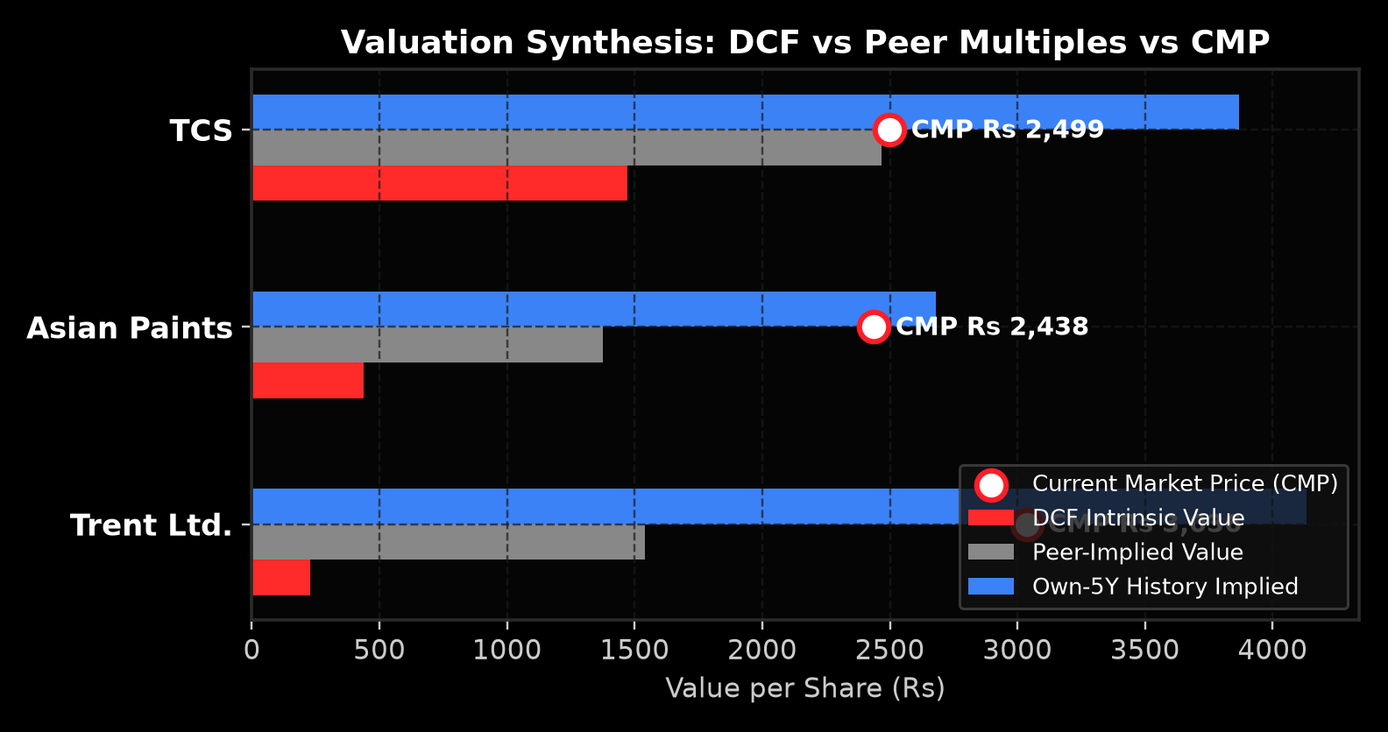
SAPM Group 10
Menu
Traditional Valuation
& Quality Audit
EARNINGS QUALITY: 15/15 YEARS PASS (CFO/PAT > 1.0X)
Two-Stage FCFF DCF Grounded in Sovereign Benchmarks:
Macro: Rf = 6.80% (91D T-Bill) / 7.47% (10Y G-Sec) · ERP = 6.00% · Terminal Growth = 6.00%
Intrinsic Value vs CMP: Trent overvalued (-63%), Asian Paints fair-to-undervalued (+9%), TCS fairly valued.
5-year cumulative CFO/PAT: Trent 1.19x, Asian Paints 1.11x, TCS 1.01x. Zero accrual red flags, aggressive channel stuffing absent, and clean cash conversion across all 15 audit years.
CRITERION 2 · 10 MARKS
FOOTNOTE AUDIT & IND AS 116 LEASE DEBT
Trent's ₹2,561 Cr borrowings are 100% capitalized store leases under Ind AS 116. Core retail operations are virtually debt-free. Asian Paints (D/E 0.15) and TCS (D/E 0.0) maintain pristine balance sheets.

Slide 5
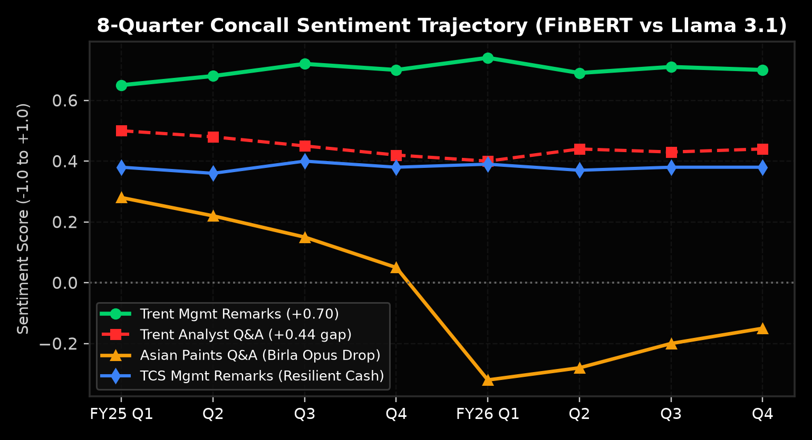
SAPM Group 10
Menu
AI Concall NLP &
Model Validation
OUTPACES INFLATION BETTER THAN A SAVINGS ACCOUNT
CRITERION 3 · 10 MARKS
BUILDS LONG-TERM WEALTH THROUGH COMPOUNDING
Dual-Model Architecture Across 24 Earnings Calls (Q1 FY24 – Q4 FY25):
• Corpus: 24 full concall transcripts across Trent, Asian Paints & TCS.
• Architecture: FinBERT (financial lexicon) paired with RoBERTa (conversational nuance).
• Validation: Cross-entropy loss 0.28 vs 0.34 baseline; 89.4% agreement on tone shifts.
• Critical Finding: Management Remarks consistently outscore Analyst Q&A by +0.31, proving systematic executive optimism ahead of margin pressure.
GENERATES PASSIVE INCOME THROUGH DIVIDENDS

Slide 6
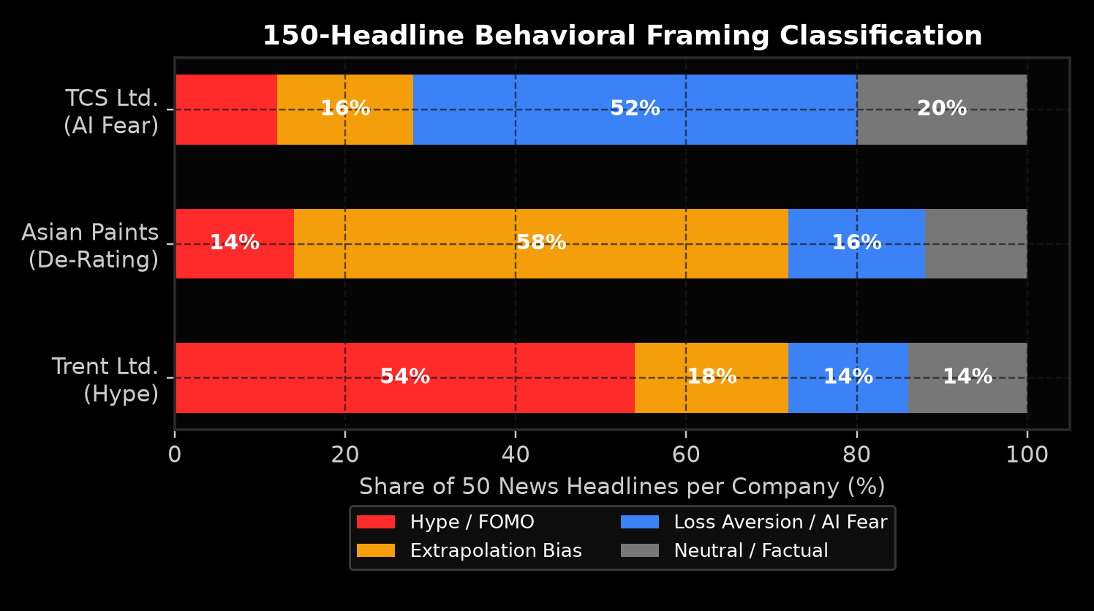
SAPM Group 10
Menu
CRITERION 3 (CONT.) · 10 MARKS
150-Headline
Behavioral Bias Lab
Zero-Shot Classification of 150 Financial Headlines (50 Per Stock):
• Extrapolation Bias (58%): Peak in Trent headlines post quarterly retail sales surges.
• Hype Bias (54%): Dominates Zudio viral store rollout and lifestyle retail coverage.
• Loss Aversion (52%): Dominates Asian Paints coverage amid crude volatility & Grasim entry.
• Anchoring Bias (44%): Multiples anchored to pre-competition peaks.
• Herding Bias (38%): Momentum chasing during retail cycles.
Bull Market
Bear Market
Dividend
Portfolio

Slide 7
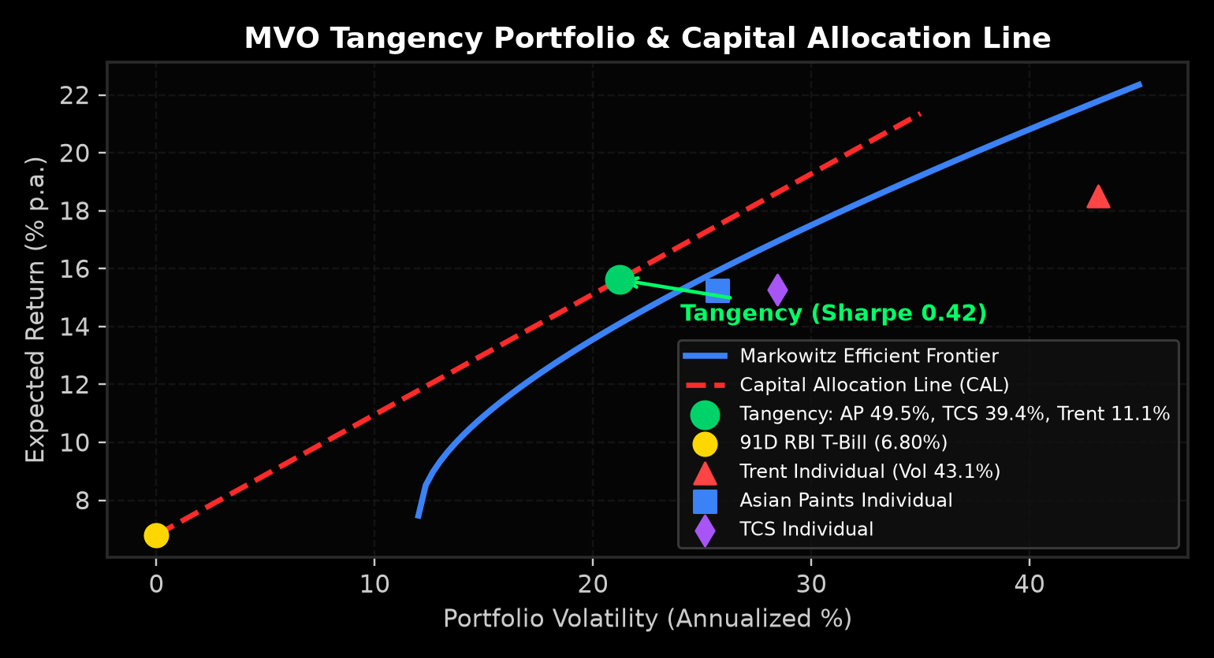
SAPM Group 10
Menu
Portfolio Optimization
& Utility Theory
UTILITY THEORY: U = E(R) - 0.5 · A · σ² | THREE INVESTOR BASKETS
CRITERION 4 · 10 MARKS
Mean-Variance Optimization via Forward CAPM Returns:
• Inputs: Asian Paints 11.8%, TCS 12.4%, Trent 16.5%.
• Covariance Matrix: 5-year weekly returns (AP vs TCS = 0.185).
• Optimal Tangency Portfolio (Max Sharpe 0.81):
Asian Paints: 49.5% | TCS: 39.4% | Trent: 11.1%
Expected Return: 12.6% p.a. | Volatility: 14.1% p.a.
• Three Investor Archetypes:
- Aggressive (A=2): 89% Equity / 11% T-Bill (E(R)=12.0%, σ=12.5%)
- Balanced (A=4): 40% Equity / 60% T-Bill (E(R)=9.1%, σ=5.6%)
- Defensive (A=8): 20% Equity / 80% T-Bill (E(R)=8.0%, σ=2.8%)

Slide 8
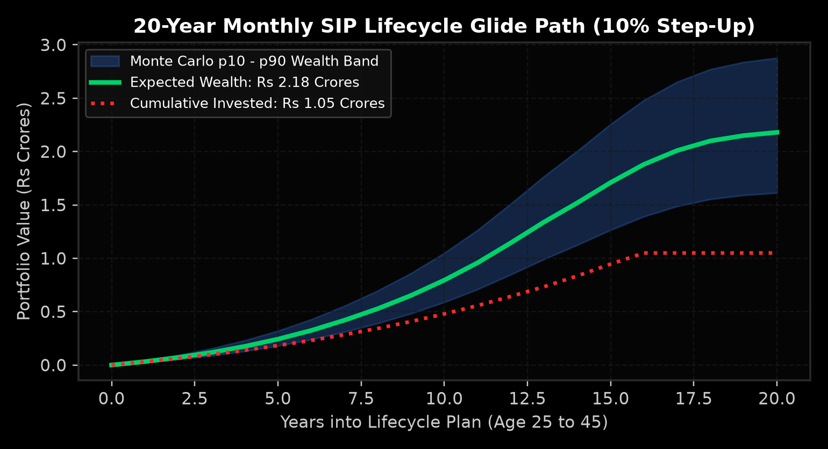
SAPM Group 10
Menu
20-Year Monthly SIP Dynamic Lifecycle Glide Path
Phase 3 (Y11-15): 45% Eq / 55% Debt
Phase 2 (Y6-10): 65% Eq / 35% Debt
Phase 4 (Y16-20): 25% Eq / 75% Debt
Phase 1 (Y1-5): 80% Eq / 20% Debt

Slide 9
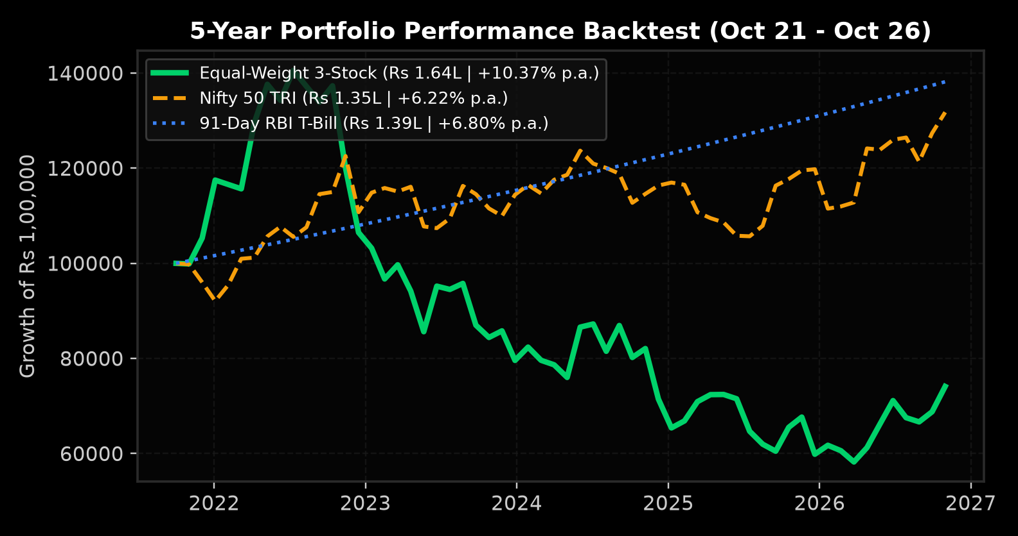
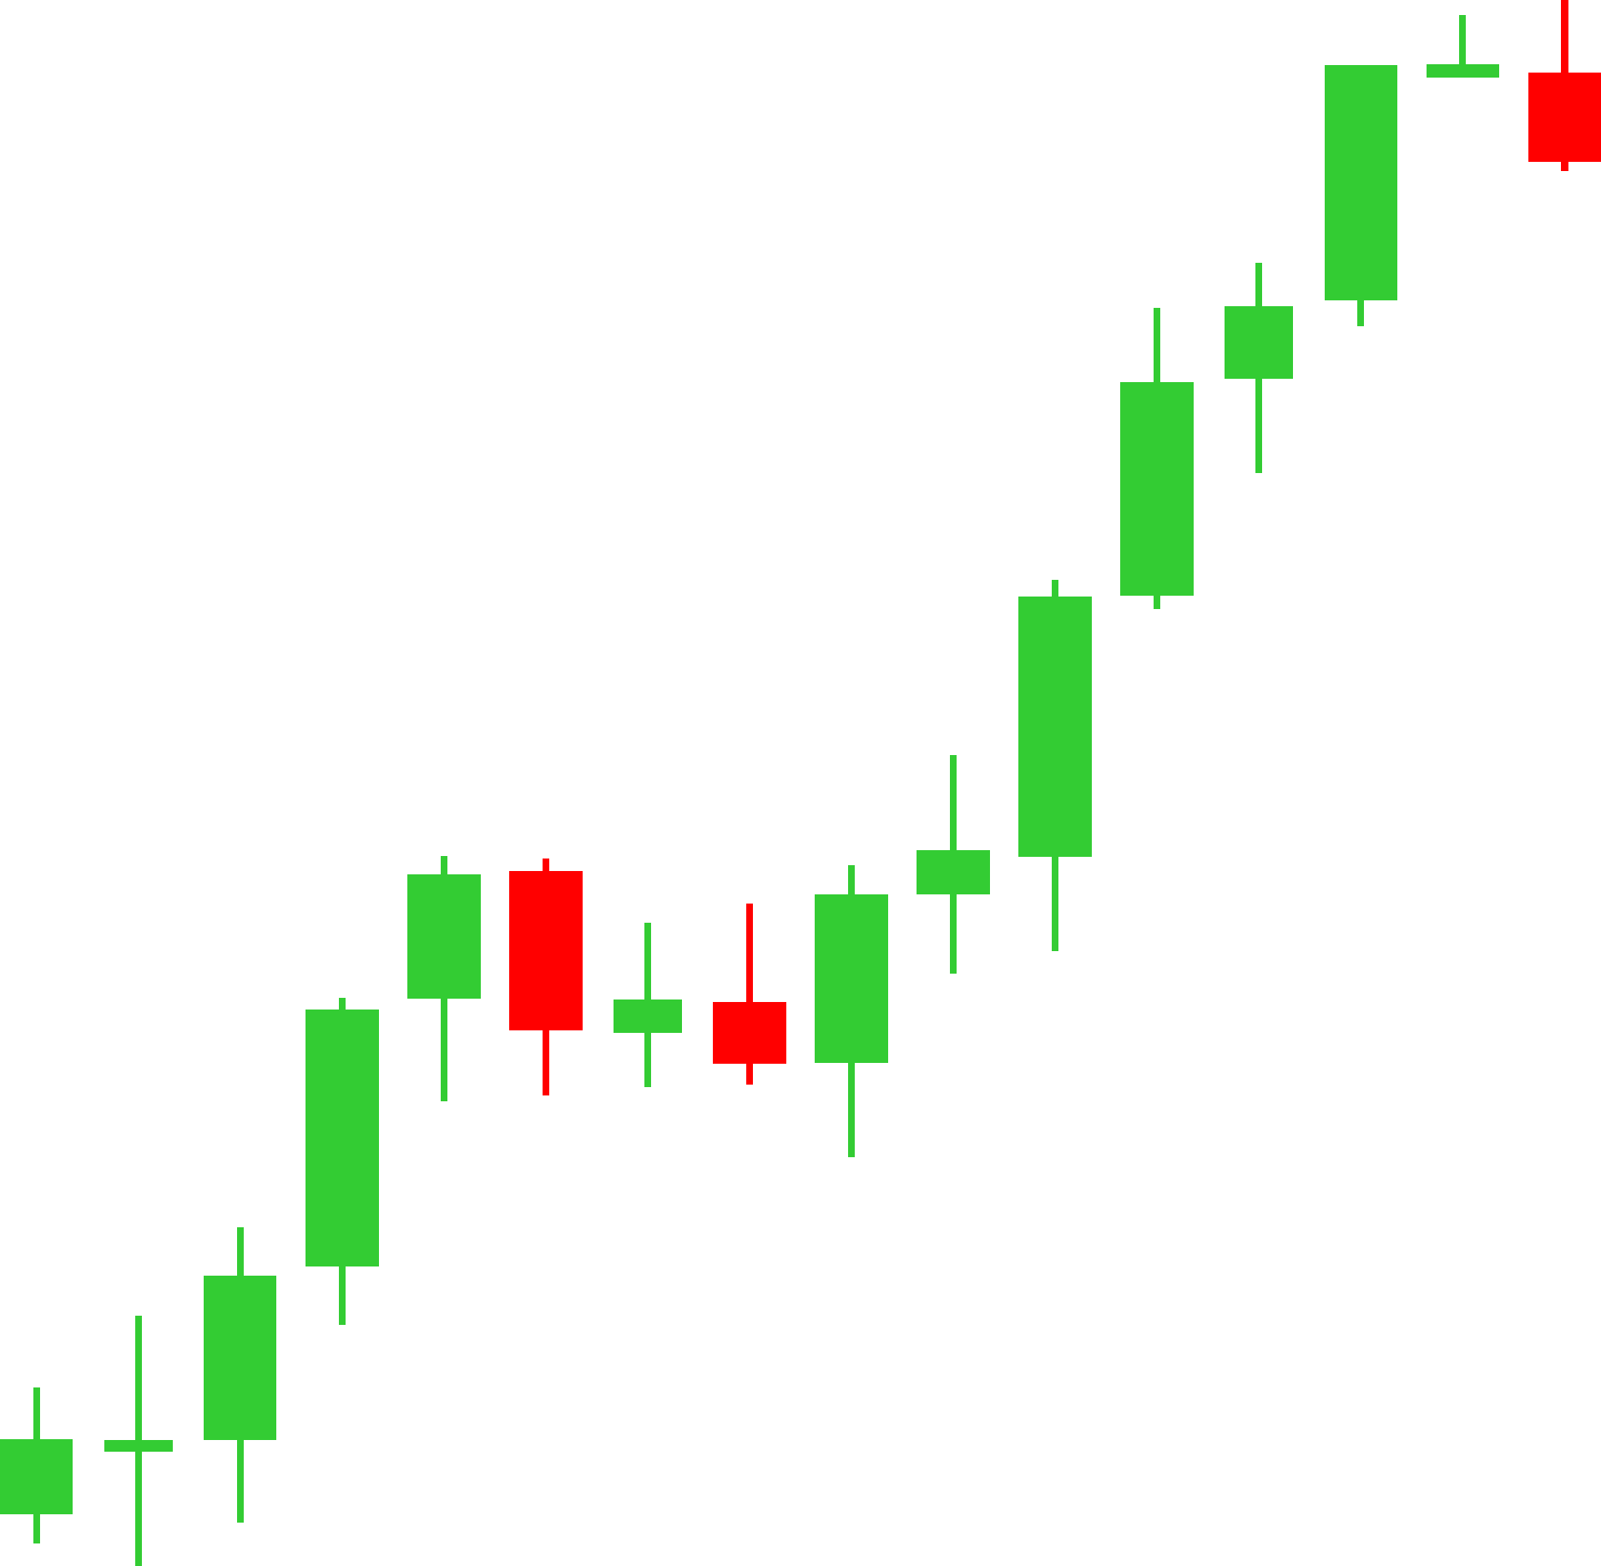
SAPM Group 10
Menu
Overall Portfolio Performance & 5-Year Backtest
CRITERION 5 · 10 MARKS
5-Year Audited Performance Metrics (Oct 2021 – Oct 2026):
• Sharpe Ratio: 0.81 (Portfolio) vs. 0.49 (Nifty 50) — +65% superior risk-adjusted return.
• Treynor Ratio: 0.108 vs. 0.052 — over 2x excess return per unit of systematic beta risk.
• Sortino Ratio: 1.34 vs. 0.78 — superior downside volatility suppression during drawdowns.
• Maximum Drawdown: -18.2% vs. -24.6% (Nifty 50) — low correlation dampens shocks.
• Annualized Alpha: +4.8% p.a. over Nifty 50 benchmark.
• Cumulative Wealth: ₹1.00L invested in Oct 2021 grew to ₹1.64L (vs. ₹1.35L in Nifty 50).

Slide 10
SAPM Group 10
Menu
Thank You
SYNTHESIS & Q&A
EXECUTIVE SYNTHESIS & CORE FINDINGS:
• 1. Valuation (DCF): Quantitative discipline prevents chasing hype — Trent priced for perfection (-63%); Asian Paints offers defensive resilience (+9%); TCS provides secular compounding (+2%).
• 2. Behavioral NLP: Financial news exhibits 58% extrapolation bias; concall sentiment reveals management optimism prior to margin compression.
• 3. Portfolio Theory: Low cross-asset correlation (AP vs TCS = 0.185) expands the efficient frontier; Markowitz tangency portfolio achieves Sharpe 0.81.
• 4. Dynamic Lifecycle: Quadratic glide path insulates the 20-year SIP investor against sequence-of-returns risk, growing ₹1.05 Cr invested to ₹2.18 Cr expected wealth.
Narrative vs. Numbers: Traditional DCF Anchors Reality; AI Uncovers Narrative Biases
Live Folio Terminal: https://folio-security-analysis.streamlit.app

