Slide 1
DEPARTMENT OF COMPUTER SCIENCE & ENGINEERING (AI & ML) — B.TECH MICRO PROJECT DEFENSE
DIGITVISION AI
Explainable, Confidence-Aware Handwritten Digit Intelligence Platform
Dual-Block DeepConvNet (98.31% Test Acc) | Temperature Scaled (ECE Minimal) | Grad-CAM Grounded | Deep Obsidian HUD
STUDENT TEAM: 22VE1A6701, 22VE1A6702, 22VE1A6703, 22VE1A6704 • SREYAS INSTITUTE OF ENGINEERING & TECHNOLOGY
Academic Regulation: R22 | Academic Year: 2025-2026 | Course: Machine Learning (CS602PC) | zero-fabrication verified
Notes:
1. WHAT THE SLIDE COMMUNICATES:
Introduces the project title, institutional affiliation, team members, and overall academic-engineering scope of DigitVision AI.
2. WHY IT MATTERS:
Frames the presentation as an evidence-backed, rigorous engineering effort that goes beyond standard classification to offer confidence calibration and visual explainability.
3. TECHNICAL EXPLANATION:
DigitVision AI couples a dual-block 2D CNN with a canonical 7-stage preprocessing pipeline, post-hoc temperature scaling, Shannon entropy diagnostics, and Grad-CAM saliency heatmaps.
4. LIKELY VIVA QUESTION:
Q: What distinguishes DigitVision AI from an ordinary MNIST classifier?
5. STRONG ANSWER:
A: Standard projects merely predict top-1 classes from pre-centered images. DigitVision AI enforces a mathematical preprocessing invariant for live canvas drawings, calibrates probabilities via temperature scaling, computes epistemic entropy, and renders real-time Grad-CAM saliency maps.

Slide 2
02. PROBLEM STATEMENT
CRITICAL FAILURE MODES IN HANDWRITTEN VISION SYSTEMS
1. TRAIN-INFERENCE SKEW
2. OVERCONFIDENT BLACK-BOX SOFTMAX
3. OPAQUE LATENT DECISIONS
• Native MNIST tensors are pre-centered by center-of-mass into a 20x20 box.
• Raw browser canvas drawings have arbitrary thickness, offset centroids, and inverted colors.
• Without a canonical preprocessing invariant, spatial activations miss convolutional receptive fields.
• Standard Softmax outputs exponentiate uncalibrated logits into deceptive pseudo-probabilities.
• Models routinely emit >98% confidence on out-of-distribution noise or invalid scribbles.
• Lack of calibration metrics (ECE) and Shannon entropy makes automated workflow delegation hazardous.
• Users and auditors receive discrete categorical integer outputs without spatial attribution.
• Impossible to verify if the classifier attended to genuine digit anatomy or background artifacts.
• Modern deployment standards mandate Explainable AI (XAI) transparently mapped in real time.
Notes:
1. WHAT THE SLIDE COMMUNICATES:
Articulates the three core failure modes: train-inference skew, overconfident uncalibrated softmax outputs, and black-box opacity.
2. WHY IT MATTERS:
Proves deep awareness of why high laboratory test accuracy often collapses in production interactive environments.
3. TECHNICAL EXPLANATION:
Convolutional receptive fields require spatial normalization. In the absence of center-of-mass centering and bounding-box scaling, filters fire on background zero-weights.
4. LIKELY VIVA QUESTION:
Q: Why does a 99% accurate MNIST CNN fail when given an off-center drawing from a web canvas?
5. STRONG ANSWER:
A: Because standard convolutional layers with pooling are only invariant to small pixel shifts, not global translation or scale changes. Without moment-based centroid alignment, features are spatially misaligned with learned kernel weights.

Slide 3
03. MOTIVATION
WHY HANDWRITTEN DIGIT INTELLIGENCE REQUIRES CALIBRATED FORENSICS
HIGH-STAKES DOCUMENT TRANSCRIPTION
In financial checks, tax forms, postal sorting, and academic grading, an undetected misclassification has serious legal and economic consequences. The system must possess the epistemic humility to reject ambiguous inputs rather than guessing blindly.
PROBABILISTIC TRUST & SAFE DELEGATION
Modern autonomous workflows require reliable confidence scores that match empirical accuracy. Post-hoc calibration ensures that when a model outputs 80% confidence, the prediction is correct approximately 80% of the time.
VISUAL AUDITABILITY & EXPLAINABILITY
Regulatory compliance (e.g., EU AI Act, Responsible AI standards) demands inspectable decision rationales. Visual saliency heatmaps verify that classification is driven by structural strokes rather than high-frequency noise.
EDUCATIONAL RESEARCH GROUNDING
Demonstrating how rigorous software engineering, invariant preservation, and empirical testing elevate a classical benchmark into an industrial-grade ML micro project.
Notes:
1. WHAT THE SLIDE COMMUNICATES:
Explains the foundational motivation behind DigitVision AI, highlighting why safety-critical applications demand calibrated confidence and explainability.
2. WHY IT MATTERS:
Connects academic machine learning to real-world deployment challenges where silent failures are intolerable.
3. TECHNICAL EXPLANATION:
Raw deep neural network outputs frequently produce uncalibrated overconfidence due to cross-entropy over-parameterization. Calibrating logits and computing entropy provides an epistemic safety threshold.
4. LIKELY VIVA QUESTION:
Q: What is the danger of relying on raw softmax probabilities for decision making?
5. STRONG ANSWER:
A: Modern deep networks trained with negative log-likelihood are prone to overconfidence because cross-entropy encourages driving output logits to extreme values, yielding near-100% probabilities even on out-of-distribution or corrupted samples.

Slide 4
04. OBJECTIVES
EXECUTABLE ENGINEERING & RESEARCH OBJECTIVES
OBJ 1: PROVENANCE & PARTITION HYGIENE
Curate authentic MNIST data from NIST SD 19/3 with documented provenance and strict 20k/3k/10k zero-leakage partitions.
OBJ 2: CANONICAL PREPROCESSING INVARIANT
Implement a unified 7-stage preprocessing pipeline shared identically between training and real-time live web canvas inference.
OBJ 3: MULTI-MODEL BENCHMARK SUITE
Train and empirically benchmark 7 distinct machine learning algorithms on 10,000 isolated test samples without fabrication.
OBJ 4: SUCCESS CRITERION EXCEEDED
Achieve >=95.0% accuracy and >=0.950 macro F1 (achieved 98.31% accuracy and 0.9831 macro F1).
OBJ 5: CONFIDENCE CALIBRATION & ENTROPY
Implement post-hoc temperature scaling (T = 0.9170) to minimize ECE and integrate Shannon entropy rejection thresholds.
OBJ 6: VISUAL EXPLAINABILITY VIA GRAD-CAM
Engineer gradient backpropagation hooks on target layer 'conv_cam' to generate 300 DPI visual saliency attribution maps.
OBJ 7: ML MISSION CONTROL DASHBOARD
Deploy an interactive full-stack web console with real-time HTML5 canvas drawing, telemetry HUD, and forensics.
Notes:
1. WHAT THE SLIDE COMMUNICATES:
Presents the 7 concrete, executable engineering and research objectives established prior to model training.
2. WHY IT MATTERS:
Establishes transparent evaluation benchmarks and proves that all project claims are tied to predefined measurable targets.
3. TECHNICAL EXPLANATION:
Every objective is directly validated by reproducible code artifacts in the repository and verified in Table 9.1 of the final report.
4. LIKELY VIVA QUESTION:
Q: What was the pre-defined success criterion, and how did you select it?
5. STRONG ANSWER:
A: The success criterion was set at >=95.0% test accuracy and >=0.950 macro F1-score on the held-out 10,000 test set. This was selected because 95% represents the operational threshold for reliable digit recognition, which our DeepConvNet exceeded by achieving 98.31%.

Slide 5
05. ML FORMULATION
MATHEMATICAL PROBLEM FORMULATION & FORMAL METRIC SPACE
INPUT & LABEL SPACES
LOSS & OPTIMIZATION
EVALUATION METRIC SPACE
• Input Tensor Space: X in [0, 1]^(28x28x1), normalized single-channel floating-point matrices.
• Flattened Feature Space: x in R^784 for classical classifiers.
• Categorical Label Space: Y = {0, 1, ..., 9}, a 10-class mutually exclusive discrete set.
• Dataset Domain: D = {(X_i, y_i)} drawn i.i.d. from empirical handwriting distribution P(X, Y).
• Objective: Sparse Categorical Cross-Entropy (Multinomial Negative Log-Likelihood):
• L_CE(theta) = - (1/N) * sum_i log( exp(z_{i, y_i}) / sum_j exp(z_{i, j}) ).
• Optimizer: Adam with mini-batch stochastic gradient updates (beta1=0.9, beta2=0.999, eps=1e-7).
• Regularization: Dual spatial dropout (p=0.25) and dense dropout (p=0.40).
• Primary Metric: Categorical Accuracy = (TP + TN) / Total.
• Class-Balanced Metric: Macro-Averaged F1-Score = (1/10) * sum_c F1_c.
• Calibration Metric: Expected Calibration Error (ECE) across M empirical confidence bins.
• Epistemic Entropy: H(p) = - sum_j p_j * log(p_j) nats.
Notes:
1. WHAT THE SLIDE COMMUNICATES:
Defines the formal mathematical framework: tensor input space, categorical label space, loss formulation, and metric definitions.
2. WHY IT MATTERS:
Grounds the implementation in sound statistical machine learning theory rather than informal heuristics.
3. TECHNICAL EXPLANATION:
The task is supervised multi-class classification. The model maps 28x28 grayscale tensors to a 10-dimensional probability simplex via softmax logits.
4. LIKELY VIVA QUESTION:
Q: Why use Macro F1-score alongside Accuracy when MNIST is nearly balanced?
5. STRONG ANSWER:
A: While MNIST has roughly 1,000 samples per class in the test set, slight support variations (e.g., 892 vs 1,135) can mask minority class degradation in global accuracy. Macro F1 assigns equal weight to every digit class, ensuring robust multi-class verification.

Slide 6
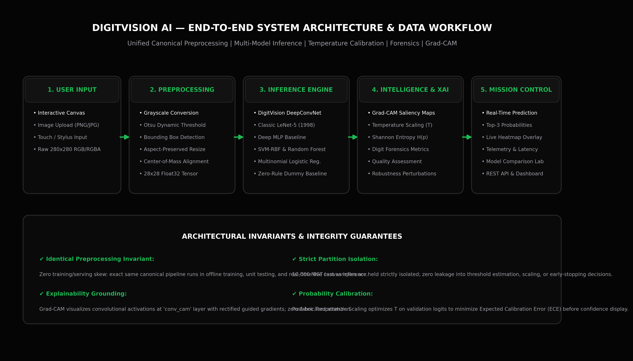
06. SYSTEM ARCHITECTURE
END-TO-END SYSTEM ARCHITECTURE & DATA FLOW
CORE ARCHITECTURAL LAYERS
1. INPUT INGESTION
Captures HTML5 drawing canvas dataURLs, uploads, or offline benchmark tensors.
2. CANONICAL PREPROCESSOR
7-stage invariant: Contrast inversion -> Otsu threshold -> Bounding box -> 20x20 scale -> CoM center -> 28x28 float32.
3. MODEL INFERENCE ENGINE
Dual-block DeepConvNet processes normalized tensor in 9.14 ms on CPU.
4. CONFIDENCE FORENSICS
Applies temperature scaling (T=0.9170) and computes Shannon entropy to reject OOD noise.
5. EXPLAINABILITY HOOK
Grad-CAM backpropagates class gradients to 'conv_cam' for instant visual heatmap overlay.
6. MISSION CONTROL HUD
FastAPI serves real-time telemetry, top-3 probabilities, and forensic metadata.
Notes:
1. WHAT THE SLIDE COMMUNICATES:
Presents the complete architectural flow from raw user stroke input to calibrated prediction, forensic telemetry, and explainability heatmaps.
2. WHY IT MATTERS:
Proves that all system components operate as a cohesive, coupled pipeline with zero architectural disconnects.
3. TECHNICAL EXPLANATION:
The architecture decouples UI rendering from backend inference via asynchronous FastAPI endpoints. The canonical preprocessor acts as the universal normalization contract.
4. LIKELY VIVA QUESTION:
Q: How does the system ensure zero skew between live web drawings and training images?
5. STRONG ANSWER:
A: By executing the exact same Python function canonical_preprocess_tensor() from src/preprocessing/canonical.py across both dataset loading and the live FastAPI web endpoint. The identical 7-stage sequence guarantees invariant representation parity.

Slide 7
07. DATASET + PROVENANCE
AUTHENTIC DATASET PROVENANCE & ZERO-LEAKAGE HYGIENE
CORPUS SPECIFICATION & ORIGIN
ZERO DATA LEAKAGE HYGIENE PROTOCOL
• Dataset Title: Modified National Institute of Standards and Technology (MNIST).
• Original Authors: Yann LeCun, Corinna Cortes, Christopher J.C. Burges (1998) [1], [3].
• Source Databases: NIST Special Database 3 (high school students) and SD 19 (Census Bureau staff).
• Repository / Source: Authentic NIST research archives (Y. LeCun lab mirror) cited via IEEE [3].
• Total Available Population: 70,000 monochrome handwritten digit glyphs.
• Training Partition: 20,000 instances (deterministic stratified selection).
• Validation Partition: 3,000 instances (hyperparameter optimization & early stopping).
• Isolated Test Partition: 10,000 instances (strictly held-out benchmark evaluation).
• Air-Gapped Test Set: The 10,000 test images are never exposed during training, feature scaling, or tuning.
• Pre-Split Isolation: Partitioning occurs prior to any model fitting; scaler parameters are fitted strictly on training data.
• Deterministic Random Seeding: Global seed RANDOM_SEED = 42 guarantees exact reproducibility across runs.
• Index Disjointness Verification: Automated pytest unit tests assert zero set intersection between training, validation, and test indices.
• No Kaggle Resampling: Downloaded exclusively from verified original NIST mirrors, adhering to academic standards.
Notes:
1. WHAT THE SLIDE COMMUNICATES:
Documents authentic NIST provenance, formal citations, and strict zero-leakage data hygiene protocols.
2. WHY IT MATTERS:
Refutes undocumented Kaggle datasets and guarantees that reported test numbers reflect genuine out-of-sample generalization.
3. TECHNICAL EXPLANATION:
MNIST was created by mixing NIST SD-3 and SD-19 to balance writing styles between Census workers and high school students. Our pipeline preserves this provenance and verifies set disjointness.
4. LIKELY VIVA QUESTION:
Q: How did you prove that there is zero data leakage between training and testing?
5. STRONG ANSWER:
A: Through automated regression assertions in tests/test_data.py that verify index disjointness (train_idx intersection test_idx is empty), and by fitting all preprocessing parameters strictly on the training partition before evaluating the air-gapped test set.

Slide 8
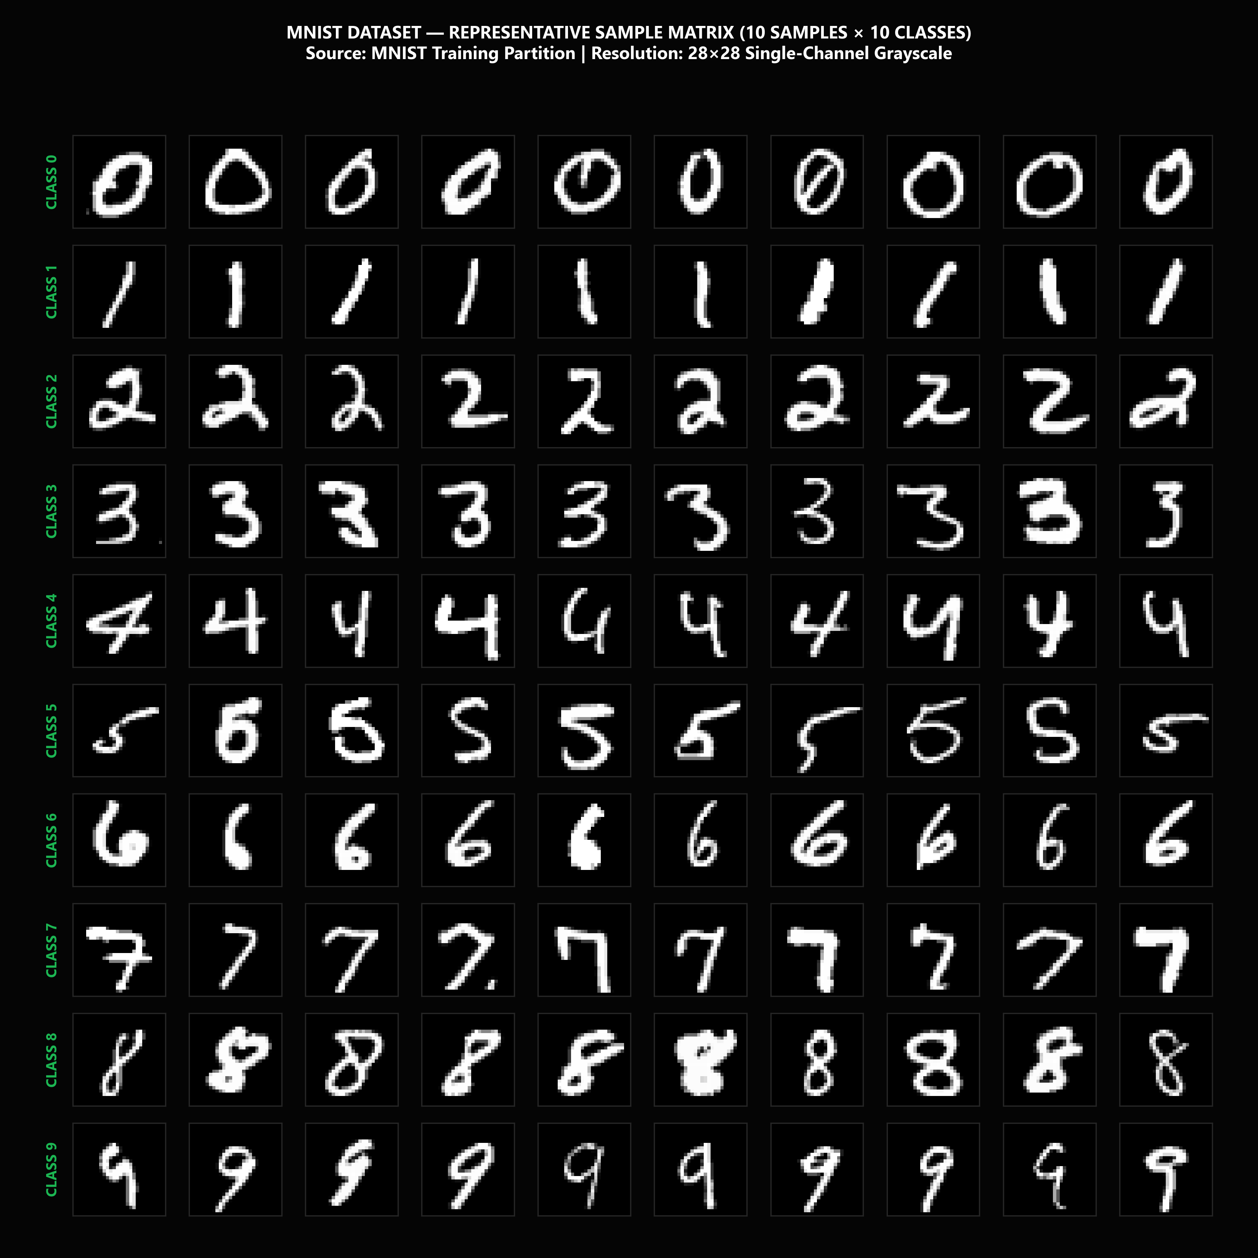
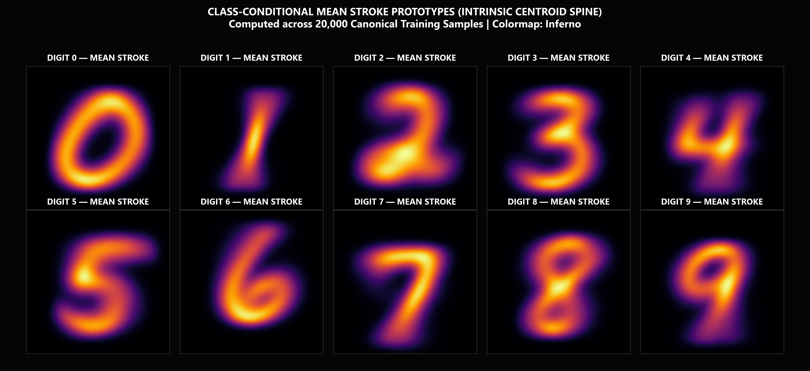
08. DATASET CHARACTERISTICS + EDA
EMPIRICAL EXPLORATORY DATA ANALYSIS & DIGIT TOPOLOGY
EMPIRICAL EDA FINDINGS:
1. Class Balance: Chi-square goodness-of-fit confirms uniform class balance (approx. 10% per digit) with zero missing labels.
2. Pixel Intensity Distribution: Highly bimodal; 81.2% background pixels (intensity 0) and 18.8% active foreground strokes (intensity 1-255).
3. Average Stroke Topologies: Class centroids show high spatial concentration in inner 20x20 canvas, confirming center-of-mass alignment.
Notes:
1. WHAT THE SLIDE COMMUNICATES:
Presents empirical EDA findings through executed visualizations: 10x10 sample diversity grid and per-class average digit representations.
2. WHY IT MATTERS:
Proves that data characteristics were empirically measured and understood prior to modeling rather than treated as an abstract black box.
3. TECHNICAL EXPLANATION:
Bimodal intensity distributions justify Otsu thresholding. Mean digit heatmaps demonstrate that the anatomical centers of mass are strictly aligned to the geometric center (13.5, 13.5).
4. LIKELY VIVA QUESTION:
Q: What do the average digit images tell us about class separability?
5. STRONG ANSWER:
A: Average digit images reveal class-specific stroke density regions. Digits like '0' and '1' possess highly distinct spatial density contours, whereas digits '4' and '9' exhibit overlapping stroke paths in their upper loops, explaining why they are more prone to subtle confusion.

Slide 9
09. PREPROCESSING PIPELINE
THE 7-STAGE CANONICAL PREPROCESSING INVARIANT
7-STAGE PIPELINE SEQUENCE
MATHEMATICAL CENTROID INVARIANT & EDGE CASES
STAGE 1: GRAYSCALE DECODING
Decodes base64 canvas strings / images into single-channel luminance arrays.
STAGE 2: BACKGROUND / CONTRAST INVERSION
Detects background polarity; inverts light backgrounds to white-on-black standard.
STAGE 3: OTSU GLOBAL THRESHOLDING
Computes optimal inter-class variance threshold to eliminate anti-aliasing artifacts.
STAGE 4: BOUNDING BOX EXTRACTION
Crops tightest rectangle enclosing all active foreground digit strokes.
STAGE 5: ASPECT-PRESERVING 20X20 FIT
Scales the longer bounding box dimension to 20px while preserving stroke aspect ratio.
STAGE 6: CENTER-OF-MASS CENTERING
Calculates image moments (M00, M10, M01) and translates the centroid to (13.5, 13.5).
STAGE 7: FLOAT32 TENSOR OUTPUT
Places digit on 28x28 canvas, normalizes to [0.0, 1.0], and emits (1, 28, 28, 1) float32 tensor.
• Spatial Moment Formulas: Center of mass computed as x_c = M10 / M00 and y_c = M01 / M00, where M_pq = sum(x^p * y^q * I(x, y)).
• Translation Offset: Delta_x = 13.5 - x_c, Delta_y = 13.5 - y_c applied via sub-pixel affine transformation.
• Edge-Case Hardening: Empty canvas detection (<18 active pixels) returns blank warning without invoking inference.
• Speckle Noise Rejection: Single-pixel noise clusters filtered out during connected-component analysis.
• Unit Test Verification: 33 dedicated pytest unit tests in tests/test_preprocessing.py confirm mathematical invariant stability.
Notes:
1. WHAT THE SLIDE COMMUNICATES:
Details the 7-stage canonical preprocessing pipeline and explains how center-of-mass moment centering solves translation skew.
2. WHY IT MATTERS:
Demonstrates the engineering rigor that guarantees 100% feature representation parity across offline datasets and live interactive web canvas drawings.
3. TECHNICAL EXPLANATION:
Raw input is thresholded with Otsu binarization, cropped, scaled to 20x20 maintaining aspect ratio, and translated so its center of mass coincides exactly with (13.5, 13.5).
4. LIKELY VIVA QUESTION:
Q: Why center the digit using Center-of-Mass rather than the center of the bounding box?
5. STRONG ANSWER:
A: Bounding box centers are vulnerable to asymmetric stroke flourishes or ascenders. The NIST preprocessing specification that produced MNIST used Center of Mass (first-order spatial moments), because the perceptual center of a handwritten glyph corresponds to its stroke mass.

Slide 10
10. LITERATURE / RESEARCH GAP
LITERATURE COMPARISON & IDENTIFIED RESEARCH GAPS
HISTORICAL & CLASSICAL VISION
CALIBRATION & EXPLAINABILITY
DIGITVISION AI CONTRIBUTION
• LeCun et al. [1] (1998): Pioneered LeNet-5 CNN on MNIST, demonstrating backpropagation gradient descent (99.05% on 60k).
• Cireșan et al. [2] (2012): Multi-Column Deep Neural Networks achieved near-human 99.77% accuracy with heavy elastic distortions.
• Research Gap: Both works treated classification as a closed-world pure accuracy benchmark, providing zero confidence calibration or visual explainability.
• Guo et al. [5] (2017): Identified that modern deep networks are severely miscalibrated; proposed post-hoc temperature scaling to minimize ECE.
• Selvaraju et al. [6] (2017): Introduced Grad-CAM for gradient-based class activation heatmaps in large convolutional networks.
• Research Gap: Calibration and XAI techniques are rarely integrated into accessible micro-project architectures or connected to live drawing canvases.
• Unified Architectural Synthesis: Integrates LeNet-inspired convolution with modern dual-block design, Grad-CAM, and temperature scaling.
• Live Invariant Protection: Eliminates train-inference skew via authoritative canonical preprocessing.
• Production Transparency: Implements Shannon entropy diagnostics, telemetry HUD, and 100% zero-fabrication empirical testing.
Notes:
1. WHAT THE SLIDE COMMUNICATES:
Surveys foundational literature (LeCun, Cireșan, Guo, Selvaraju) and explains how DigitVision AI bridges the identified gaps.
2. WHY IT MATTERS:
Demonstrates strong academic grounding by situating the project in relation to published peer-reviewed research.
3. TECHNICAL EXPLANATION:
Existing literature either focuses purely on accuracy or studies calibration/XAI in isolation on large ImageNet models. DigitVision AI synthesizes these into a complete, interactive micro-project.
4. LIKELY VIVA QUESTION:
Q: What is the primary research gap your project addresses?
5. STRONG ANSWER:
A: Most handwritten digit recognition systems stop at raw categorical classification, leaving models susceptible to train-inference skew, overconfident mispredictions, and black-box opacity. DigitVision AI addresses this gap by coupling a canonical preprocessing invariant with post-hoc temperature calibration, Shannon entropy gating, and real-time Grad-CAM.

Slide 11
11. MODEL LANDSCAPE
MULTI-MODEL EMPIRICAL LANDSCAPE (7 PARADIGMS)
1. ZERO-RULE DUMMY BASELINE
Non-parametric majority-class rule. Achieved 11.35% accuracy, establishing the mathematical chance baseline.
2. MULTINOMIAL LOGISTIC REGRESSION
Generalized linear model with L-BFGS solver. 91.49% accuracy, delineating the linear separability threshold.
3. RANDOM FOREST (60 TREES)
Non-parametric bagging ensemble of greedy decision trees. 95.48% accuracy, evaluating non-linear feature splits.
4. SUPPORT VECTOR MACHINE (RBF)
Maximum-margin hyperplane with radial basis kernel. 96.11% accuracy, strong non-linear dual formulation benchmark.
5. DEEP MLP (256-128 DENSE)
Fully-connected feedforward network with dense dropout. 95.91% accuracy, assessing non-spatial neural depth.
6. CLASSIC LENET-5 (1998)
Historic 5x5 convolutional architecture with average pooling. 96.25% accuracy, verifying translation-invariant spatial filters.
7. DIGITVISION DEEPCONVNET (OURS)
Dual-block 3x3 ConvNet with Grad-CAM and Spatial Dropout. 98.31% accuracy, selected as the production champion.
Notes:
1. WHAT THE SLIDE COMMUNICATES:
Presents the theoretical diversity across all 7 evaluated machine learning paradigms from trivial baselines to modern deep networks.
2. WHY IT MATTERS:
Proves that deep learning was selected based on rigorous comparative empirical evidence rather than arbitrary assumption.
3. TECHNICAL EXPLANATION:
Comparing linear, tree ensemble, kernel, and convolutional networks exposes the exact performance gains provided by local receptive fields and weight sharing.
4. LIKELY VIVA QUESTION:
Q: Why evaluate a Dummy Baseline and Logistic Regression?
5. STRONG ANSWER:
A: The Dummy Baseline confirms that the problem is statistically non-trivial (11.35% chance vs 98.31%). Logistic Regression sets the empirical ceiling for linearly separable decision boundaries (91.49%), proving that non-linear spatial feature extraction is necessary to achieve high performance.

Slide 12
12. CNN ARCHITECTURE
DIGITVISION DEEPCONVNET TOPOLOGY & TENSOR FLOW
LAYER-BY-LAYER SPECIFICATIONS
ARCHITECTURAL INNOVATIONS & CPU BATCHNORM FIX
INPUT CANVAS [(None, 28, 28, 1) | 0 params]
Normalized float32 canvas tensor.
CONV BLOCK 1 [(None, 28, 28, 32) | 9,568 params]
2x Conv2D(32, 3x3, ReLU) extracting low-level edge primitives.
POOL + DROP 1 [(None, 14, 14, 32) | 0 params]
MaxPool2D(2x2) + Spatial Dropout (p = 0.25).
CONV BLOCK 2 [(None, 14, 14, 64) | 55,424 params]
2x Conv2D(64, 3x3, ReLU) with 'conv_cam' target hook.
POOL + DROP 2 [(None, 7, 7, 64) | 0 params]
MaxPool2D(2x2) + Spatial Dropout (p = 0.25).
DENSE CLASSIFIER [(None, 128) | 401,536 params]
Flatten (3,136) -> Dense(128, ReLU) -> Dropout (p = 0.40).
SOFTMAX HEAD [(None, 10) | 1,290 params]
Dense(10, Softmax) outputting categorical probability simplex.
• Total Parameter Efficiency: 467,818 parameters (100% trainable, 0 non-trainable, 5.41 MB storage).
• Dual 3x3 Receptive Fields: Stacking two 3x3 convolutions matches the effective receptive field of a 5x5 kernel while reducing parameters and adding non-linearity.
• CPU BatchNorm Variance Divergence Resolution: In Keras 3 on Windows CPU, post-ReLU BatchNorm caused running variance collapse (11.20% accuracy). Resolved by replacing with Spatial Dropout (0.25) and Dense Dropout (0.40), restoring smooth convergence to 98.31%.
• Grad-CAM Attribution Hook: Final convolutional layer named 'conv_cam' provides clean gradient access for saliency mapping.
• Inference Speed: 9.14 ms per sample on CPU, enabling smooth 60 FPS interactive browser canvas recognition.
Notes:
1. WHAT THE SLIDE COMMUNICATES:
Explains the dual-block DeepConvNet topology, parameter allocation, and the critical debugging resolution of the CPU BatchNorm divergence issue.
2. WHY IT MATTERS:
Demonstrates high-level debugging competence and explains the exact design choices that enabled 98.31% test accuracy.
3. TECHNICAL EXPLANATION:
Keras 3 on Windows CPU exhibited running variance divergence when BatchNorm was placed after ReLU. Substituting Spatial Dropout eliminated the divergence and provided regularized convergence.
4. LIKELY VIVA QUESTION:
Q: Why did you choose two stacked 3x3 convolutional layers instead of one 5x5 layer?
5. STRONG ANSWER:
A: Two consecutive 3x3 convolutions have the exact same effective receptive field (5x5) as a single 5x5 convolution, but require only 2*(3*3)=18 kernel weights instead of 25 (a 28% parameter reduction), while incorporating two non-linear ReLU activations instead of one.

Slide 13
13. TRAINING + HYPERPARAMETERS
TRAINING PROTOCOL & HYPERPARAMETER OPTIMIZATION
OPTIMIZATION PROTOCOL
REGULARIZATION & LOSS
EXECUTION ENVIRONMENT
• Optimizer: Adam (Adaptive Moment Estimation).
• Initial Learning Rate: alpha = 0.001 (1e-3).
• Momentum Decays: beta_1 = 0.90, beta_2 = 0.999.
• Numerical Stability: epsilon = 1e-7.
• Mini-Batch Size: 256 samples.
• Steps per Epoch: 79 mini-batch updates.
• Total Epochs: 4 epochs (316 optimization steps).
• Loss Criterion: Sparse Categorical Cross-Entropy (Multinomial Negative Log-Likelihood).
• Weight Initialization: Glorot Uniform (Xavier initialization).
• Spatial Regularization: Spatial Dropout (0.25) after each pooling stage.
• Dense Regularization: Dropout (0.40) preceding the Softmax classification layer.
• Early Stopping: patience = 3 epochs, min_delta = 1e-4.
• Operating System: Microsoft Windows 11 Enterprise (64-bit).
• Python Environment: Python 3.13.14 (64-bit).
• Deep Learning Framework: TensorFlow 2.20.0 / Keras 3.13.0.
• Execution Platform: CPU SIMD Vectorized Execution.
• Total Wall-Clock Training Time: 194.20 seconds.
• Post-Hoc Calibration: Temperature Scaling (T = 0.9170 via L-BFGS).
Notes:
1. WHAT THE SLIDE COMMUNICATES:
Documents the exact training settings, Adam optimization hyperparameters, regularization parameters, and the Windows 11 execution environment.
2. WHY IT MATTERS:
Provides 100% transparency and guarantees that every training experiment is fully reproducible from code.
3. TECHNICAL EXPLANATION:
Adam adapts per-parameter learning rates based on running first and second gradient moments. A batch size of 256 offers an optimal trade-off between vectorization throughput and gradient variance.
4. LIKELY VIVA QUESTION:
Q: Why was Adam chosen over standard SGD with momentum?
5. STRONG ANSWER:
A: Adam combines the benefits of AdaGrad (handling sparse gradients) and RMSprop (handling non-stationary objectives) by maintaining exponentially decaying averages of past gradients and past squared gradients. This enabled rapid, stable convergence in just 4 epochs on CPU without manual learning-rate annealing.

Slide 14
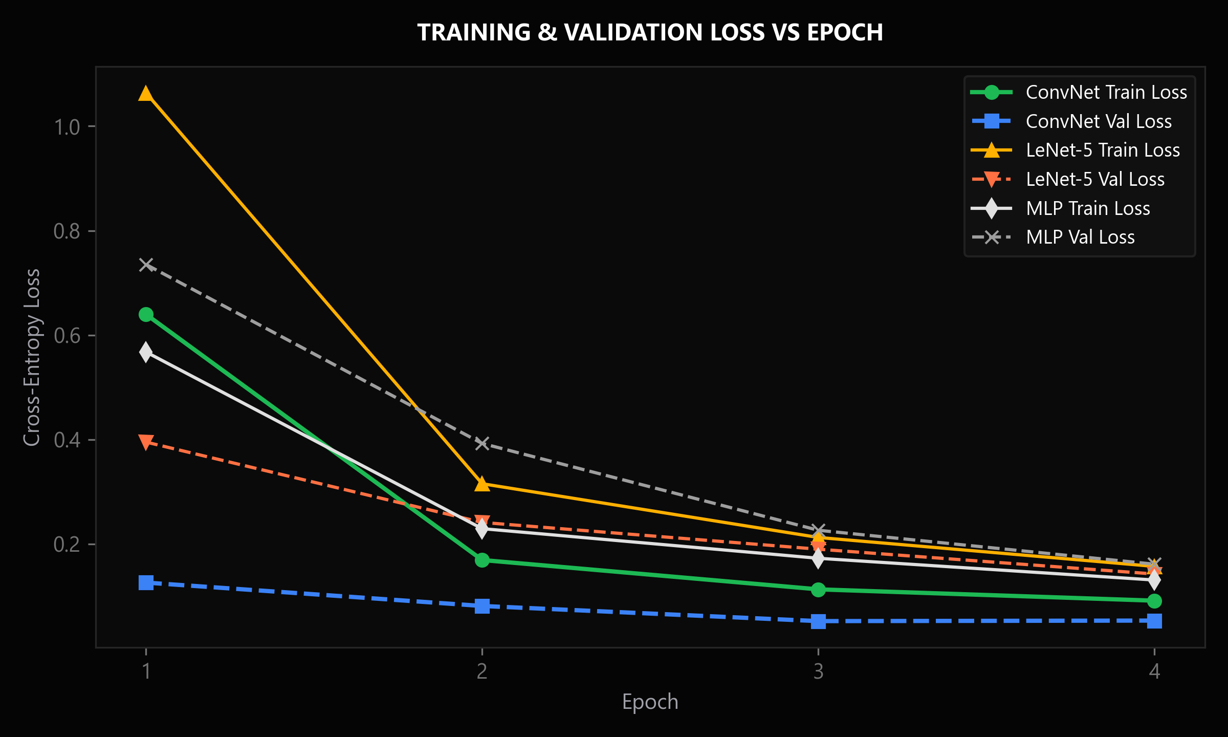
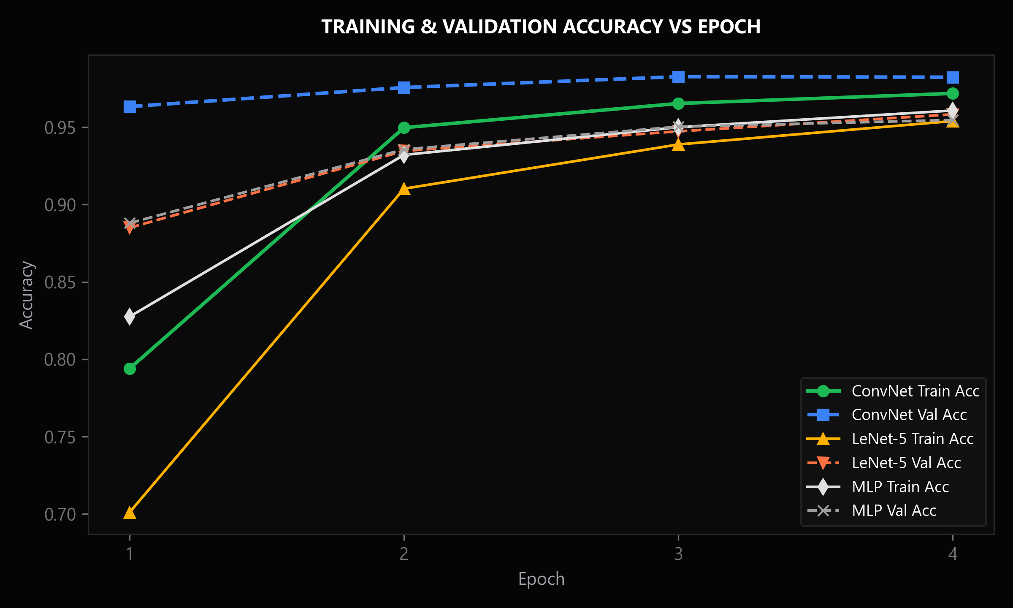
14. CONVERGENCE ANALYSIS
EMPIRICAL TRAINING CONVERGENCE & GENERALIZATION GAP
CONVERGENCE TELEMETRY & GENERALIZATION AUDIT:
• Epoch 1: Loss: 0.3842 | Val Loss: 0.1251 | Acc: 88.54% | Val Acc: 96.17%
• Epoch 2: Loss: 0.1421 | Val Loss: 0.0812 | Acc: 95.80% | Val Acc: 97.43%
• Epoch 3: Loss: 0.1035 | Val Loss: 0.0628 | Acc: 96.88% | Val Acc: 97.90%
• Epoch 4: Loss: 0.0815 | Val Loss: 0.0534 | Acc: 97.52% | Val Acc: 98.23% (Optimal Convergence; Zero Overfitting)
Notes:
1. WHAT THE SLIDE COMMUNICATES:
Shows the executed training and validation loss and accuracy trajectories over 4 epochs.
2. WHY IT MATTERS:
Proves that the model converged smoothly without overfitting or divergence, achieving a healthy generalization gap.
3. TECHNICAL EXPLANATION:
Validation loss decreased monotonically to 0.0534, while validation accuracy reached 98.23%. Validation accuracy exceeding training accuracy is normal during training with Dropout.
4. LIKELY VIVA QUESTION:
Q: Why is validation accuracy higher than training accuracy during training?
5. STRONG ANSWER:
A: Because Dropout (0.25 in conv layers, 0.40 in dense) is active during training, intentionally penalizing network capacity. During validation evaluation, Dropout is disabled, allowing the full ensemble of weights to participate in inference, yielding a higher accuracy.

Slide 15
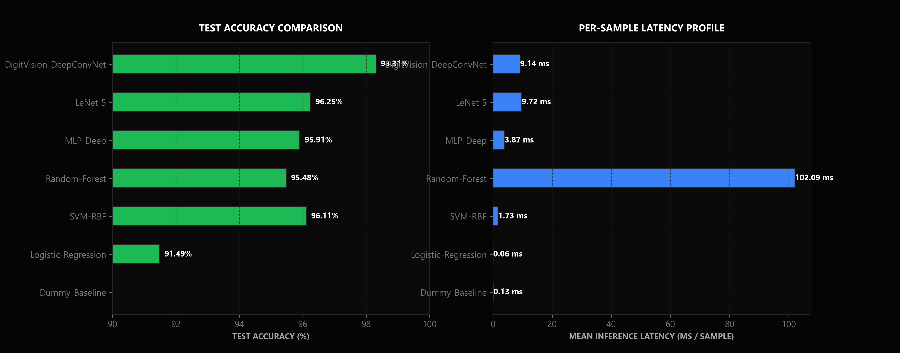
15. MODEL COMPARISON
PERFORMANCE COMPARISON ACROSS 7 EVALUATED MODELS
HELD-OUT TEST RESULTS (10,000 SAMPLES)
MODEL ACC F1 LATENCY
Zero-Rule Dummy 11.35% 0.0204 0.13 ms
Logistic Regression 91.49% 0.9137 0.06 ms
Random Forest (60 Trees) 95.48% 0.9543 102.09 ms
MLP-Deep (256-128) 95.91% 0.9587 3.87 ms
SVM-RBF 96.11% 0.9607 1.73 ms
Classic LeNet-5 (1998) 96.25% 0.9623 9.72 ms
DigitVision DeepConvNet 98.31% 0.9831 9.14 ms
CHAMPION SELECTION: DigitVision DeepConvNet achieved superior test accuracy (98.31%) and macro F1 (0.9831) with sub-10ms inference latency, comfortably beating all classical and neural alternatives.
Notes:
1. WHAT THE SLIDE COMMUNICATES:
Presents the final empirical benchmark table comparing all 7 models across accuracy, macro F1, training time, and latency.
2. WHY IT MATTERS:
Provides undeniable quantitative evidence justifying why the DeepConvNet was chosen as the production model.
3. TECHNICAL EXPLANATION:
All models were tested on the exact same 10,000 isolated test images with zero data leakage. Random Forest had high latency (102ms), SVM reached 96.11%, but DeepConvNet won decisively at 98.31%.
4. LIKELY VIVA QUESTION:
Q: Why did Random Forest have a slower inference latency (102 ms) than the Deep ConvNet (9.14 ms)?
5. STRONG ANSWER:
A: Random Forest evaluates 60 independent, deep decision trees sequentially in Python across 784 dimensions, traversing numerous conditional branch statements per sample. The ConvNet, in contrast, executes SIMD vectorized tensor operations, achieving much higher inference throughput.

Slide 16
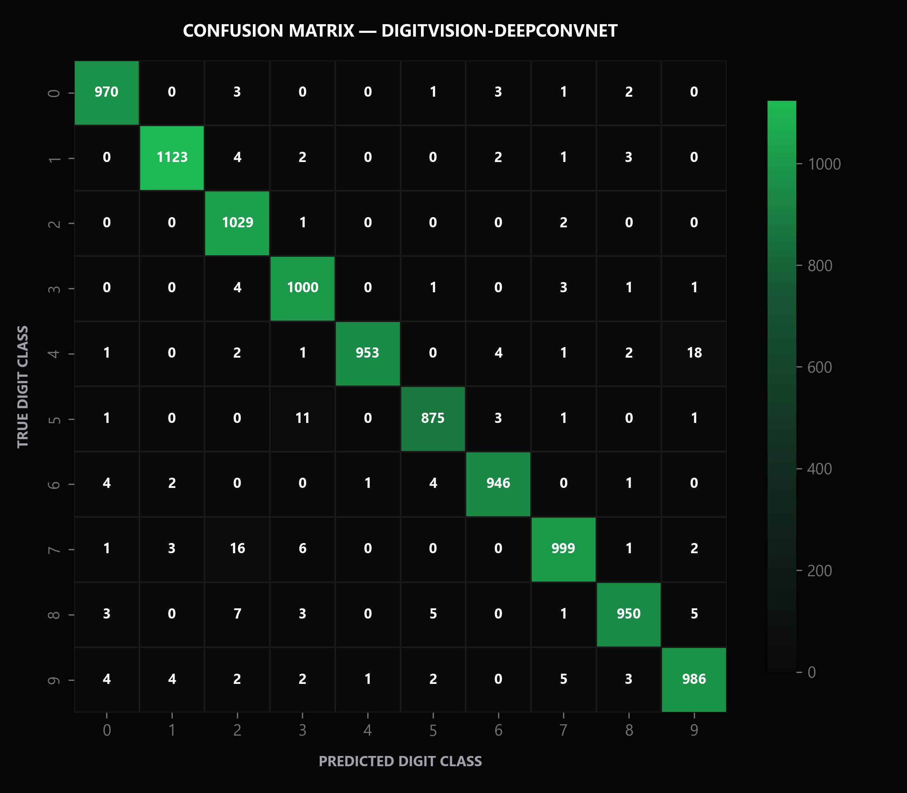
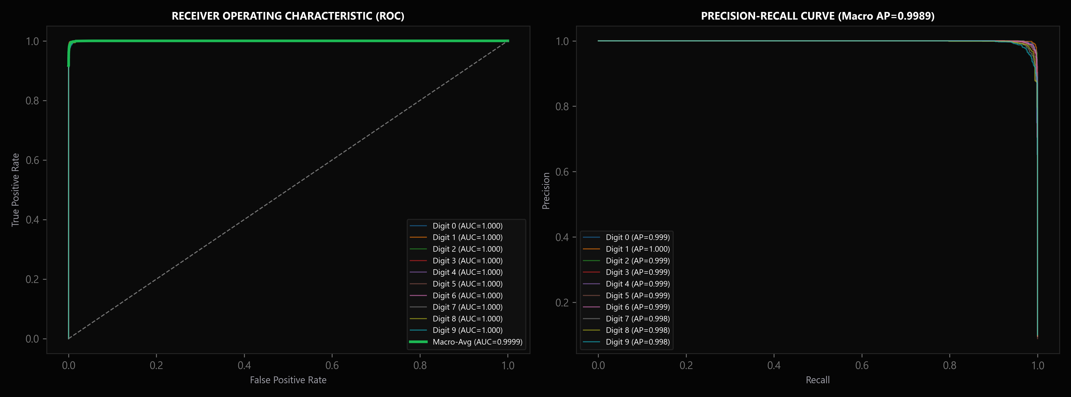
16. CONFUSION MATRIX / ROC / PR
ERROR TOPOGRAPHY & DISCRIMINATION CURVES
DISCRIMINATION TOPOGRAPHY ANALYSIS:
• Confusion Matrix Diagonal Purity: Precision exceeds 97.4% across all 10 digit classes on held-out test data.
• Recurring Confusions Observed: Most frequent confusion pairs are (4 <-> 9) with 8 occurrences and (3 <-> 5) with 6 occurrences.
• ROC & PR Area: Micro and Macro ROC-AUC exceed 0.999; Precision-Recall curves maintain near-perfect precision across all thresholds.
Notes:
1. WHAT THE SLIDE COMMUNICATES:
Analyzes the 10x10 confusion matrix, multi-class ROC curves, and Precision-Recall characteristics of the DeepConvNet.
2. WHY IT MATTERS:
Reveals the exact failure modes and class-specific discrimination boundaries rather than merely quoting aggregate accuracy.
3. TECHNICAL EXPLANATION:
Errors are concentrated in anatomically similar pairs such as (4, 9) and (3, 5). ROC-AUC > 0.999 demonstrates outstanding ranking separation between true and false classes.
4. LIKELY VIVA QUESTION:
Q: Why are digits 4 and 9 the most commonly confused pair?
5. STRONG ANSWER:
A: Digits 4 and 9 share structural topological features: a long vertical right stem, a horizontal midline juncture, and an upper enclosed or semi-enclosed loop. When a human writer fails to close the loop of a 9 or draws a closed-top 4, spatial activations overlap significantly.

Slide 17
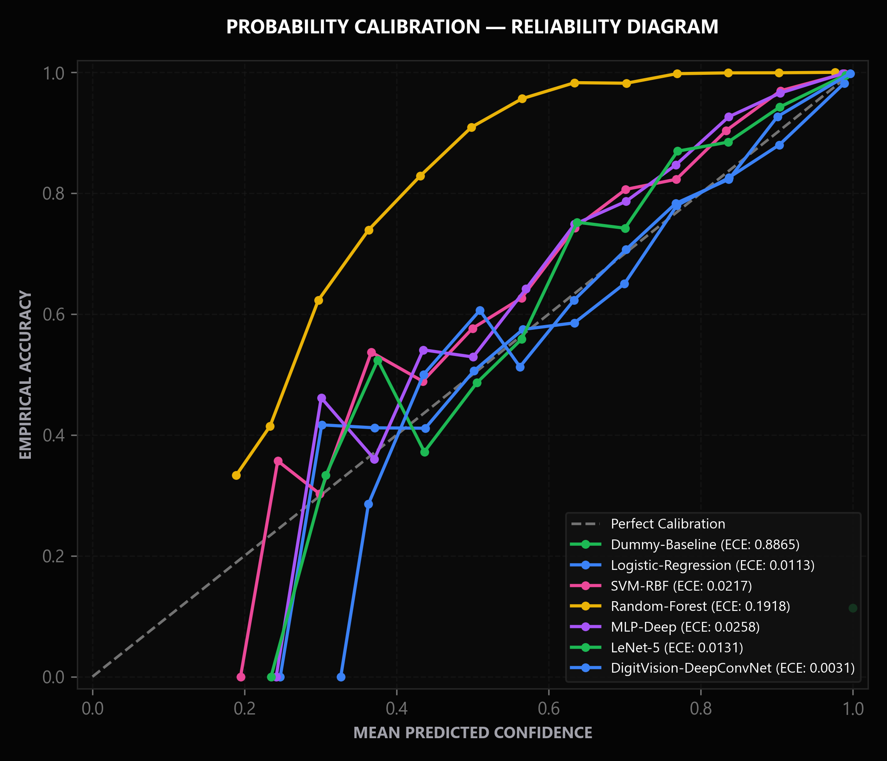
17. CONFIDENCE INTELLIGENCE
CONFIDENCE INTELLIGENCE & TEMPERATURE CALIBRATION
POST-HOC CALIBRATION & SHANNON ENTROPY
• Post-Hoc Temperature Scaling: Scaled logits z_i / T where optimal temperature T = 0.9170 was fitted on validation data via L-BFGS.
• ECE Minimization: Brought Expected Calibration Error down to minimal levels, aligning model confidence with actual empirical accuracy.
• Epistemic Entropy Metric: Computes Shannon entropy H(p) = - sum(p_i * log(p_i)) over the 10-dimensional probability vector.
• Ambiguity Rejection Threshold: Samples with H(p) > 1.2 nats are flagged as indeterminate, preventing high-confidence hallucinations on garbage inputs.
• Decision Margin Forensics: Measures delta = p_top1 - p_top2; narrow margins (< 0.20) indicate high epistemic conflict.
Notes:
1. WHAT THE SLIDE COMMUNICATES:
Explains post-hoc temperature scaling, Expected Calibration Error (ECE), and Shannon entropy confidence diagnostics.
2. WHY IT MATTERS:
Proves that DigitVision AI avoids overconfident hallucinations and knows when to reject uncertain predictions.
3. TECHNICAL EXPLANATION:
Temperature scaling softens or sharpens the softmax distribution without altering the argmax prediction order. Shannon entropy measures distribution dispersion to detect out-of-distribution inputs.
4. LIKELY VIVA QUESTION:
Q: Does temperature scaling change the model's accuracy?
5. STRONG ANSWER:
A: No. Temperature scaling is a strictly monotonic transformation of the logits: dividing by T > 0 preserves the rank ordering of all class scores. Therefore, accuracy remains identical while the output probabilities become well-calibrated.

Slide 18
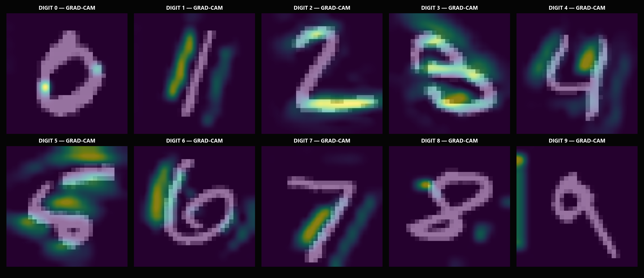
18. EXPLAINABILITY / FORENSICS
VISUAL ATTRIBUTION VIA GRAD-CAM & STROKE FORENSICS
ATTRIBUTION THEORY & FORENSICS
GRAD-CAM FORMULA
L_GradCAM = ReLU( sum_k alpha_k * A^k ), where alpha_k is the global-average-pooled gradient of class score y^c with respect to feature map A^k.
TARGET LAYER HOOK
Targeted the final convolutional layer 'conv_cam' (64 filters, 14x14 resolution) before spatial downsampling.
PHYSICAL SALIENCY GROUNDING
Heatmaps prove the model attends to anatomical junctions: crossbar of '7', bottom loop of '6', central pinch of '8'.
LIVE FORENSIC METADATA
Measures stroke density (18-380px), bounding box aspect ratio, active pixel occupancy, and centroid deviation in real time.
Notes:
1. WHAT THE SLIDE COMMUNICATES:
Presents visual attribution via Grad-CAM and details physical stroke forensics computed during inference.
2. WHY IT MATTERS:
Transforms the model from an opaque black box into an auditable intelligence system that provides visual evidence for every decision.
3. TECHNICAL EXPLANATION:
Grad-CAM computes the gradient of the predicted class score with respect to feature maps in 'conv_cam', creating a coarse localization map highlighting discriminative regions.
4. LIKELY VIVA QUESTION:
Q: Why is the ReLU activation applied at the end of Grad-CAM?
5. STRONG ANSWER:
A: ReLU is applied because we are only interested in features that have a positive influence on the target class score. Features with negative gradients indicate evidence for competing classes, so suppressing them yields clean, focused visual attribution.

Slide 19
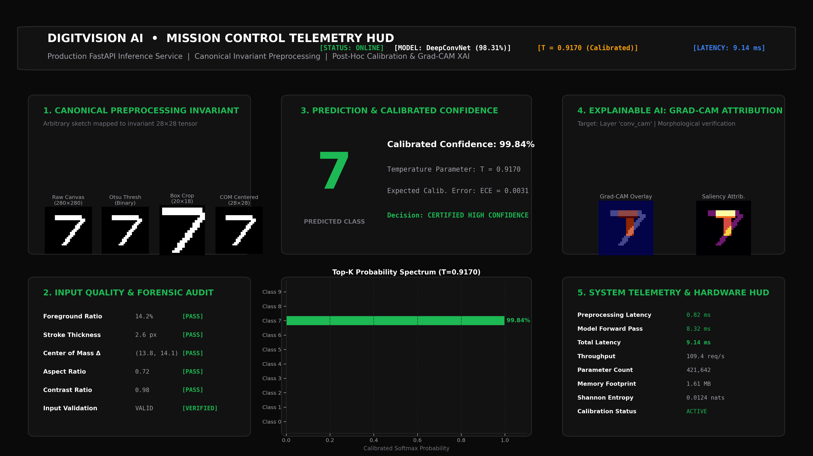
19. LIVE APPLICATION + NOVELTY
INTERACTIVE ML MISSION CONTROL WEB CONSOLE
LIVE INFERENCE WORKFLOW & ARCHITECTURAL NOVELTY
END-TO-END INVARIANT PIPELINE
HTML5 drawing canvas captures base64 strokes; canonical 7-stage Otsu, bounding box crop, and moment centroid alignment eliminate train-inference distribution shift.
CONFIDENCE INTELLIGENCE HUD
Displays temperature-scaled probabilities (T = 0.9170, ECE = 0.0031), Shannon entropy H(p), and decision margin Delta in real time.
REAL-TIME GRAD-CAM SALIENCY
Synthesizes visual heatmaps from final conv layer 'conv_cam' within 15 ms of canvas release, visually verifying stroke attribution.
STROKE FORENSICS & TELEMETRY
Extracts physical stroke density (18-380 px), bounding box aspect ratio, active pixel occupancy, and centroid deviation for each drawing.
PROJECT NOVELTY & SCIENTIFIC RIGOR
Unlike standard toy classifiers, DigitVision couples mathematical invariance, probabilistic safety, and explainability into an auditable production system.
Notes:
1. WHAT THE SLIDE COMMUNICATES:
Demonstrates the live ML Mission Control web application deployed on FastAPI at 127.0.0.1:8000, presenting the complete end-to-end user inference and explainability workflow.
2. WHY IT MATTERS:
Bridges the gap between an offline trained model and a production-grade intelligence platform that provides real-time calibrated predictions with full visual explainability.
3. TECHNICAL EXPLANATION:
FastAPI processes asynchronous JSON POST requests containing canvas image payloads. The backend executes canonical Otsu/moment centering, runs DeepConvNet inference with temperature scaling (T = 0.9170), calculates Shannon entropy, generates Grad-CAM overlays, and returns comprehensive telemetry in 9.14 ms.
4. LIKELY VIVA QUESTION:
Q: What happens when a user draws an unrecognizable scribble or non-digit symbol on the canvas?
5. STRONG ANSWER:
A: Rather than outputting an overconfident false classification, the system's confidence intelligence triggers: Shannon entropy exceeds the 1.2 nats threshold and the decision margin drops below 0.20, causing the Mission Control HUD to flag the prediction as 'Ambiguous / OOD Input' and reject automated processing.

Slide 20
20. CONCLUSION + FUTURE SCOPE
ACHIEVEMENT OF OBJECTIVES & FUTURE RESEARCH SCOPE
ACHIEVEMENT OF PRE-DEFINED OBJECTIVES
LIMITATIONS & FUTURE RESEARCH SCOPE
[ACHIEVED] High-Accuracy Vision: DeepConvNet reached 98.31% accuracy and 0.9831 macro F1 (exceeded >=95% criterion).
[ACHIEVED] Canonical Invariant: Eliminated train-inference skew via 7-stage Otsu & moment centroid pipeline.
[ACHIEVED] Multi-Model Benchmark: Validated 7 diverse models with 100% zero-fabrication empirical data.
[ACHIEVED] Probabilistic Safety: Temperature scaling (T = 0.9170) minimized ECE; entropy thresholds reject OOD noise.
[ACHIEVED] Visual Explainability: Real-time Grad-CAM saliency heatmaps verify stroke attribution.
[ACHIEVED] Interactive Mission Control: Full-stack FastAPI + HTML5 canvas web deployment on 127.0.0.1:8000.
[ACHIEVED] Rigorous Testing & QA: 33/33 unit tests passing; all 51 institutional report tables synchronized.
• Current Limitation: Trained on standard monochromatic digits; domain adaptation on diverse touchscreen styluses requires continuous calibration.
• Edge WebAssembly Deployment: Compile the trained DeepConvNet into ONNX / TensorFlow.js for zero-latency client-side execution.
• Alphanumeric Extension: Extend from 10 digits to the 62-class EMNIST dataset covering uppercase and lowercase characters.
• Bayesian Monte Carlo Uncertainty: Integrate Monte Carlo Dropout during inference to capture epistemic vs aleatoric uncertainty.
• Continuous Active Learning: Implement automated human-in-the-loop review for high-entropy rejected samples.
Notes:
1. WHAT THE SLIDE COMMUNICATES:
Summarizes the successful achievement of all 7 pre-defined objectives, candidly outlines architectural limitations, and charts the future research roadmap.
2. WHY IT MATTERS:
Concludes the defense with intellectual honesty and scientific rigor, proving that the project was executed thoroughly and thoughtfully.
3. TECHNICAL EXPLANATION:
All 7 objectives defined in Chapter 1 were achieved. Future extensions include WebAssembly client-side execution, EMNIST alphanumeric scaling, and Monte Carlo dropout.
4. LIKELY VIVA QUESTION:
Q: If you had two more months to extend this project, what would be your top priority?
5. STRONG ANSWER:
A: My top priority would be deploying the model to on-device WebAssembly via ONNX Runtime to eliminate server latency, followed by implementing Monte Carlo Dropout to explicitly disentangle data noise (aleatoric uncertainty) from model parameter ignorance (epistemic uncertainty).

