Slide 1
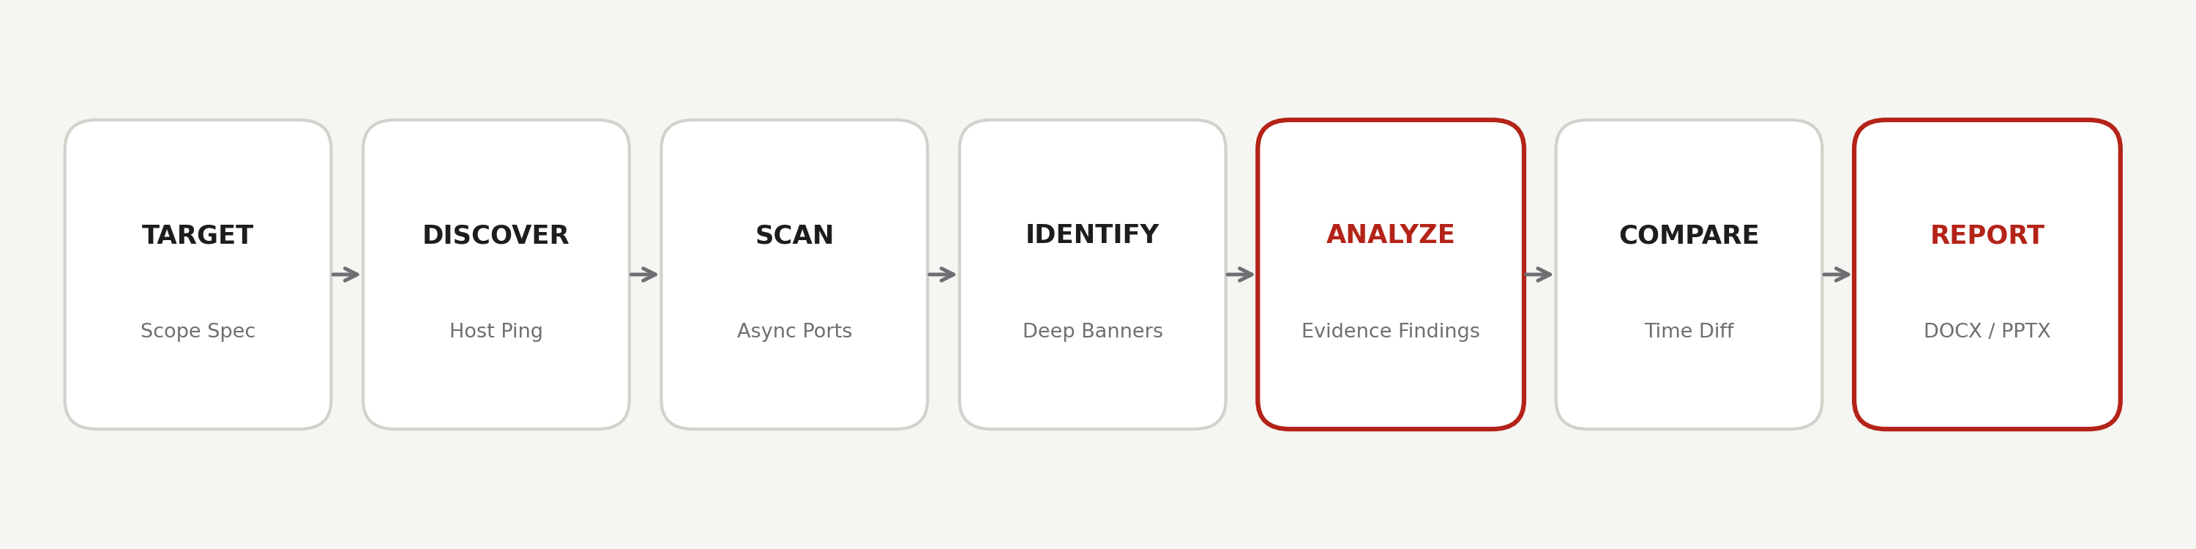
COMPUTER NETWORKS PROJECT · ACADEMIC DEFENSE
SHIELDSCAN
Modern Network Visibility & Security Assessment Platform

Slide 2
The Network Assessment Challenge
Traditional tools generate overwhelming raw output without context, evidence, or historical intelligence.
01
Raw Scanner Output
Terminal tools dump thousands of lines of raw text. Security operators must manually parse ports and look up service banners.
02
Unverifiable Claims
Conventional tools report speculative vulnerabilities without providing auditable evidence of how or why the finding was derived.
03
Zero Historical Context
Point-in-time scans do not track network drift. Identifying newly exposed ports or resolved risks requires tedious manual diffs.

Slide 3
System Objectives & Engineering Scope
Designing a non-destructive, evidence-driven network assessment architecture.
Multi-Vector Discovery
Verify alive systems via ICMP Echo, TCP SYN connects, and reverse DNS across subnets without hanging.
Asynchronous Enumeration
Conduct high-speed port scanning with controlled concurrency pools and adaptive timeout handling.
Deep Service Fingerprinting
Interrogate services using live protocol handshakes (HTTP, TLS certificates, SSH banners, MySQL).
Evidence-Based Findings
Classify exposures strictly supported by observed data into Informational, Low, Medium, and High risk.
Historical Drift Detection
Track differential changes (+/- hosts, +/- open ports, version upgrades) across consecutive assessments.
Automated Executive Reporting
Generate single-source-of-truth DOCX reports and structured exports instantly with zero placeholders.

Slide 4
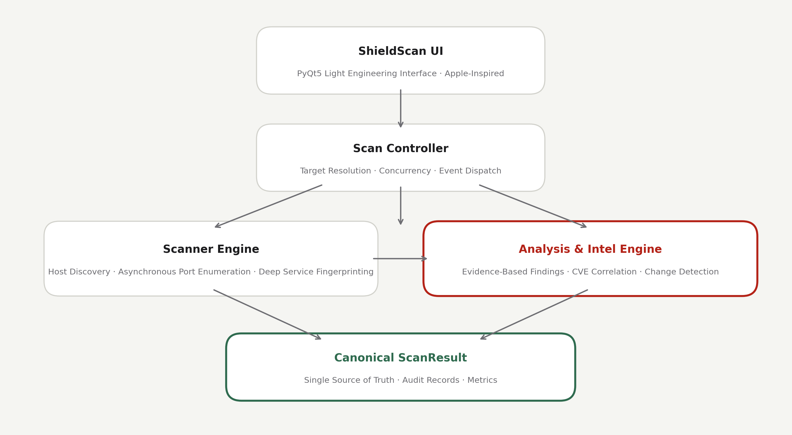
ShieldScan Product Architecture

Slide 5
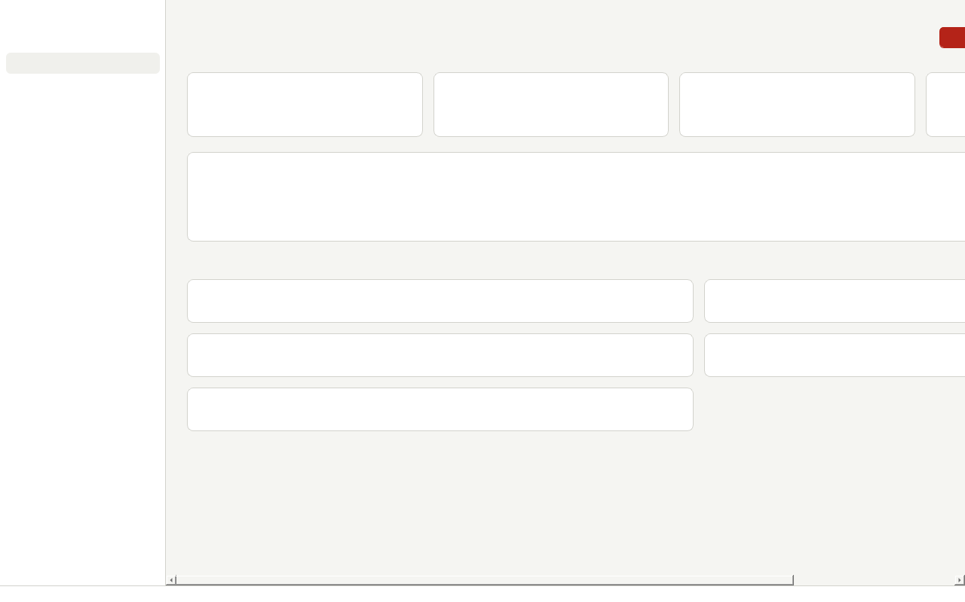
Live Network Assessment: 127.0.0.1
Assessment completed in 1.25s under the 'Standard Assessment' profile.
1
Hosts Discovered
Out of 1 scope targets
1
Open Ports
0 filtered / firewalled
1
Services Identified
Fingerprinted via banners & TLS
1
Security Findings
High: 0 | Med: 0
Key Observational Intelligence
• [INFORMATIONAL] Active Service Verification: HTTP (127.0.0.1:80) — Evidence: HTTP 200 OK

Slide 6
Why ShieldScan? Complete Network Intelligence
SCAN + VISUALIZE + ANALYZE + COMPARE + REPORT in one unified product experience.
Evidence-First Integrity
Never manufactures findings or CVE matches. Every reported risk is traceable directly to an observed raw banner, TLS handshake, or protocol packet.
Integrated Visual Dashboard
Replaces cluttered CLI flags and hacker aesthetics with an Apple-inspired clean UI designed for clarity, progressive depth, and instant comprehension.
Automated Change Detection
Instantly diffs consecutive network scans to highlight newly opened ports, removed hosts, and version migrations across time.
One-Click Executive Reporting
Derives professional Word (.docx) reports and slide presentations directly from canonical scan data with zero manual transposition.

Slide 7
From Raw Network Data to Understanding
Empowering defensive engineers with accessible network clarity and reliable evidence.
Project Summary
✓ Transformed port scanning into a comprehensive network visibility platform.
✓ Strictly enforced Apple-inspired light engineering UI (zero dark/neon hacker styling).
✓ Established single-source-of-truth canonical ScanResult model for all reports and UI.
✓ Demonstrated defensive network assessment without offensive exploitation.
Future Roadmap
→ Heuristic OS Fingerprinting: TCP/IP stack window size and TTL analysis.
→ Interactive Topology Graph: Force-directed visual mapping of subnet relationships.
→ Continuous Distributed Agent: Background daemon monitoring for enterprise networks.
→ Expanded Protocol Probing: Native SMB2/3 tree connect and LDAP schema enumeration.

