Slide 1

Customer Segmentation
Claims
Classification
12/01/2016

Slide 2
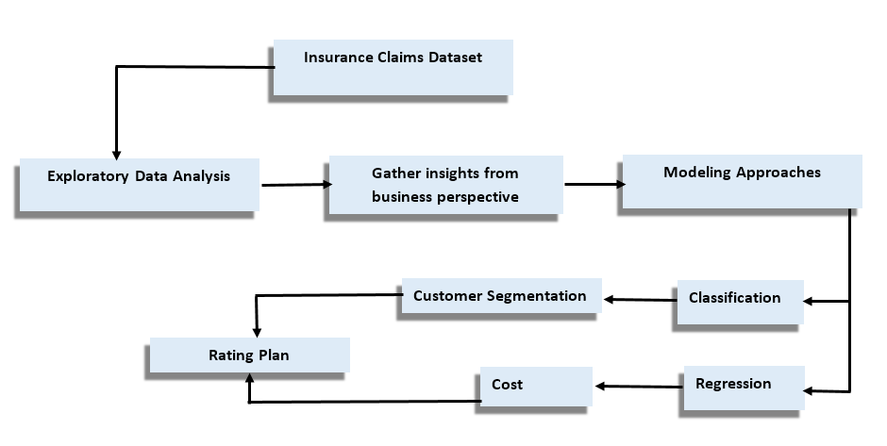
What we did?

Slide 3
How we did?
Logistic Regression, Stepwise, Decision Tree, Discriminant Analysis
Confusion Matrix, Gini Index
Models used:
Evaluation Metrics:
Backward elimination Technique
SAS JMP, Gretl
Variable Selection:
Technology:

Slide 4
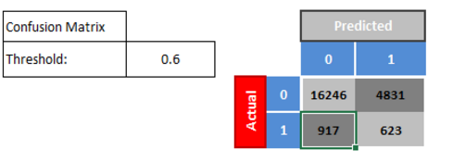

Modeling Technique
Logistic Regression
Linear Regression
Backward Elimination
131.805 + [ 164.772 * Exposure +
[-21.0107 *(AgeCat) + 7.01917 * Veh_Value ]
False Positives : Classifying a customer who is not likely to claim as “Likely” would impact business
False Negatives : Classifying a customer who has a claim as “Not Likely” would have a negative influence on the customers

Slide 5
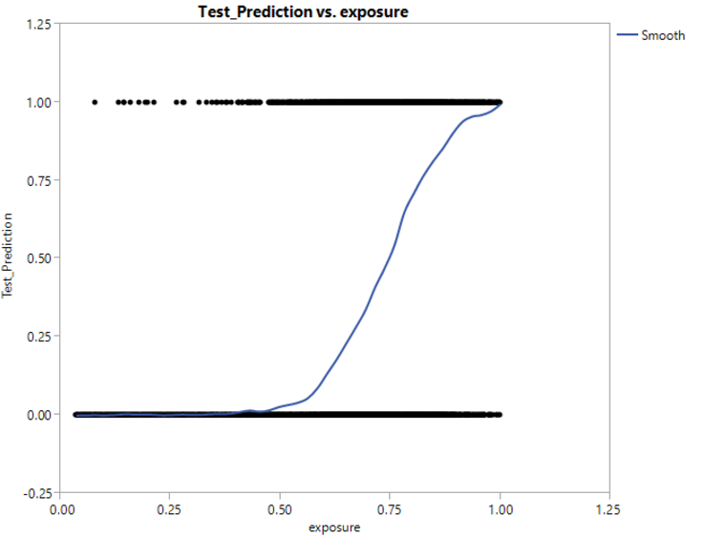
Model Influencers
Exposure
Age Category
Vehicle Age

Slide 6
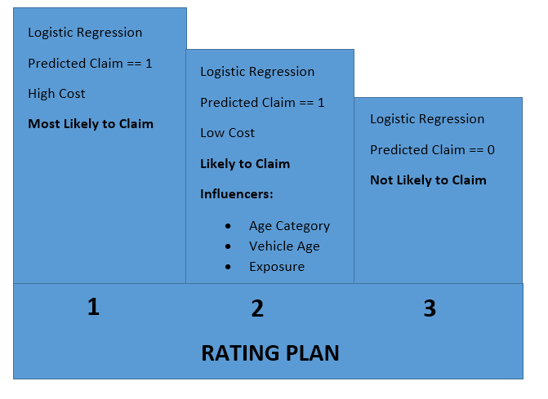
Classification Approach
Objective: To devise a rating plan for the company to segment the customers
Solution:

Slide 7

Additional Variables
Driver Behavior
Driving History
Vehicle Safety Index
Transportation Fatalities

Slide 8

By
Sriram R
Prashant PS
Sriraman S
Thejes SV
Tejas Naren TN

