Slide 1
RevHire – Job Portal Application
A FULL STACK DEVELOPMENT PROJECT
Team Members
Teja Subhash Reddy
Bhavana
Anumala Shekar
Chandra Shekar
Pujitha
TECH STACK: Java | Angular | Spring Boot | MySQL | Maven

Slide 2
AbStract
.
RevHire is a full-stack web application developed to as a real-world recruitment platform. The application connects job seekers and employers through a structured hiring workflow. It implements secure authentication, role-based access control, REST APIs, and relational database design. The project demonstrates complete frontend-backend integration similar to industry standards.

Slide 3
Objective of the project
T
• To build a complete full-stack web application • To implement secure JWT-based authentication • To create role-based access control • To develop end-to-end job application workflow • To practice team collaboration using Git
Job Seeker ↔ RevHire ↔ Employer

Slide 4
TEchNology stack
Frontend: Angular, Route Guards, Interceptors
Backend: Spring Boot, REST APIs, Spring Security
Database: MySQL, JPA/Hibernate

Slide 5
Role based access
.
Job Seeker Features
• Register/Login • Resume creation & upload • Search jobs with filters • Apply & track status • Save jobs

Slide 6
.
Employer Features
• Company registration • Post/manage jobs • View applicants • Shortlist/Reject • Dashboard analytics
.

Slide 7
Team Responsibilities
.
Teja – Authentication, Security , Notifications Chandra – Job Seeker Flow & Resume Bhavana – Employer Module Anumala – Application Logic & Status Handling Pujitha – Profile Management & Saved Jobs

Slide 8
Authentication & secuRIty
• JWT token generation • Secured REST endpoints • Role-based access control • Notification trigger logic

Slide 9
.
Job Seeker Module (Chandra)
• Registration & Login integration • Resume builder logic • Job search filters • Apply job workflow • Track application status

Slide 10
.
Employer Module (Bhavana)
• Company registration • Post job functionality • Edit / close job • View applicants • Shortlist / Reject candidates

Slide 11
.
Application Logic (Anumala)
• Application status transitions • Under Review → Shortlisted / Rejected • Withdraw logic • Backend validation rules

Slide 12
.
User Management & Saved Jobs (Pujitha)
• User Management • Save job functionality • Remove saved job

Slide 13
DATABASE DESIGN
users
employer-profile
Job-posts
Job-applications
Jon-seeker profiles
Resume-texts
Resume-files
Favourites-jobs
Job-skills
notifications
.

Slide 14
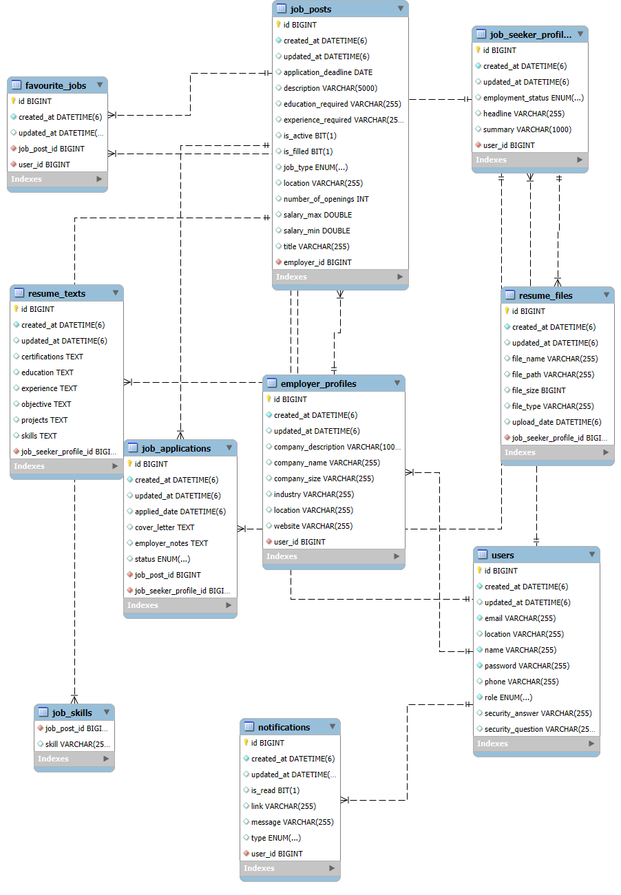
Database Design
.

Slide 15
System Architecture
.
Controllers
Security
Configuration
Service
DTO
Repository
Entity
Exceptions

Slide 16
Future Enhancements
Convert this monolithic application into micro-services application .
Improve the Better UI Experience.
Need to Add some additional Features For real time experience.
Deploy the application to cloud (AWS/Azure) with CI/CD pipeline.
Add resume scoring / ATS-style screening for employers.
.

Slide 17
CONCLUSION
.
RevHire successfully a real-world job portal platform.
The system supports multiple roles including Job Seeker, Employer.
Secure authentication and role-based authorization are implemented using JWT.
The application demonstrates complete frontend–backend–database integration.
Structured workflow enables job posting, application tracking, and status management.
The project follows layered architecture and RESTful API design principles.

Slide 18
THANK YOU
.

