Slide 1
Media Description Generator
Team Genesis

Slide 2

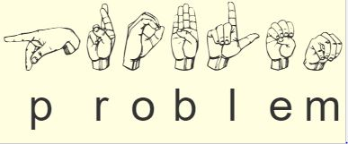
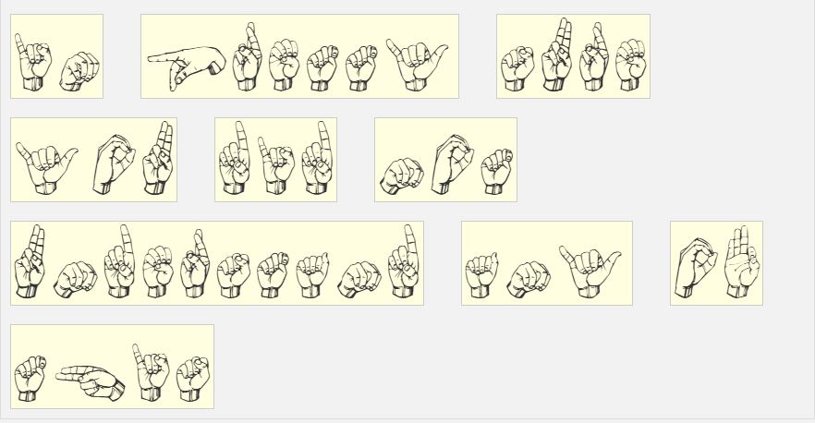
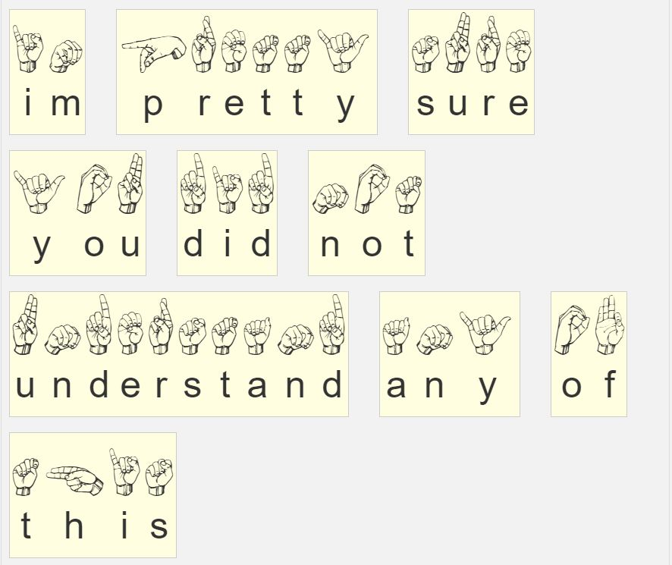

Slide 4
Purpose
Making information more accessible to people with disability.
Extraction of facts from ground data to act as an unbiased news source.
Richer subtitle generation for non-speech sounds.
Archival of hefty media in an extremely compact text format.(WaybackMachine inspired)

Slide 5
Overview
Classification
Description
Spectrogram
Keywords
Sound
Recognition

Slide 6
Approach
The audio is first converted to uncompressed WAV format.
The wav is then converted into a spectrogram.
The spectrograms can then be treated as images where we can benefit from transfer learning using the pretrained models (like Resnet).
After being fed separately to classification and speech recognition network, appropriate keyword description is generated.
The obtained keywords can further be used to generate readable sentences using NLG.

Slide 7
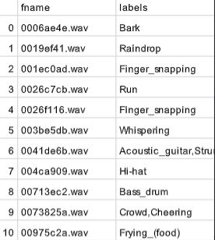
Training Data
Dataset : Freesound Audio Tagging which contains snippets of audio with labels.
Number of Classes | 81
Total number of clips | 4970
Total duration | 10.5 hours
Average Labels per clip | 1.2
Notes:
We used only curated set for training due to resource constraints and for stronger transfer learning demonstration.

Slide 8
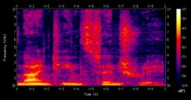
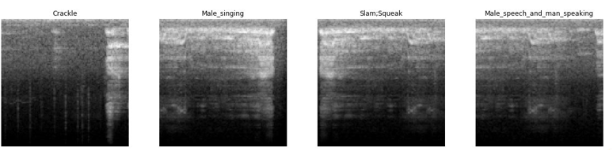
Spectrogram Generation
Audio of length n seconds is converted into [128x 128 x n] Grayscale image.
Fed into a CNN (ResNet18 ) Pretrained on ImageNet (Transfer Learning)
Classified into one of 81 labels inlcuding Gasp,Printer, Gong, Bark, Male singing,etc.
The audio falling in human voice category are fed to speech recognition model (Deep Speech)
A Spectrogram

Slide 9
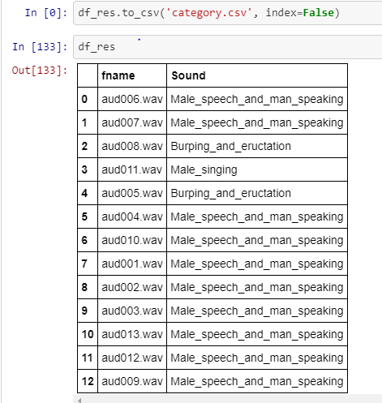
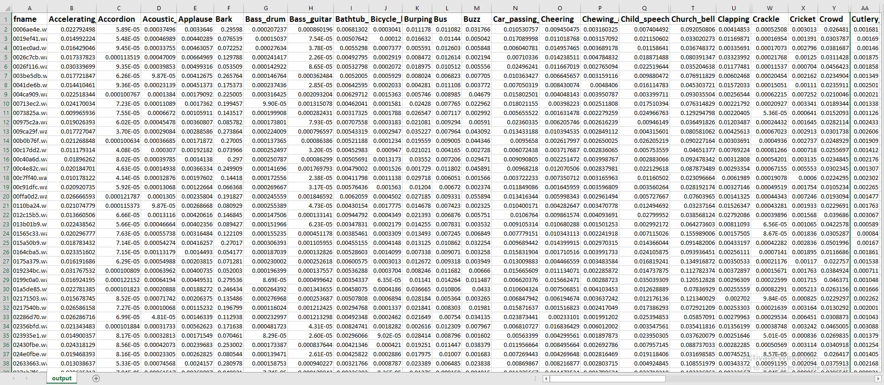
Classification in Depth
Argmax()
Pandas

Slide 10
Speech recognition
The following sound categories are then fed to the model for recognition:
Child_speech_and_kid_speaking, Female_singing, Female_speech_and_woman_speaking, Male_singing, Male_speech_and_man_speaking, Whispering, Yell
Audio sample
Man: "the cowed and oregon state have gone military" Man: "to strike away the lad is a" BURPING_AND_ERUCTATION Male singing: "they believe in using their heads when it comes" BURPING_AND_ERUCTATION...

Slide 11
Speech recognition
The architecture used is Deep Speech which is built upon RNNs.
The training data used is the audiobooks offered by LibriVox.
The audiobooks are then split into 10 second files.
Small dataset is compensated by using data augmentation techniques on spectrograms such as flipping and silence padding.
Dataset
Length | 20 hours
Size | 1.3 GB
Audio samples | 6000

Slide 12
Transfer Learning
The parameters of ResNet18 are initialized for ImageNet dataset instead of being random. The random initialization demonstrably converged slower than initializing to ImageNet weights.
However freezing inner layers not gave good results. Instead we had to unfreeze all layers to get fast convergence. It may be because the images of ImageNet have much different features therefore inner layers also require training.

Slide 13
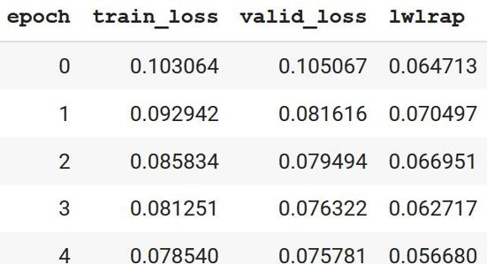
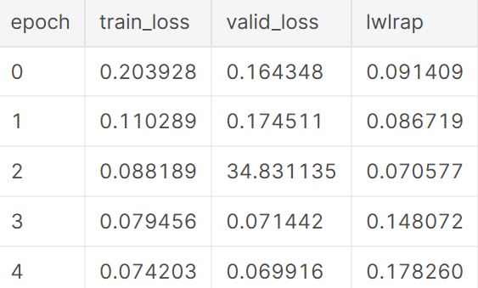
ImageNet Initialization
Random Initialization

Slide 14
Tools used
pandas-profiling – exploratory analysis
Fast.AI (PyTorch wrapper)
LibROSA – spectrogram handling
SoX – uncompressing audio to WAV
Google Colab - Cloud based training

Slide 15
Use cases
Providing descriptive facts from ambient sounds to the hearing-impaired.
A standard repository of facts which form the basis of all news outlets.
Improved subtitles on streaming services.
Detecting unusual activity in lengthy surveillance media to strengthen security.

Slide 16
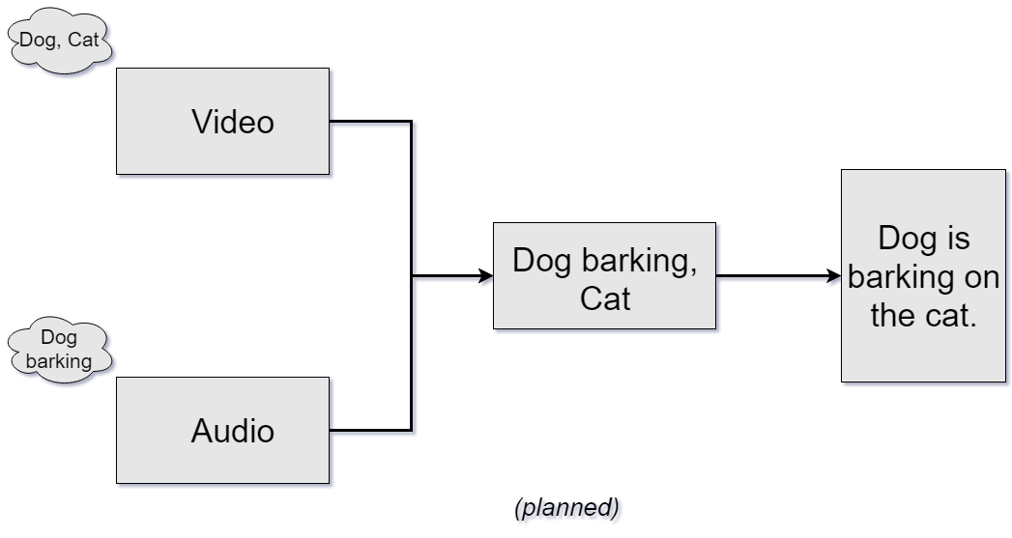
Future prospects
Generating more natural descriptions from the keywords using Natural Language Generation techniques.
Pairing with objection detection algorithms for video to provide more context.

Slide 17
Acknowledgments
Implementation of LwLARP metric is taken from Dan Ellis.
For data profiling, pandas-profiling is used to obtain general overview of data.
Use of FastAI library to structure and train the model.
Other resources include StackOverflow, Medium and the rest.

